Slide 1
Search Bar
Data Analytics
Mike Maryn

Slide 2

Overview
Big Data
Research
ELK Stack
Uses
Heat Map
Marketing

Slide 3

What? Why?
Store User Log Data
Name
Health Rating
Location
Searchable
User Friendly
Easily Consumed
Big Data
Hard to search
Hard to understand
Business
Marketing
Trends

Slide 4

Queries
curl -XPOST 'localhost:9200/bank/_search?pretty' -d '
{
"query": { "match_all": {} },
"_source": ["account_number", "balance"]
}'
SELECT * FROM Customers;
db.restaurants.find().sort( { "borough": 1, "address.zipcode": 1 } )

Slide 5
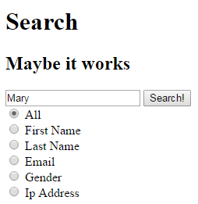
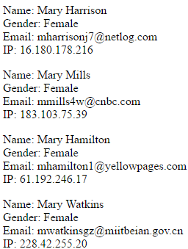
How it looks (so far)

Slide 6
How it works (Overview)

Slide 7
How it works (Webpage)

Slide 8
Demo

Slide 9
Questions?

Slide 10




ELK Stack

Slide 11
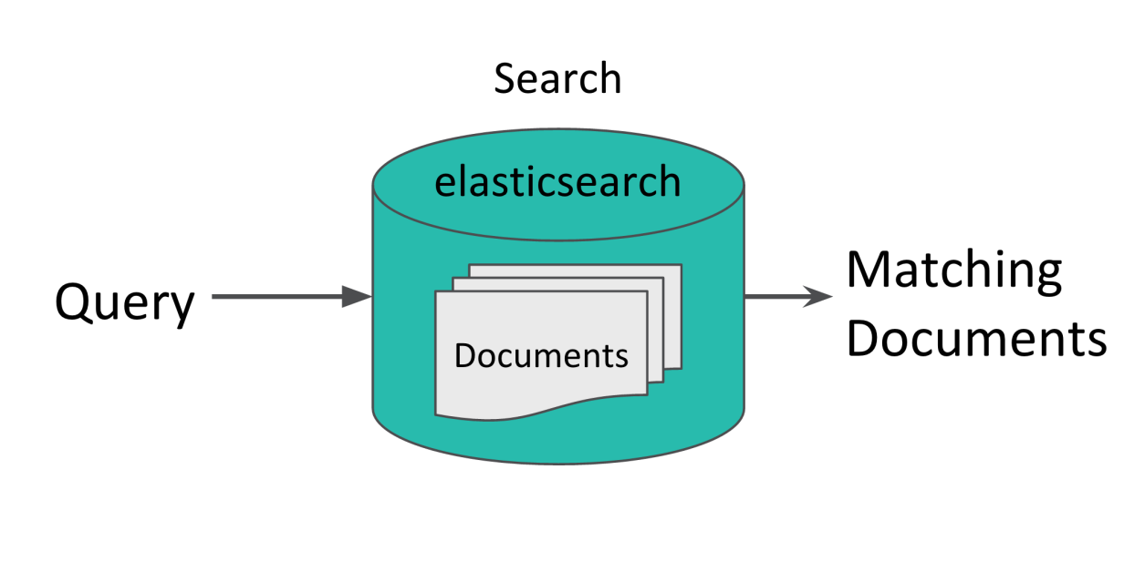
ElasticSearch
Search Engine
Database
JSON Documents

Slide 12
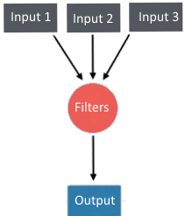
Logstash
Data Pipeline
Collects
Processes
Forwards

Slide 13

Kibana
Visualization of Data as
Pie Charts
Bar Graphs
Heat Maps
Line Graphs

Slide 14

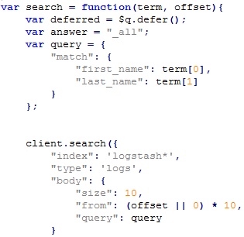
AngularJS
JavaScript Frameworks
Special Features
For Us
Creates Queries

