Slide 1
MedVoice Software Design Document
Megan Lyn Del Rosario
December 21, 2015

Slide 2
Agenda
Introduction
Reference Material
Definitions and Acronyms
System Overview
System Architecture
Data Design
Component Design
Human Interface Design
Requirements Matrix

Slide 3
Introduction
Purpose: The purpose of this Software Design Document is to ensure that database transactions with the MedVoice mobile application meets its requirements outlined in the Medvoice SRS document.
Scope: MedVoice will have the ability to retrieve and send data to and from a selected database upon logging into the mobile application. Using the collected data, users will be grouped according to interests and similarities. This Software Design Document will focus solely on aggregating user data upon logging into the mobile application via Facebook, and describe transactions between MongoDB and the mobile application.

Slide 4
Reference Material
[1] Docs.mongodb.org, "The MongoDB 3.2 Manual — MongoDB Manual 3.2", 2015. [Online]. Available: https://docs.mongodb.org/manual/?_ga=1.115763206.1624318876.1449113191. [Accessed: 18- Dec- 2015].
[2] C. Sears, "Components · Ratchet", Goratchet.com, 2015. [Online]. Available: http://goratchet.com/components/. [Accessed: 18- Dec- 2015].
[3] Getbootstrap.com, "Components · Bootstrap", 2015. [Online]. Available: http://getbootstrap.com/components/. [Accessed: 18- Dec- 2015].
[4] W3schools.com, "W3Schools Online Web Tutorials", 2015. [Online]. Available: http://www.w3schools.com/. [Accessed: 18- Dec- 2015].
[5] Facebook Developers, "Facebook Login for Apps - Developer Documentation - Facebook for Developers", 2015. [Online]. Available: https://developers.facebook.com/docs/facebook-login. [Accessed: 18- Dec- 2015].

Slide 5
Definitions and Acronyms
SRS | Software Requirements Specification.
SDD | Software Design Document
XAMPP | X(“Cross”-platform), Apache HTTP Server, MariaDB (MongoDB), PHP and Perl. Multiple software that works together in order to serve websites.
GUI | Graphical User Interface
DB | Database; a place where data is stored for a web server.
RDBMS | Relational Database Management Systems
NoSQL | Refers to a database that is “non relational”, provides a mechanism for storage and retrieval of data that is modeled in means other than tabular relations used in relational databases.
HTML | Hypertext Markup Language
CSS | Cascading Style Sheets
JS | JavaScript
PHP | PHP Hypertext Preprocessor
Client | Remote server; any software application that requests data from a web server.
Browser | A software application for retrieving, presenting, and traversing information resources on the World Wide Web.
Web Server | A computer that is configured to be a web server whose job is to serve web pages when a request is made by a client.

Slide 6
System Overview
HTML, CSS, JS,
Bootstrap, Ratchet, PHP
User
Information
Facebook
Localhost
PHP Scripting
Web Server
(Computer)
Apache
Client
(Browser)
MedVoice
FaceBook Username
Database
MongoDB
FaceBook Password
User
Information
MongoDB
Login with Facebook
Notes:
What is a webserver?
Computer
When configured as a web server, its job is to serve web pages
Converting our computer to a web server, we are using XAMPP and the server is Apache
What is a database?
A place where data is stored for the web server
We want to be able to grab data at any point and time in a storage base (MongoDB)
Client
Sends a request from a remote server (client), server grabs data from database and gives to client
Scripting language
Custom website display information for client’s specific request (dynamic website)
Can be on the same website but can be seeing different things because of different requests
The name of our server is localhost

Slide 7
System Architecture: Architectural Design
System Overview | Details
GUI | Sign into app with existing user account Check Credentials Forgot Password? (Edit) User Profile Send data to MongoDB Ability to login through Facebook Permissions Send data to MongoDB
XAMPP | Creation and Test Environment Apache HTTP Server Localhost Connect to database Serve Website (GUI)
MongoDB | Store data for web server/ Communicate with web werver Render Data Data Modeling

Slide 8
System Architecture: Decomposition Description
XAMPP
XAMPP: X (“Cross”-platform), Apache HTTP Server, MariaDB (MySQL), PHP and Perl
Free and open source cross-platform web server solution stack package developed by Apache Friends
Development package/development environment (creation and test environment)
Not meant to be deployed, insecure because default settings are insecure
Localhost
PHP Scripting
Web Server
(Computer)
Apache
Client
Browser
Database
MongoDB
Notes:
What is XAMPP?
Development purposes
Development environment, used for creation and test

Slide 9
System Architecture: Decomposition Description (Cont.)
Cross-platform, open source document-oriented database
Classified as NoSQL database
Horizontal Scalability
Query Language
Ad hoc queries
Fast performance
Embedded Data model
Replication
Duplication of Data
Load balancing
Aggregation: MapReduce
Server-side JavaScript Execution
Special Support for Locations: understands longitude and latitude natively
Driver Support (Java, JavaScript, Python, Ruby, C#, PHP, more)
NoSQL Database
Document Oriented Databases
MongoDB
Notes:
RDBMS (relational DB), OLAP (Online Analytical Processing), NoSQL
NoSQL
- Relational databases answered the problem of no standard implementation (incapable or difficulty handling big data)
Big data: relative to the system and depends on its capabilities, data that is difficult to be processed using a traditional system because of it size (i.e. 100MB document, unable to send via email); organization specific (i.e. one company can handle 500 TB data per day, another can’t)
horizontally scalability: more computing power, performance is linearly proportional to the number of computers

Slide 10
System Architecture: Design Rationale
XAMPP vs. WAMP
Big Data Applications
Legend: 1-10 (1:Poor, 10:Excellent) | XAMPP | WAMP
Usability | 10 | 1
User Interface | 8 | 5
Performance | 10 | 10
Score | 28 | 16
Applications involving complex transactions
Not a suitable solution for
MongoDB
Could be used in
Traditional Applications
MongoDB vs. MySQL
NoSQL
Performance
Legend: 1-10 (1:Poor, 10:Excellent) | MongoDB | MySQL
(Horizontal) Scalability | 8 | 2
Performance | 7 | 5
Format Flexibility | 8 | 5
Driver Support | 7 | 5
Score | 30 | 17
RDBMS
Functionality
Notes:
Query language
Faster performance than relational DB
Horizontal scalability
RDBMS offer more functionality than NoSQL, but performance is more than RDBMS
Complex transactions: multiple inserts, multiple updates, committing work at the end while conditions are true

Slide 11
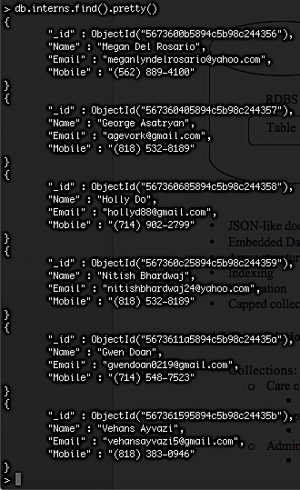
Data Design: Data Description
RDBMS
MongoDB
Table
Collection
RDBMS
Converts records into objects
Object Oriented Programming Language
No conversion required
MongoDB
Notes:
RDBMS
-Table would have records, an entity is represented by a table, each record represents an instance of an entity (i.e. Employee is an entity, Bill is an instance of an entity, table of employee with record for bill), within each record there are multiple fields (i.e. name)
MongoDB
collections: Table
Document: Record
Collection called employee, one doc for Bill
BSON
Interns: collection, George:document/object, fields: key,value pair
Flexibility: don’t have to have the same number of fields unlike RDBMS, array structure, embedded object (i.e. address, mobile phone)
NoSQL doesn’t mean we can’t query (i.e. db.interns.find())
RDBMS: used with programming like php, java so on that are object oriented, storing instance of an entity in object format while the same info is going into the DB in relational format – conversion has to take place, very costly most headache comes from here when using RDBMS

Slide 12
Component Design
System Overview | Details
GUI | Register an account to collect data Sign into app with existing user account Check Credentials Forgot Password? (Edit) User Profile Send data to MongoDB Ability to login through Facebook Permissions Send data to MongoDB
MongoDB | Store data for web server/ Communicate with web werver Render Data Data Modeling

Slide 13
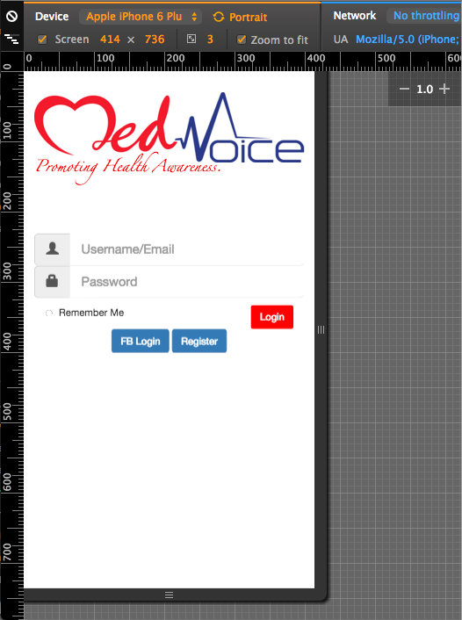
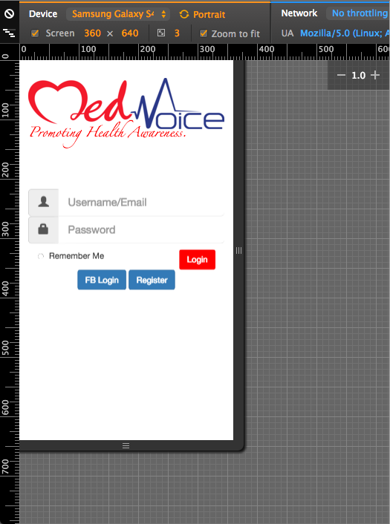
Human Interface Design

Slide 14
Human Interface Design: Screen Objects and Action
Object | Action
Login | User authentication Link to Dashboard
FB Login | Permission Link to Dashboard Send FB data to MongoDB
Register | Required Info First/Last Name Age Weight Height Email/username Password

Slide 15
Requirements Matrix
SRS Document | SDD Document
1.2 Scope | 1.2 Scope
2 Overall Description | 2 System Overview 3 System Architecture
3 Specific Requirements | 4 Data Design 5 Component Design

