Slide 1
JPython Update
Jim Hugunin
Corporation for National Research Initiatives

Slide 2
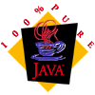
What’s JPython?
The Python Language implemented in
Adheres very closely to the standard implementation (CPython)
Python code runs on any JVM
  JPython applet in Remote Microscope demo
Python can use Java packages
  includes subclassing from Java
  Python classes can even be subclassed by Java

Slide 3
Overview
Where it is today (20 minutes)
  What it can do
  Outstanding differences
Where it is going (30 minutes)
  Taking more advantage of Java
  JPython-2.0 to be 10X faster that CPython-1.5?

Slide 4
Dejanews searches for “jpython”
You should use JPython
You should use Python (and it it has this nifty JPython available too)
Maybe should compile language X to JVM
  JPython used as existence proof
  Counters bad experiences (Jacl, …)
Embed Java instead of Perl, Tcl, or Python
  People can always use at least JPython on top

Slide 5
A new kind of posting
Job Posting to comp.lang.java.corba on 10/30/98
Responsibilities:
  ... Develop test harnesses in JPython to ensure non-regression Integration tests can be run automatically after a build is done. ...

Slide 6
Object Domain CASE Tool
Commercial tool released in September
100% Pure Java UML Tool
Forward and reverse engineering of Java, C++ and Python code

Slide 7
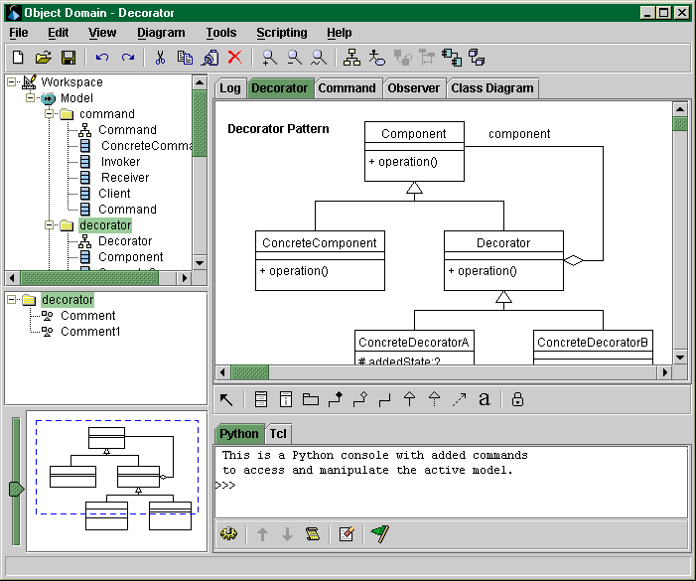

Slide 8
Java Scripting Competition
Big three scripting languages
  Perl - Nothing
  Tcl - Jacl
    last release in February, terrible performance
  Python - JPython
    last release in October, good performance
Other options
  Scheme - Kawa
  NetRexx - merges Rexx and Java

Slide 9
JPython vs. Jacl Performance
Simple benchmark from web (had Tcl code)
  iterative factorial (using floats)
  recursive factorial (using floats)
  string manipulation test
  exec’ing process in os
  simple file i/o
Don’t take benchmark’s too seriously!

Slide 10
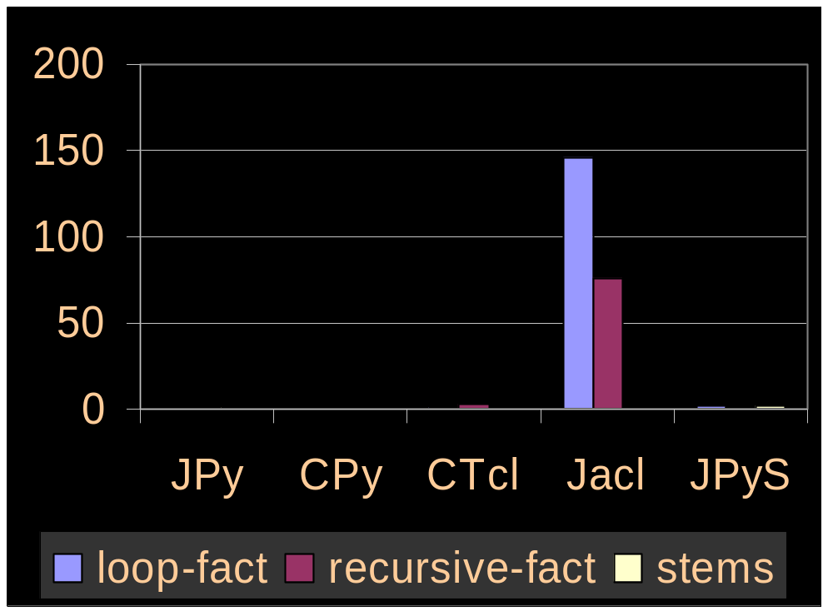

Slide 11
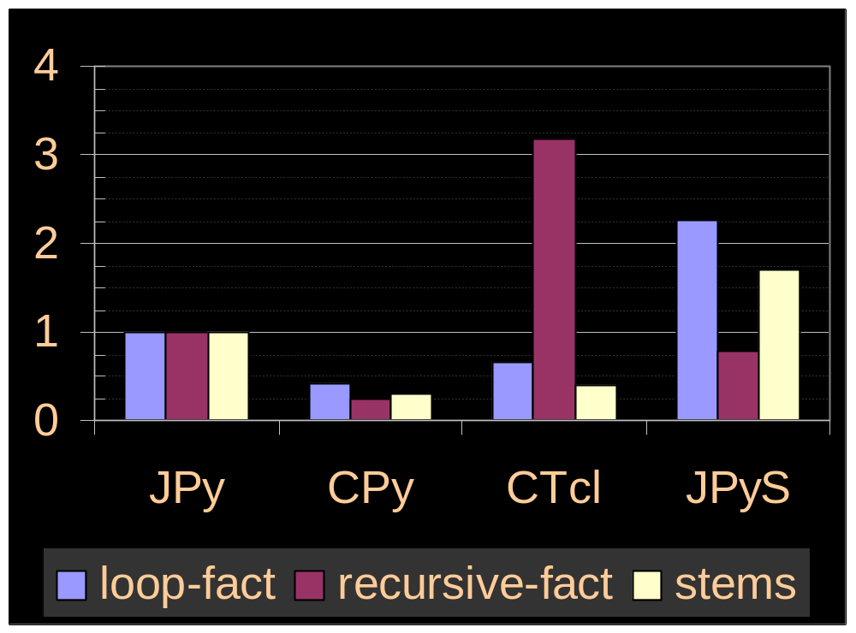

Slide 12
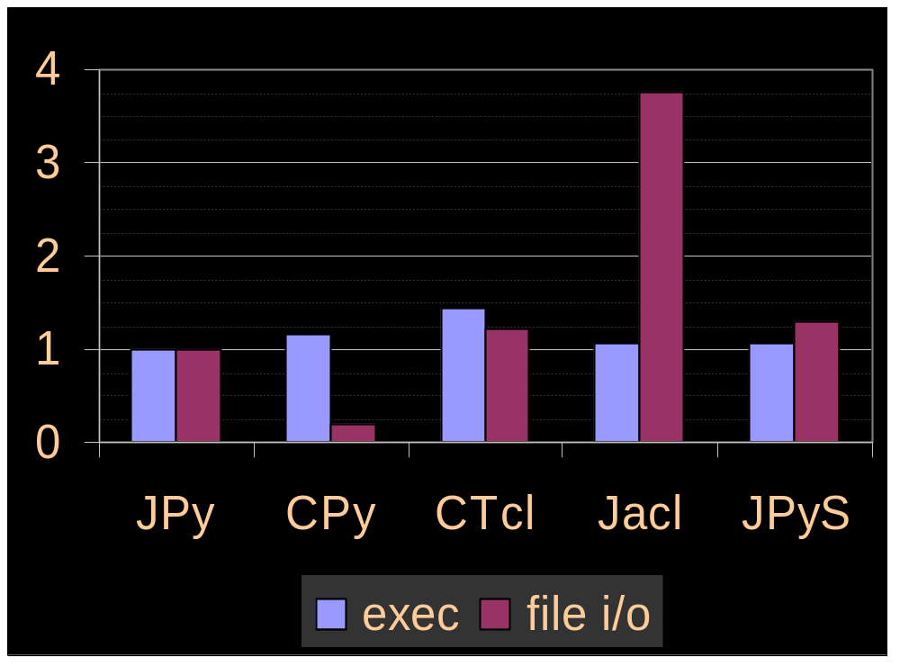

Slide 13
Trivial Access to Java Packages
Use Java packages with no wrappers
Even better than SWIG
Java’s design makes this possible
  int sum(double *data, int n);
  vs.
  int sum(double[] data);

Slide 14
GUI Example
from TkInter import Button
def quit(): sys.exit()
QUIT = Button(frame, text='QUIT', foreground='red', command=quit)
from javax.swing import JButton
def quit(event): sys.exit()
QUIT = JButton(text='QUIT', foreground=red, actionPerformed=quit)

Slide 15
Outstanding Differences
Trivial Differences
  JPython -> "1.0E20" CPython -> "1e+020”
  CPython doesn't allow 001.1, and does allow 0e
Things that just need to be fixed
  looping over a dictionary is allowed
  printing recursive list -> StackOverflowError
  importing site at startup, command-line options
  standard exceptions are not class-based

Slide 16
Big Differences
Weaker system interaction
  weak os and no select or signal modules
  no readline or signal handling in interpreter
No C-based extensions (but Java packages)
True garbage collection
Better merging of types and classes
Performance worse by 2X-10X

Slide 17
JPython and System Interaction
Java lacks Python’s close system interaction
  Least common denominator choice
os module
  much of posix is impossible without JNI
select, signal
fancy socket stuff
Ctrl-C handling, readline support

Slide 18
Can’t use existing C-based extension modules
Means C extensions must be rewritten in Java to be used in JPython
  I think this is much easy than writing in C...
Often can write them in JPython as a thin wrapper around existing Java packages
  os is an example
Might change in the future, but unlikely

Slide 19
Missing built-in modules
Some surprising modules are there:
  pdb, profile, marshal
Some are (relatively) straightforward
  operator, struct, cmath, zlib, binascii
  cPickle, cStringIO, bsddb (Finn Bock)
Some are a lot of work
  TkInter, imp
  Numeric (Tim Hochberg)

Slide 20
More missing built-in modules
Some might never be there based on JPython’s design
  rexec, dis
Some are really hard based on Java’s design
  posix (os), select, signal
Some are considered outdated
  regex, regsub

Slide 21
Lots of Extra Modules
javax.swing
java.sql
com.ibm.xml
javax.mail
javax.media
com.ms.com

Slide 22
Garbage Collection
No reference counting at all in JPython
Use Java’s garbage collection model instead
Circular references no longer leak
Finalization time is now unclear

Slide 23
Better merging of types/classes
[].__class__ makes sense
Can pass any container to exec/eval
  not just dictionaries
Still some outstanding issues
  __finditem__
    vs.
  raise IndexError on __getitem__

Slide 24
Performance Issues
CPython is 2-10X faster
  only 2-6X faster on platforms with a JIT
Excuses, excuses...
  JPython is version 1.0 (actually 1.0.3)
  Java is version 1.1
JPython-2.0 can be up to 2000X faster
  wait until the end of my talk

Slide 25
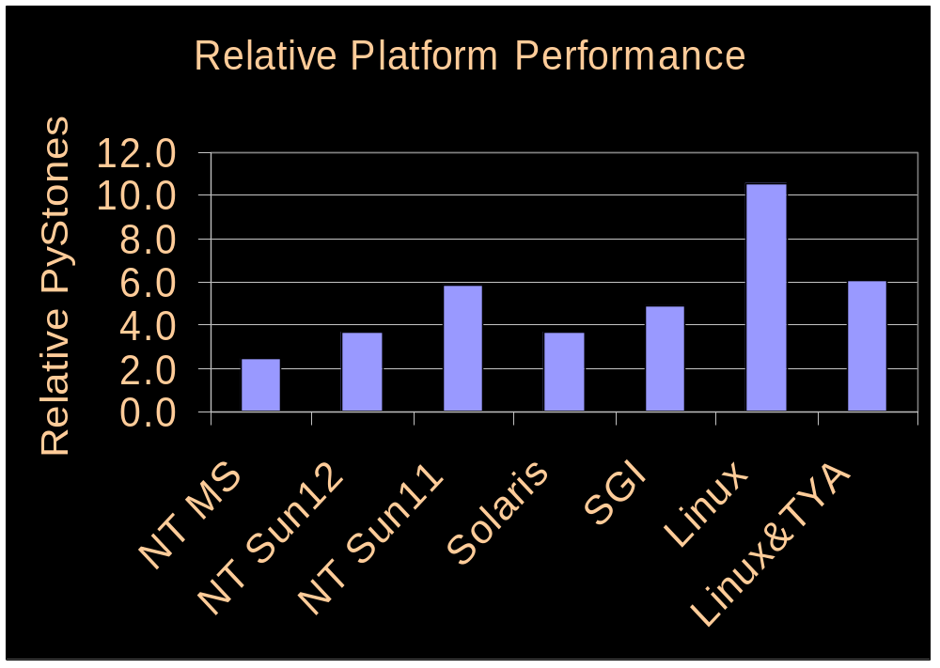

Slide 26
Current Design is Conservative
Uses Java stack (but not really stack frames)
Uses Java for bytecode
All operations are basically method calls corresponding to Python bytecodes
JVM stack looks a lot like PVM stack
x + y
  x._add(y)
  frame.getlocal(1)._add(frame.getlocal(2))

Slide 27
Why not Java Stack Frames?
Would Break
  locals()
  sys.settrace()
Would make harder
  correct exception line numbers
  handling local variable name errors

Slide 28
Why not Java namespaces?
Messing with other modules namespaces
  import foo
  foo.range = myrange
Covert namespace manipulation
  foo.__dict__[‘bar’] = 42
Compile-time vs. run-time paths

Slide 29
Why not Java objects on stack?
Dynamic namespaces
  break most type inference
  can’t know function return types if you don’t know what function is actually being called
Generally can’t know more than PyObject

Slide 30
jpythonc2
Very aggressive compilation
Using Java’s advantages whenever possible
Requires some “assumptions”
Whole-program analysis is the trick
  Let’s you make sure assumptions hold
Without whole-program analysis?
  Requires programmer annotations of some form

Slide 31
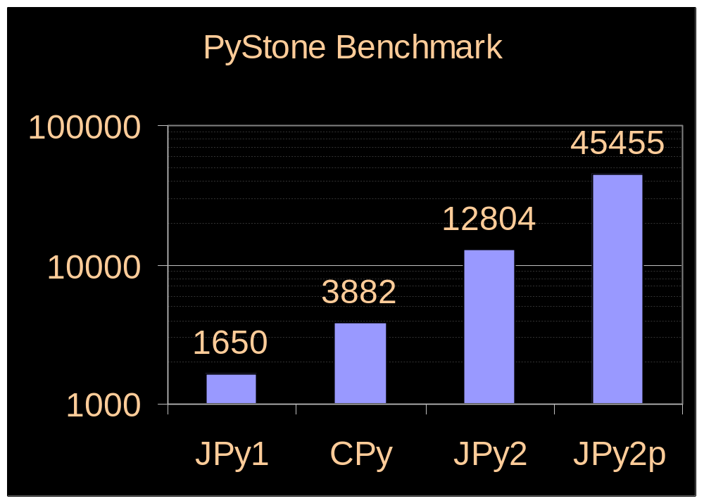

Slide 32
Using Java Stack Frames
Locals as Java local variables
  Most JIT’s use registers to hold these
Breaks locals()
  can detect use of locals() and disable!
Breaks sys.settrace()
  this is the price you pay

Slide 33
Using Java Namespaces
None
Three interpretations (in module foo)
  __builtin__.None
    might have been altered from original
  foo.None
    possibly both this and above
    might have been altered in various ways
  local variable None

Slide 34
Two solutions
Whole-program analysis can detect
  and abort if needed
Could add restrictions
  Can’t change __builtin__.None
  Only foo can set foo.None
  foo doesn’t use globals() or foo.__dict__

Slide 35
Using primitive types
Java has primitive bytecodes in VM
  JIT’s often turn these into machine code
  Can add two ints extremely efficiently
Need to know types to pull this off
Overflow bounds checking
  Much more efficient if choose to disable
  Still savings from not allocating/freeing objects

Slide 36
Type inference
Complete (whole-program)
    def foo(x):
      y = x+10
    foo(100)
Partial (ML-like)
    def foo:int(x:int):
      y = x+10

Slide 37
The importance of Any
    x = 2
    y = x+10
x and y are now integers
    y = “goodbye”
y is now an Any

Slide 38
Fully Dynamic Implementation
Module foo
x = 42
JPython-1.0
  public static PyInteger _c42 = new PyInteger(42);
  frame.setglobal(“x”, _c42);

Slide 39
Static Namespaces
Module foo
x = 42
JPython-2.0
  public static final PyInteger _c42 = new PyInteger(42);
  public static PyObject x;
  foo.x = _c42;

Slide 40
Primitive Types
Module foo
x = 42
JPython-2.0p
  public static int x;
  foo.x = 42;

Slide 41
Another Example
Python Module
  None
Dynamic Namespaces
  frame.getglobal(“None”);
Static Namespaces
  __builtins__.None;

Slide 42
Compiler Design
Symbolic (Partial) Evaluation
  Completely object-oriented
  Results of operations are types + code to produce
Interesting future possibilities
  Blitz -- very efficient C++ lib for numeric
  re - compile-time optimization of regex’s
  …

Slide 43
Systems to Benchmark
Complete Systems
  JPy1 - JPython-1.0.3
  CPy - CPython-1.1.5
Aggressive compiler prototypes
  JPy2 - aggressive namespace, no primitive types
  JPy2p - Use raw ints for integers, same for strings
    Also, disable numeric bounds checking
Hardware: P-II 233; OS: NT4.0sp3; JVM: MS

Slide 44
Simple Benchmarks
def while_test(i):
while i > 0: i = i - 1
def for_test(i):
y = 0
for x in range(i): y = y + 1
def recursive_test(i):
if i > 0: recursive_test(i - 1)

Slide 45
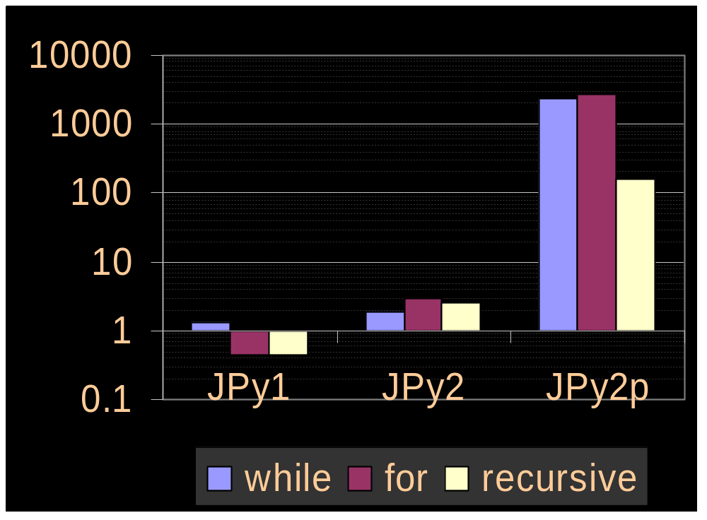

Slide 46
PyStone Results
Not the last word in benchmarks, but…
Must support a large subset of Python
  Ident1, Ident2, … = range(6)
  from time import clock
  “Pystone(%s) time for %d passes = %g” % (__version__, LOOPS, benchtime)
  class Record: …
  map(lambda x: x[:], Array1Glob)

Slide 47
Disclaimer
Handles almost nothing not in pystone
  First generation prototype
Made one small change to pystone
  Doesn’t use default args
  Just didn’t have time to implement in jpythonc2

Slide 49
Where the time’s going
Proc8 manipulates lists of ints
Type inference system treats lists as Any’s
Could probably infer types of list elements
  Mutable nature of lists makes this challenging
  Might be easier to include type annotations
What if we leave this section of code out?

Slide 50
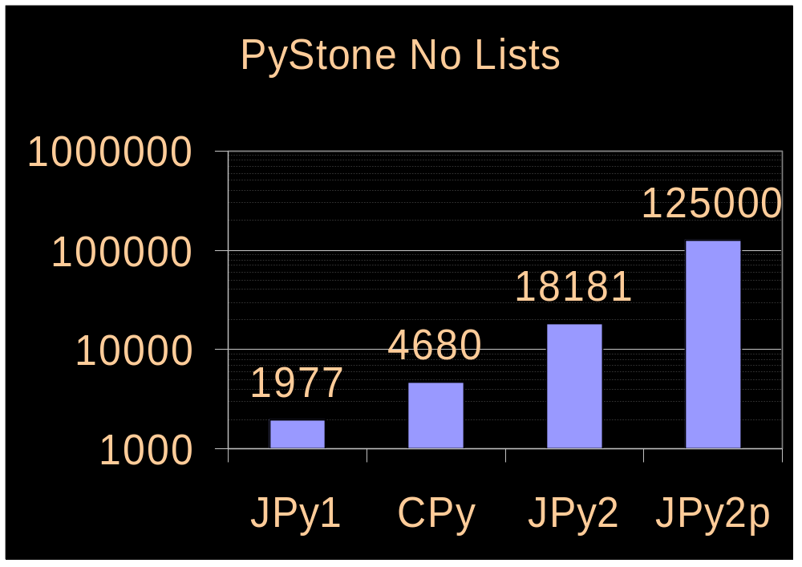

Slide 51
Complete Type Inference Limitations
Requires whole-program analysis to work
  Can only be used with jpythonc/freeze
Gives up advantages of typing for documentation/safety
Solution is optional static types?

Slide 52
Optional Static Types
ML-style partial type inference
  Deafult signature is Any
Allows mixing of typed/untyped code
Things that disable optimization
  __getattr__, getattr(), __dict__, globals(), exec, eval, ...
Things that throw runtime exceptions
  math.pi = “foo”

Slide 53
Add Java to Python or Python to Java?
How to merge Python and Java?
Python + Optional Static Types
Java + Syntactic Sugar + Dynamic Types

Slide 54
Little Things I Like About Java
(Most could be added to Python)
interfaces
synchronized methods/blocks
labeled breaks/continues
block comments /**/
assign ops (+=, *=, ...)
boolean considered fundamental type
never write “from StringIO import StringIO”

