Slide 1
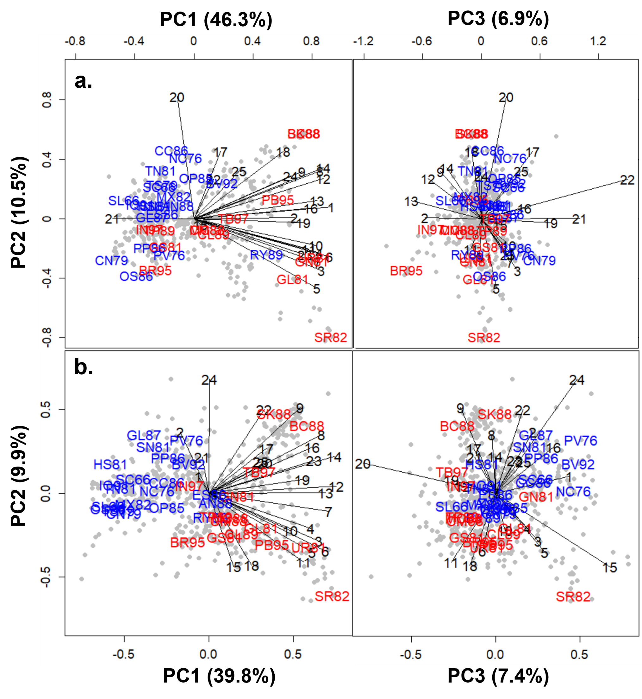
Figure 2: Biplots of the performances of the 686 genotypes in each ESWYT cycle from (a) the COP-based K model and (b) the GRM-based K model. The vectors indicate the ESWYT cycles/years (1 to 25). The names of the 35 released cultivars (Table 2) are included in these biplots. The cultivars in red do not carry the 1B/1R translocation, while the cultivars in blue have the 1B/1R translocation. Refer to Table 1 for a description of these models.

Slide 2
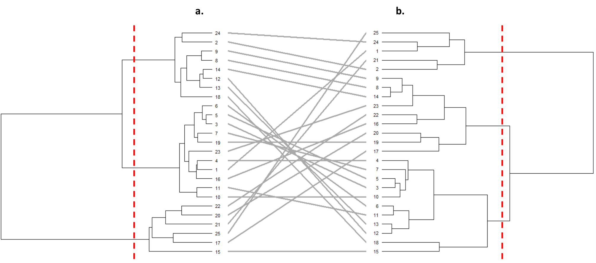
Figure 3: Comparison of the optimised dendrograms of the first 25 ESWYT cycles/years based on the genotype-by-year performance tables from (a) the COP-based K model and (b) the GRM-based K model. The red vertical dotted lines indicate the three-group levels. Refer to Table 1 for a description of these models.
Notes:
Figure 3: Comparison of the optimised dendrograms of the first 25 ESWYT cycles/years based on the genotype-by-year performance tables from (a) the COP-based K model and (b) the GRM-based K model. The red vertical dotted lines indicate the three-group levels. Refer to Table 1 for a description of these models.

Slide 3
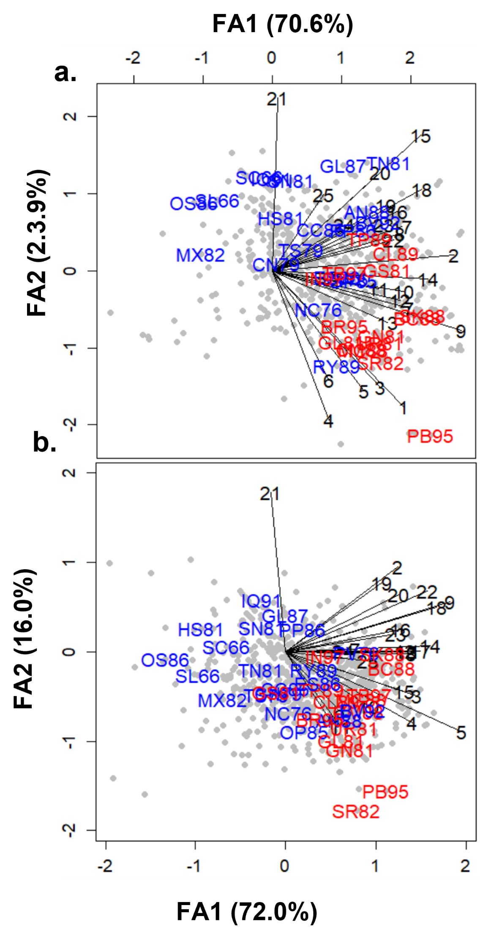
Figure 4: Biplots of the performances of the 686 genotypes in each ESWYT cycle from (a) the COP-based KFA model and (b) the GRM-based KFA model. The vectors indicate the ESWYT cycles/years (1 to 25). The name of the 35 released cultivars (Table 2) are included in these biplots. The cultivars in red do not carry the 1B/1R translocation, while the cultivars in blue have the 1B/1R translocation. Refer to Table 1 for a description of these models.
Notes:
Figure 4: Biplots of the performances of the 686 genotypes in each ESWYT cycle from (a) the COP-based KFA model and (b) the GRM-based KFA model. The vectors indicate the ESWYT cycles/years (1 to 25). The name of the 35 released cultivars (Table 2) are included in these biplots. The cultivars in red do not carry the 1B/1R translocation, while the cultivars in blue have the 1B/1R translocation. Refer to Table 1 for a description of these models.

Slide 4
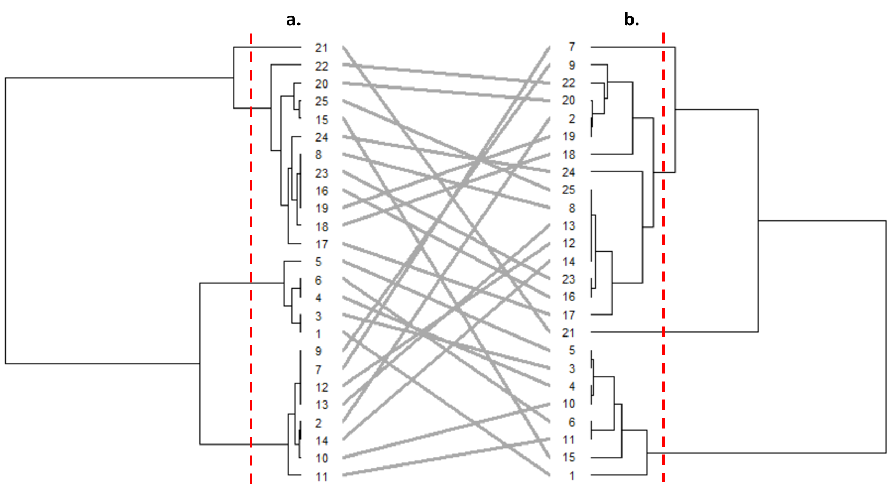
Figure 5: Comparison of the optimised dendrograms of the first 25 ESWYT cycles/years based on the correlation matrix among years (W matrix) estimated using factor analytic model from (a) the COP-based KFA model and (b) the GRM-based KFA model. The red vertical dotted lines indicate the four-group levels. Refer to Table 1 for a description of these models.

