Slide 1
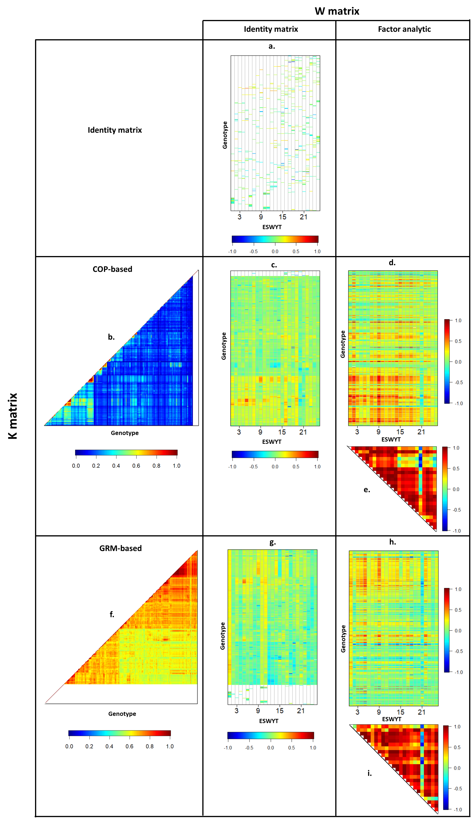
Notes:
Figure 1: Heatmaps for the performances (Best Linear Unbiased Predictors, BLUPs) of the 686 genotypes in each ESWYT cycle/year from the five prediction models (Table 1) presented by cross-tabulating the genetic relationship matrices among genotypes (K matrix) with the correlation matrices among years (W matrix) calculated from the covariance matrix from the factor analytic (FA) model. (a) BLUPs from the ID model; (b) Lower-triangular K matrix calculated using the pedigree (COP-based K matrix); (c) BLUPs for COP-based K model; (d) BLUPs from COP-based KFA model; (e) Upper-triangular W matrix from the COP-based KFA model; (f) Lower-triangular K matrix calculated using the marker data (GRM-based K matrix); (g) BLUPs from GRM-based K model; (h) BLUPs from GRM-based KFA model; and (i) Upper-triangular W matrix from the GRM-based KFA model. The white in the heatmaps indicates either a missing BLUP for untested genotypes, zeros in the K matrices, or diagonal values in the W matrix. The ordering of the genotypes is consistent with the respectively optimised dendrograms and is explained in the text

