Slide 1
CITY SCAN TUNIS, TUNISIA OCTOBER, 2025

Slide 2
// | label: Read plots from config // | echo: false yaml = import("https://esm.sh/js-yaml@4") import {addPlot} from "./JS/plotManager.js" plotConfig = FileAttachment("source/plots.yml").text() plots = yaml.load(await plotConfig)
Executive Summary

Slide 3
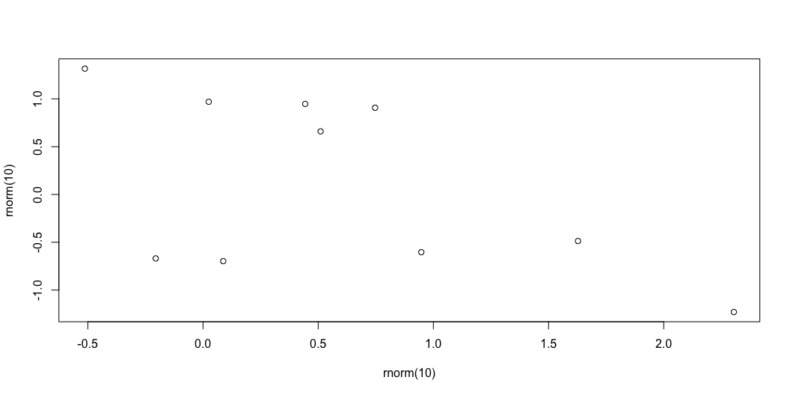
Test Slide
//| output: asis fillSlide("population") // import {chart_pga} // with {columnWidth as plotWidth} // from "@carolinecullinan/tunis-tunisia" chart_pga = addPlot(plots.population_growth) // fillSlide("population_growth", chart_pas) html`<section class="level4"> ${md`#### Population Growth`} ${chart_pga ?? ""} ${addSlideText(slide_texts.population_growth)} </section>`
Setting The Context
Population and Demographic Trends
A scatter plot of random data.

