Slide 1





LENGTH OF STAY PREDICTION FOR EMERGENCY DEPARTMENT
SUBMITTED TO:
MUHAMMAD SHAHID
SUBMITTED BY:
JASPREET KAUR (0730470) KANCHAN BAGGA (0732356) VARINDERJIT SINGH (0730482)

Slide 2

OVERVIEW
Problem Statement
Introduction
Objectives
Data Source
Dataset
Factors
Analytical Problem
Ethical Concerns
Challenges
References

Slide 3
PROBLEM STATEMENT
The ability to predict the length of stay (LOS) as early as possible in the preadmission stage after first checkup might be helpful to monitor quality care for the hospital admission management team. In this project we shall develop model to predict the LOS in Emergency department at admission time for general patients.

Slide 4

INTRODUCTION
LOS: LOS means length of stay which directly describes the time interval of stay for each patient in hospital’s emergency department. This is the time from entry to exit in ED for each patient on the basis of historical data. It depends upon their condition as well like according to the health emergency it will access the period of cure.
Our project is to build a prediction model that tells the LOS with high accuracy for each patient at preadmission time. LOS varies on various factors. Example – Diagnosis, Emergency type(Sudden or by appointment).
Some other factors also may have impact on LOS that we will be explored in this project.
This project will help in bed allocation and early appointment dates prediction and we can reduce hospital expenses by reducing LOS.

Slide 5
OBJECTIVE
Bed allocation
Quality of care
Medical staff
Time access
Proper equipment
Measure of readmission and discharges
Reduce the length of stay

Slide 6
Tools & Techniques
Excel
Python
SQL

Slide 7
DATASET
Our dataset is MIMIC-III (Medical Information Mart for Intensive Care). It is a huge, single focus database involving data identifying with patients admitted to basic consideration units at in enormous tertiary consideration emergency clinic. In that dataset contains the 26 tables which one table has 7544 rows and 17 columns. This was uncleaned dataset. We had enough null values in our dataset. We had abundant the data to training and testing purpose to predict the accuracy.
But we are working on just emergency department data with the record of 598 types of diagnosis and 7543 patients.

Slide 8

DATA SOURCE
MIMIC-III (Medical Information Mart for Intensive Care)
Opensource data
26 CSV files
Link
https://physionet.org/content/mimiciii/1.4/

Slide 9
FACTORS
Age
gender
Marital status
Admission type
History of previous admission
Type of treatment

Slide 10
ANALTICAL PROBLEM
The biggest task was to clean the dataset and remove the null values because of having numerous rows and columns. For this we have used excel.
To analyze further, we have sorted the columns and found correlations among all the columns using excel and SQL.
The main motive to choose python for its features and model selection as it needs neural networks for prediction which can be only capable by python to solve the problem.
To solve the analytical problem it must to think analytical.

Slide 11
ETHICAL CONCERNS
Consent: As this dataset is opensource, we don’t need to have any consent to collet this dataset. We have downloaded this dataset from Physionet.org
Consistency: We have huge volume of record in our dataset. It is very reasonable for experimenting on this dataset.
Clarity: This dataset is used for model building with highest accuracy to predict LOS for general patients. So it very clear that how we use this data.

Slide 12
CONTINUE WITH FIVE C’s
Control : Although, this dataset is publicly available, but it is controlled by the GitHub. We can use it only for experiment purpose.
Consequences: This data can never harm any individual. Instead, it will help in the better caring in hospital by predicting length of stay.

Slide 13
Pre-Processing
Remove the null Values
Drop the unnecessary columns
Check the skewness
dATA balancing

Slide 14
METHODOLOGY
Random Forest
Gradient Boosting
Neural networks
Decision Tree
K-Neighbor

Slide 15
Python Programing
Data exploration & Implementation of Models

Slide 16
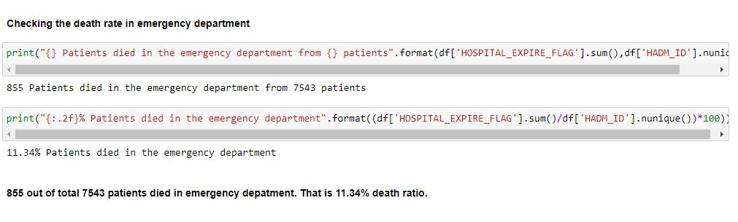
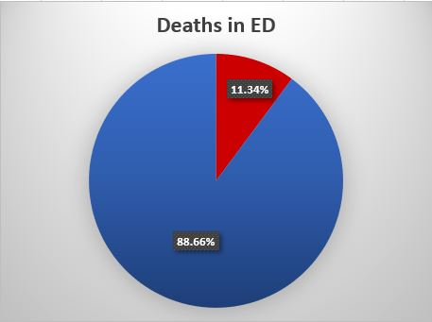
Data exploration

Slide 17
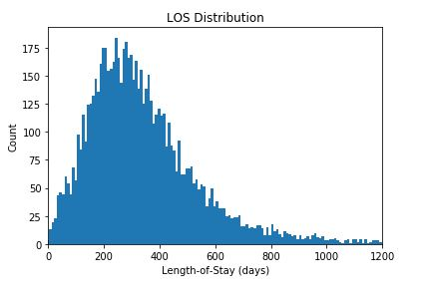
Target variable distribution

Slide 18
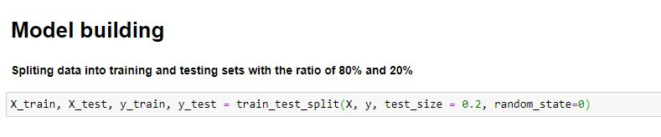
Splitting data into testing & training

Slide 19
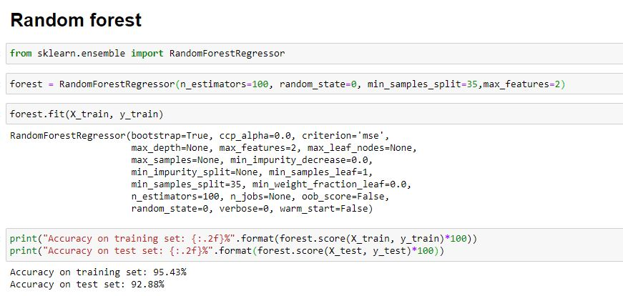
Random Forest
Random forest is an ensemble learning method for classification, regression and other tasks that operate by constructing a multitude of decision trees at training time.

Slide 20
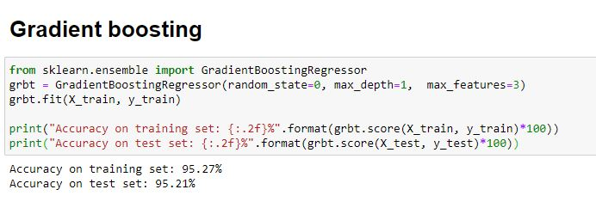
Gradient Boosting
Gradient boosting is a machine learning technique for regression and classification problems, which produces a prediction model.
It generalizes models by optimizing of an arbitrary differentiable function.

Slide 21
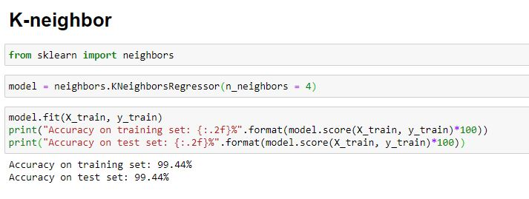
K-neighbor
The k-nearest neighbors (KNN) algorithm is a simple, easy-to-implement supervised machine learning algorithm that can be used to solve both classification and regression problems.

Slide 22
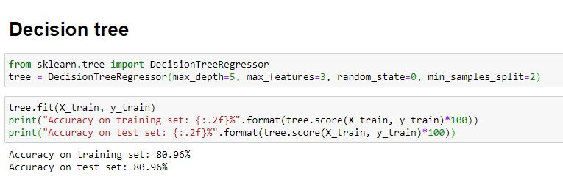
Decision tree
A decision tree is a decision support tool that uses a tree-like model of decisions and their possible consequences, It works according to logical conditions. It is one way to display an algorithm that only contains conditional control statements.

Slide 23
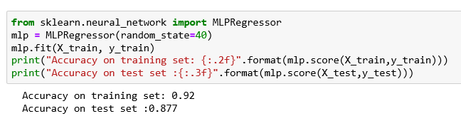
NEURAL NETWORK
Multilayer perception or MLP’s are the classical type of neural networks that are compromised of one or more layers of neurons in which the Data is nourished to the internal layer, there may be one or more secreted layers in case levels of concept, and prediction are made on the external layer.

Slide 24
CHALLENGES
Initially, it troubled to find the dataset
it took few days to get access from authority on legal base.
Moreover, it gives enormous choices that make it complicated to select one of these.
The dataset includes lots of diagnoses that’s why it is difficult to give the priority to anyone among all for the prediction.
While we were doing coding part the accuracy rates were very low.
Due to the low accuracy we had to repeat the splitting part change the ratio to improve the accuracy and the weightage of factors.
Current Scenario of COVID-19 affect the project work highly as we cancelled all the group meetings to maintain social distancing. We used Other ways for group discussions.

Slide 25
REFERENCES
https://physionet.org/content/mimiciii/1.4/
https://towardsdatascience.com/predicting-hospital-length-of-stay-at-time-of-admission-55dfdfe69598
https://www.nature.com/articles/sdata201635
https://www.ncbi.nlm.nih.gov/pmc/articles/PMC1067345/

Slide 26
Project Contribution
Major Task | Member Name | Sub Tasks | Description | Completed on | Status
Topic selection | Kanchan Bagga | Finding project topic, Topic related search | Project that could be useful in future. Should have something new. Scope for job placement. Should be useful in real life as a tool. | February 04, 2020 | Done
Dataset | Jaspreet Kaur | Finding dataset (Searching, getting access and downloading) | Searched dataset from different websites. Sent emails to many of the organizations for accessing their datasets. Got access for MIMIC dataset and downloaded | February 18, 2020 | Done
 | Jaspreet Kaur Kanchan Bagga Varinderjit Singh | Target and supporting variables selection | Target variable (LOS) was already cleared in everyone’s mind but all the supporting variables were needed to select that could effect on LOS. | February 25, 2020 | Done
 | Kanchan Bagga | Data Cleaning (Changing format, keeping necessary data only) using excel | Changed downloaded files format. Made one single file from 27 files by merging all necessary columns in master file only. Removed unnecessary columns only, removed outliers, data about emergency department only was kept. Some new columns are made. Missing data rows are removed. | March 03, 2020 | Done
 | Varinderjit Singh | Cleaned data understanding & exploration | Understood & explored cleaned data in SQL Server for my satisfaction and cross checking. | March 05, 2020 | Done

Slide 27
Project related research | Jaspreet Kaur | Searching work done on related projects | Projects that are already made on same topic. So that we could come to know what is done and what different we can do. | March 03,2020 | Done
Article reading | Varinderjit Singh Kanchan Bagga Jaspreet Kaur | Studied 10 (4-3-3) articles individually | Study articles based on how we can use machine learning in our project. For understanding what kind of models, we can use and how we can improve their accuracy. | March 12, 2020 | Done
Model Study | Jaspreet Kaur | ANN, Logistic regression, K-neighbor | YouTube tutorials, Google search | March 23, 2020 | Done
 | Kanchan Bagga | CNN, Random forest, Gradient boosting | YouTube tutorials, Google search | March 19, 2020 | Done
 | Varinderjit Singh | Confusion matrix, Multiple linear regression | YouTube tutorials, Google search | March 20, 2020 | Done
Model Building | Varinderjit Singh | Neural network, Multiple linear regression, Confusion matrix |  | March 27, 2020 | Done
 | Kanchan Bagga | Random forest, Gradient boosting |  | March 24, 2020 | Done
 | Jaspreet Kaur | Logistic regression, K-neighbor |  | March 24, 2020 | Done
Report writing | Jaspreet Kaur |  |  | --- | Pending
Presentation | Kanchan Bagga |  |  | April 08, 2020 | Done

Slide 28

THANK YOU

