Slide 1
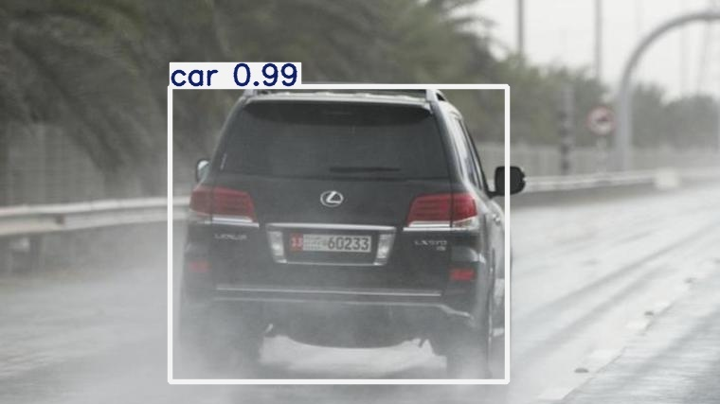
MSC ARTIFICIAL INTELLIGENCE · RESEARCH PROJECT
Performance evaluation of YOLO-based vehicle detection under adverse conditions
Validation-bound evidence across ACDC, corrected DAWN and Combined training
Varis Jahirbhai Kureshi · 35042321
Supervisor: Yasir Javed · Sheffield Hallam University
Notes:
This presentation evaluates how YOLOv8l vehicle detection changes across adverse conditions and across real-data domains. The title image is an author-generated corrected DAWN prediction cropped only to remove truncated detections at the frame edge; no box, class or confidence was edited. The central discipline is that every quantitative number is a validation-bound estimate. CARLA evidence is retained only as a qualitative engineering diagnostic and never enters the real-data metric matrix.
[Sources]
- Author-generated corrected DAWN qualitative output
- Author-generated final dissertation, Abstract and Chapter 1
[/Sources]

Slide 2
Domain shift is the central research challenge
RESEARCH QUESTION
How does YOLOv8l vehicle detection change across adverse conditions and across real-data domains?
Answer in one line
Within-domain performance was stronger than direct transfer. Combined training improved balance, but did not dominate every metric.
Descriptive, non-causal conclusion
02
Notes:
The research question asks how detection changes under adverse conditions and, more importantly, across real-data domains. The concise answer is that within-domain performance was stronger than direct cross-domain transfer. Joint ACDC and corrected DAWN training produced a better balance across both validation domains, but it did not dominate every metric. Because training used one seed and no independent hold-out test set, this is a descriptive and non-causal conclusion. I therefore avoid claims of architectural superiority or generalized real-world robustness.
[Sources]
- Author-generated final dissertation, Chapters 1, 4 and 7
[/Sources]

Slide 3
Real-data metrics and CARLA evidence answer different questions
Seven-cell quantitative matrix
CARLA diagnostic assets
ACDC, corrected DAWN and Combined checkpoints
Bounded clear, rain, fog and synthetic night scenes
Ultralytics validation metrics
Engineering and rendering diagnostics
Within-domain controls + cross-domain transfer
Qualitative presentation evidence only
Precision, Recall, F1, mAP@0.5, mAP@0.5:0.95
No numerical ranking against ACDC or DAWN
No construct mixing
03
Notes:
This slide protects construct validity. The seven-cell matrix contains only protocol-matched Ultralytics validation outputs from ACDC, corrected DAWN and Combined checkpoints. CARLA answers a different question: whether controlled weather and synthetic-night scenes can support engineering and visual diagnostics. Rendering fidelity, ground-truth generation and presentation tracking are not equivalent to real-world validation. Therefore no CARLA number is ranked against ACDC or DAWN. Keeping these evidence streams separate prevents an attractive simulation result from being misreported as empirical real-world performance.
[Sources]
- Author-generated final dissertation, Sections 3.5 and 6.3
- https://carla.readthedocs.io/en/0.9.16/
[/Sources]

Slide 4
The protocol locks training, provenance and reporting
Training
YOLOv8l · 640 px · 100 epochs
Execution
Seed 0 · deterministic mode · single seed
DAWN integrity
Labels corrected non-destructively before retraining
Traceability
Five accepted checkpoints SHA-256 locked · commit 1eb81b5
F1
2PR / (P + R) from each exact unrounded row
Boundary
Validation estimates—not test accuracy
04
Notes:
The protocol combines reproducibility controls with data-integrity controls. Every accepted run used YOLOv8l, 640-pixel images and 100 epochs. Execution used deterministic mode with seed zero, so the study cannot estimate stochastic variance. The archived DAWN numeric class-ID mismatch was corrected non-destructively in a separate label copy before retraining and revalidating all seven cells. Five accepted checkpoints were SHA-256 locked and tied to repository commit 1eb81b5. Dataset support was unequal: ACDC used 1,600 training and 406 validation images, corrected DAWN used 422 and 120, and the combined training pool was 79.1% ACDC. That imbalance is part of the interpretation, not a hidden preprocessing detail.
[Sources]
- Author-generated final dissertation, Sections 3.2–3.7 and Appendix G
- Author-generated corrected evidence manifest at commit 1eb81b5
- https://docs.ultralytics.com/modes/train/
[/Sources]

Slide 5
Seven protocol-matched cells define the quantitative evidence
All values are validation-bound estimates
Train → validate
P
R
F1
mAP50
mAP50–95
ACDC → ACDC
.6226
.4014
.4881
.4221
.2634
ACDC → DAWN
.5955
.1190
.1983
.1362
.0797
DAWN → ACDC
.2055
.1330
.1615
.1122
.0666
DAWN → DAWN
.8465
.5794
.6879
.6277
.4369
Combined → ACDC
.5225
.4129
.4613
.4069
.2452
Combined → DAWN
.8142
.6093
.6970
.6382
.4228
Combined → Union
.5808
.4376
.4991
.4472
.2720
ACDC→DAWN F1 = .1983 from unrounded same-row P and R; displayed P/R are rounded.
05
Notes:
These seven rows are the complete quantitative evidence boundary: two within-domain controls, two direct transfers, two combined-model domain validations and one combined union validation. Precision, recall, F1, mAP50 and mAP50–95 all come from the same protocol-matched validation rows. A crucial reconciliation is the ACDC-to-DAWN F1. The authoritative unrounded values are precision 0.595542 and recall 0.118977, producing F1 0.198331, reported as 0.1983. The displayed precision and recall are rounded, so recomputing from those display values is not the governing calculation.
[Sources]
- Author-generated Corrected Evidence sheet
- Author-generated final dissertation, Table 4.1
[/Sources]

Slide 6
Direct transfer failure is dominated by low recall
0.1362
ACDC → DAWN · recall 0.1190
0.1122
DAWN → ACDC · recall 0.1330
06
Notes:
The strongest failure is direct transfer. ACDC-to-DAWN mAP50 falls to 0.1362 and recall to 0.1190. DAWN-to-ACDC mAP50 is 0.1122 with recall 0.1330. The low recall indicates that missed objects are a major observed transfer symptom. Harmonized class names do not harmonize camera response, illumination, scene composition, object scale or annotation policy. The available aggregate rows do not support a complete class-by-weather causal decomposition, so I describe those mechanisms as plausible explanations rather than proven causes. A matched error ledger would be required for class-specific attribution.
[Sources]
- Author-generated cross-domain validation matrix
- Author-generated final dissertation, Sections 4.2 and 5.1
[/Sources]

Slide 7
Combined training improves balance without universal superiority
ACDC validation
DAWN validation
0.4069
0.6382
Combined mAP@0.5
Combined mAP@0.5
Defensible claim
The joint configuration is the most balanced descriptive outcome across the two validation domains—not the universally best model.
07
Notes:
Combined training improves balance. Its mAP50 is 0.4069 on ACDC and 0.6382 on corrected DAWN, avoiding the severe off-domain collapse of the single-domain checkpoints. However, the DAWN-only within-domain control remains slightly stronger on some DAWN metrics. The defensible conclusion is therefore not that Combined is universally superior. It is the most balanced descriptive outcome across the two recorded validation domains. That distinction matters because the combined pool is also dominated by ACDC images, so aggregate performance can emphasize the larger domain and its common classes.
[Sources]
- Author-generated final dissertation, Table 4.1 and Section 5.1
[/Sources]

Slide 8
Small support can create apparently strong results
Rare train class
DAWN Rain saturation
3
0.9916
retained validation instances
mAP@0.5 · 42 validation images
A displayed ≈0.83-confidence train box is one qualitative prediction—not class accuracy or robust class performance.
Repeated framing, similar viewpoints and limited background diversity can make a small subset easy to saturate.
Both remain validation-bound descriptive observations.
08
Notes:
Two apparently strong observations require support-aware interpretation. The ACDC validation set contains only three train-class instances. A displayed detection at about 0.83 confidence is one prediction, not class accuracy or evidence of robust train performance. Separately, DAWN Rain reaches mAP50 of 0.9916 on only 42 retained validation images. Repeated framing, similar viewpoints and limited background diversity make a small subset comparatively easy to saturate. Both numbers remain valid for their recorded validation subsets, but neither supports a broad claim. The selected visuals are deliberately successful illustrations and are not representative error analysis.
[Sources]
- Author-generated final dissertation, Sections 4.4, 5.2 and 6.2
- Author-generated Appendix J class-support evidence
[/Sources]

Slide 9
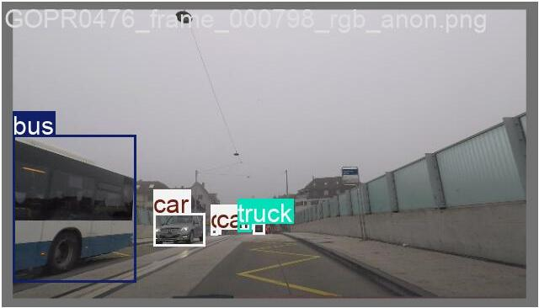
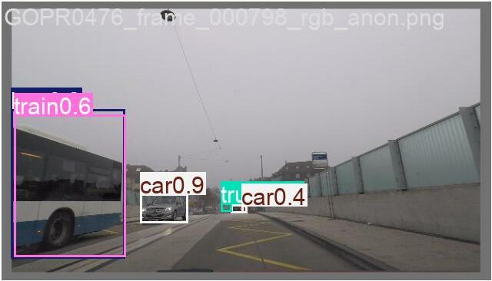
Matched ACDC Fog evidence reveals detection errors
Ground truth · matched frame
YOLO prediction · same frame
Matched crop only: source pixels and annotations are unchanged. It illustrates errors, but does not estimate cell-level error rates.
09
Notes:
This is the required matched ACDC Fog evidence. Both panels show the same validation frame cropped from the authoritative batch-zero ground-truth and prediction composites. The crop improves legibility only; source pixels, boxes, classes and confidences are unchanged. In this frame, the annotated bus is predicted as train, while other vehicle labels differ across the two panels. That makes the example useful for discussing classification disagreement and possible extra detections. It remains one selected frame, not a frequency estimate, and it cannot substitute for a matched error taxonomy across all seven matrix cells. Full panels are preserved in Appendix J.
[Sources]
- Author-generated ACDC Fog val_batch0_labels.jpg and val_batch0_pred.jpg
- Author-generated final dissertation, Appendix J
[/Sources]

Slide 10
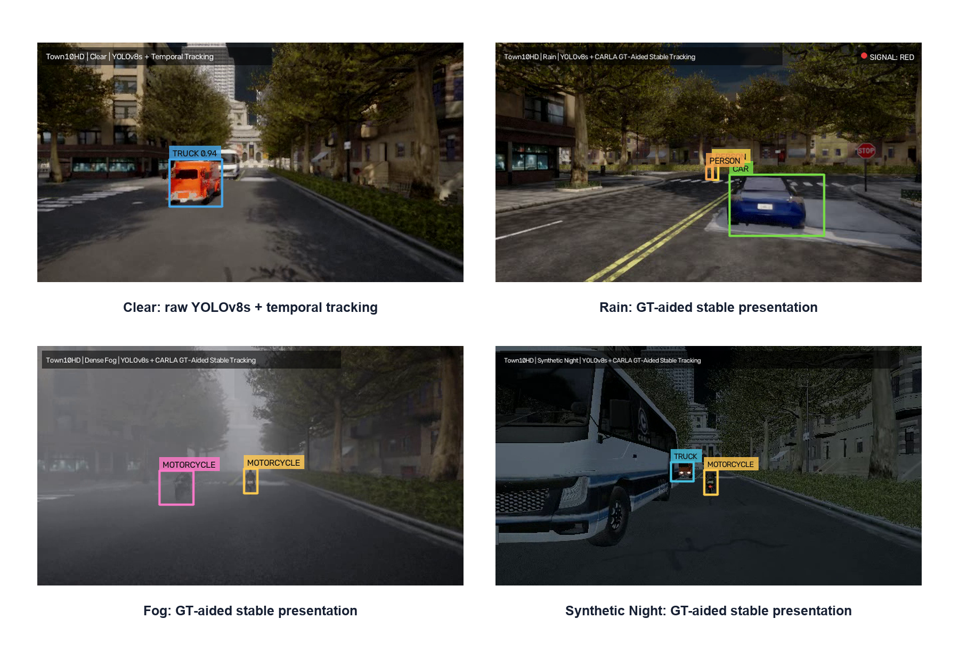
CARLA remains a qualitative diagnostic boundary
Permitted interpretation
Controlled engineering demonstration
Weather and night diagnostics
Qualitative presentation asset
Not permitted
Direct numerical comparison with ACDC or DAWN
Regular shader reflections ≠ irregular glare, spray, lens droplets or sensor noise.
10
Notes:
CARLA remains outside the quantitative matrix. Its value is controlled engineering demonstration: a fixed route, bounded clear, rain and fog settings, and a documented synthetic-night presentation asset. The visual gap to real weather remains substantial. CARLA shaders produce comparatively regular reflections, fog attenuation and wet-asphalt highlights. Real scenes add irregular headlight glare, tyre spray, lens droplets, motion blur, exposure changes, sensor noise and compression artefacts. These feature differences can alter detector inputs even when a scene appears semantically similar. For that reason I make no direct numerical CARLA-to-ACDC or CARLA-to-DAWN comparison.
[Sources]
- Author-generated CARLA diagnostic outputs
- Author-generated final dissertation, Sections 3.5 and 6.3
- https://carla.readthedocs.io/en/0.9.16/
[/Sources]

Slide 11
Four limits bound every conclusion
01
No independent hold-out
02
Single seed
Metrics are validation-bound estimates.
No variance, confidence interval or significance estimate.
03
Unequal support
04
Incomplete ledgers
Class and condition claims may be unstable.
T13 not established; T14–T15 partial.
The study is descriptive and non-causal.
11
Notes:
Four limits bound every conclusion. First, checkpoint selection and reporting use validation data rather than an untouched independent hold-out. Second, the single seed provides no variance, confidence interval or significance estimate. Third, unequal class and condition support can make rare-class or small-subset observations unstable. Fourth, the formal evidence register records T13 as not established and T14 to T15 as partial; these statuses are retained rather than converted into passes. Together, these limits mean the study is descriptive and non-causal. They do not invalidate the evidence, but they define exactly what the evidence can support.
[Sources]
- Author-generated final dissertation, Sections 5.2 and 6.4
- Author-generated Appendix J test register
[/Sources]

Slide 12
The contribution is an evidence-controlled evaluation workflow
Integrity
Traceability
Validity
Correct labels non-destructively
Lock checkpoints and commit lineage
Keep simulation outside real-data metrics
Required extension
Multiple seeds · pre-registered selection · untouched hold-out · matched error taxonomy
12
Notes:
The main contribution is an evidence-controlled evaluation workflow. Integrity comes from correcting labels non-destructively. Traceability comes from checkpoint hashes, repository lineage and exact metric reconciliation. Validity comes from keeping non-equivalent simulation outputs outside the real-data matrix. A stronger follow-on study would use multiple seeds, pre-register checkpoint selection, preserve an untouched target-domain hold-out and build a matched error taxonomy covering false negatives, background confusion and localization failures. Those extensions would convert the current descriptive evidence into a more statistically robust assessment.
[Sources]
- Author-generated final dissertation, Chapters 6 and 7
[/Sources]

Slide 13
VIVA DISCUSSION
The evidence supports domain dependence—not universal robustness.
Questions and methodological challenge
Varis Jahirbhai Kureshi · 35042321
Notes:
The final conclusion is intentionally narrow: the evidence supports domain dependence, not universal robustness. I welcome questions on the DAWN label correction, the seven-cell design, the F1 reconciliation, support imbalance, single-seed limitations or the CARLA boundary.
[Sources]
- Author-generated final dissertation synthesis
[/Sources]

