Slide 1
AI in the Film World
By: Alexa Varjian

Slide 2
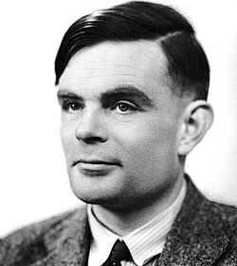
AI History
1950s
Computers- extensive calculators
Turned to scientists when needing specific calculations
Alan Turing (British Mathematician)
Credited with the idea of AI
Did not have the tech needed to prove it

Slide 3
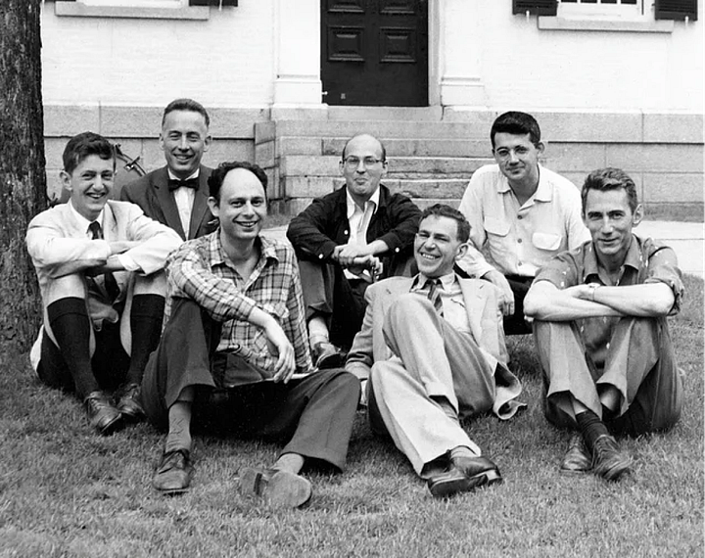
AI History
Summer 1956
Professor John McCarthy
First coined the term “Artificial Intelligence”
Invited researchers to take part in summer workshop focused on possibility of AI
Group is credited for creating the AI field
2 years after Alan Turing passed away

Slide 4
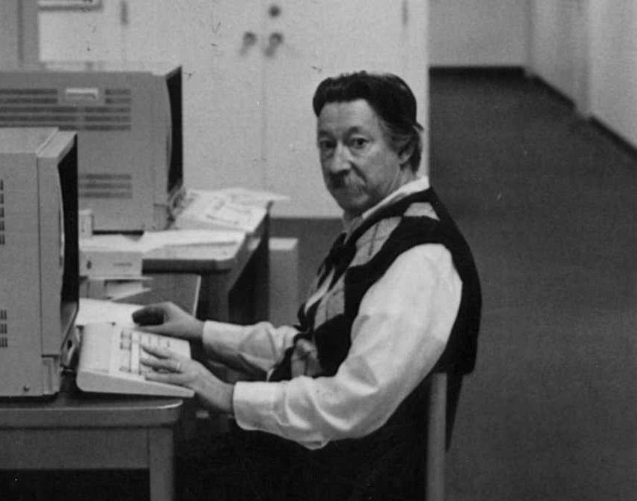
AI History
ELIZA
Joseph Weizenbaum
Known as the first chatbot (1966)
Used to simulate therapy
Repurposed answers users gave and turned into questions that helped the conversation continue
American Association of AI
1980s

Slide 5

AI in Film
Pre-Production
On Set Production
Post-Production

Slide 6
Pre-Production
Planning, scheduling and budgeting
Repetitive and tedious tasks
Looking at data
AI can help!
Many techniques used such as:
machine learning (ML)
computer vision
natural language processing (NLP)
Make process much easier
not as time consuming

Slide 7
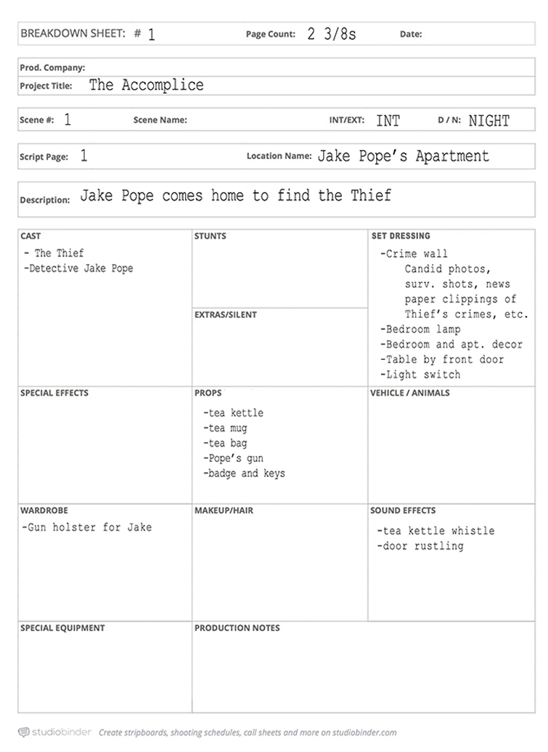
Script Breakdown
Dissecting a script
Organizing everything into different categories based on elements
Actors
Props
Costumes
Locations
Crucial for budget/time management
Must look through script and tag everything
Very tedious
NLP and ML can help!

Slide 8

AI: Script Breakdown
Natural language processing
Helps AI understand, interpret, and produce human language
ChatGPT
Uses NLP because when we ask a prompt, it can understand us and produce what we want them to
Machine learning
Type of AI that allows computers to learn without explicitly being programmed on how to do something
ChatGPT
Uses ML to know information without us telling them
“Break down this script into all its elements!”

Slide 9
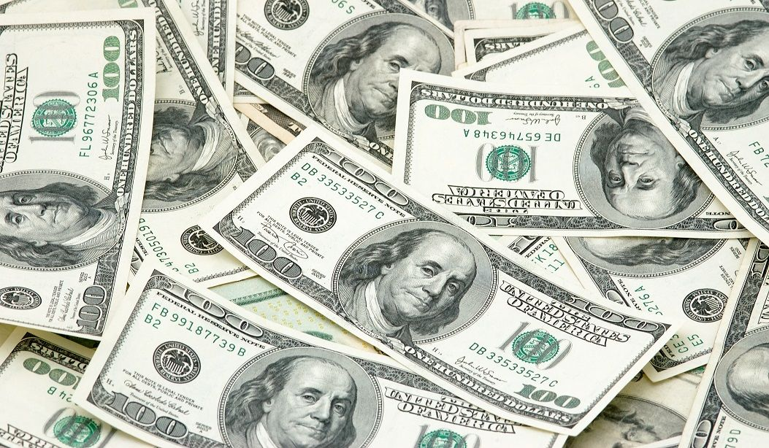
Budget Estimation
AI can look at different data to estimate this!
Historical finance data
Scripts
Actors
Locations
Film duration
Uses this data to create rough film estimate
Using AI driven solution
Compare budget of film to budgets of similar projects

Slide 10
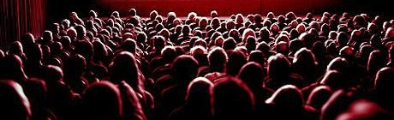
Target Audience/Success or Fail
Uses analytics from past audience preferences to determine target audience
Helps producers and writers determine story development and who they’re making this film for
Can also predict the success (or lack thereof) of the film you’re creating!
Using other scripts, box office history, and consumer data

Slide 11
Negatives
Ethical Considerations
Such as job displacement for many who can and will be replaced by AI
Transparency
Something AI generates could end up being false or biased
(Data quality or malfunction)
Can be problem for producers

Slide 12

AI in Screenwriting
Three months for FIRST draft
AI can do it in a couple minutes or even seconds!
Example
Andy Herd creating Friends episode
NLP/ML are used
Analyzes structure, style and semantics of existing scripts to find themes and it generates script based on what you tell it to write
Can also show your work to AI and it can revamp it, identify plot holes, etc.
Negative
Need to be very specific as to what you want out of it or else the result it produces will be awful
Limits creativity

Slide 13


AI in Screenwriting
Andy Bobrow, tv writer and producer, did an experiment
Had AI help with scene
Told it the character names, location and that magic was involved
Said the result was lackluster
Bobrow and Guy Goldstein (Writer Duet founder) say that AI lacks basic human quality needed to make stories good and worth reading/watching
Goldstein says AI lacks an opinion and a “why”
Doesn’t understand why the story is important to tell
AI should be used as an assistant to the writer, not THE writer

Slide 14
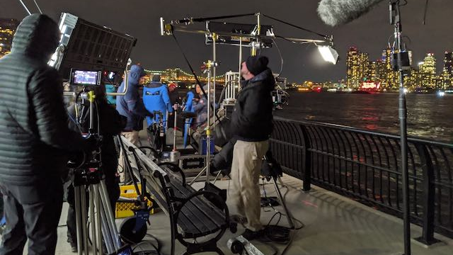
AI and On Set Production
AI brings great help to film sets as well
Automating tasks like documenting, inventory checks, and data syncing
Lessens overhead costs and gives you opportunity to meet tight deadlines
Helps manage technical stuff so you and crew can focus your time on the quality of your film, the camera angles, etc.
Generates quick insights which can help prevent errors or missing certain shots
So, you won’t have to correct so many things in postproduction
AI analytics help enhance camera setups, lighting, and even your shot list
Once again allowing more time to focus on getting everything done that you need to and creating your best work!

Slide 15
On Set Production: Limitations
Limitations
Potential issues with data security
(Encryption is needed to avoid intellectual property theft or data breaches)
Potential impact on set production jobs

Slide 16
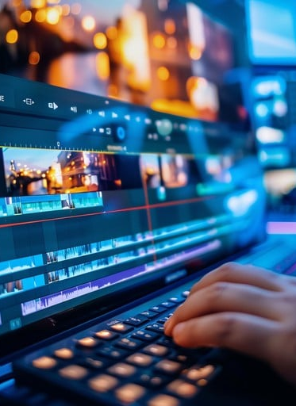
AI in Post-Production
What AI can assist with:
Add/Change dialogue
Before AI, we used ADR (Automated Dialogue Replacement)
Need to go back into the scene and re-articulate actor’s mouth to say a new line and make it look natural
Super expensive/time consuming
Go back in and cut behind the shoulder of the character speaking or to a place where the dialogue can be said off screen
With AI, ADR has been changed (visual ADR)
Censorship editing
Dialogue replacement
Syncing same line replacement

Slide 17

Dubbing/Captioning/Translating
Streaming services are now releasing content to audiences and using AI translation and sync tools
Helps keep the emotional nuance across all different languages
Example: Watch the Skies
Originally a Swedish film
TrueSync technology was used to make English version

Slide 18

Picture Improvement/Edit Acceleration
AI is currently working to help restore frames that were once considered unusable
It can denoise (remove unwanted grain or discoloration), deblur, and upscale frames
AI is becoming part of the nonlinear editing (NLE) process
Speeds everything up from dialogue transcription to scene search and audio cleanup

Slide 19
Object Removal/Continuity Fixes/AI Inpainting
Can help remove unwanted objects across moving footage
DeepEditor can handle motion blur and difficult lightings

Slide 20

Sound Design/Audio
Considered one of AI’s most powerful uses in postproduction
AI can:
Separate stems (split and extract audio files into separate files for each instrument)
Recreate missing ambience
Add sound effects into an already recorded environment
Makes added effects sound natural

Slide 21
Job Insecurity
Study by Concept Art Association and the Animation Guild
Surveyed 300 people across entertainment industry
Study said the jobs most likely to be affected are:
Sound for film, tv, and video games
Developing 3-D assets
Foreign language dubbing
Study said the jobs least likely to be affected are:
Script writing
Performing music
80% of early adopters of AI are using AI tools for postproduction purposes

Slide 22
The Flipside
Not everyone believes AI will take over the film industry
Tomas Elliott- Assistant professor of English at Northeastern University in London
Specializes in film history
“Cinema has navigated such huge transformations over its history, and in the long run these things tend to not have such widespread effects as the panic would suggest,” (Mello-Klein, 2024)
Josh Rose- Filmmaking professor and cinematographer
“The amount of human time it takes to write a book, write a song, write a joke, create a choreography, write a symphony, or even take a photograph is, actually, one of the most important parts of the creation.” (Rose, 2025)

Slide 23
References
100 Dollar Bills. (n.d.). Corporate Finance Institute. Retrieved April 6, 2026, from https://corporatefinanceinstitute.com/resources/economics/money/.
Andy Bobrow. (n.d.). Fandom.com. Retrieved April 6, 2026, from https://brooklyn99.fandom.com/wiki/Andy_Bobrow.
Brown, S. (2025, June 2). Machine learning and generative AI: What are they good for in 2025? | MIT Sloan. MIT Sloan. https://mitsloan.mit.edu/ideas-made-to-matter/machine-learning-and-generative-ai-what-are-they-good-for
Casey, R. (2025, February 17). How could the rise of AI impact the job of a screenwriter? | ENGLISH 110-37 Introduction to Academic Writing. Charleston.edu. https://blogs.charleston.edu/engl110-25f23/2025/02/17/how-could-the-rise-of-ai-impact-the-job-of-a-screenwriter-2/
Cho, W. (2024, January 30). The Hollywood Jobs Most at Risk From AI. The Hollywood Reporter. https://www.hollywoodreporter.com/business/business-news/ai-hollywood-workers-job-cuts-1235811009/
Communication team (2024, October 29). The Magic AI in Pre-Production: Making the Invisible Visible. Numalis. https://numalis.com/the-magic-ai-in-pre-production-making-the-invisible-visible/
Coursera Staff. (2024, May 16). The History of AI: A Timeline of Artificial Intelligence. Coursera. https://www.coursera.org/articles/history-of-ai
Do Camera Crews Use AI on Set? (2025, October 24). BeverlyBoy Productions. https://beverlyboy.com/filmmaking/do-camera-crews-use-ai-on-set/
Example of a Breakdown Sheet. (n.d.). Premium Beat. Retrieved April 6, 2026, from https://www.premiumbeat.com/blog/basics-breaking-down-film-script/.
Film Slate, Clipboard, and Reel of Film. (n.d.). Studiovity. Retrieved April 6, 2026, from https://blog.studiovity.com/essentials-of-pre-production-paper-work/.
Flawless Voices. (2025, October 30). AI in Post Production: 7 Ways It’s Being Used in 2025. Flawlessai.com; Flawless AI Inc. https://flawlessai.com/blog/ai-in-post-production
GeeksforGeeks. (2021, July 14). Introduction to Natural Language Processing (NLP). GeeksforGeeks. https://www.geeksforgeeks.org/nlp/introduction-to-natural-language-processing-nlp/
Girl (Half Blurry, Half Clear). (n.d.). airbrush. Retrieved April 6, 2026, from https://airbrush.com/image-enhancer.
Guy Goldstein. (n.d.). LinkedIn. Retrieved April 6, 2026, from https://www.linkedin.com/in/guy-goldstein-2a041652/.
Joseph Weizenbaum at Work. (n.d.). New Scientist. Retrieved April 6, 2026, from https://www.newscientist.com/article/2463843-worlds-first-ai-chatbot-has-finally-been-resurrected-after-decades/.
Mello-Klein, C. (2024, October 15). Is AI going to destroy movies or is the panic overblown? A film historian says these fears are not new. Retrieved March 28, 2026, from Northeastern Global News website: https://news.northeastern.edu/2024/10/15/ai-in-hollywood-impact/
Miller, A. (2022, August 13). ADR in Film: Everything You Need to Know About the Process. Backstage.com. https://www.backstage.com/magazine/article/adr-film-explained-examples-75425/
Minsky, M. (1956). Privatdozent. Retrieved April 6, 2026, from https://www.privatdozent.co/p/the-birth-of-ai-1956.
Nighttime Film Set. (n.d.). Beyond Film School. Retrieved April 6, 2026, from https://www.beyondfilmschool.com/all-the-interesting-production-assistant-positions-on-set/.
Photograph Portrait of Alan Turing. (1951). Wikipedia. Retrieved April 6, 2026, from https://en.wikipedia.org/wiki/Alan_Turing.
Post-Production Editing. (n.d.). stockcake. Retrieved April 6, 2026, from https://stockcake.com/i/video-editing-process_870970_930387.
Rose, J. (2025, May 28). Prediction: A.I. Will Not Replace Hollywood Filmmaking. Medium. https://joshrose.medium.com/prediction-a-i-will-not-replace-hollywood-filmmaking-4b61c4c2ff03
Sunwarper. (2023, April 23). Stem Separation and Music Making: Gimmick or Game Changer? Sunwarper. https://www.sunwarper.com/post/stem-separation-and-music-making
Swinson, B. (2025, April 23). “How Screenwriters Can Ethically Use AI” Insights from Screenwriter Andy Bobrow and WriterDuet Founder Guy Goldstein. Creative Screenwriting. https://www.creativescreenwriting.com/how-screenwriters-can-ethically-use-ai-insights-from-screenwriter-andy-bobrow-and-writerduet-founder-guy-goldstein/
Theater Audience. (n.d.). Third Space. Retrieved April 6, 2026, from https://thirdspace.org.au/blog/film-should-we-enter-dialogue.
“Watch the Skies” Poster. (n.d.). IMDb. Retrieved April 6, 2026, from https://www.imdb.com/title/tt14807348/.

Slide 24
Thank You!

