Slide 1
TaxPrep Client Experience — Demo
GenAI agentic solution (LangChain style) — Demo deliverables
No Azure Functions
Prepared for AI Challenge

Slide 2
Problem & Objective
Predict client satisfaction (Satisfied / Dissatisfied) and explain top drivers without classical ML models.

Slide 3
High-Level Architecture (No Azure Functions)
- Ingestion -> ETL -> Vector DB
- LangChain-style agents for Scoring, Explanation, Action
- Azure GPT-4 + Anthropic Claude as LLMs
- Containerized Streamlit app + scoring service (ACI/AKS)
- CI/CD via GitHub Actions

Slide 4
Demo Flow
1. Upload CSV or generate sample
2. Run GenAI Scoring
3. View labels, confidence and top drivers
4. Export results and trigger actions (CRM, emails)

Slide 5
Evaluation & Metrics (Prototype)
Prototype evaluation (sample):
- Accuracy progression: 72% → 85%
- Target: Accuracy ≥ 80%
- Focus: Improve recall for Dissatisfied class

Slide 6
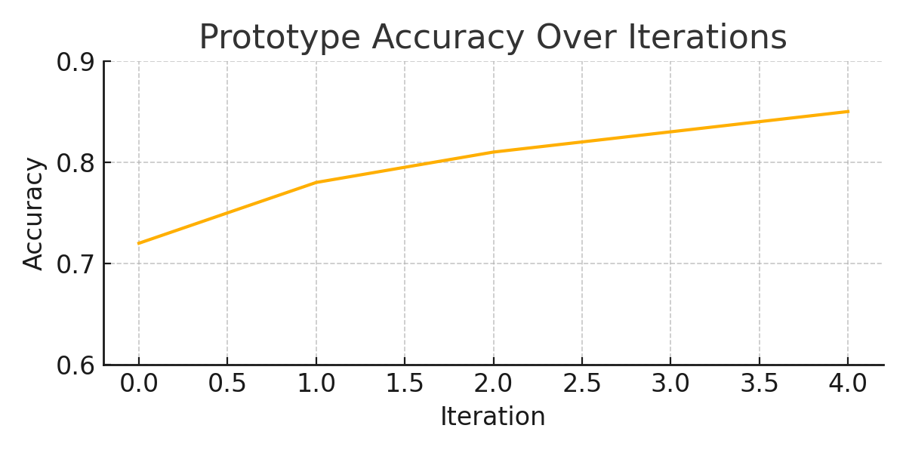
Prototype Metrics Chart

