Slide 1


Automated System for Assessment of Programming
Apoorva Rayangoudar
Shubha Ravikumar
Chetan Nanjundareddy
Nagendravarma Nagaraju
Prashant Patil
CONFIDENTIAL: For limited circulation only
© 2010 MindTree Limited

Slide 2
The Problem Statement
A large number of participants take part in programming courses every year.
Participants need continuous programming practice in order to be able to correctly implement the concepts taught in programming classes.
The programming assignments have to be evaluated by the instructors quickly, to help participants progress well. As a result, instructors will have high workload of grading each program.
Moreover, the only way to assess a program is to run it against several sets of test data to verify its correctness. This is time consuming when done manually.

Slide 3
The Proposed Solution
An automatic evaluation tool will reduce this workload.
The web application developed by us is an automated system for assessment of solutions to programming assignments.
It allows instructors to specify programming exercises for a group of participants.
Participants can view the problem statements assigned to them, and work on the programs. They can also test their solution against a set of public test cases, available along with each problem statement.
Once the participant uploads the solution, the system automatically grades the program based on the complete set of test cases.
Instructors and students can see statistics about each programming assignment. Various kinds of reports can be generated from the system.

Slide 4
Users and Use Cases
This web application will have two categories of users:
Administrators
Test Takers
Use cases common to both users
Login
Logout

Slide 5
Users and Use-Cases
Use cases for Administrators
Create a group of candidates
Create a candidate
Associate a group with a candidate
Add an assessment
Add a test case to an assessment
Schedule an assessment - for a group or a test taker
Update an assessment - activate, deactivate
View assessment reports for a group or a test taker

Slide 6
Users and Use-Cases
Use cases for Test Takers
View assigned assessments
Start an assessment
Compile and execute a solution
View compilation & runtime results
Submit a solution
View reports

Slide 7
Software Technologies Used
The web application has been developed using the following technologies:
Java Development Kit
Java Enterprise Edition
Spring Framework
Hibernate Framework
MySQL Database Server
Apache Tomcat Web Server

Slide 8
System Design
We have followed the typical 3-tier architecture using the software technologies listed above. The components of each tier are given below.
Presentation Tier
Java Server Pages
JavaScript/Validators
Business Logic Tier
Business Objects
Hibernate Integration
Data Tier
Data Access Objects
Object-Relational Mapping
Resource Bundles
Transaction Management
Service Beans

Slide 9
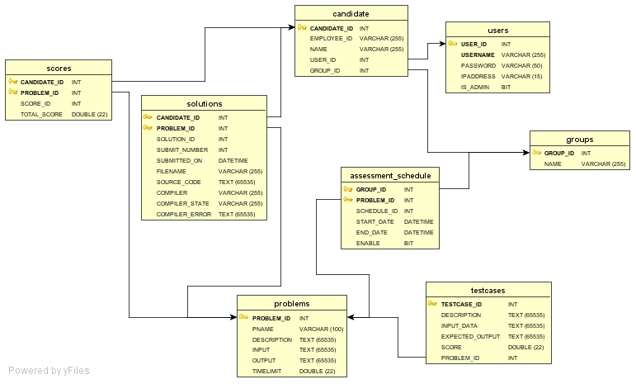
Database Design
An entity-relationship diagram depicting the database tables is given below:

Slide 10
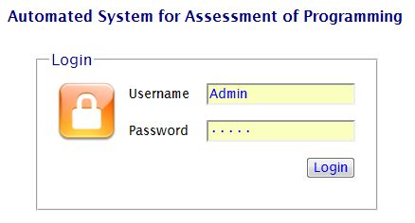
Demonstration of the Usage … Administrator Login

Slide 11
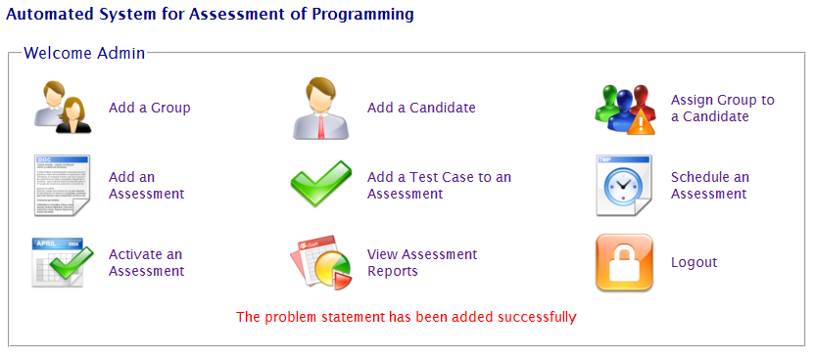
Demonstration of the Usage … Administrator Home Page

Slide 12
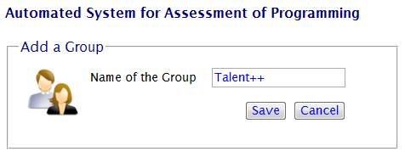
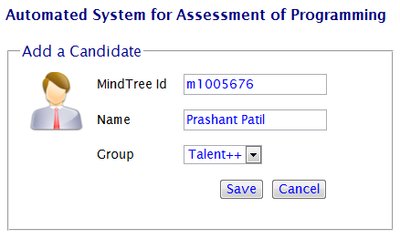
Demonstration of the Usage … Adding Groups & Candidates

Slide 13
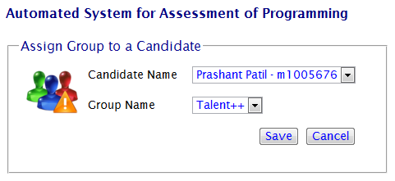
Demonstration of the Usage … Assigning a Group

Slide 14
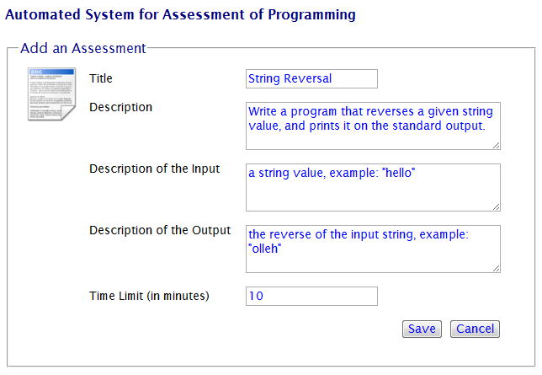
Demonstration of the Usage … Defining Problem Statements

Slide 15
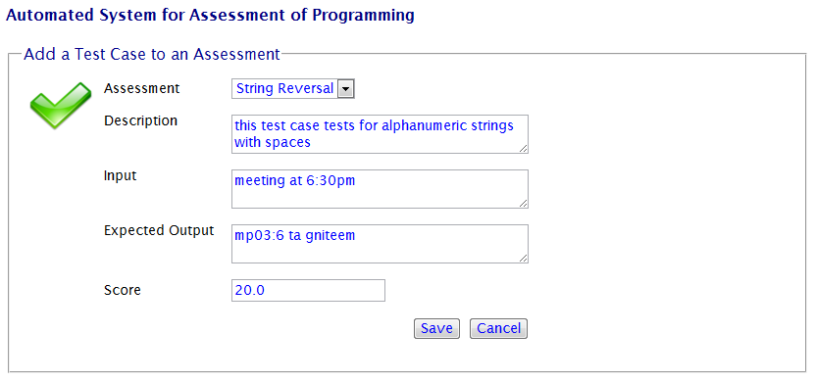
Demonstration of the Usage … Defining Test Cases

Slide 16
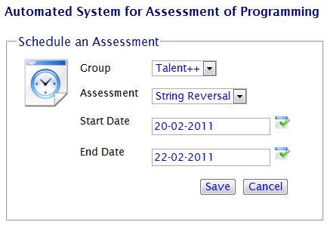
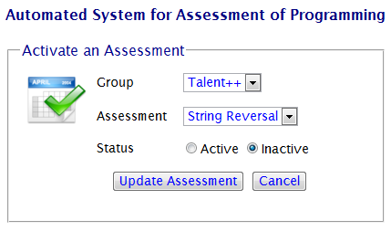
Demonstration of the Usage … Scheduling Assessments

Slide 17
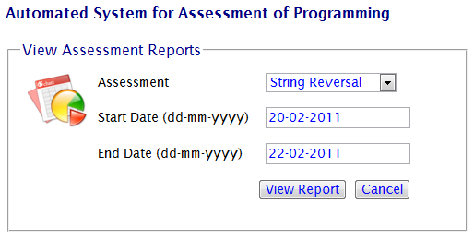
Demonstration of the Usage … Generating Reports

Slide 18
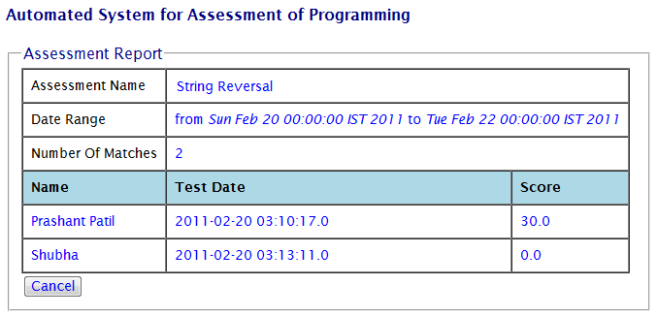
Demonstration of the Usage … Sample Report

Slide 19
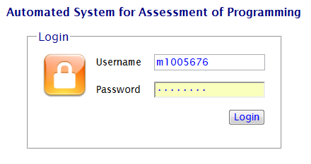
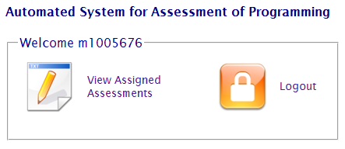
Demonstration of the Usage … Candidate Login & Home Page

Slide 20
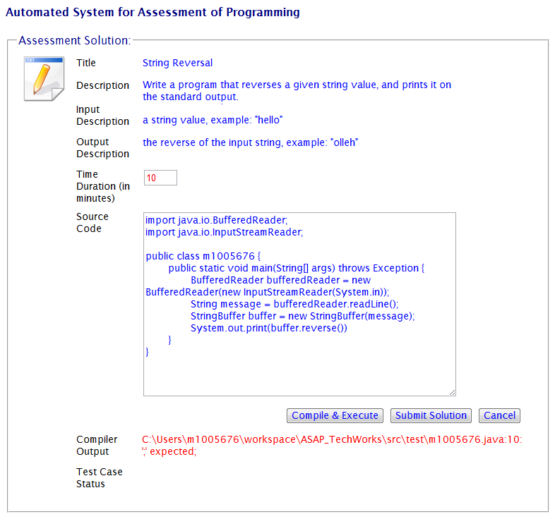
Demonstration of the Usage … Compiling Solutions

Slide 21
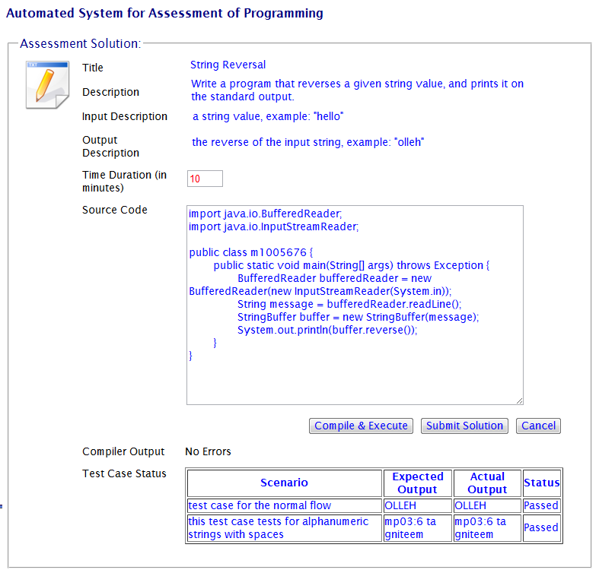
Demonstration of the Usage … Executing Solutions

Slide 22
Future Enhancements
The following enhancements are planned for the current system:
Support for multi-file programs
Support for other programming languages
Support for web and database applications
Enhanced security
Plagiarism detection
Code quality reports
Generation of various other reports

Slide 23
Development Team
The following developers designed and implemented this complete application:
Apoorva Rayangoudar (M1012679)
Shubha Ravikumar (M1012776)
Chetan Nanjundareddy (M1012718)
Nagendravarma Nagaraju (M1012773)

Slide 24


Prashant Patil
prashant_patil@mindtree.com
+91.9986149072
www.mindtree.com
CONFIDENTIAL: For limited circulation only
© 2010 MindTree Limited

