Slide 1

Intrusion detection system using pfsense and snort in GNS3

Slide 2
Overview
Aim: To create an intrusion detection system using pfsense and snort inside a gns3 virtual machine.
Approach: we have used pfsense and the built-in snort to create an intrusion detection system over the pfsense firewall.
Goal: to prevent and block all the intrusions which are done over the system which is connected to the pfsense.
Tools:gns3,pfsense, snort.

Slide 3
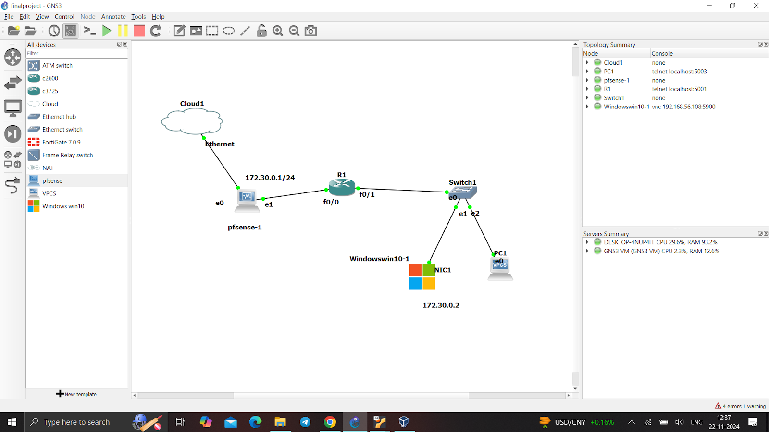
Lab setup:
We have used the GNS3 and the virtual box to run our gns3 vm and pfsense firewall.
This is our network setup inside the GNS3

Slide 4
Architecture:

Slide 5
Initialization:
After successful execution of the gns3 with firewall configuration we were able to open the windows host virtual machine inside the gns3.
This system needs to have an intrusion detection system as this is the host device which is connection to the firewall using a switch.

Slide 6
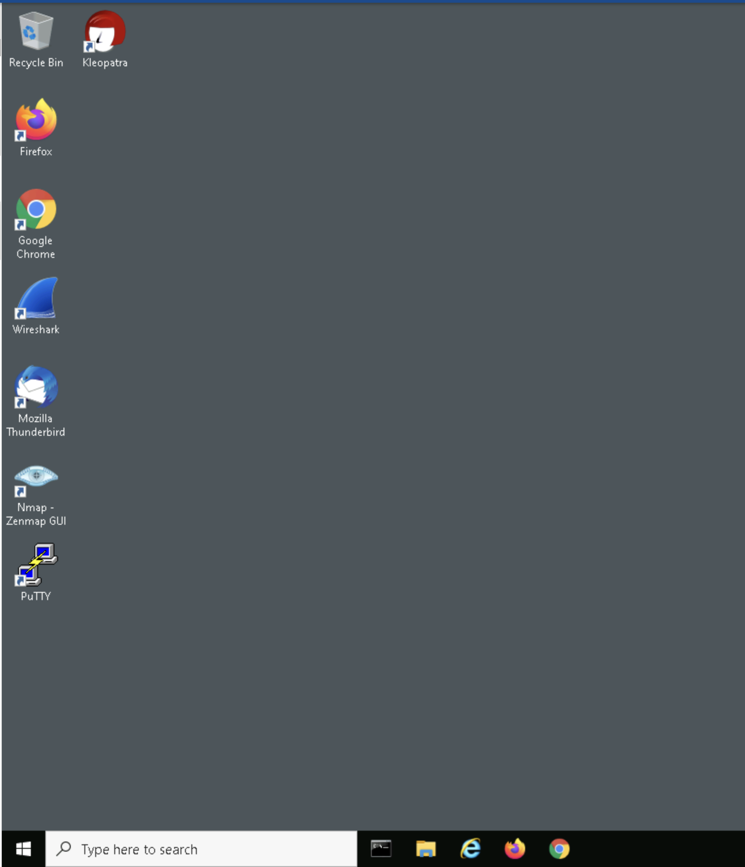
Successful windows running steup:
The system is up and we are able to use it with slight delay in response as this is taking up a lot of ram which requires upto 2gb alone to itself.

Slide 7
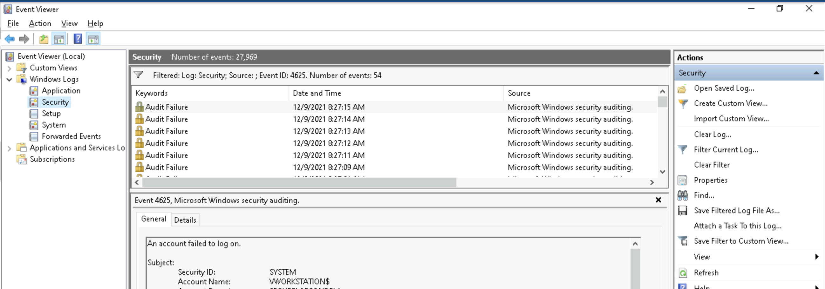
The image you can see that in the event viewer there are lot of audit failures , this is because there might be a chance of brute forcing or the user might have tried multiple times.

Slide 8
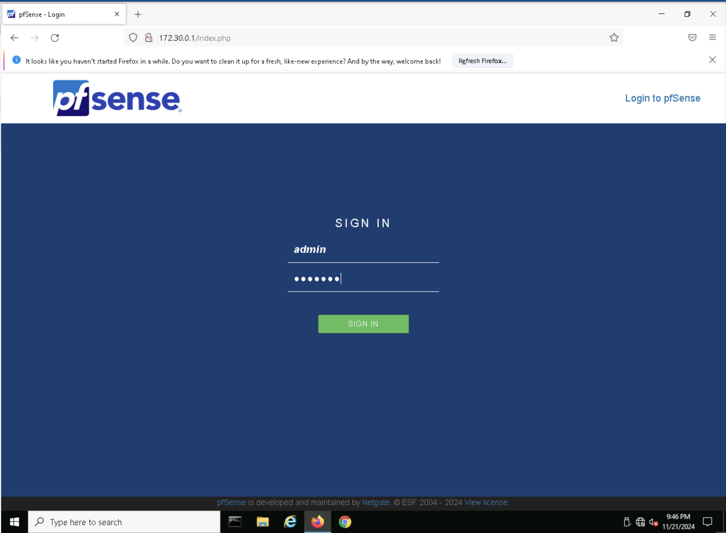
Pfsense

Slide 9
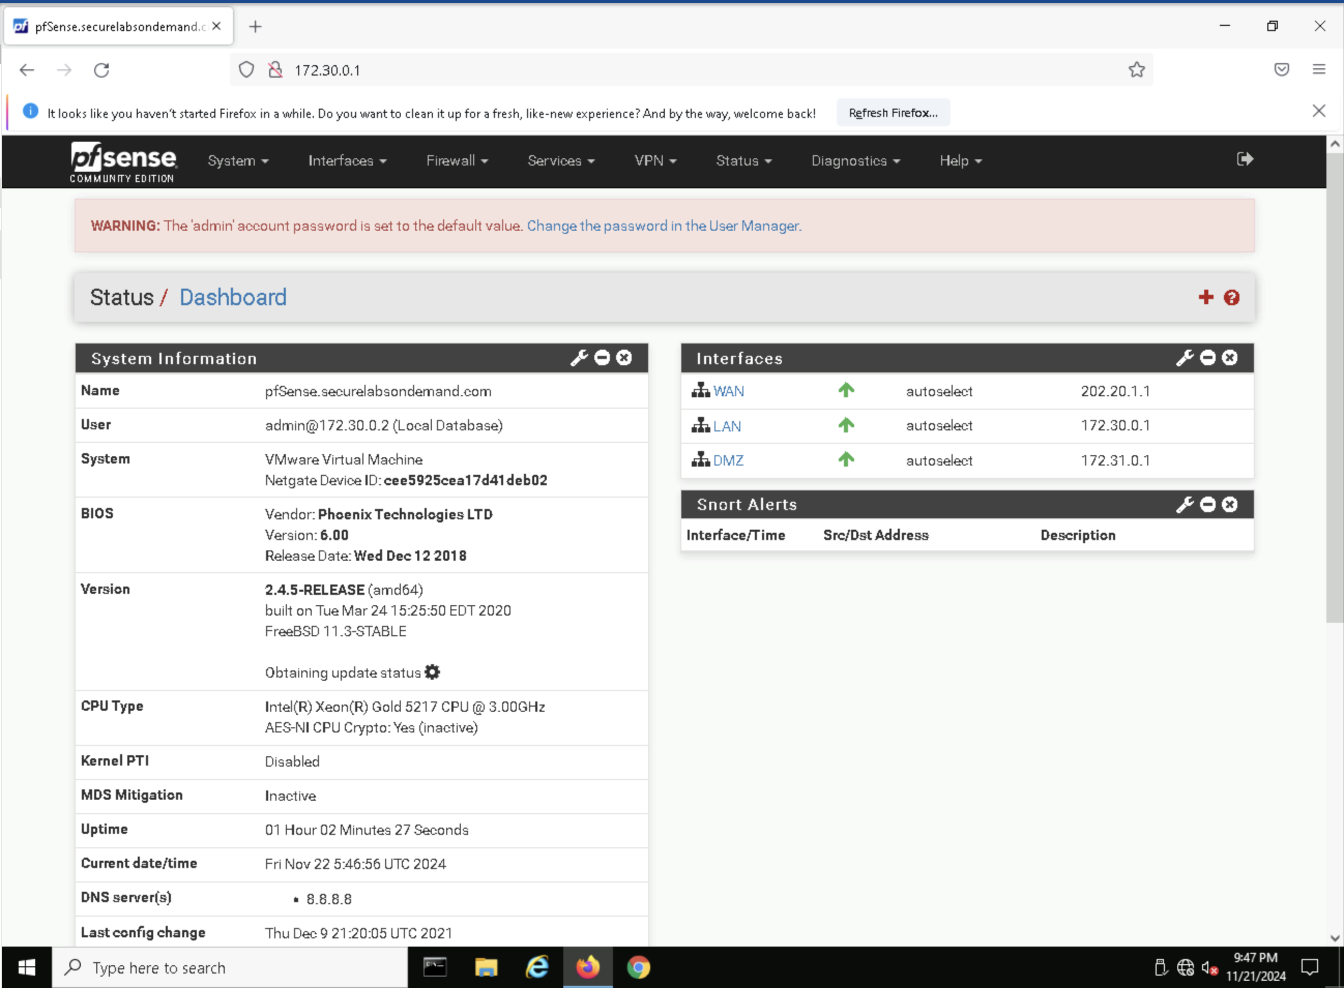
The basic configurations of pfsense and it's interfaces.

Slide 10
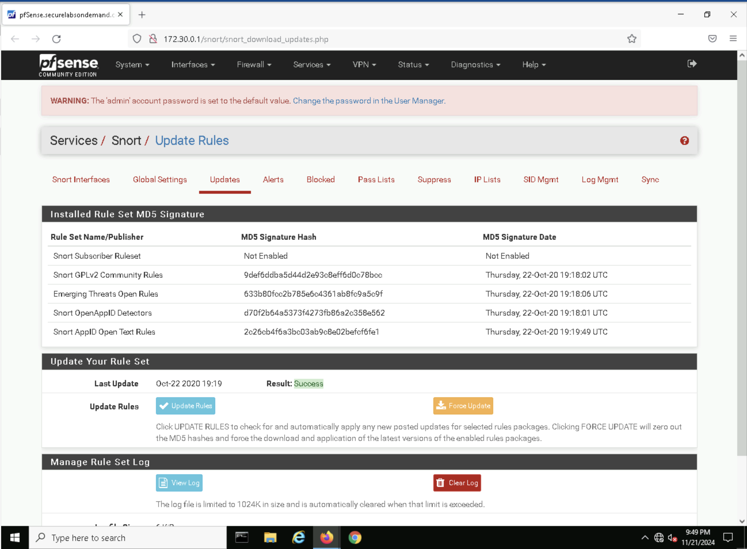
Pfsense have a serives which also includes a snort.
Short is a basic intrusion detection system which is used by many firewall companies to detect any such intrusions.
This have a user interface which is simpler and easy to set up rules and restrictions easily.

Slide 11
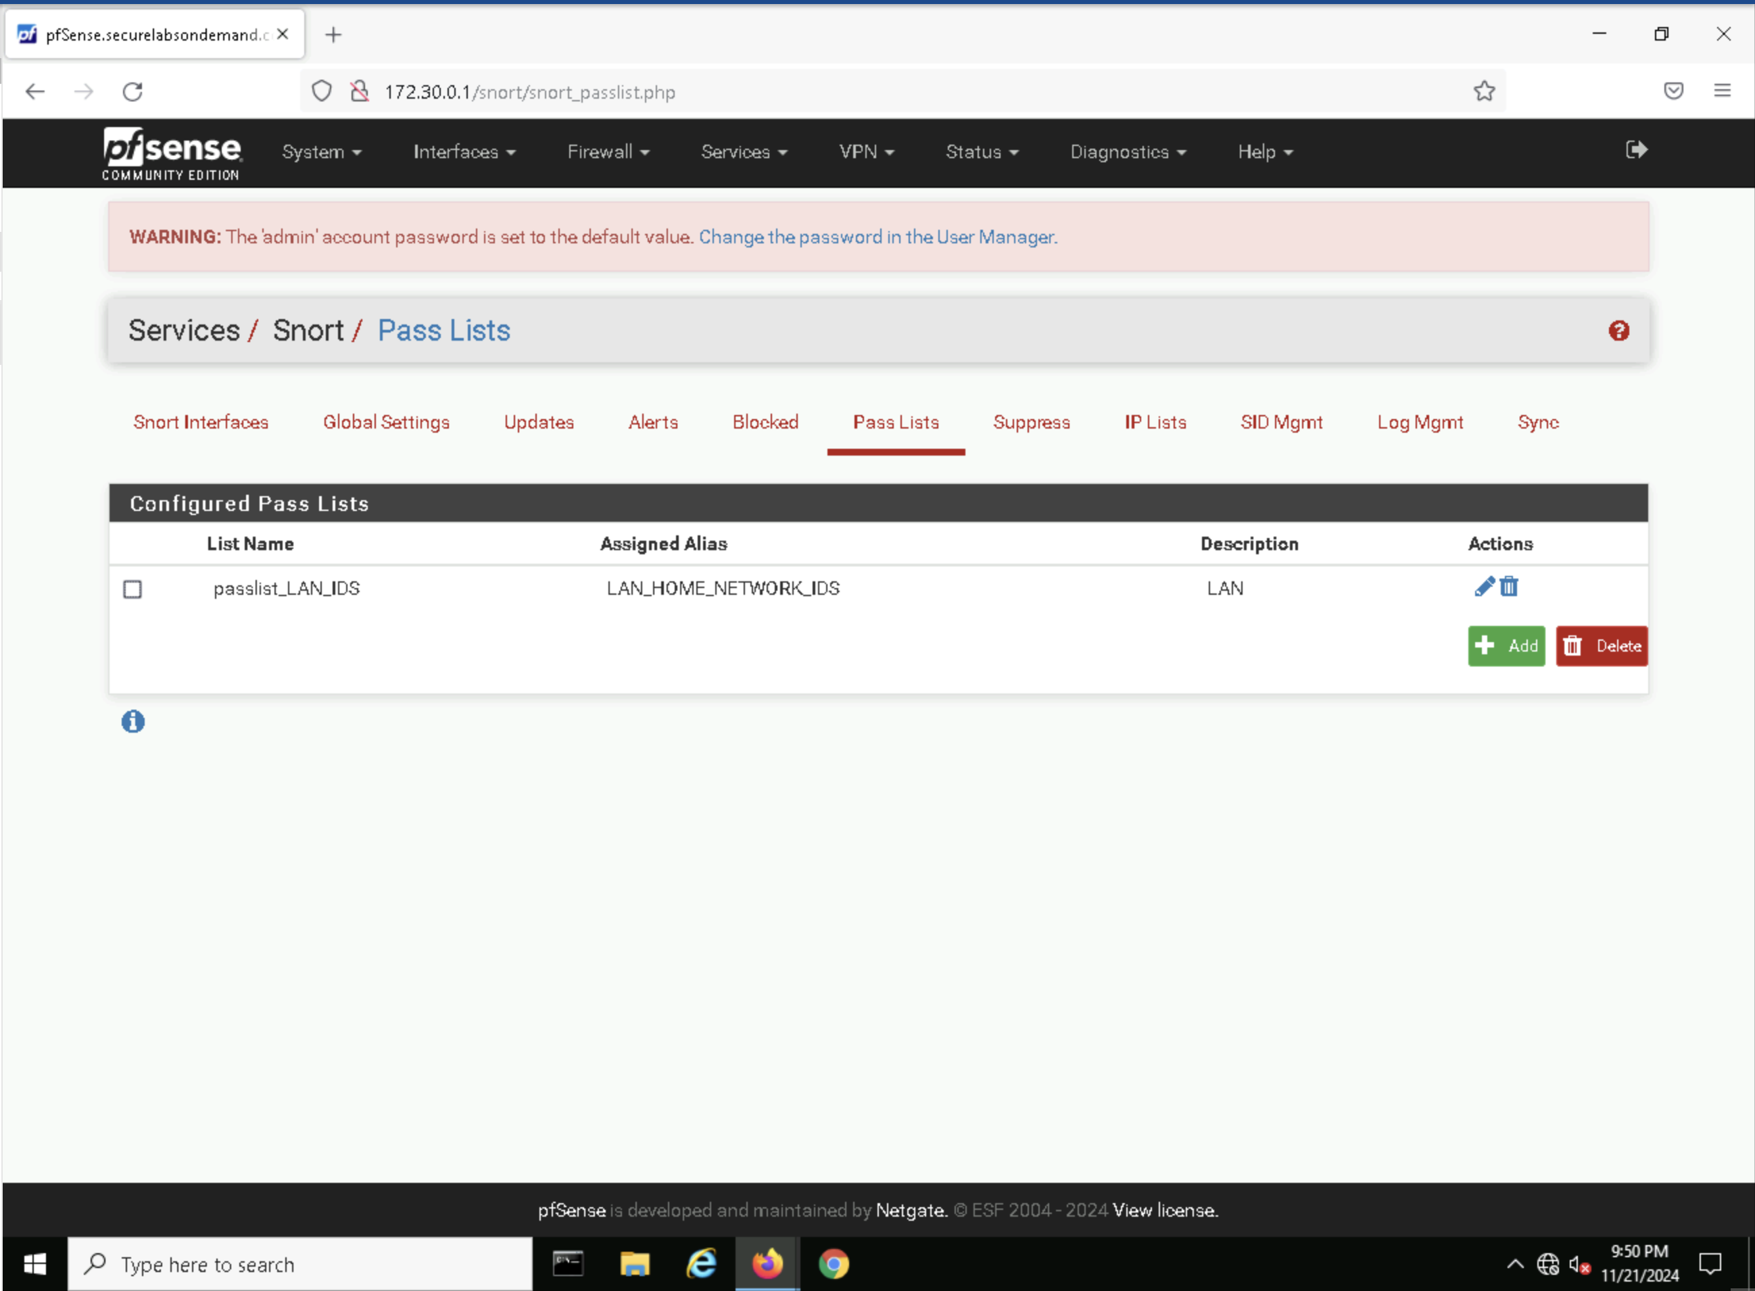
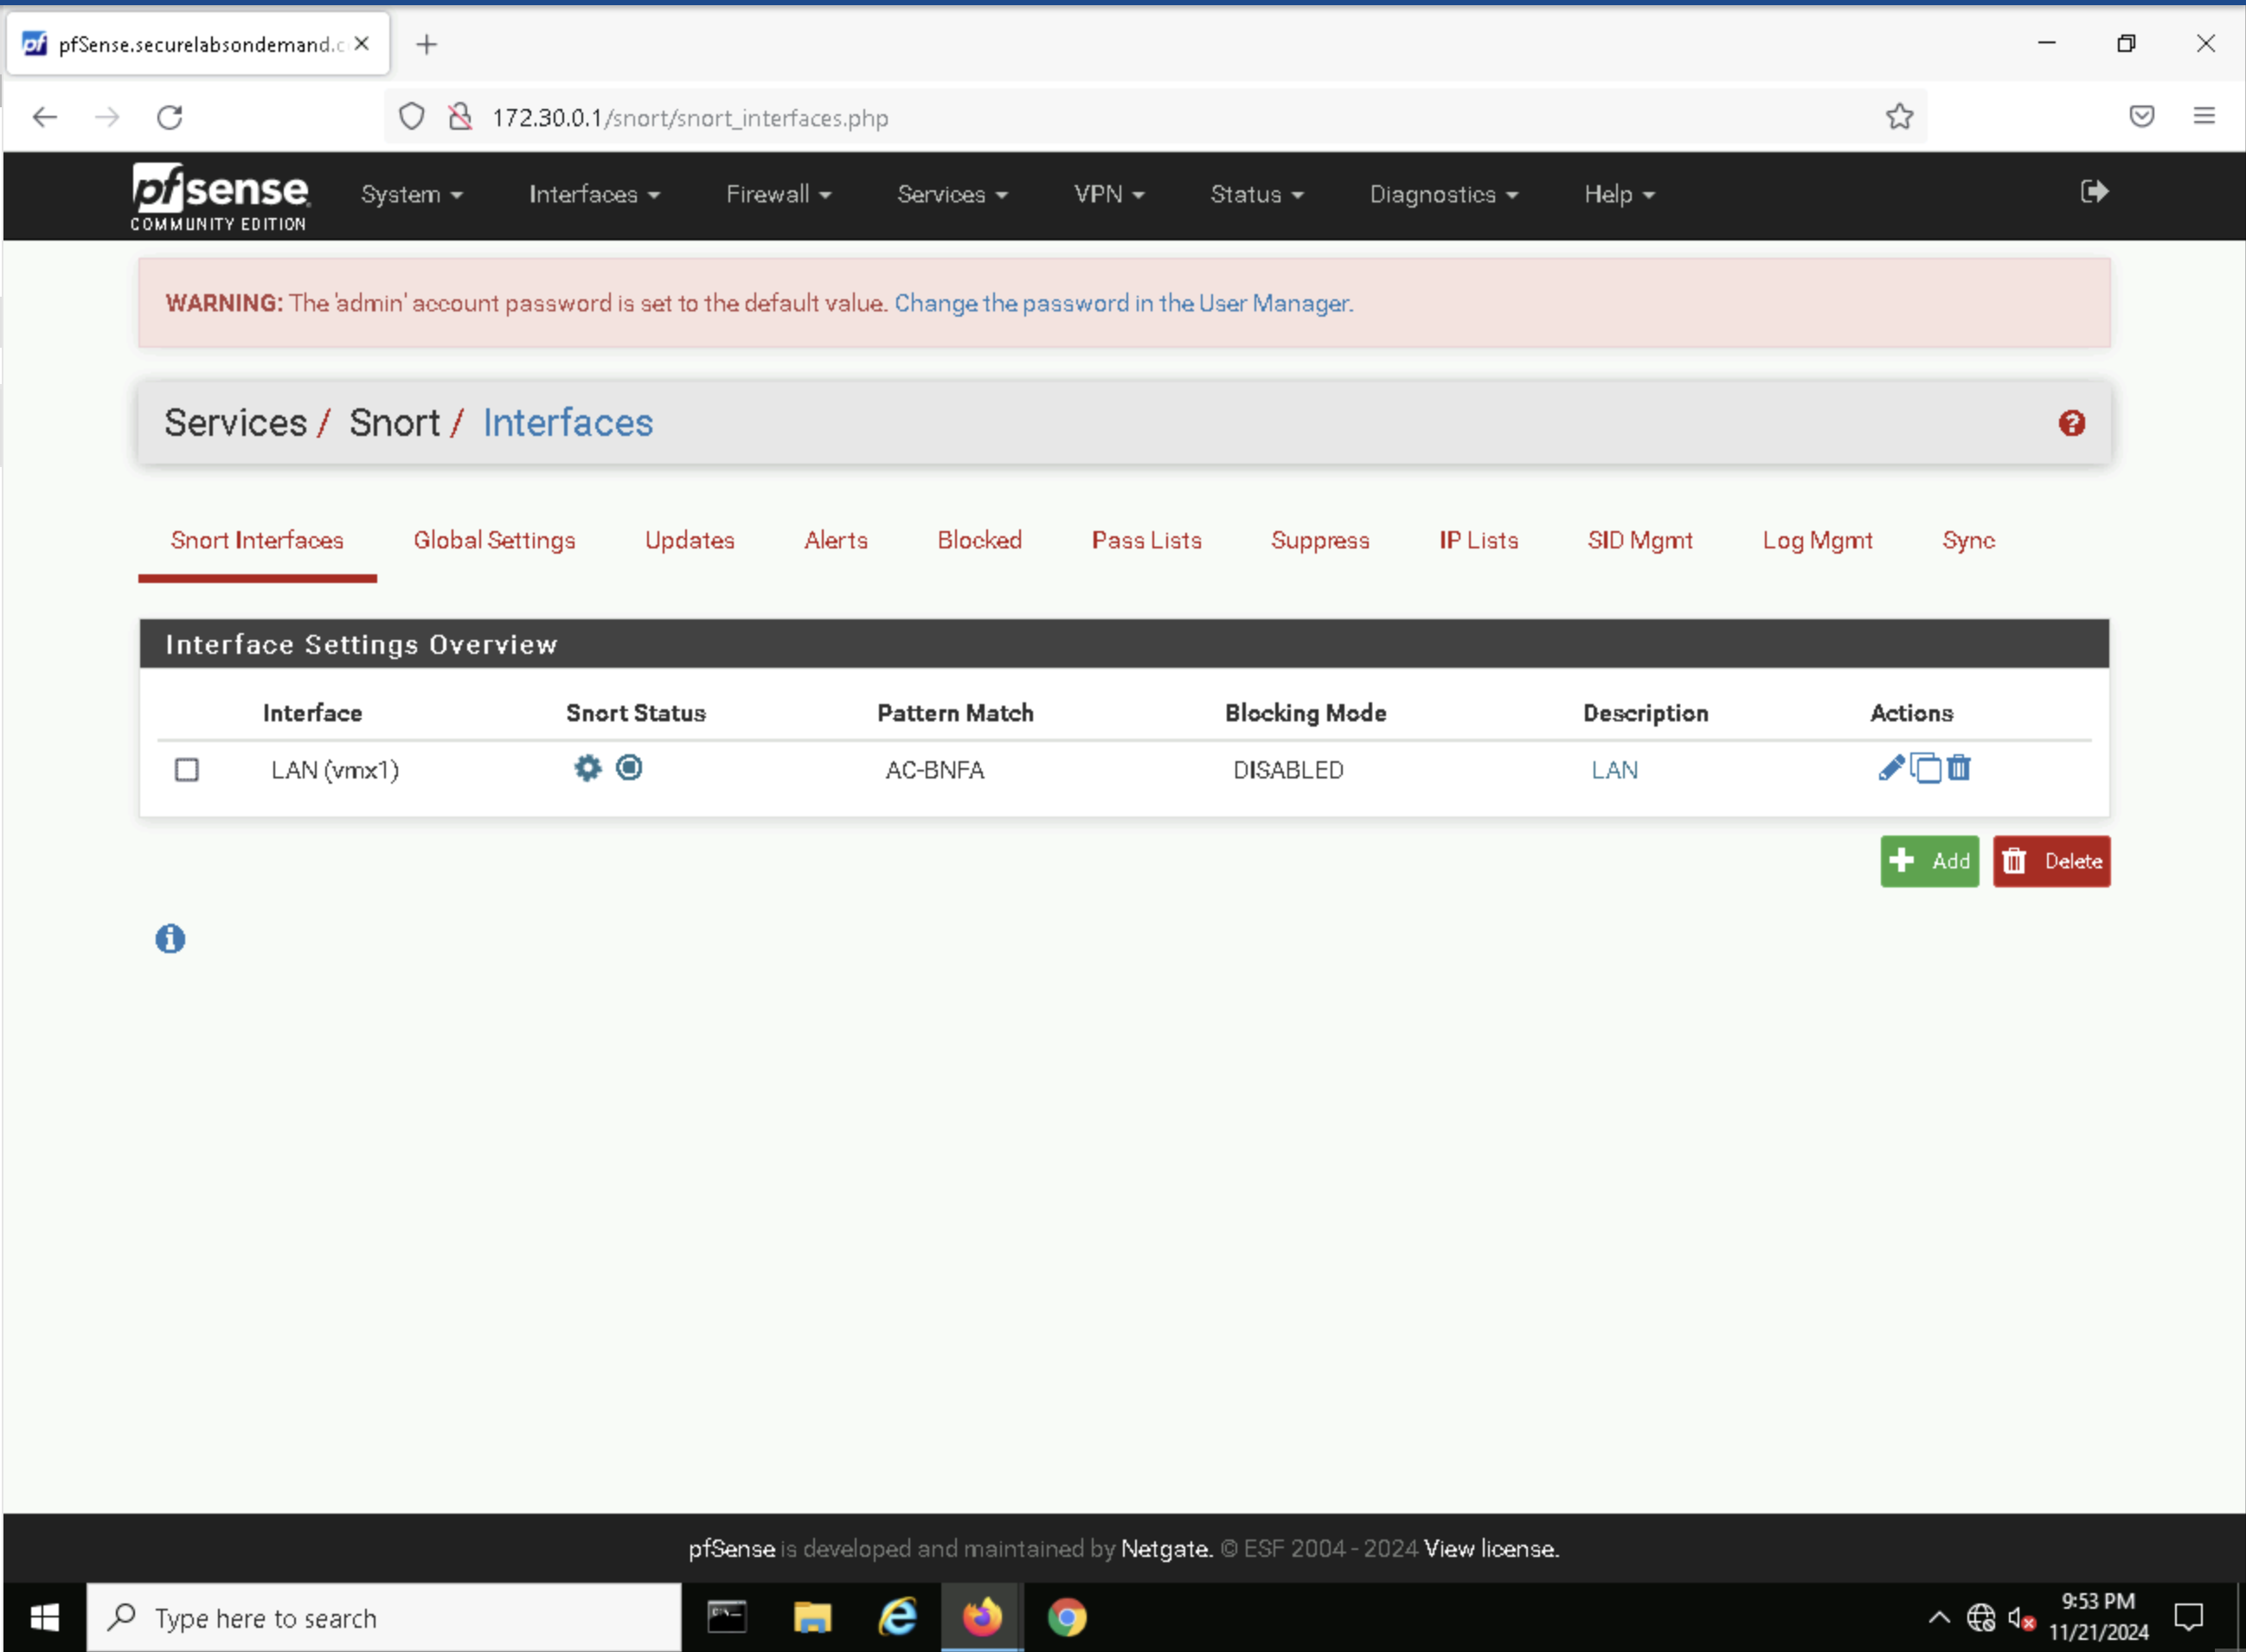

Slide 12
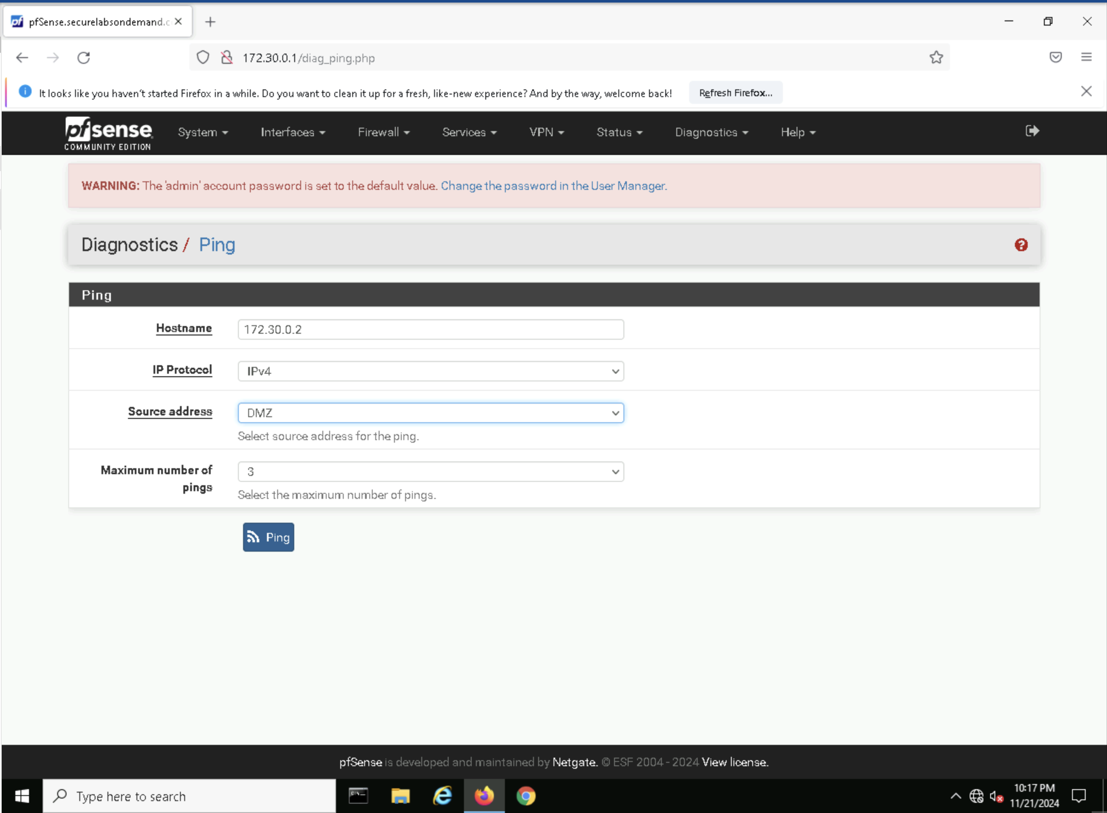
We can ping the workstation using the diagnostic ping in the pfsense.

Slide 13
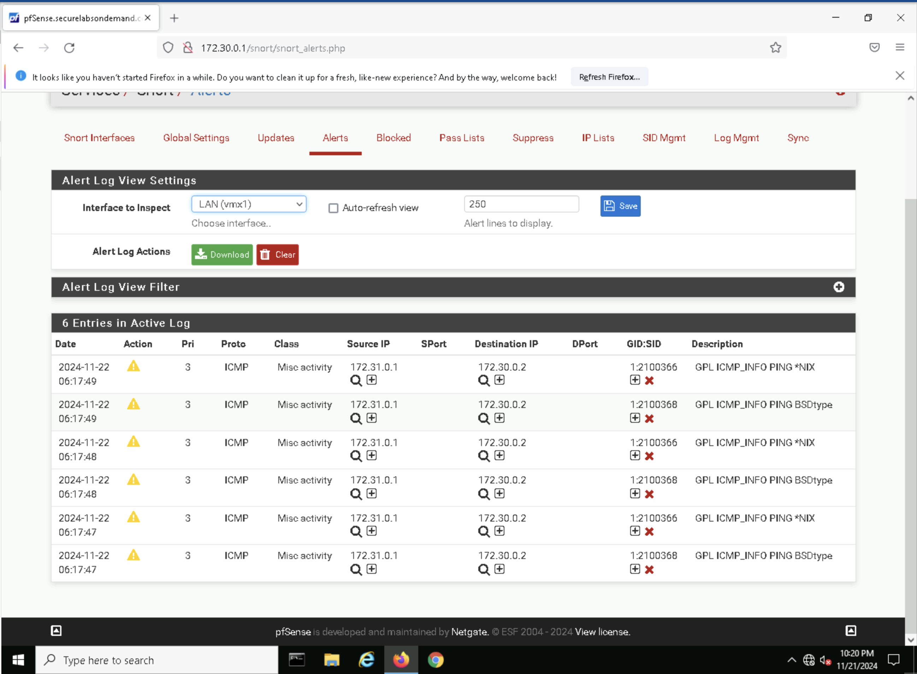
Whenever there are new entries in the activity log it detects and alerts us. As we have configured over the lan interface.

Slide 14

Outcomes:
We have understood how to setup the gns-3 and the gns-3 vm and also to setup the pfsense firewall and also to create an intrusion detection system using the snort.
We are able to detect the lan traffic of the workstation and able to detect the packets and the network which are blocked.
We can also implement the intrusion prevention system but it requires more ram and the current system is not capable of the complex tasks.

Slide 15

Future works and drawbacks:
We can improve the firewall with more security parameters such as adding user authentication and access controls.
The drawback is that we have to assign every single rule manually to block the necessary sites. there are some automated firewalls with more advanced security measures.

Slide 16

Thank you

