Slide 1
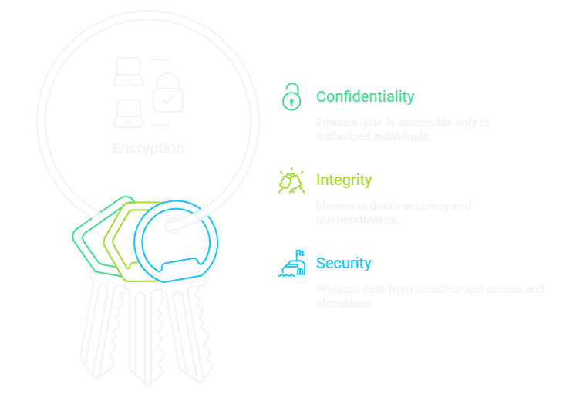
VITAL WATCH : Securing Every Heartbeat
ENCRYPTION is the process of encoding information, making it unreadable without the correct key. This transforms readable data (plaintext) into an unintelligible format (ciphertext). It is the fundamental practice for ensuring data privacy and security in the digital age.

Slide 2
Why Encryption is Vital for Patient Data ?
Healthcare monitoring devices, such as the Vital Watch, collect and transmit highly sensitive Protected Health Information (PHI). Securing this data is not just a technical necessity, but a legal and ethical mandate.
Regulatory Compliance (HIPAA, GDPR)
Preventing Data Breaches
Maintaining Patient Confidentiality
Encryption is a primary control mechanism mandated by global healthcare regulations to protect patient privacy and avoid massive legal penalties.
In the event of physical device loss or network interception, AES-128 encryption renders the captured patient data useless to malicious actors.
Securing heart rate, temperature, and other metrics ensures trust between the patient and the healthcare provider, fostering greater adoption of remote monitoring.

Slide 3
Introducing AES-128: The Gold Standard for Data Protection
The Advanced Encryption Standard (AES) is a symmetric block cipher adopted by the U.S. government and used worldwide. It is a robust and highly secure algorithm chosen for its efficiency and strength.
Trusted Worldwide: The same encryption trusted by banks, hospitals, and governments – now protecting our vital health data.
Guards Every Heartbeat: Each reading(HR, BP,SpO2) is transformed into unreadable code before transmission ensuring privacy in every pulse.
Unbreakable in practice: Even with supercomputers, it would take billions of years to crack a single AES-128 key.
Lightweight yet powerful: Designed for efficiency-perfect for low-power devices like our Vital Watch.
Foundation of Trust: Encryption not inly secures data but also builds confidence in the reliability and integrity of our system.

Slide 4
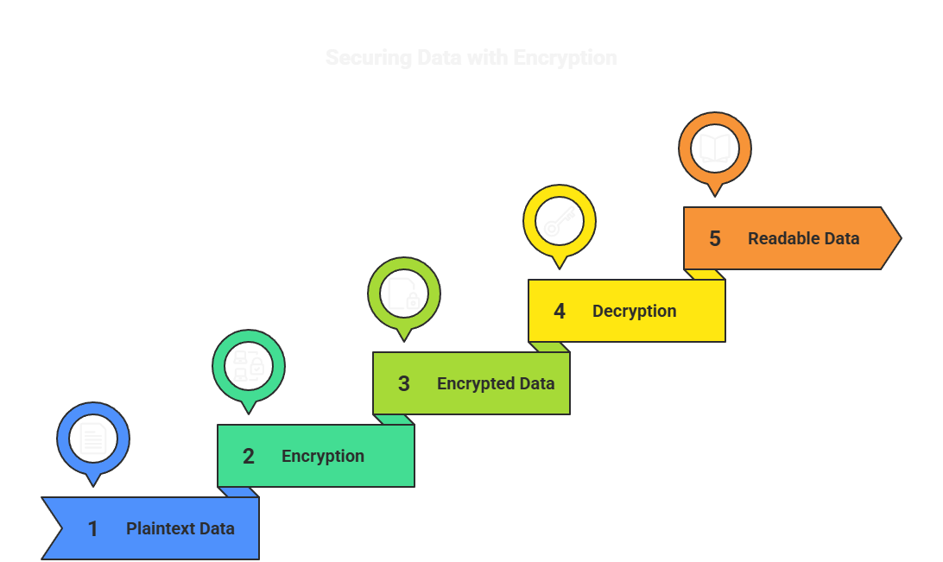
Heart Rate: 78b pm
SpO2: 96%
BP: 120/80 mmHg
Using same AES key
4A 9F B3 22 6C A1 5E 9B 3C F1 6A 2E 4C 77
Using AES-128
Heart Rate: 78 bpm
SpO2: 96%
BP: 120/80 mmHg

Slide 5
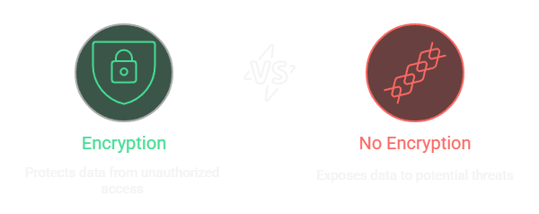
With Integrated AES-128
Without Robust Encryption
Data is susceptible to passive eavesdropping.
Data is cryptographically protected against all modern attacks.
High risk of regulatory fines and loss of certification.
Meets or exceeds global health data security mandates.
Patient adoption is hindered by privacy concerns.
Enhanced credibility and market reputation as a secure solution.
Compromised data means loss of clinical utility and trust.
Ensures uninterrupted, reliable flow of trusted PHI for diagnostics.

