Slide 1


Team Details
Team: Agent Forge
Team leader: Leena Varma
Members: Nanda Varshitha, Deekshitha, Umesh
Problem: Help scam victims prepare accurate reports and understand their next step.

Slide 2
Brief about the idea
Relay helps someone who has just transferred money after an impersonation scam.
The person confirms the incident facts, reviews a source-linked contact plan and prepares recipient-specific reports for self-submission.
Gemini supports the language work. Deterministic rules enforce permissions, versions and report checks.
Deployed development prototype. Synthetic data only. No recovery or official acceptance claim.

Slide 3
Opportunities
Difference: a structured case and versioned report workflow, with source references and explicit user confirmation.
How it helps: reduces the work of organizing incident details and preparing separate recipient reports. User research and impact measurement remain pending.
Proposed USP: reviewable AI drafts tied to confirmed facts, a pack version and automated checks. Copying or downloading never silently sends a complaint.

Slide 4
List of features offered by the solution
Working text flow: guided intake, editable facts and validated evidence upload.
Source-linked proposed contact order and recipient-specific report drafts.
Verification, version checks, explicit approvals, PDF download and case deletion.
Firebase authentication, App Check and server-side ownership checks.
Optional institution delivery is simulated. Voice and advanced cloud features remain disabled pending acceptance gates.

Slide 5
Process flow diagram or Use-case diagram
1. Describe the incident
2. Confirm key facts
3. Review contact plan
6. Download and self-submit
5. Review current version
4. Generate checked reports
Follow steps 1–6. Failed checks block the report. Downloads do not submit to an institution.

Slide 6
Wireframes/Mock diagrams of the proposed solution (optional)
The implemented browser flow uses these screens:
Intake: describe the fictional incident and inspect the recorded facts.
Plan: review proposed recipients and referenced draft guidance.
Report: inspect verification results and download the current PDF.
Tracker: view explicitly simulated institution outcomes.
Actual prototype screenshots follow in the required snapshots section.

Slide 7
Architecture diagram of the proposed solution
Browser
Firebase Hosting
Cloud Run API
Auth, App Check, owner checks
Gemini
Google GenAI SDK + ADK
Firestore
Facts, state, report versions
Private worker
Pub/Sub jobs and checks
Private Cloud Storage
Evidence and PDFs
Browser calls API. API stores state and schedules jobs. Worker calls Gemini and saves checked outputs.
Storage remains private. Model processing location differs from storage residency.

Slide 8
Technologies to be used in the solution
Firebase Hosting: React / TypeScript browser application.
Firebase Authentication and App Check: identity and app attestation.
Cloud Run: Python / FastAPI API and private background worker.
Firestore: durable case facts, job state, report versions and audit events.
Gemini with Google GenAI SDK and ADK: intake, classification, drafting and verification.
Cloud Storage and Pub/Sub: private files and asynchronous work. GitHub Actions: CI.

Slide 9
Estimated implementation cost (optional)
Development planning target: INR 1,000. This is a planning target, not a billing cap or measured total.
Cloud Run uses bounded development capacity and scales to zero. Cold starts can delay the first request.
Model calls and stored files contribute usage-based costs. Actual monthly cost and cost per completed case have not been measured.
Before production: measure usage, configure budget alerts and establish capacity and reliability targets.

Slide 10
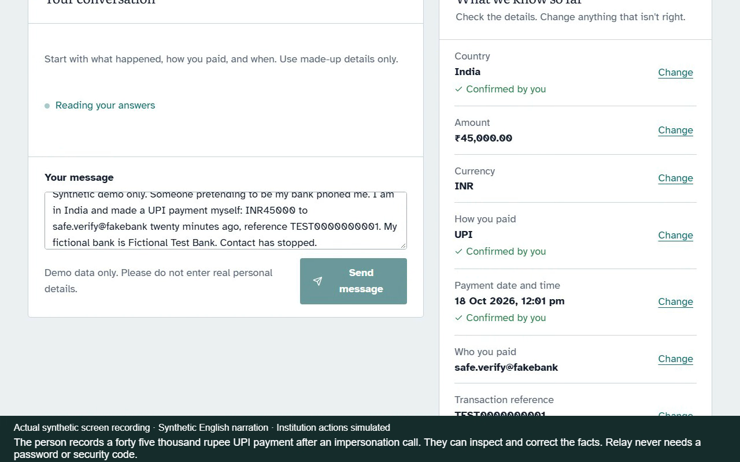
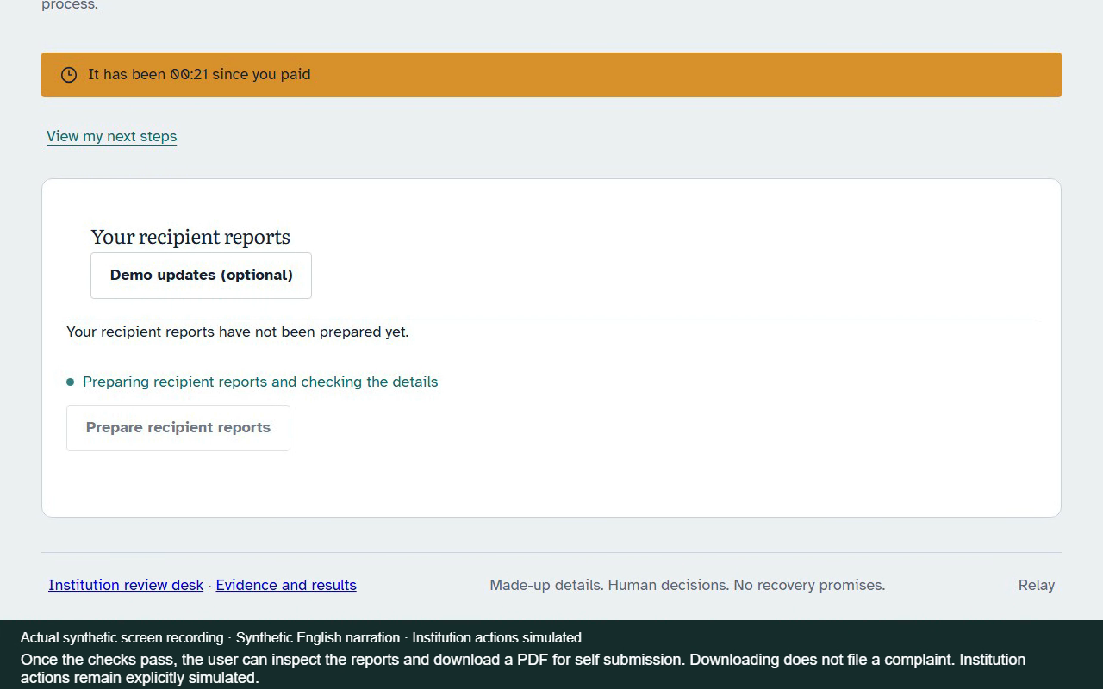
Snapshots of the prototype
Actual hosted synthetic run: intake/confirmed facts and report workflow. Institution actions remain simulated.

Slide 11
Prototype Performance report/Benchmarking
Engineering regression suite: 1,155 Python tests passed, 6 skipped. Firebase rules and Firestore emulator checks passed in GitHub CI.
Hosted synthetic demonstration: one run produced three VERIFIED reports and a downloaded two-page PDF. This is functional evidence, not an accuracy estimate.
Comparative model quality, production latency, recovery outcomes and cost per case: not measured.
Source guidance remains an unreviewed draft. Automated verification does not replace qualified human review.

Slide 12
Additional Details/Future Development (if any)
Before enabling voice: resolve automatic fact saving and test English/Hindi speech, safety and browser behavior.
Complete qualified human source/language review and outside-team usability checks.
Run comparative evaluations with case-level confidence intervals, latency and cost evidence.
Finish cloud integration for Pack Studio and privacy-preserving linking.
Production readiness requires measured reliability, monitoring and operational support.

Slide 13
Submission links
Public GitHub repository
https://github.com/varmaleena/Relay
Demo video (3–4 minute submission version)
https://drive.google.com/file/d/1U6Ag1LrUGu6eN4uJwC-B0XncIogZwh5Y/view
Deployed prototype
https://work-511514.web.app
Evidence and disclosed limits
https://work-511514.web.app/results

Slide 14


