Slide 1

Note: The data and information in this document is reflective of a hypothetical situation and client. This document is to be used for KPMG Virtual Internship purposes only.
Sprocket Central Pty Ltd
Data analytics approach
[Division Name] - [Engagement Manager], [Senior Consultant], [Junior Consultant]

Slide 2
Note: The data and information in this document is reflective of a hypothetical situation and client. This document is to be used for KPMG Virtual Internship purposes only.
Agenda
Introduction
Data Exploration
Model Development
Interpretation

Slide 3
Note: The data and information in this document is reflective of a hypothetical situation and client. This document is to be used for KPMG Virtual Internship purposes only.
Introduction
Insights/Analysis Of Customer Data
Based on the analysis some of the major factors that contribute to the bike purchases:
Age
Gender
State
Brand
Job Industry
Past 3-year purchases
Frequency of bike purchase
Wealth Segments
Owns Car
Product Size
Place any supporting images, graphs, data or extra text here.

Slide 4
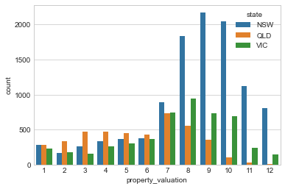
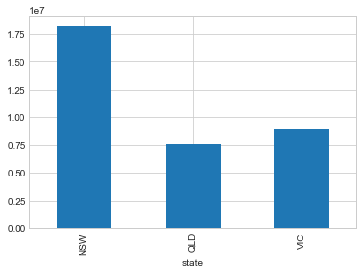
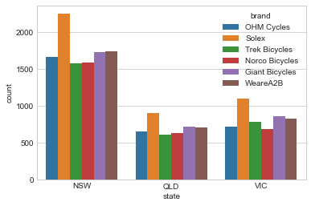
Note: The data and information in this document is reflective of a hypothetical situation and client. This document is to be used for KPMG Virtual Internship purposes only.
Data Exploration
NSW(New South Wales state) has more customers compared to VIC(Victoria) and QLD.
2. The property valuation also is a factor that can affect the bike sales, property value increases with good location, which will have access to parks, community centers, schools and much more.
3. People not owning car is more in NSW state, chances of bike purchases might be high for those people.
4. Solex bike brand is popular in all the 3 states.

Slide 5
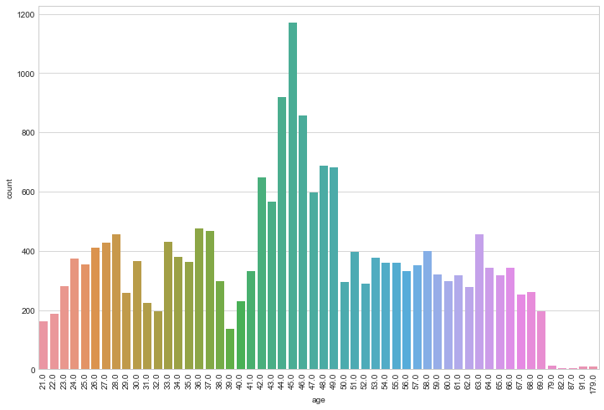
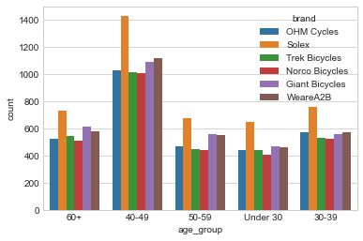
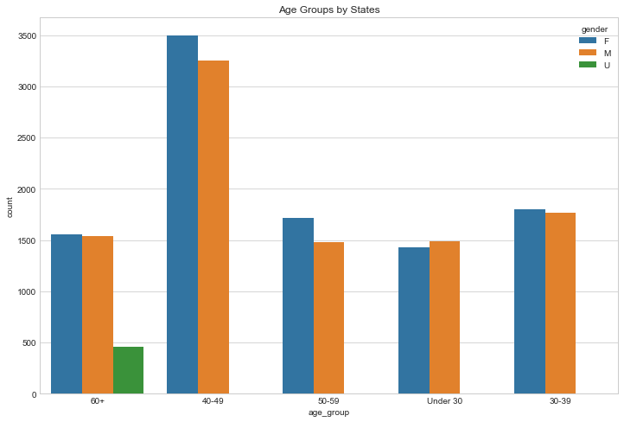
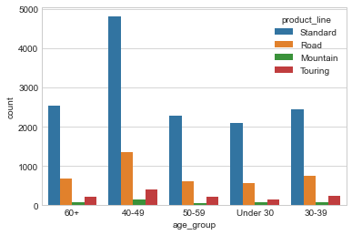
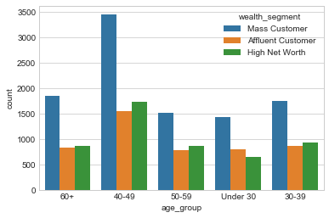
Note: The data and information in this document is reflective of a hypothetical situation and client. This document is to be used for KPMG Virtual Internship purposes only.
Data Exploration
Customers in the age group 37-50 tend to purchase more bikes.
Solex brand is popular among all the age groups.
Mass Customers are high in all the age groups.
Product line standard is popular among all the age groups.
NSW state has high concentration of age group of 40-49.
Female population is high in the age group 40-49.

Slide 6
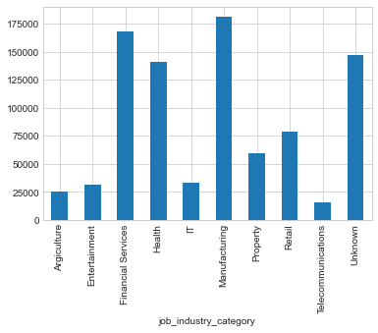
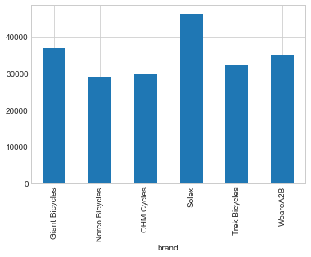
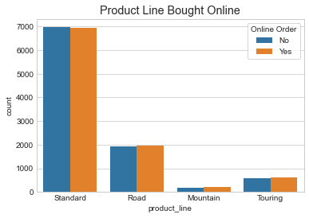
Note: The data and information in this document is reflective of a hypothetical situation and client. This document is to be used for KPMG Virtual Internship purposes only.
Data Exploration
Customers from the Marketing, Financial Services and health job industry are more frequent buyers.
Customers made more purchases through online order for the Standard product line.
Solex brand with medium product size has the highest sales.
Male Customers have made more bike related purchases compared to female customers.
Standard product line has highest number of online orders.

Slide 7
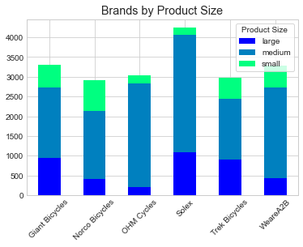
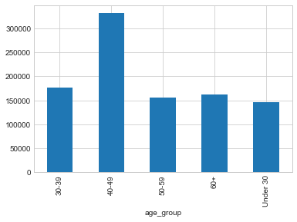
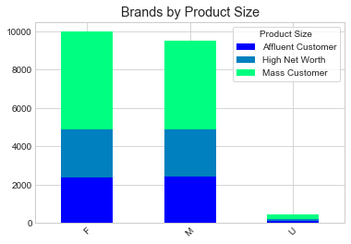
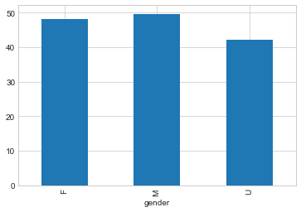
Note: The data and information in this document is reflective of a hypothetical situation and client. This document is to be used for KPMG Virtual Internship purposes only.
Model Development
Important insights from the Data
Male customers made the most bike related purchases compared to female customers.
Solex brand with medium product size made the highest sales.
Bike sales are high in the age group of 39-50.
4. Mass customers have contributed to high bike sales.

Slide 8
Note: The data and information in this document is reflective of a hypothetical situation and client. This document is to be used for KPMG Virtual Internship purposes only.
Interpretation
Recommended Strategy for the New Customers
Focus sales pitch on Male customers since they have made more bike sales in the past 3 years.
Bike sales is more likely to be high in NSW state and therefore more advertising strategy should be focused on this state since most customers are based in this state.
Mass customers have contributed more to the bikes sales, so targeting that wealth segment class can have more benefit.
Sales have been high at the locations with high property value, so targeting the communities with locations with parks, bike trails might be an added advantage.
Customers in age group 39-50 are likely to boost the bike sales.
Solex brand and medium product size is most sold bike, so targeting this brand might be more profitable.
Marketing, financial services and health job sectors have made the most purchases, so targeting the new customers in these sectors might be benefitable.
Product line standard is most likely to have more sales considering the previous sales.
People not owning car is more in NSW state, chances of bike purchases might be high for those people.

Slide 9
Note: The data and information in this document is reflective of a hypothetical situation and client. This document is to be used for KPMG Virtual Internship purposes only.
Appendix

Slide 10
Note: The data and information in this document is reflective of a hypothetical situation and client. This document is to be used for KPMG Virtual Internship purposes only.
Appendix
This is an optional slide where you may place any supporting items.

