Slide 1
MIS6382.003
Final Project
Group 8
Mujahed Ali Khan, mxx230007 Nandini Kalal, nxk230008 Niraj Punde, nxp230039 Varmi Ashokkumar Sanghani, vxs190010

Slide 2
Introduction
Phone data from a marketplace
Data size of 10000
8 Columns (unique_id,date,model,company,type,rating,price,battery_health)
Price, Rating , Battery Health are numerical data fields whereas model,Company and type are categorical data fields
Unique_id is a identifier fields and hence can be ignored from the visualization.
Upon investigation of data, we found that missing values comprised of 2.2075% dataset.
We filled the missing data of ‘rating’, ‘price’ and ‘battery_health’ columns by using mean of each column within its respective model group.
The missing data of date was filled by using mode of within each model group.

Slide 3
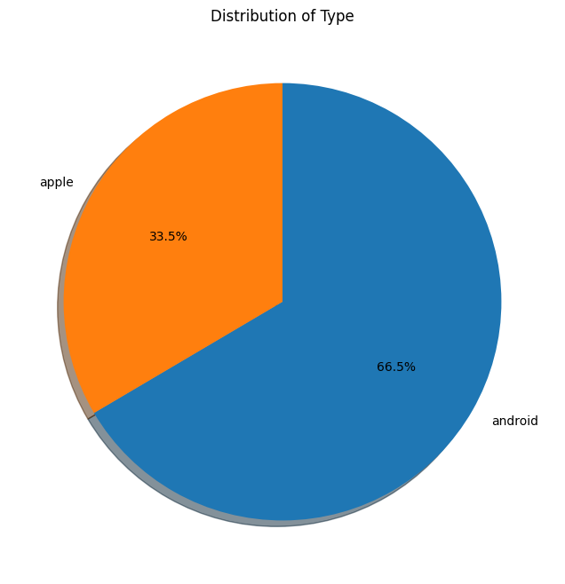
Pie Chart
Total number of phones: 10000
Number of Android phones: 6651
Number of Apple phones: 3349
Notes:
Our dataset is primarily divided into two categories: Android and Apple. The pie chart illustrates a significant difference in distribution, with Android phones accounting for 66.5% and Apple phones constituting 33.5%. This suggests a substantial Android user base, approximately twice that of Apple.

Slide 4
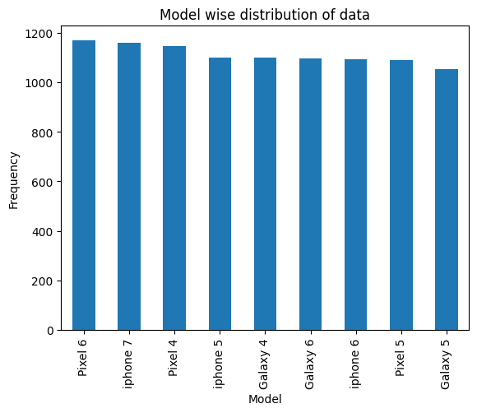
Bar Chart
Notes:
Moving on to the distribution of models, the bar chart provides a clear picture. The Pixel 6 stands out as the most popular model with 1169 instances, followed closely by the iPhone 7 and Pixel 4. This indicates a healthy competition among different manufacturers, with no single model dominating the market.

Slide 5
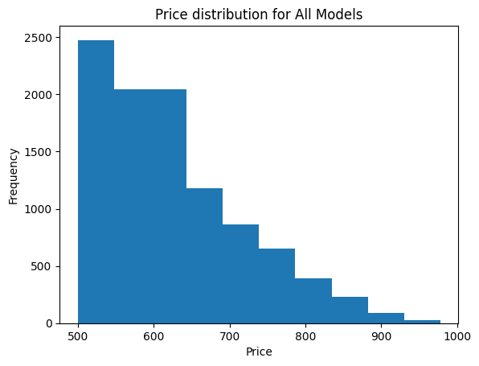
Histogram
Notes:
Analyzing the price distribution across all models, the histogram reveals a left-skewed pattern. Most models are relatively affordable, with a median price of $602.00. This suggests a diverse market, accommodating models at various price points.

Slide 6
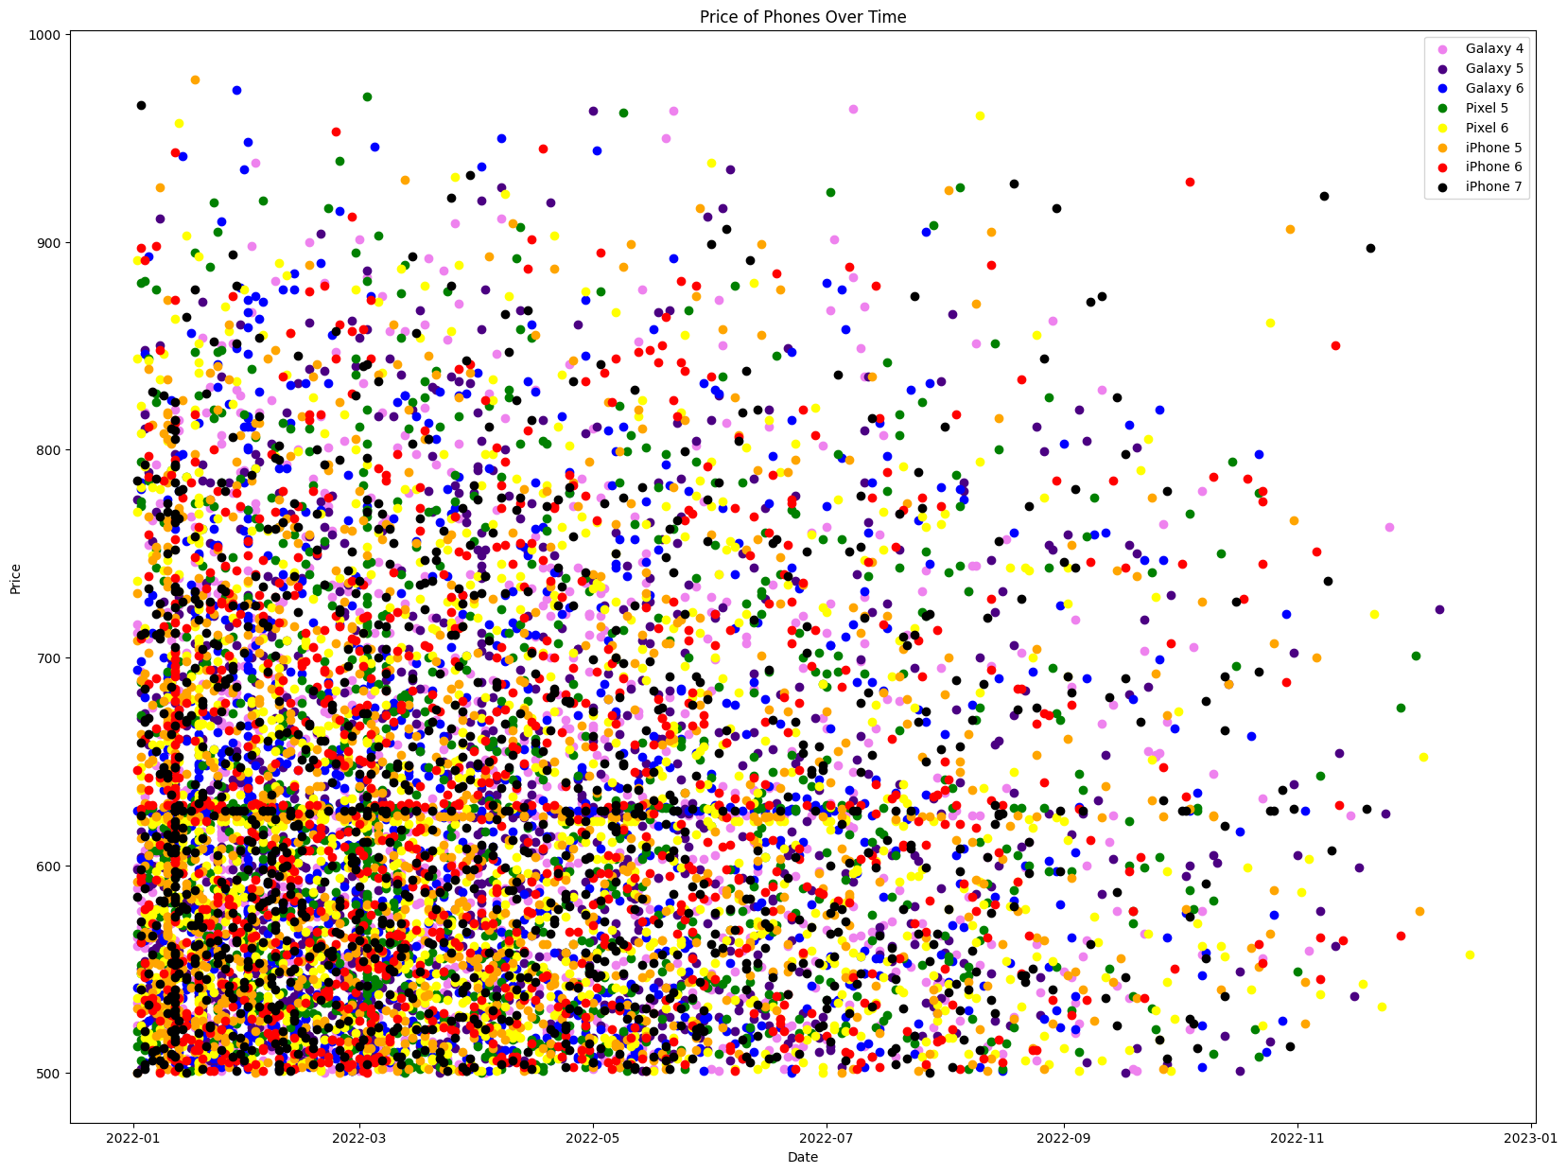
Scatter Plot

Slide 7
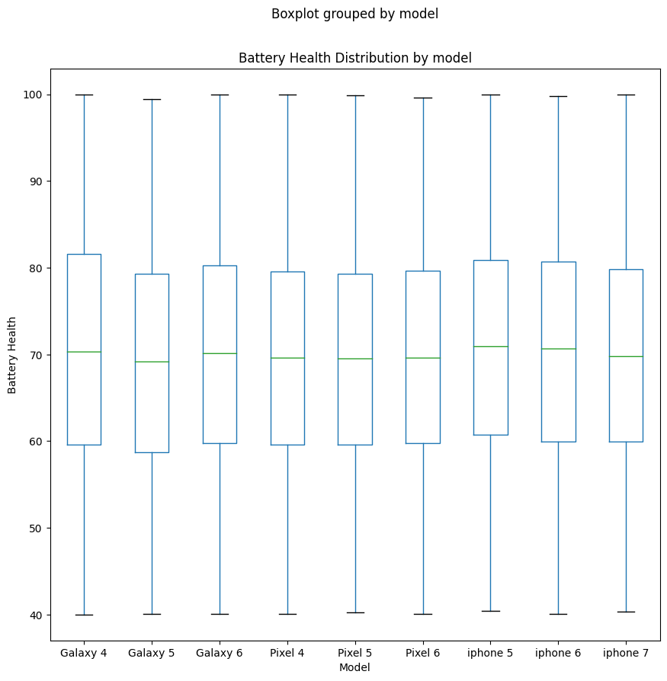
Box Plot
Notes:
The box plot illustrates battery health distribution across different smartphone brands. Samsung Galaxy smartphones lead in overall battery health, with Galaxy 6 and Pixel 6 models showcasing the highest median battery health. Variability within models suggests diverse battery performances.

Slide 8
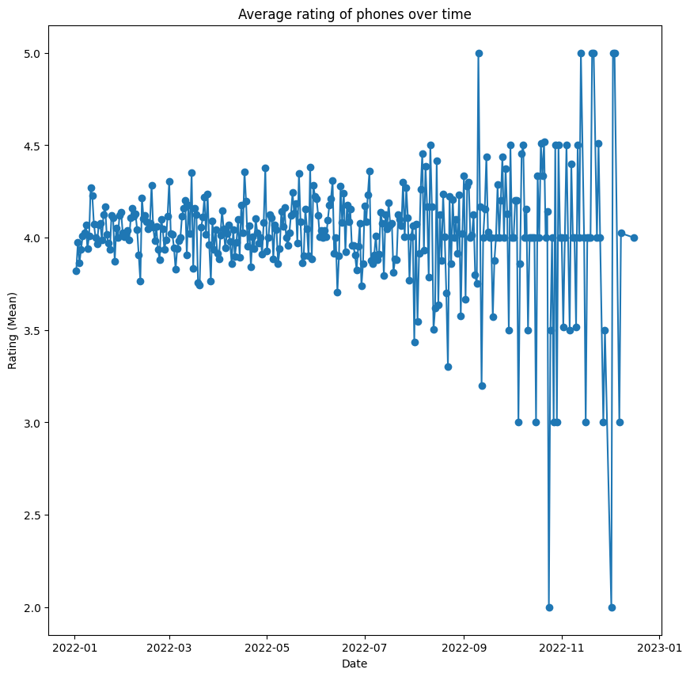
Line Plot
Notes:
Shifting focus to user satisfaction, the line plot depicts the stability of average ratings around 3.5 over the past 7 months. A slight upward trend from 3.4 in January 2022 to 3.6 in November 2022 indicates overall satisfaction with released phones.

Slide 9
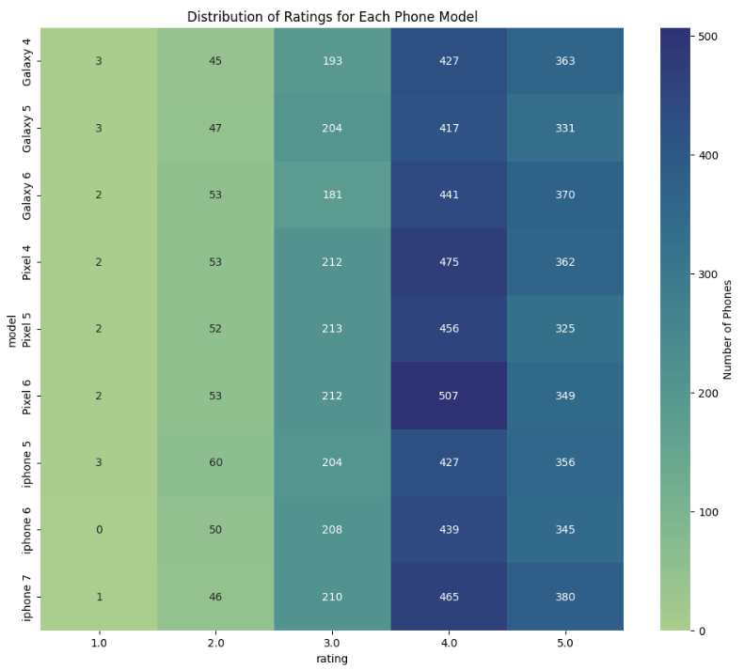
Heat Map
Notes:
Our heat map reveals valuable insights into phone ratings. The Pixel 6 stands out with the highest average rating (4.5) and a dominant 49% of 5-star ratings. In contrast, the Galaxy 4 exhibits the lowest average rating (3.5) with a considerable percentage of 1-star ratings (23%).

Slide 10
Conclusion
The pie chart illustrates the distribution of Apple and Android phones, revealing that Android phones account for 66.5%, whereas Apple phones constitute 33.5%. The data indicates a substantial difference, with Android users surpassing Apple users by approximately twice the percentage (33%).
Based on this data, it appears that the Pixel 6 is a clear leader in the market with 10.9% higher sales than the least popular one.
From this data, it can be inferred that most models are relatively affordable. The median price is around $602.00, which means that half of the models are more expensive than $602.00 and half are less expensive.
The Scatter Plot describes the trend in phone prices over the time. From the visualization it is clear that the prices have clustered in the lower left corner of the the graph, suggesting that the prices of the second hand phones do not correlate well with the time and even more recent phone will fetch around low price in the resale market.
The iPhone 5 have the highest median battery health, while pixel 4 the has the lowest median battery health. There is also some variability in battery health within each model. For example, the Galaxy 4 and Pixel 4 models have wider boxes than the Galaxy 6 and Pixel 6 models, which indicates that there is more variability in battery health for these models.
The data suggests that the Pixel 6 is the most popular and highly-rated phone model in the visualisation. The iPhone 7 and Pixel 5 are also popular and highly-rated, while the Galaxy 4, Galaxy 5, and Galaxy 6 are less popular and have lower average ratings.

