Slide 1
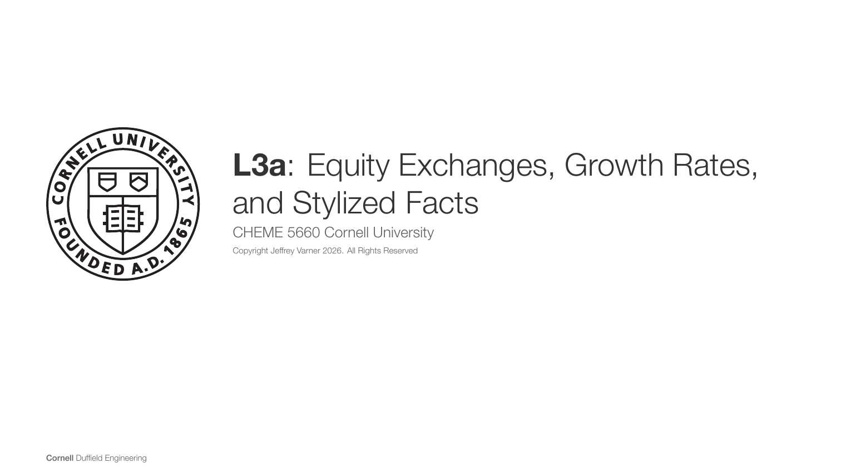
Notes:
[Sources]
- CHEME-5660-L3a-Lecture-Equity-Exchanges-Return-StylizedFacts-Fall-2026.ipynb
- lectures/week-3/L3a/docs/Notes.tex

Slide 2
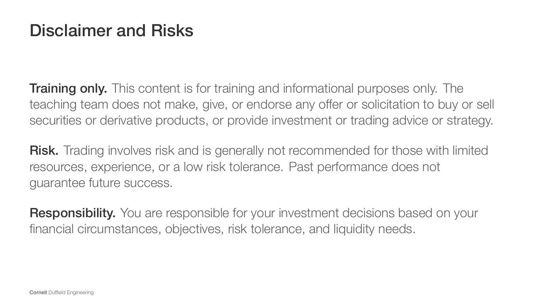
Notes:
[Sources]
- CHEME-5660-L3a-Lecture-Equity-Exchanges-Return-StylizedFacts-Fall-2026.ipynb
- lectures/week-3/L3a/docs/Notes.tex

Slide 3
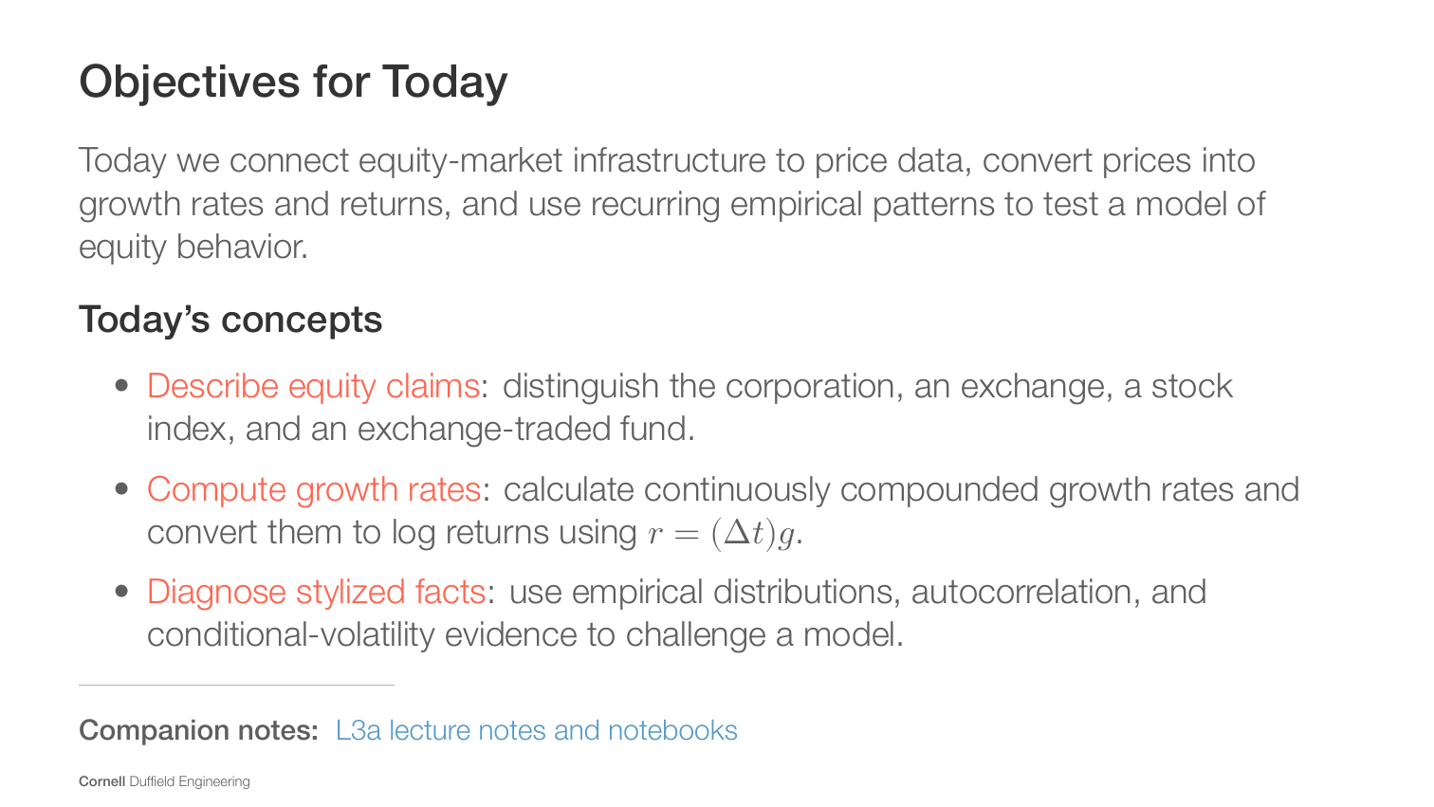
Notes:
[Sources]
- CHEME-5660-L3a-Lecture-Equity-Exchanges-Return-StylizedFacts-Fall-2026.ipynb
- lectures/week-3/L3a/docs/Notes.tex

Slide 4
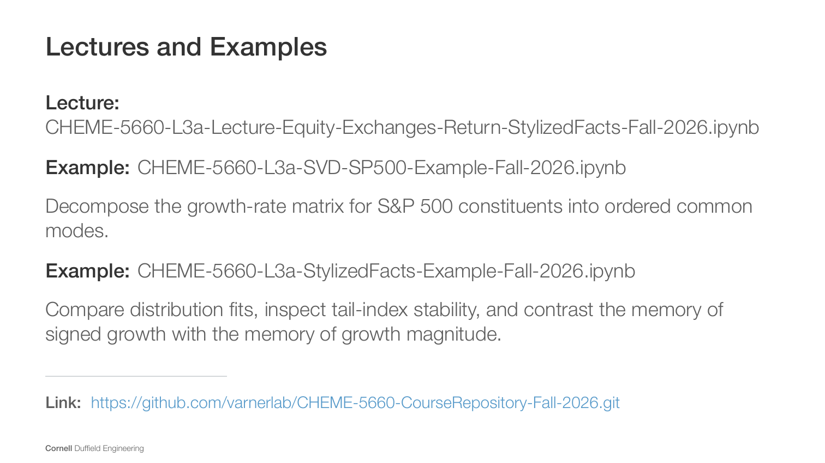
Notes:
[Sources]
- CHEME-5660-L3a-Lecture-Equity-Exchanges-Return-StylizedFacts-Fall-2026.ipynb
- lectures/week-3/L3a/docs/Notes.tex

Slide 5
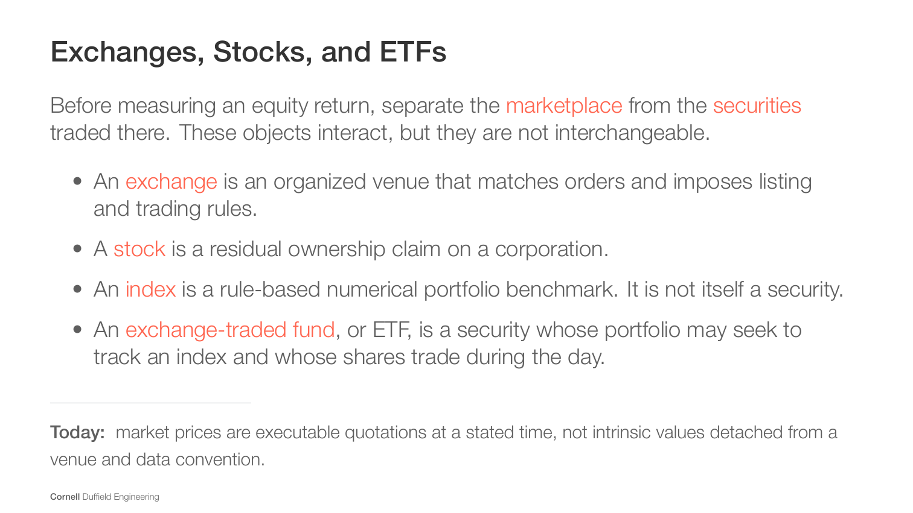
Notes:
[Sources]
- CHEME-5660-L3a-Lecture-Equity-Exchanges-Return-StylizedFacts-Fall-2026.ipynb
- lectures/week-3/L3a/docs/Notes.tex

Slide 6
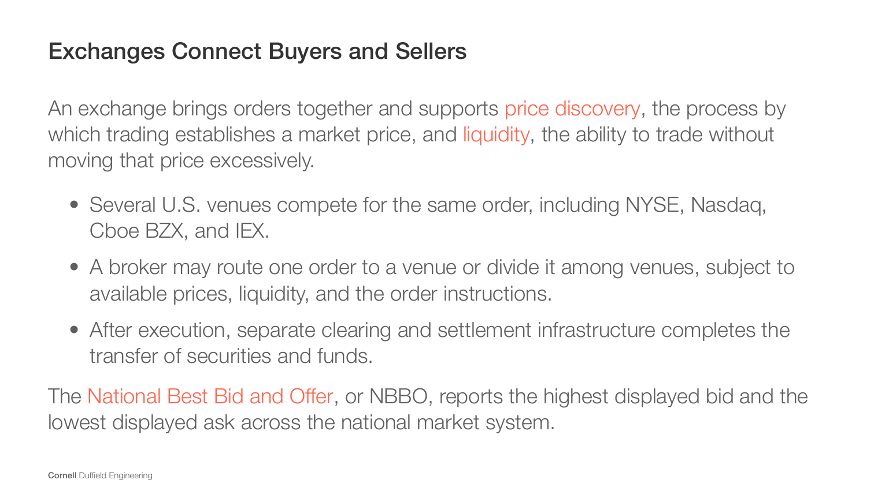
Notes:
[Sources]
- CHEME-5660-L3a-Lecture-Equity-Exchanges-Return-StylizedFacts-Fall-2026.ipynb
- lectures/week-3/L3a/docs/Notes.tex

Slide 7
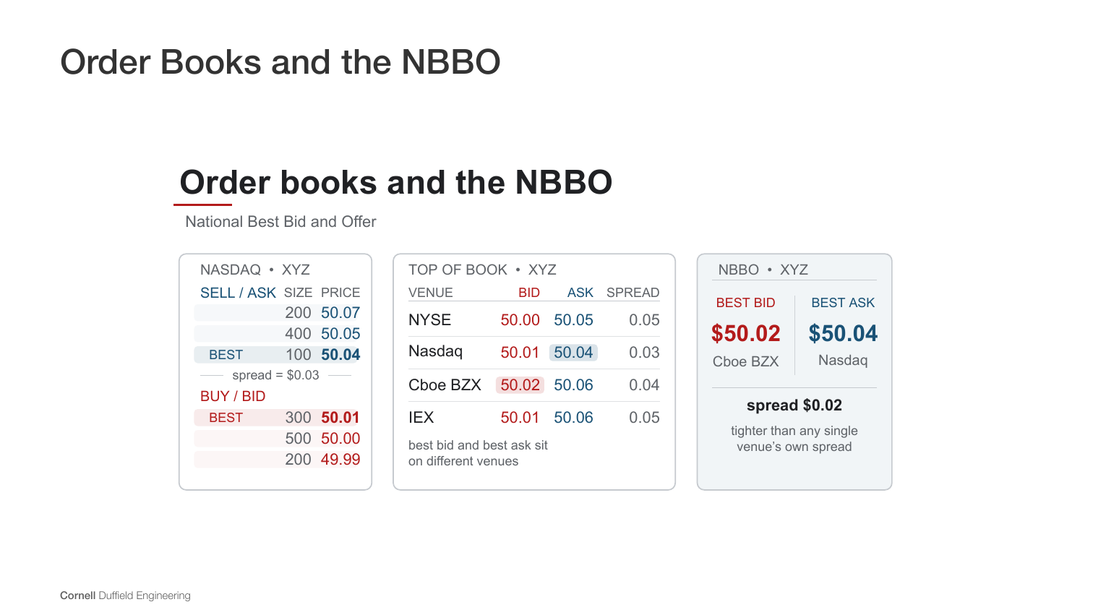
Notes:
[Sources]
- CHEME-5660-L3a-Lecture-Equity-Exchanges-Return-StylizedFacts-Fall-2026.ipynb
- lectures/week-3/L3a/docs/Notes.tex
- lectures/week-3/L3a/figs/Fig-L3a-Equity-Market-Schematic.pdf

Slide 8
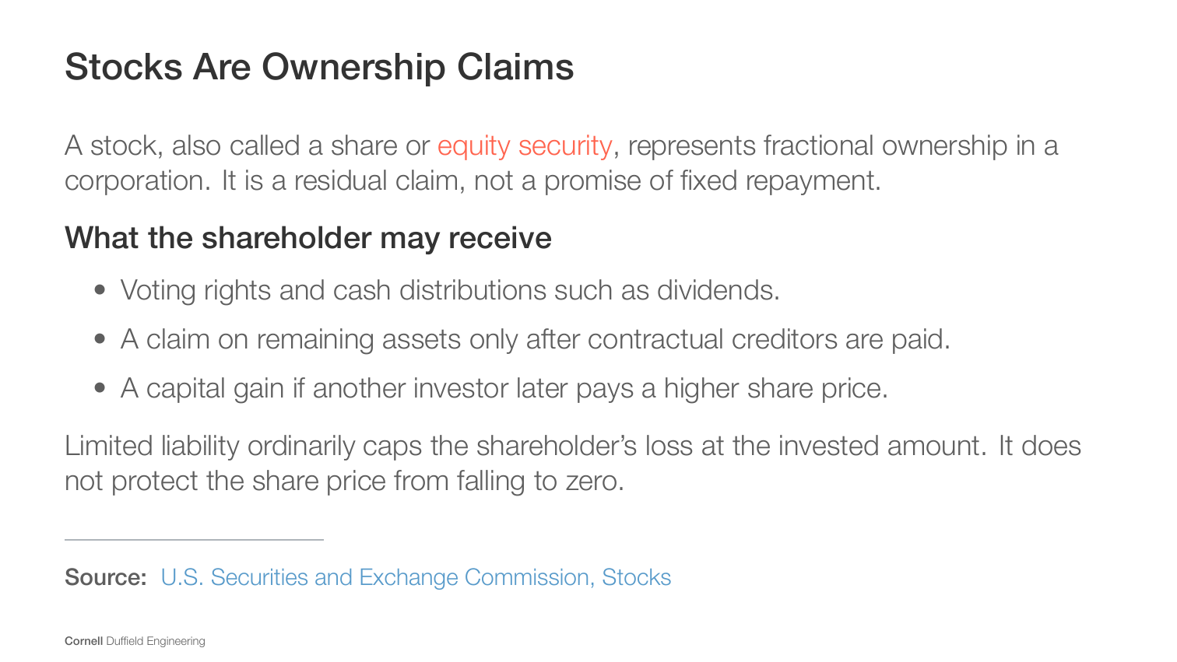
Notes:
[Sources]
- CHEME-5660-L3a-Lecture-Equity-Exchanges-Return-StylizedFacts-Fall-2026.ipynb
- lectures/week-3/L3a/docs/Notes.tex
- https://www.investor.gov/introduction-investing/investing-basics/investment-products/stocks

Slide 9
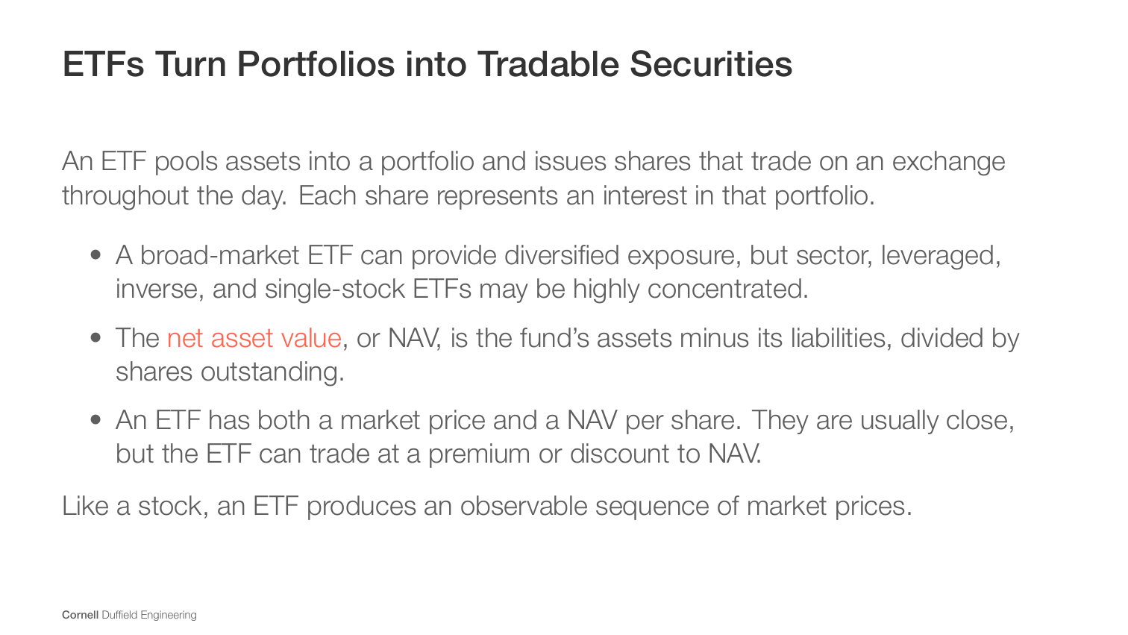
Notes:
[Sources]
- CHEME-5660-L3a-Lecture-Equity-Exchanges-Return-StylizedFacts-Fall-2026.ipynb
- lectures/week-3/L3a/docs/Notes.tex

Slide 10
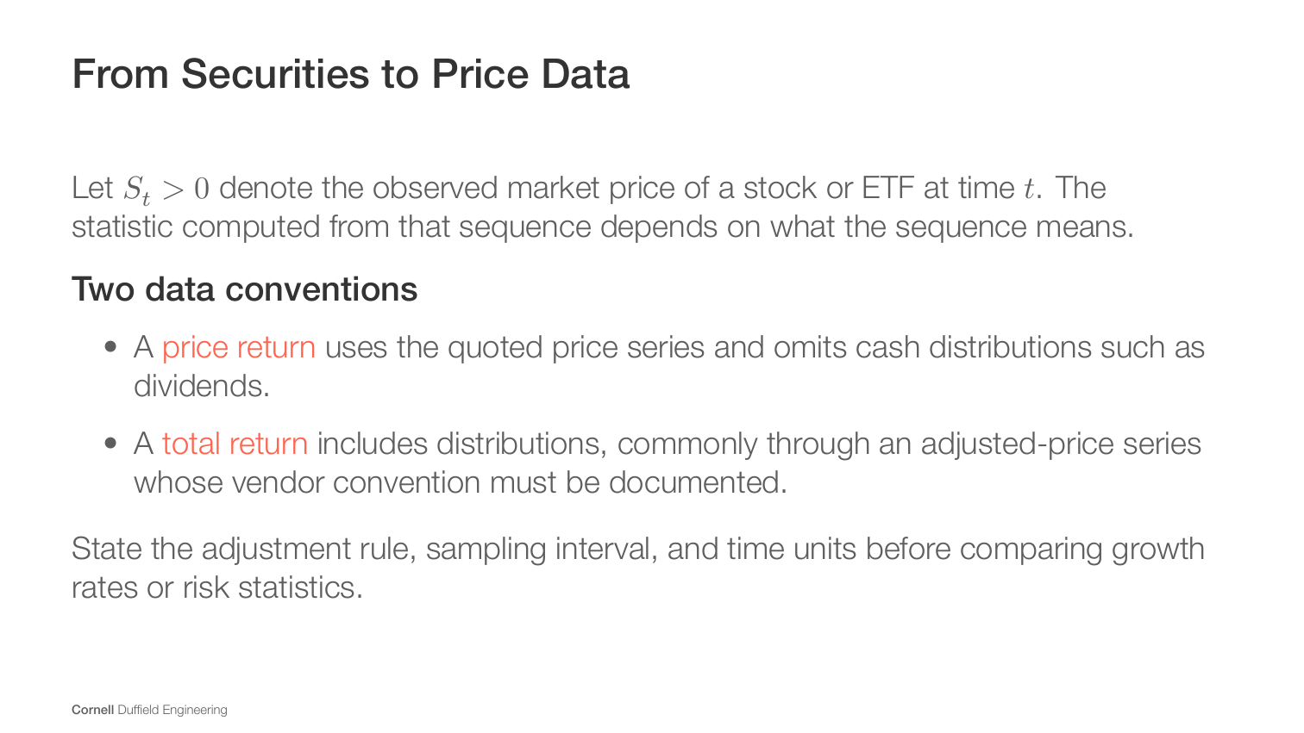
Notes:
[Sources]
- CHEME-5660-L3a-Lecture-Equity-Exchanges-Return-StylizedFacts-Fall-2026.ipynb
- lectures/week-3/L3a/docs/Notes.tex

Slide 11
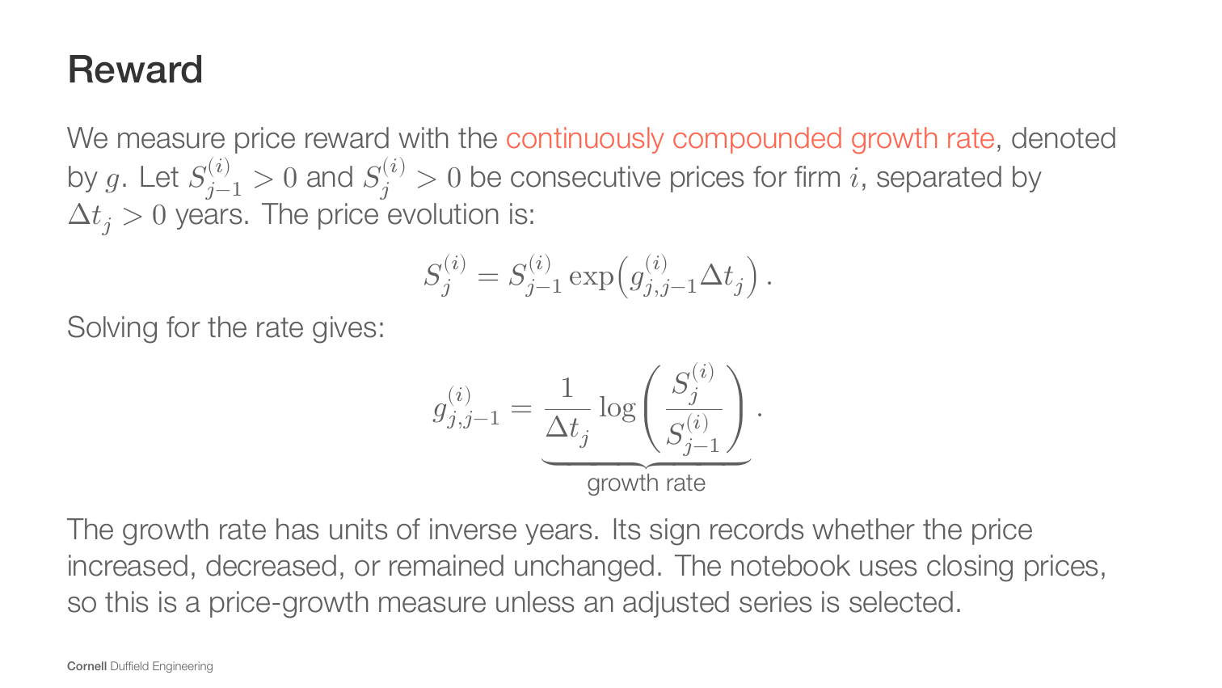
Notes:
[Sources]
- CHEME-5660-L3a-Lecture-Equity-Exchanges-Return-StylizedFacts-Fall-2026.ipynb
- lectures/week-3/L3a/docs/Notes.tex

Slide 12
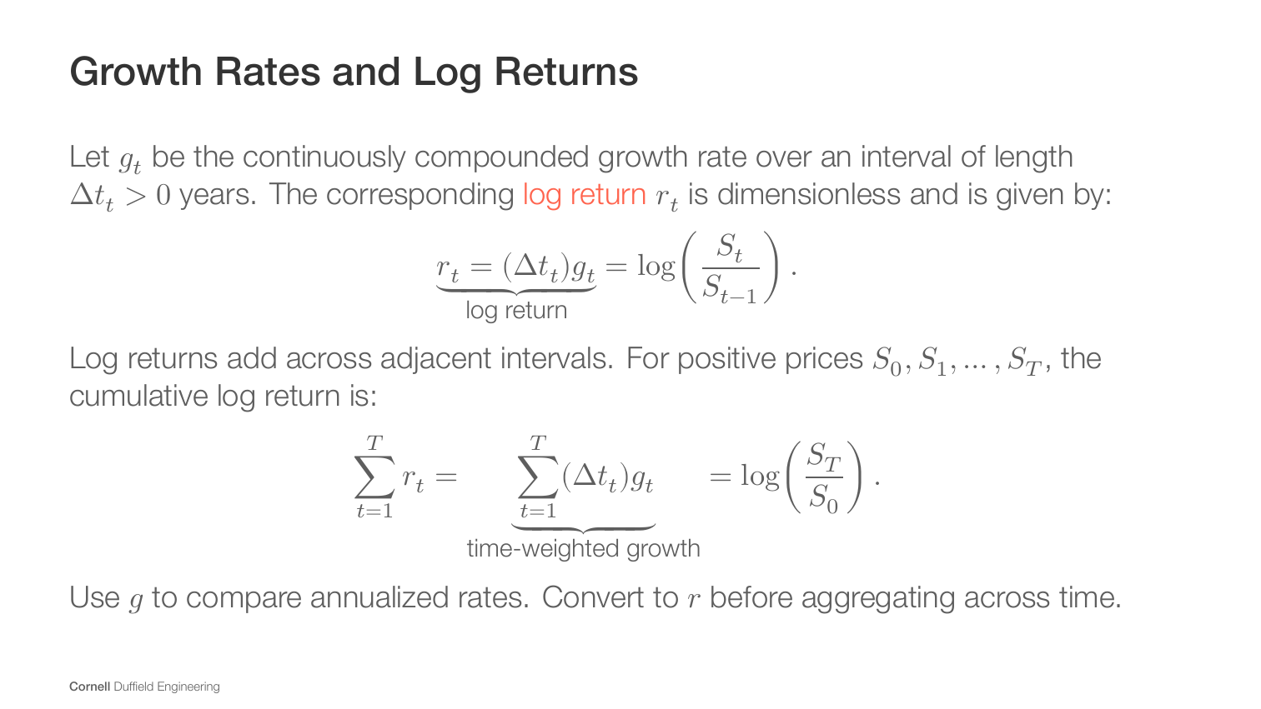
Notes:
[Sources]
- CHEME-5660-L3a-Lecture-Equity-Exchanges-Return-StylizedFacts-Fall-2026.ipynb
- lectures/week-3/L3a/docs/Notes.tex

Slide 13
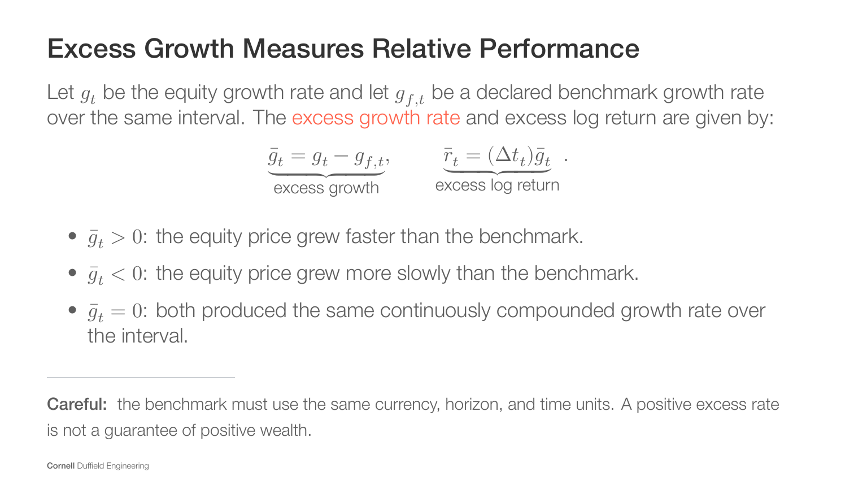
Notes:
[Sources]
- CHEME-5660-L3a-Lecture-Equity-Exchanges-Return-StylizedFacts-Fall-2026.ipynb
- lectures/week-3/L3a/docs/Notes.tex

Slide 14
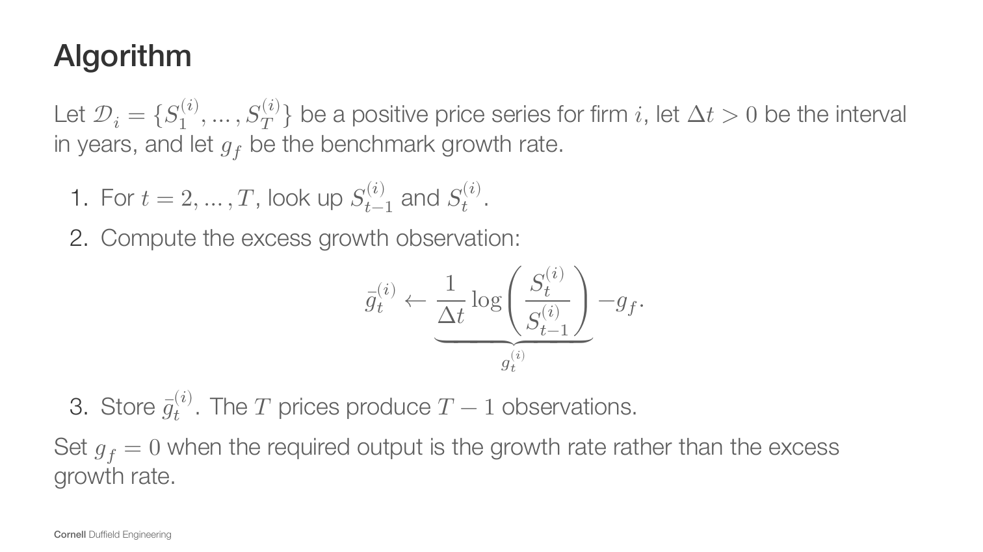
Notes:
[Sources]
- CHEME-5660-L3a-Lecture-Equity-Exchanges-Return-StylizedFacts-Fall-2026.ipynb
- lectures/week-3/L3a/docs/Notes.tex

Slide 15
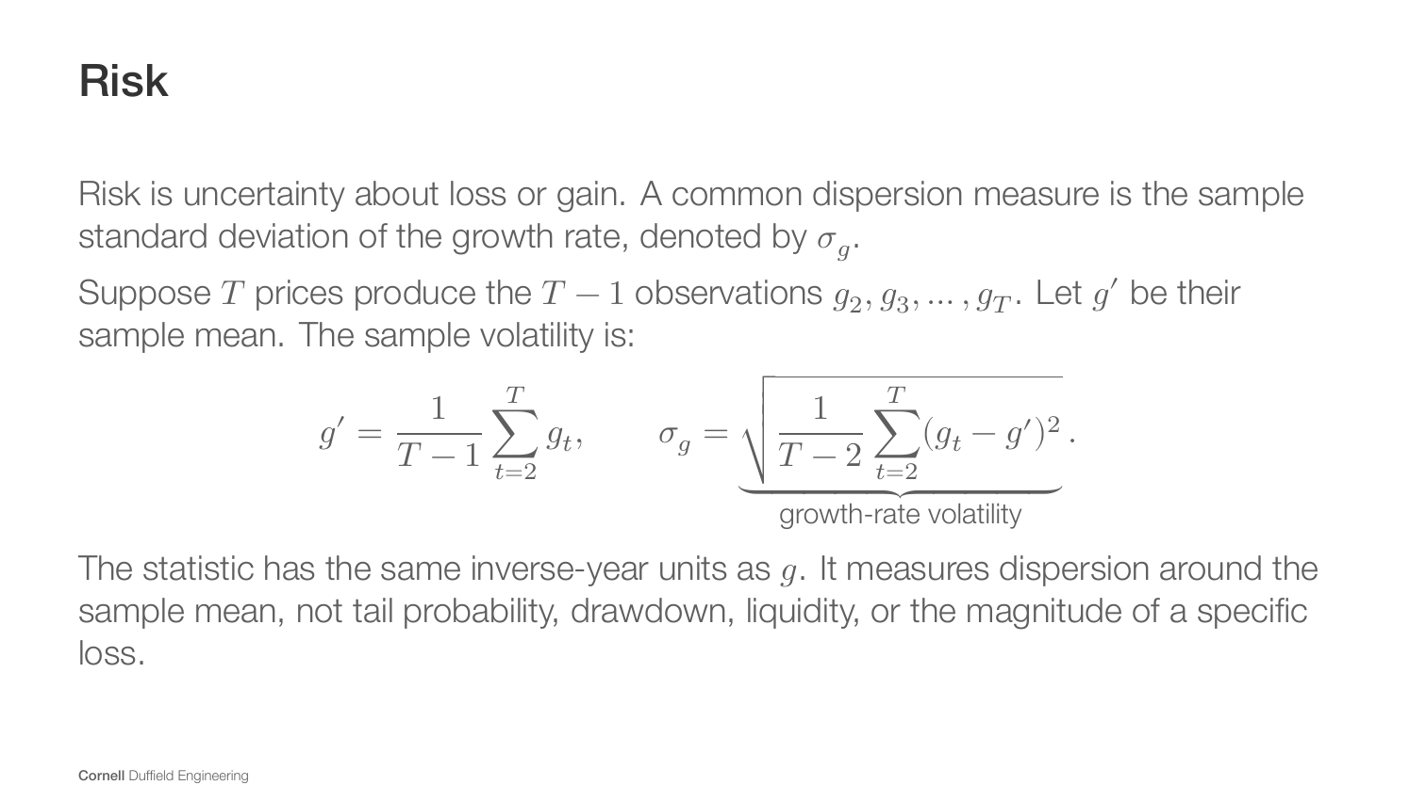
Notes:
[Sources]
- CHEME-5660-L3a-Lecture-Equity-Exchanges-Return-StylizedFacts-Fall-2026.ipynb
- lectures/week-3/L3a/docs/Notes.tex

Slide 16
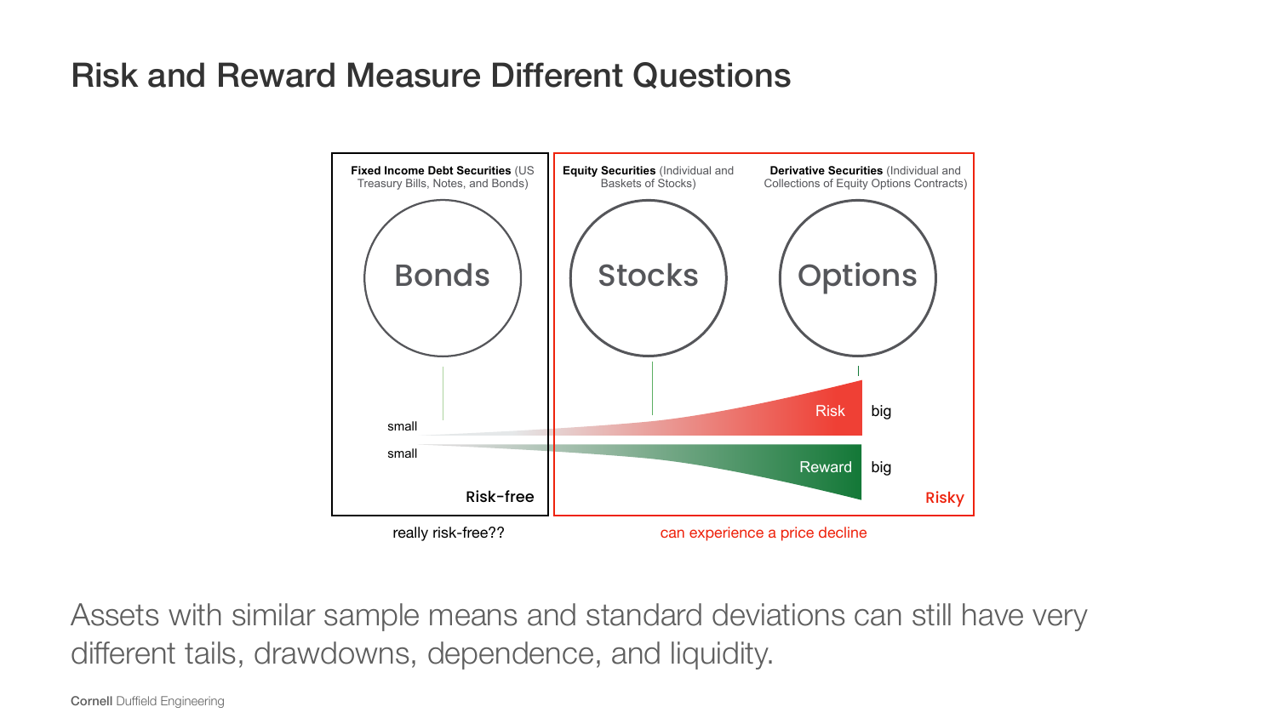
Notes:
[Sources]
- CHEME-5660-L3a-Lecture-Equity-Exchanges-Return-StylizedFacts-Fall-2026.ipynb
- lectures/week-3/L3a/docs/Notes.tex
- lectures/week-3/L3a/figs/Fig-RiskReward-Asset-Schematic.pdf

Slide 17
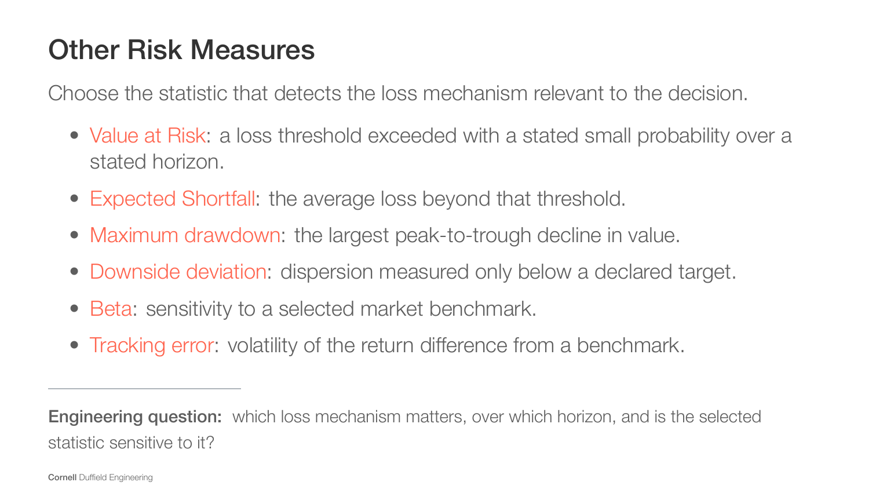
Notes:
[Sources]
- CHEME-5660-L3a-Lecture-Equity-Exchanges-Return-StylizedFacts-Fall-2026.ipynb
- lectures/week-3/L3a/docs/Notes.tex

Slide 18
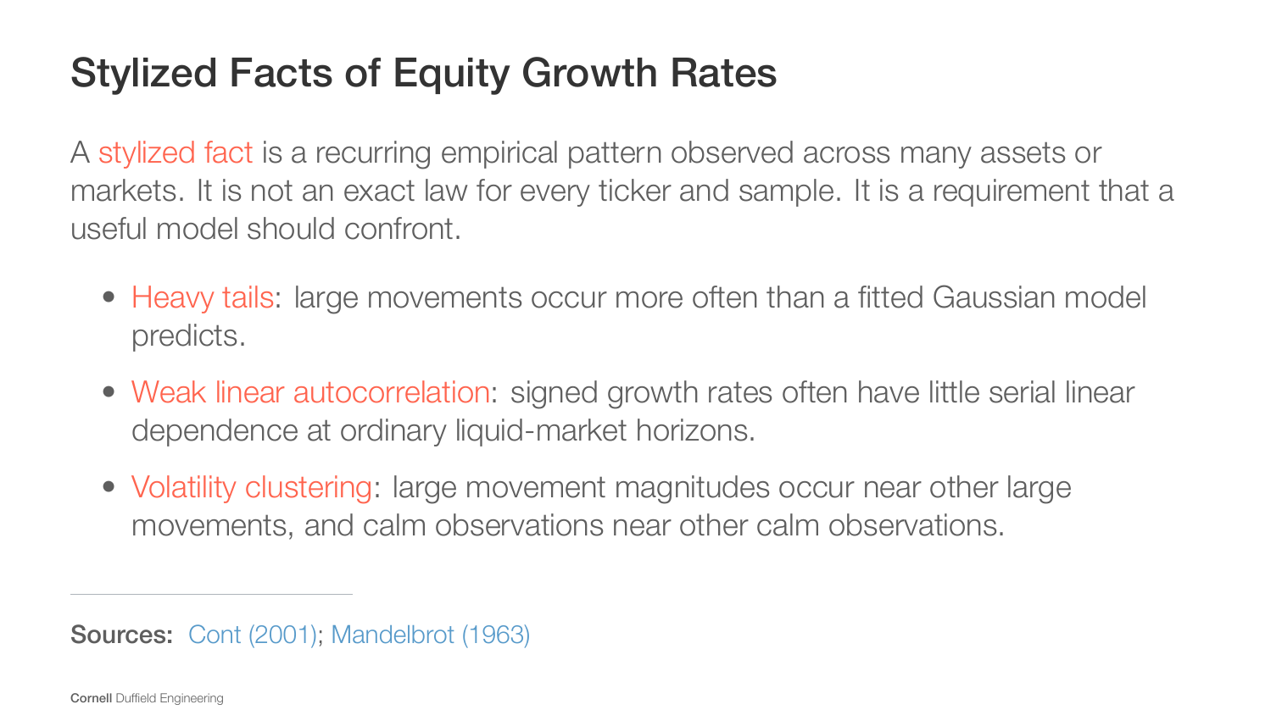
Notes:
[Sources]
- CHEME-5660-L3a-Lecture-Equity-Exchanges-Return-StylizedFacts-Fall-2026.ipynb
- lectures/week-3/L3a/docs/Notes.tex
- https://doi.org/10.1080/713665670
- https://www.jstor.org/stable/2350970

Slide 19
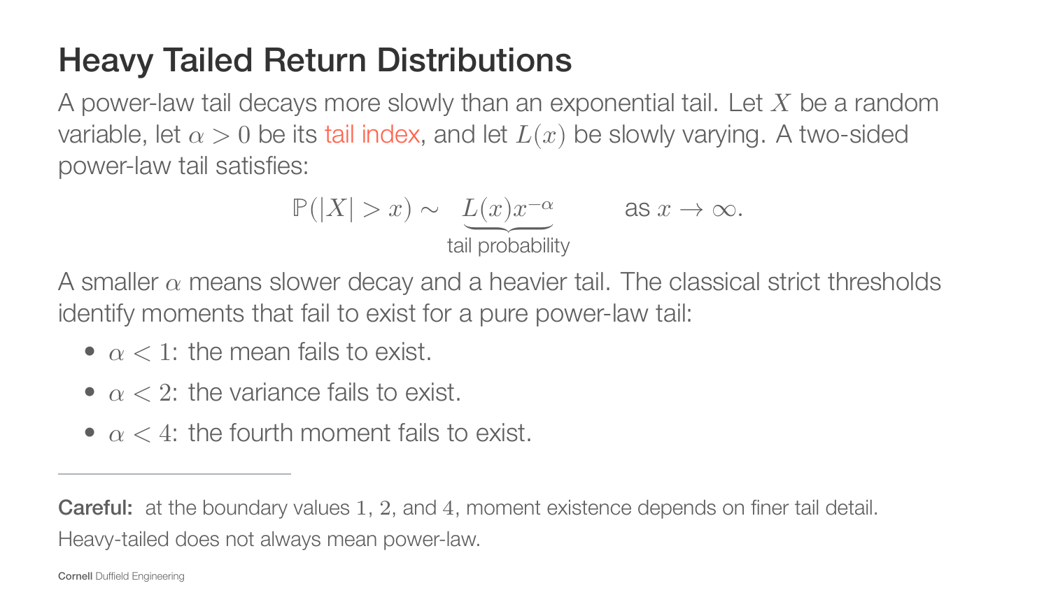
Notes:
[Sources]
- CHEME-5660-L3a-Lecture-Equity-Exchanges-Return-StylizedFacts-Fall-2026.ipynb
- lectures/week-3/L3a/docs/Notes.tex
- https://doi.org/10.1080/713665670
- https://www.jstor.org/stable/2350970

Slide 20
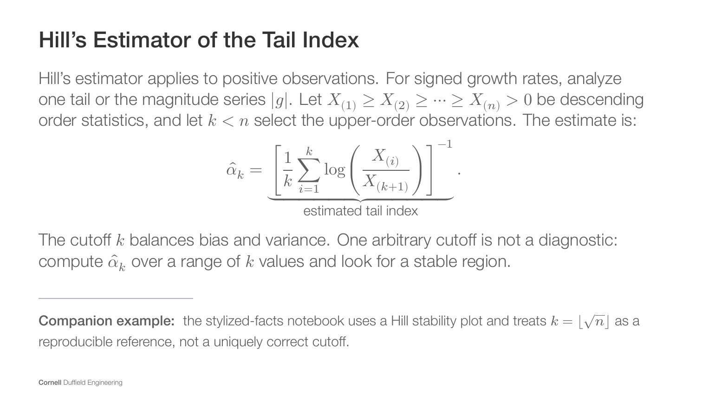
Notes:
[Sources]
- CHEME-5660-L3a-Lecture-Equity-Exchanges-Return-StylizedFacts-Fall-2026.ipynb
- lectures/week-3/L3a/docs/Notes.tex
- https://doi.org/10.1080/713665670
- https://www.jstor.org/stable/2350970

Slide 21
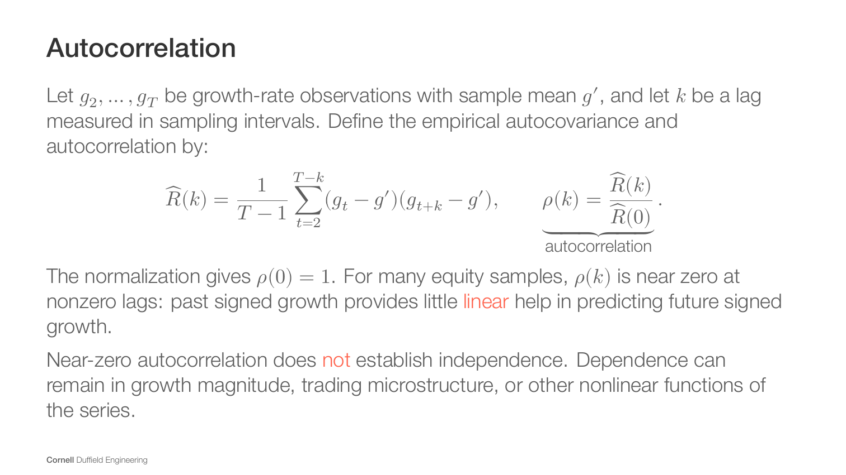
Notes:
[Sources]
- CHEME-5660-L3a-Lecture-Equity-Exchanges-Return-StylizedFacts-Fall-2026.ipynb
- lectures/week-3/L3a/docs/Notes.tex
- https://doi.org/10.1080/713665670
- https://www.jstor.org/stable/2350970

Slide 22
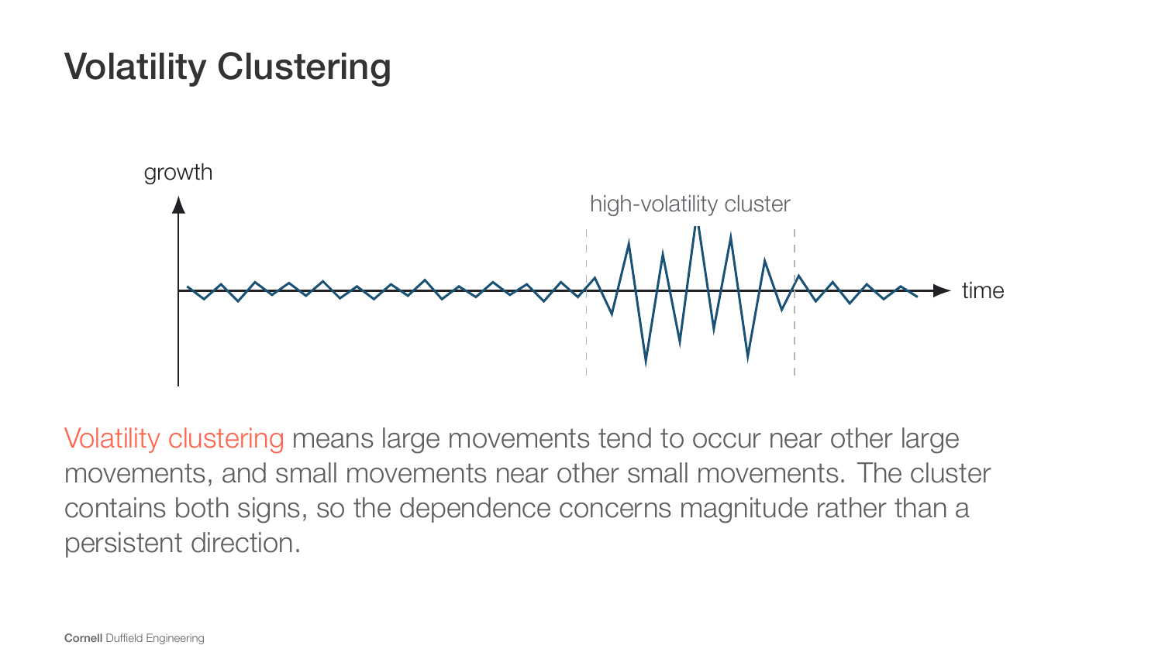
Notes:
[Sources]
- CHEME-5660-L3a-Lecture-Equity-Exchanges-Return-StylizedFacts-Fall-2026.ipynb
- lectures/week-3/L3a/docs/Notes.tex
- https://doi.org/10.1080/713665670
- https://www.jstor.org/stable/2350970

Slide 23
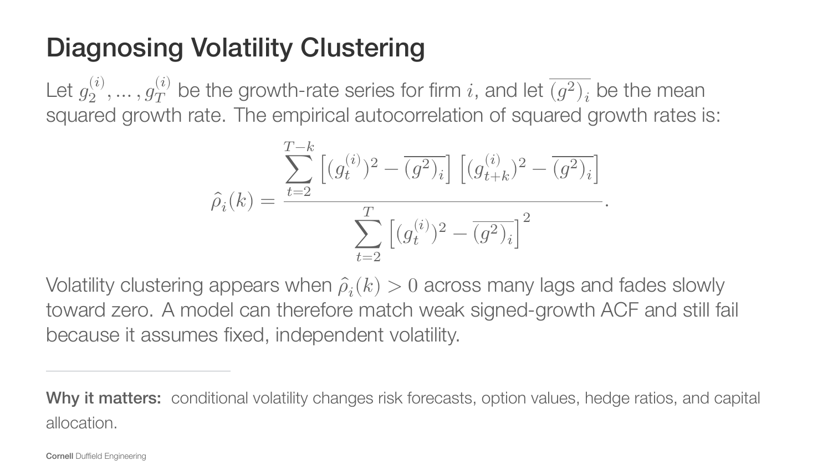
Notes:
[Sources]
- CHEME-5660-L3a-Lecture-Equity-Exchanges-Return-StylizedFacts-Fall-2026.ipynb
- lectures/week-3/L3a/docs/Notes.tex
- https://doi.org/10.1080/713665670
- https://www.jstor.org/stable/2350970

Slide 24
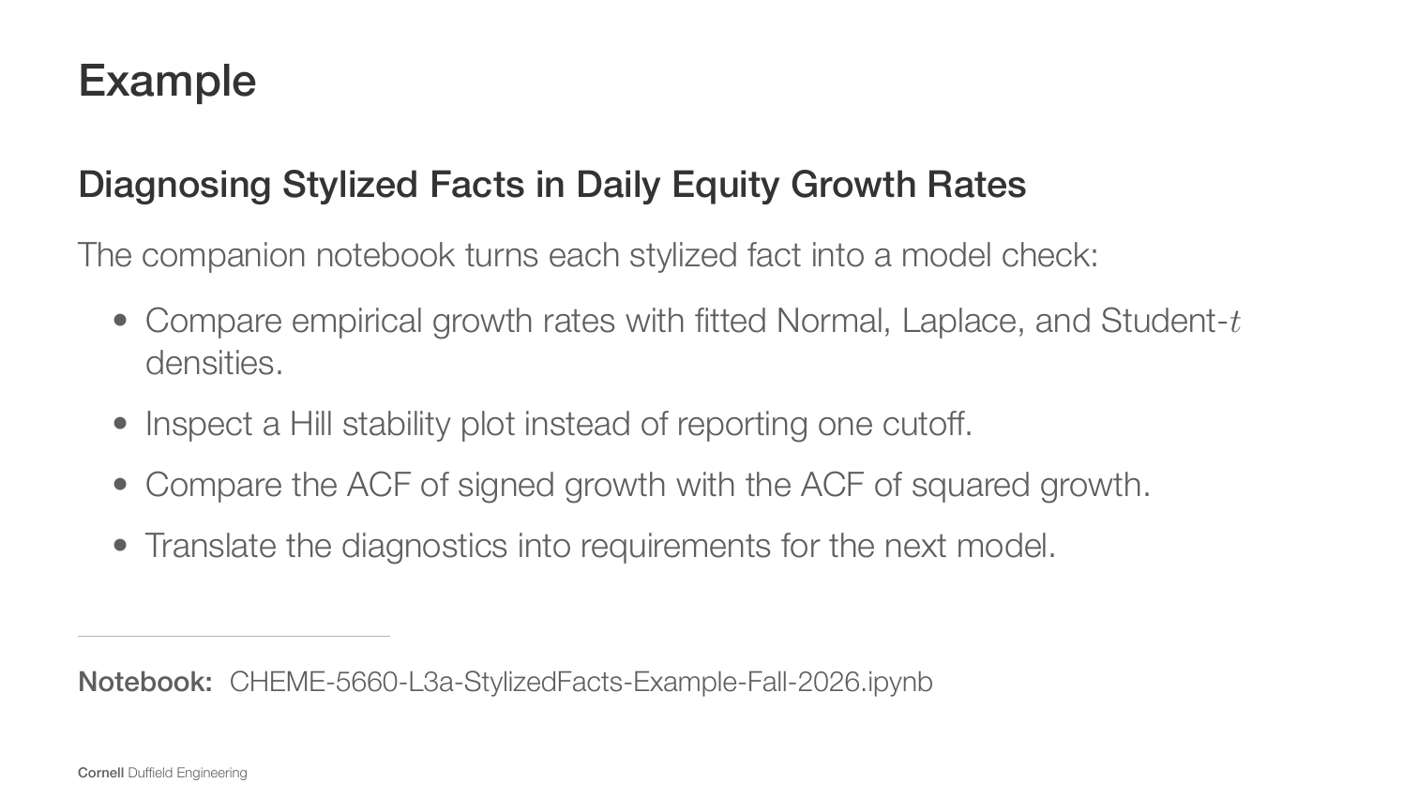
Notes:
[Sources]
- CHEME-5660-L3a-Lecture-Equity-Exchanges-Return-StylizedFacts-Fall-2026.ipynb
- lectures/week-3/L3a/docs/Notes.tex
- https://doi.org/10.1080/713665670
- https://www.jstor.org/stable/2350970

Slide 25
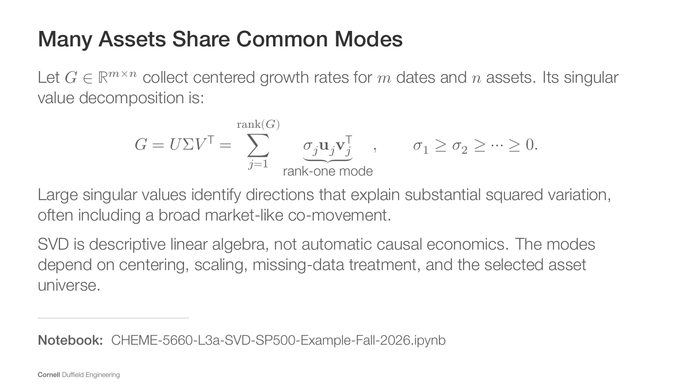
Notes:
[Sources]
- CHEME-5660-L3a-Lecture-Equity-Exchanges-Return-StylizedFacts-Fall-2026.ipynb
- lectures/week-3/L3a/docs/Notes.tex
- CHEME-5660-L3a-SVD-SP500-Example-Fall-2026.ipynb

Slide 26
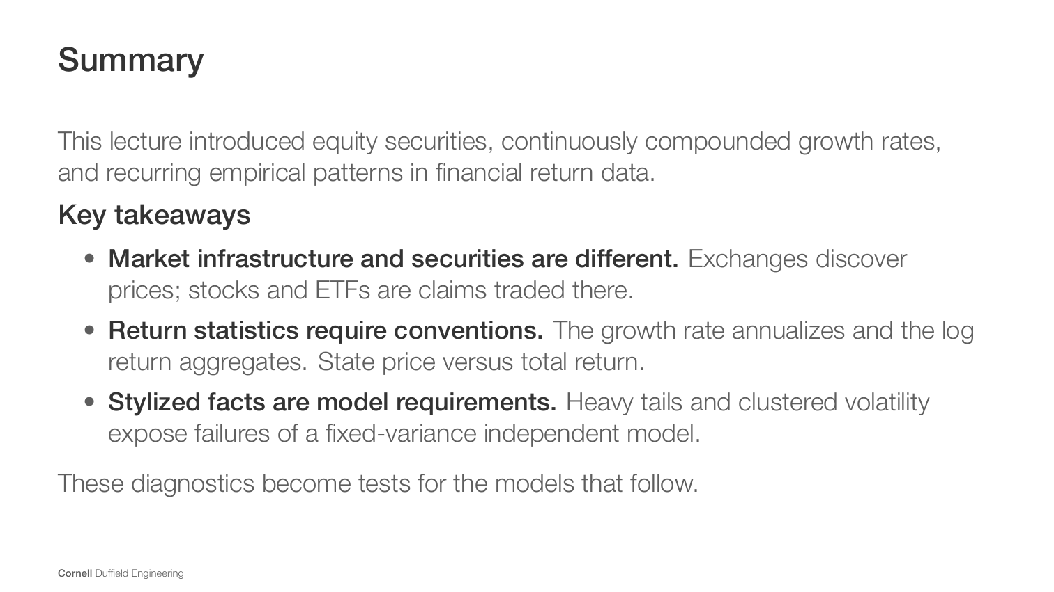
Notes:
[Sources]
- CHEME-5660-L3a-Lecture-Equity-Exchanges-Return-StylizedFacts-Fall-2026.ipynb
- lectures/week-3/L3a/docs/Notes.tex

Slide 27
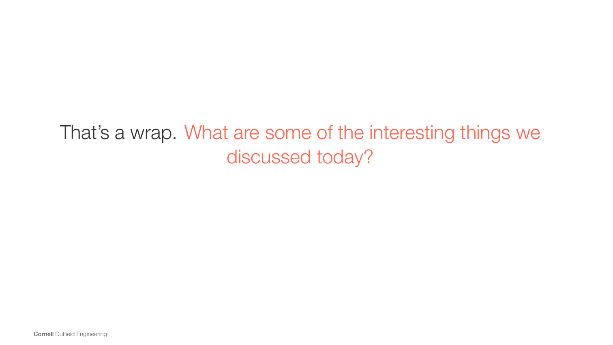
Notes:
[Sources]
- CHEME-5660-L3a-Lecture-Equity-Exchanges-Return-StylizedFacts-Fall-2026.ipynb
- lectures/week-3/L3a/docs/Notes.tex

