Slide 1
Lungs
a
Heart
Kidney
Vein
Liver
Artery
Wound
Bulk
b
Vascular Space
C^{V}, V^{V}
C_{P},Q
n^{VI}
C*
Interstitial Space
C^{I}, V^{I}
n^{IC}
n^{IC}
Intracellular Space
C^{C}, V^{C}
Notes:
7/15/16
1
1

Slide 2
Vascular Space
C^{V}, V^{V}
C_{P},Q
n^{VI}
C*
Interstitial Space
C^{I}, V^{I}
n^{IC}
n^{IC}
Intracellular Space
C^{C}, V^{C}
Notes:
7/15/16
2
2

Slide 3
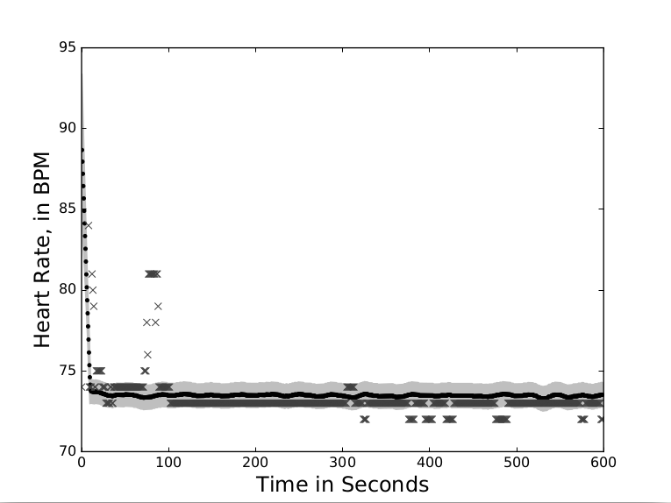
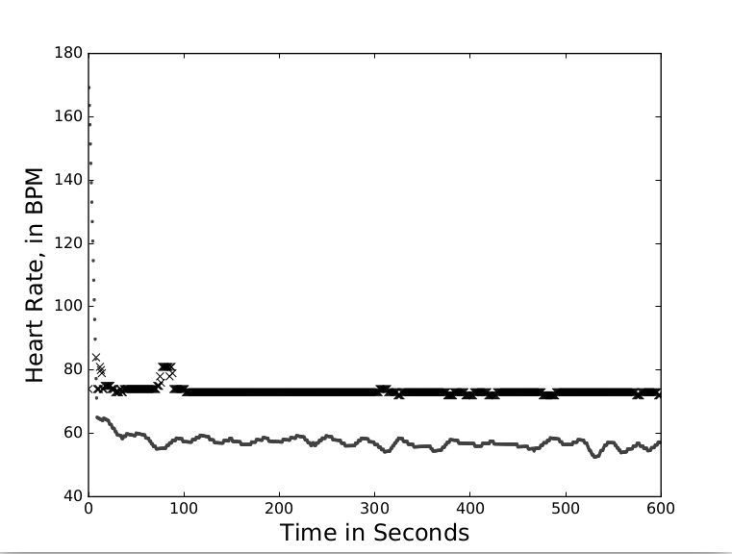
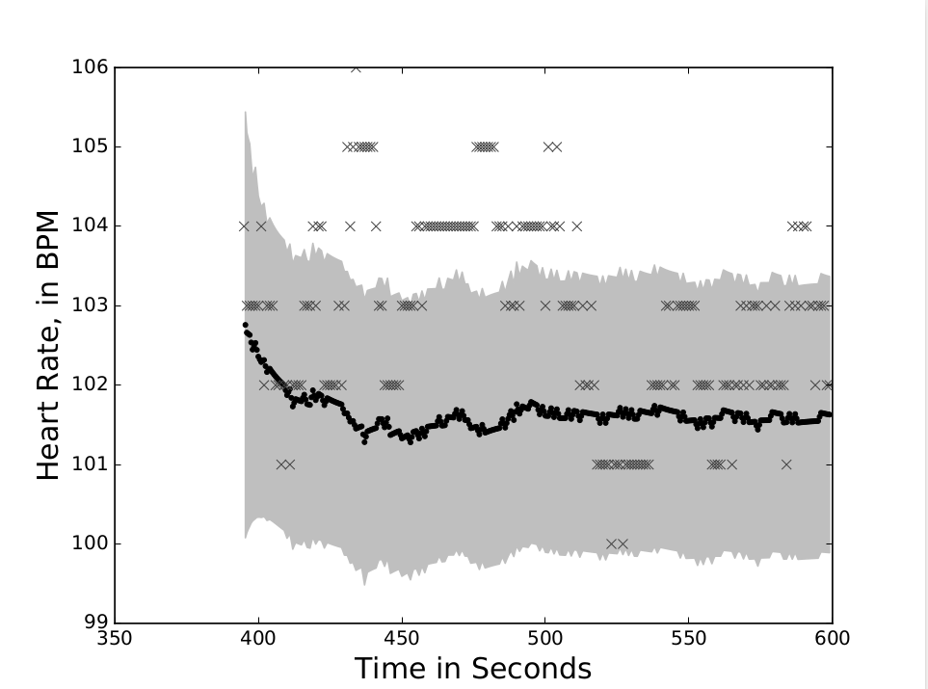
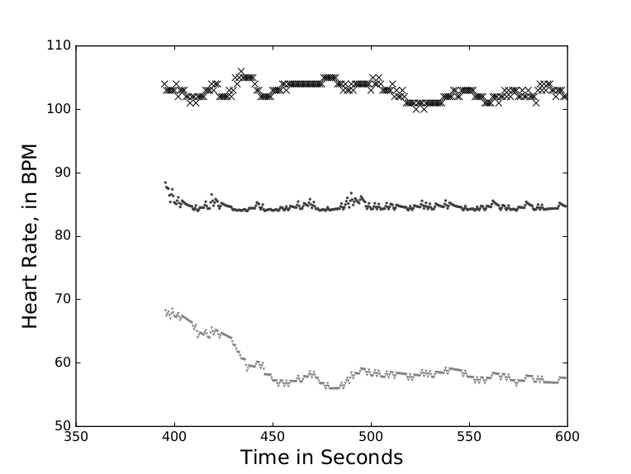
a
b
c
d
b
Notes:
7/15/16
3
3

