Slide 1

FII
FIIa
PC
APC
ATIII
TM
Trigger
Volume
Wound
Vein
Artery
Heart
Kidney
Lungs
Liver
Bulk

Slide 2
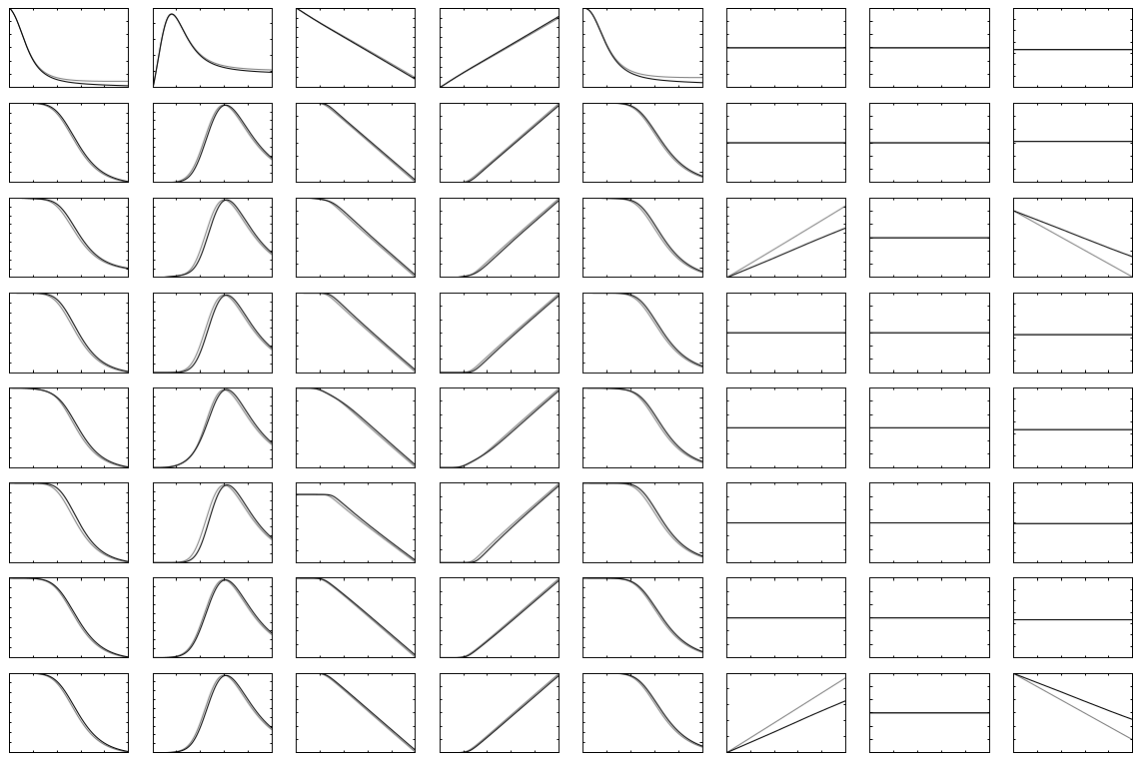
FII
FIIa
PC
APC
ATIII
TM
Trigger
Volume
Wound
Vein
Artery
Heart
Kidney
Lungs
Liver
Bulk

Slide 3
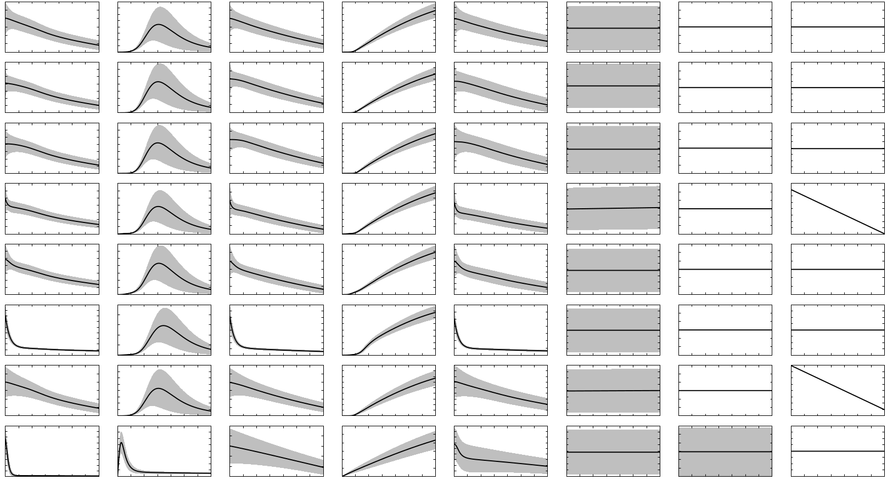
FII
FIIa
PC
APC
ATIII
TM
Trigger
Volume
Vein
Heart
Lungs
Artery
Kidney
Liver
Bulk
Wound

Slide 4
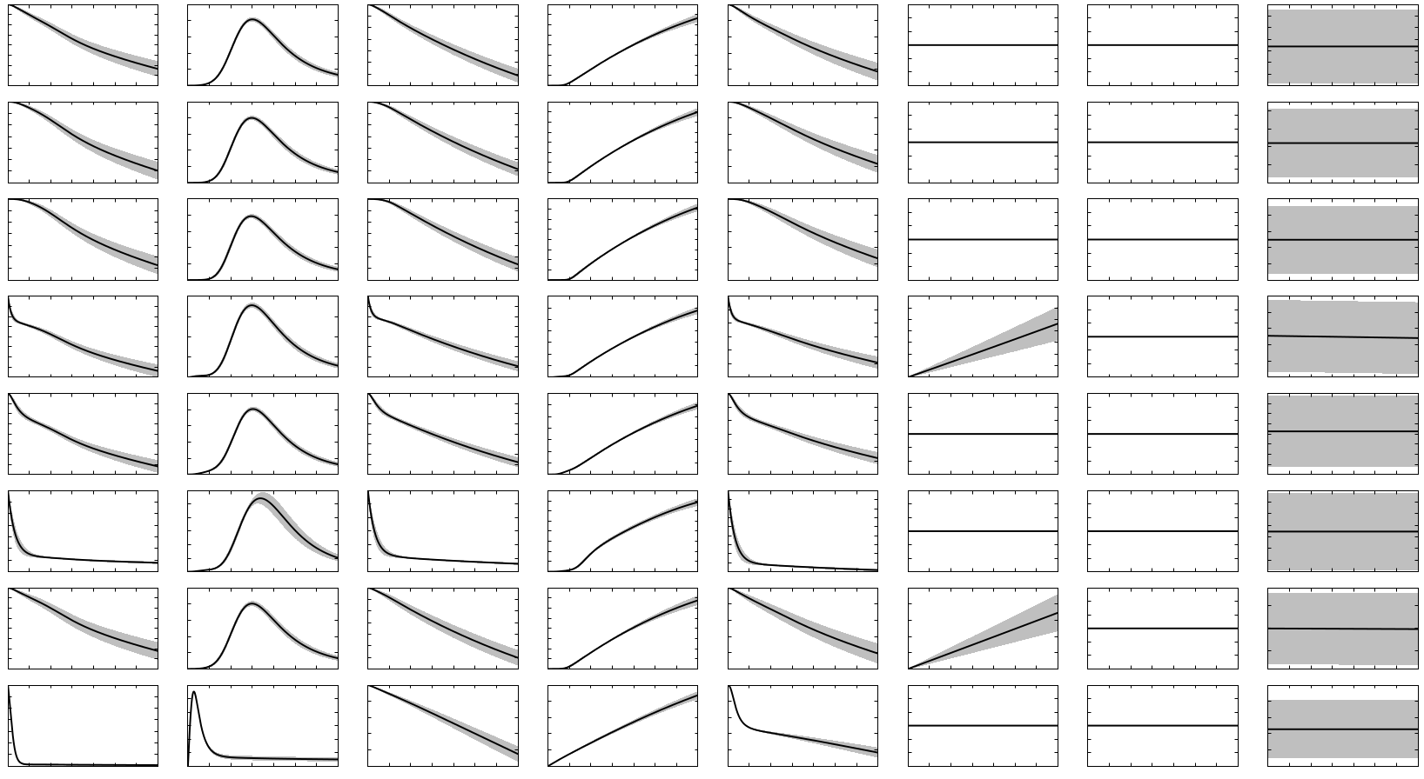
FII
FIIa
PC
APC
ATIII
TM
Trigger
Volume
Vein
Heart
Lungs
Artery
Kidney
Liver
Bulk
Wound

Slide 5
FII
FIIa
PC
APC
ATIII
TM
Trigger
Volume
Wound
Vein
Artery
Heart
Kidney
Lungs
Liver
Bulk

