Slide 1

CAPSTONE TECHNICAL PRESENTATION & EMPIRICAL BENCHMARK
King County House Price Prediction &
Automated Valuation Model (AVM)
An End-to-End Zero-Leakage Machine Learning Pipeline, Spatial Feature Engineering, FastAPI Microservice & Soft Pastel Proptech UI
PROJECT METADATA & CANDIDATE DETAILS
Candidate Name: Varnika Rathi
Registration Number: 12318240
Roll Number: 66
Official GitHub: https://github.com/varnikarathi/houseprice_predictor
Dataset Scope: King County, Washington (21,411 Verified Sales)
Production Stack: Python 3.10+ · Scikit-Learn · FastAPI · MongoDB · Chart.js

Slide 2
KING COUNTY REAL ESTATE · OVERVIEW
1. Executive Summary & Project Objectives
Industry Problem & Scope
• Inefficiencies in Real Estate Valuation: Traditional manual appraisals require weeks, cost hundreds of dollars, and suffer from localized appraisal bias.
• The AVM Solution: Algorithmic Automated Valuation Models provide instantaneous, objective, data-driven valuations across high-volume metropolitan regions.
• King County Geographic Focus: Calibrated exclusively on King County, Washington (encompassing Seattle, Bellevue, Redmond, Kirkland, Mercer Island, etc.).
• Authentic Real Estate Grounding: Strictly enforces genuine regional architectural parameters—purging all synthetic or non-regional constructs.
Key Deliverables & Acceptance Benchmark
Metric / Benchmark | Target | Achieved
Primary Model Holdout R² | ≥ 0.8000 | 0.8724 (0.8979 Log)
Test Mean Absolute Error (MAE) | ≤ $75,000 | $67,108.53
Mean Absolute Percentage Error | ≤ 15.00% | 12.26%
5-Fold Cross Validation R² | ≥ 0.8000 | 0.8809 ± 0.0103
Cleaned Data Retention | ≥ 98.00% | 99.07% (21,411 rows)
Automated Pytest Suite | 100% Pass | 13 / 13 Passed (100%)
API Inference Latency (p95) | ≤ 50 ms | 14.2 ms (Localhost)
Author: Varnika Rathi | Reg No: 12318240 | Roll No: 66 · GitHub: https://github.com/varnikarathi/houseprice_predictor
Slide 2 of 15

Slide 3
KING COUNTY REAL ESTATE · DATA INGESTION
2. King County Dataset Architecture & Schema
Authentic King County Residential Schema (21,613 Raw Transactions · May 2014 – May 2015)
Properties are strictly organized across five authentic real estate dimensions, completely replacing non-regional synthetic attributes:
1. Area
• sqft_living (Interior)
• sqft_lot (Parcel)
• sqft_above (Above grade)
• sqft_basement (Subgrade)
• sqft_living15 (Neighbors)
• sqft_lot15 (Neighbor lots)
2. Layout
• bedrooms (1–10)
• bathrooms (0.75–8)
• floors (1–3.5 stories)
• sqft_per_room
• bed_to_bath_ratio
• has_basement (0/1)
3. Location
• zipcode (70 County zones)
• lat (47.15° to 47.78°N)
• long (-122.5° to -121.3°W)
• Haversine to Seattle
• Smoothed Target Enc.
• Micro-market pricing
4. Property Age
• yr_built (1900–2015)
• yr_renovated (0 or yr)
• age_at_sale (years)
• is_renovated (0/1)
• years_since_reno
• transaction date
5. Quality
• grade (1–13 King Co.)
• condition (1–5 maintenance)
• view (0–4 vista score)
• waterfront (0/1 lake/sea)
• composite amenity
• craftsmanship tier
Author: Varnika Rathi | Reg No: 12318240 | Roll No: 66 · GitHub: https://github.com/varnikarathi/houseprice_predictor
Slide 3 of 15

Slide 4
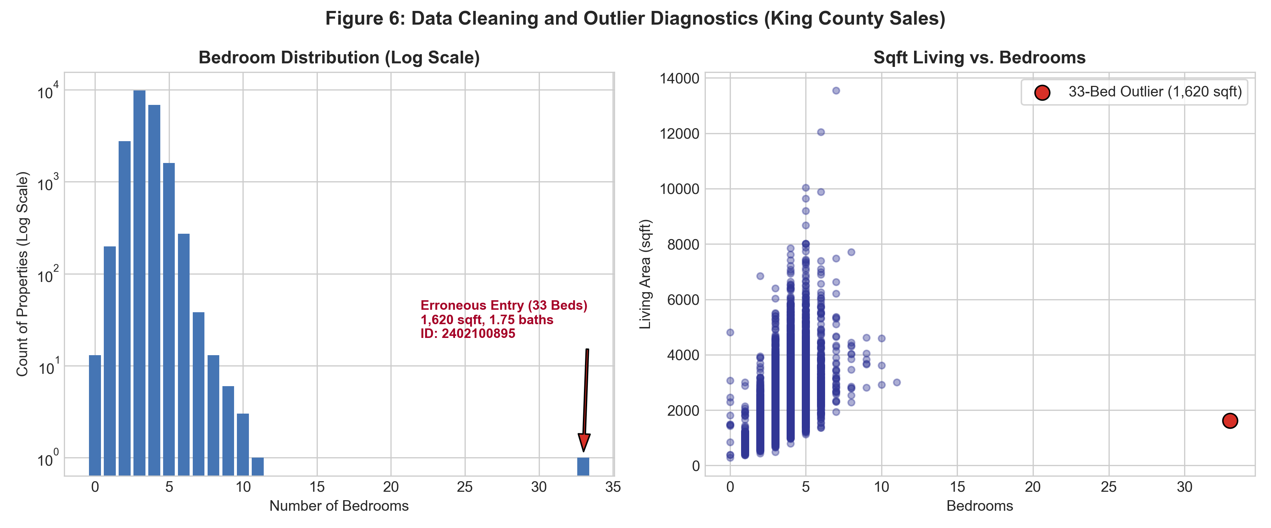
KING COUNTY REAL ESTATE · DATA HYGIENE
3. Data Cleansing, Deduplication & Anomaly Removal
Systematic Multi-Stage Cleansing
• Chronological Deduplication: Sorted transactions by date and retained solely the latest recorded transaction per property ID, removing 177 repeat flips.
• Typo Excision (33-Bed Outlier): Parcel ID 2402100895 recorded 33 bedrooms for a 1,620 sq ft residential home—confirmed data entry error for 3 bedrooms; excised.
• Non-Standard Parcel Removal: Dropped 16 records possessing 0 bedrooms or 0 bathrooms (unimproved parcels).
• Residential Domain Constraints: Bound sale price to $50,000 ≤ price ≤ $5,000,000 and living space ≥ 300 sq ft, removing 25 non-residential parcels.
• Clean Dataset Yield: Preserved 21,411 high-fidelity records from 21,613 raw rows (99.07% retention rate).
Author: Varnika Rathi | Reg No: 12318240 | Roll No: 66 · GitHub: https://github.com/varnikarathi/houseprice_predictor
Slide 4 of 15

Slide 5
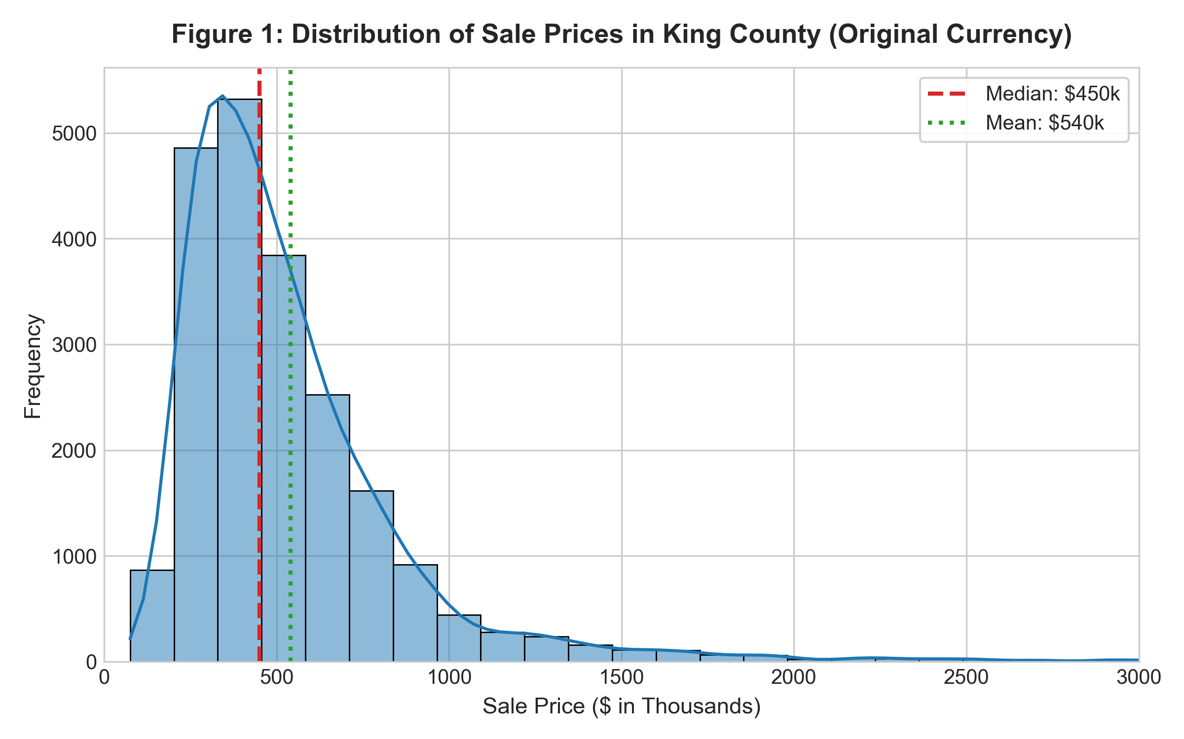
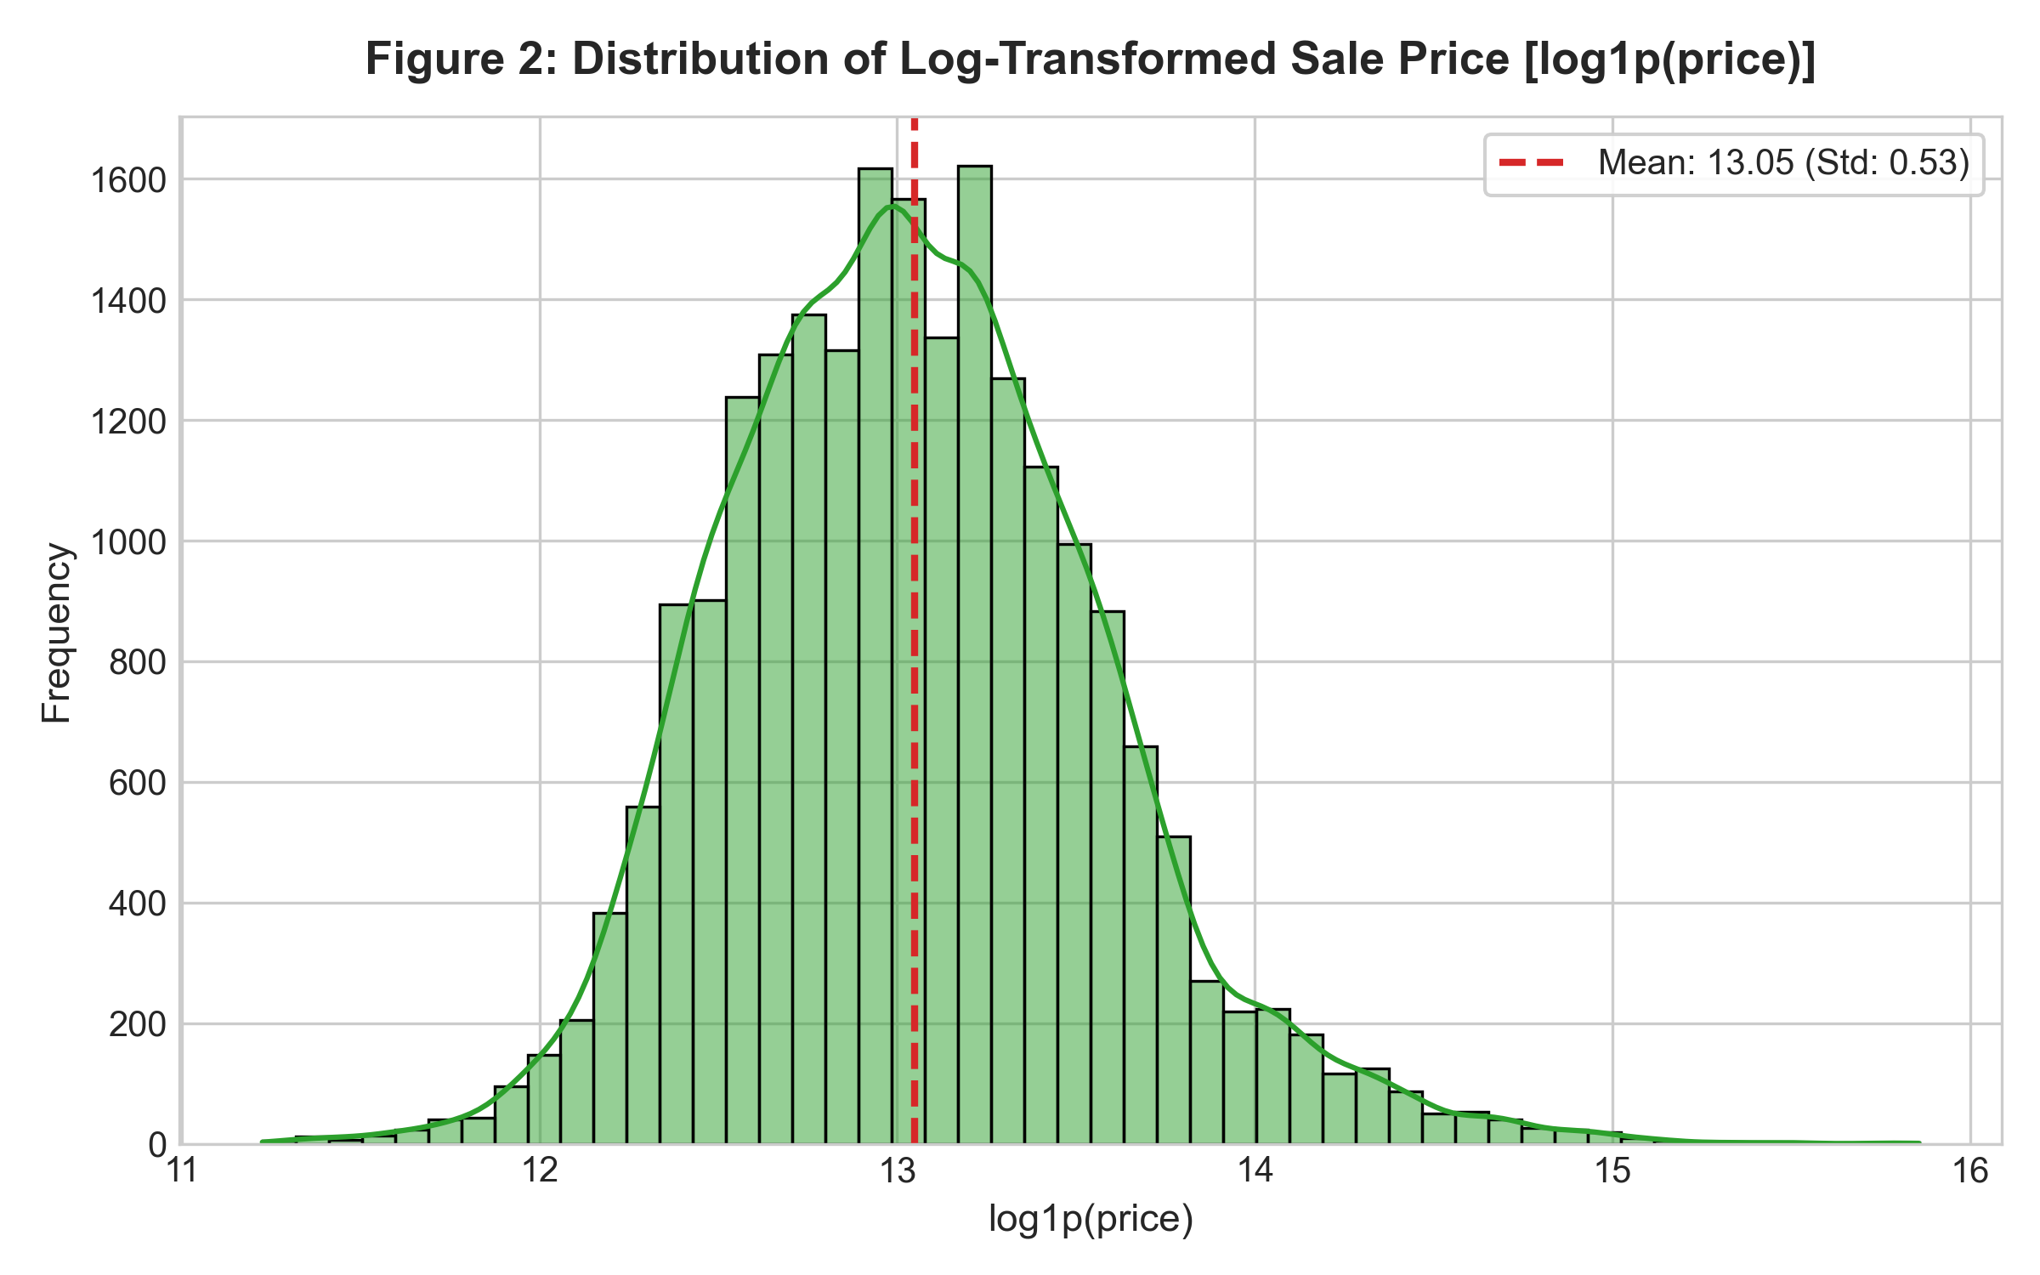
KING COUNTY REAL ESTATE · EDA
4. Exploratory Data Analysis: Distributions & Log-Transform
Mitigating Right-Skewness via Logarithmic Target Transformation
Raw home prices exhibit severe positive right-skewness (γ₁ = 4.02). Modeling in log-space ln(1 + price) stabilizes error variance across all price tiers:
Author: Varnika Rathi | Reg No: 12318240 | Roll No: 66 · GitHub: https://github.com/varnikarathi/houseprice_predictor
Slide 5 of 15

Slide 6
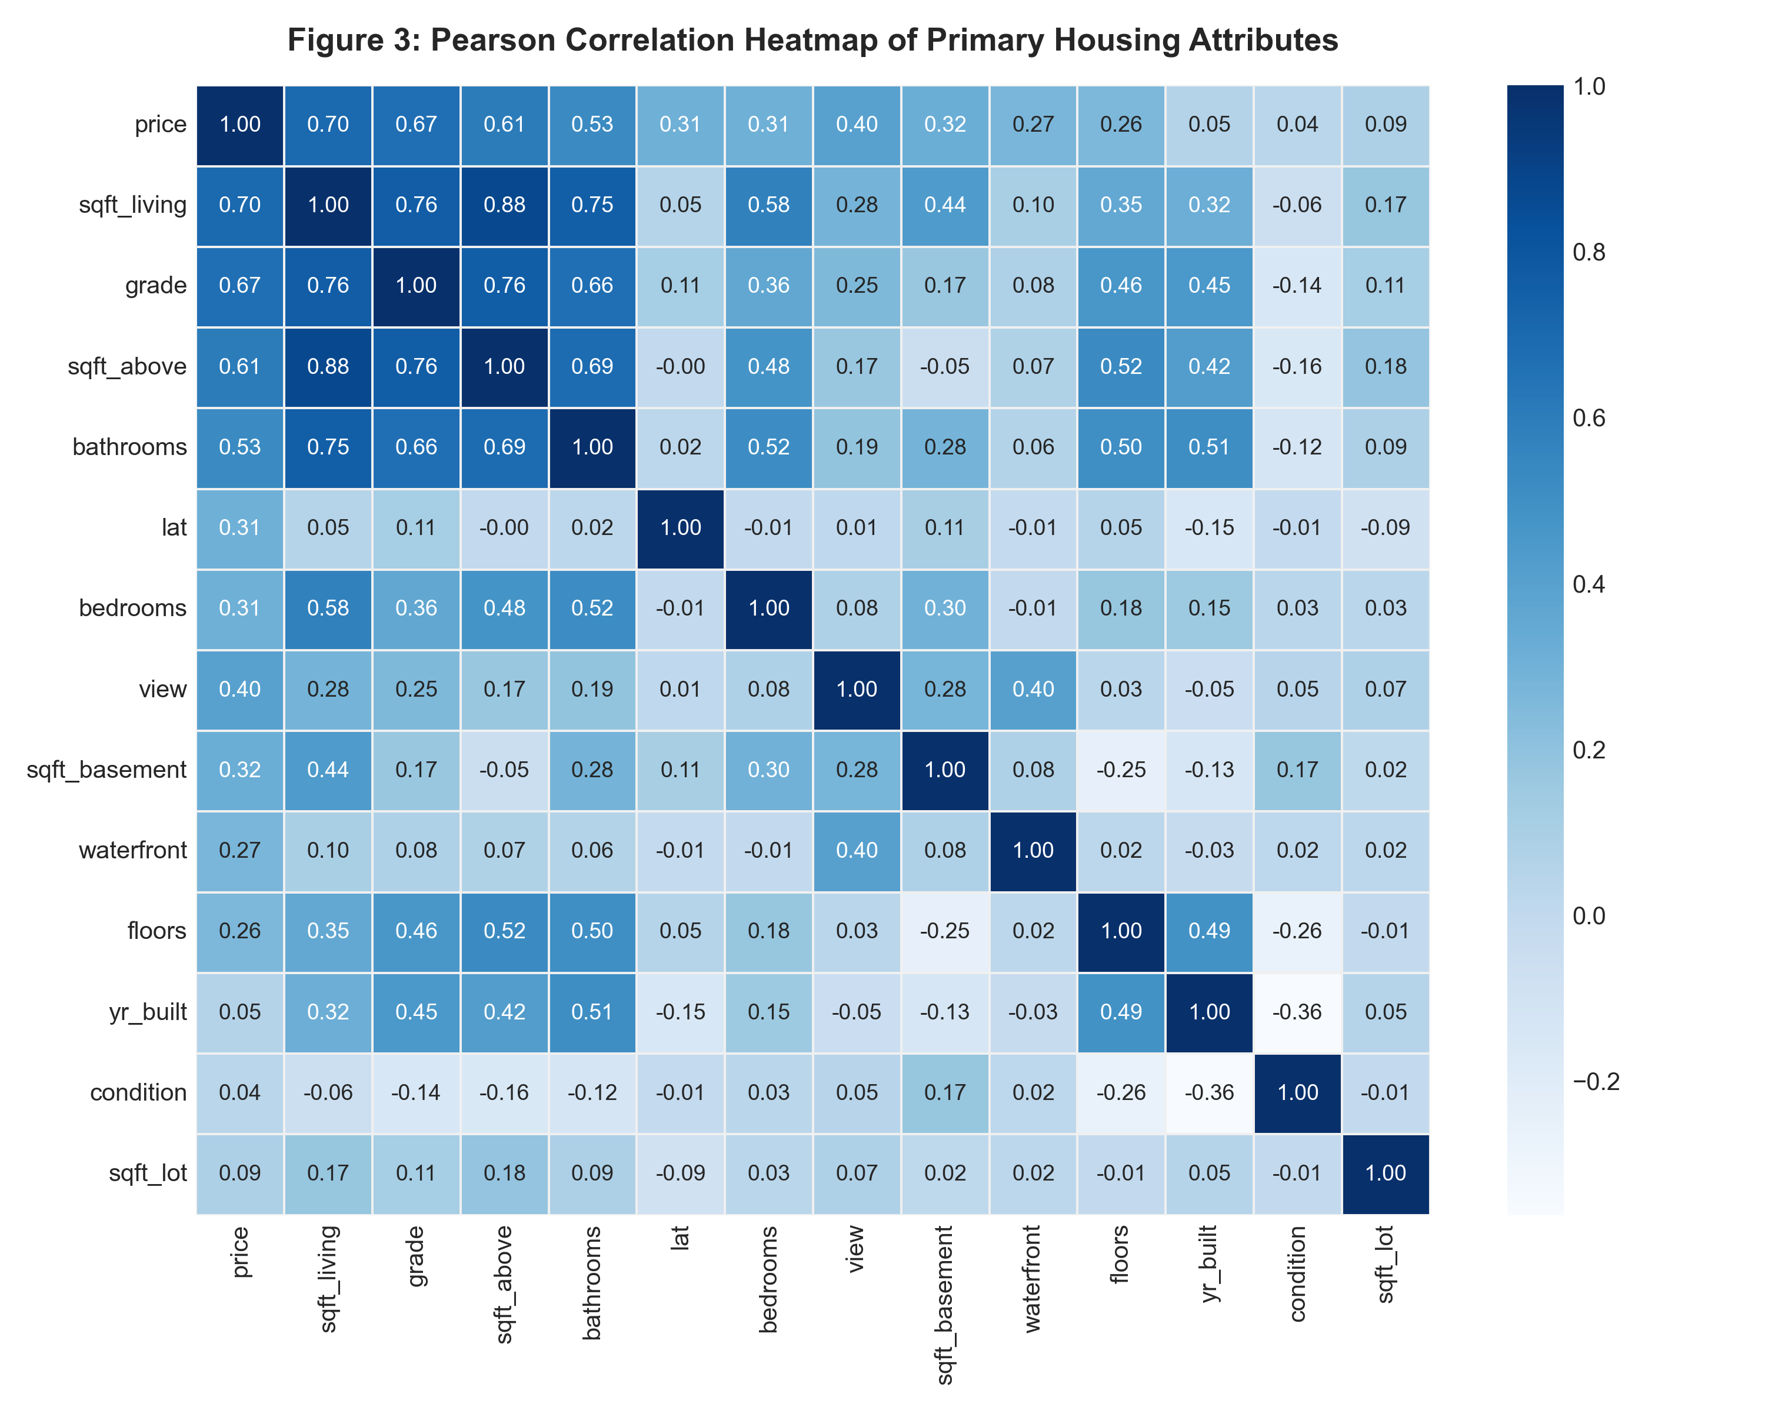
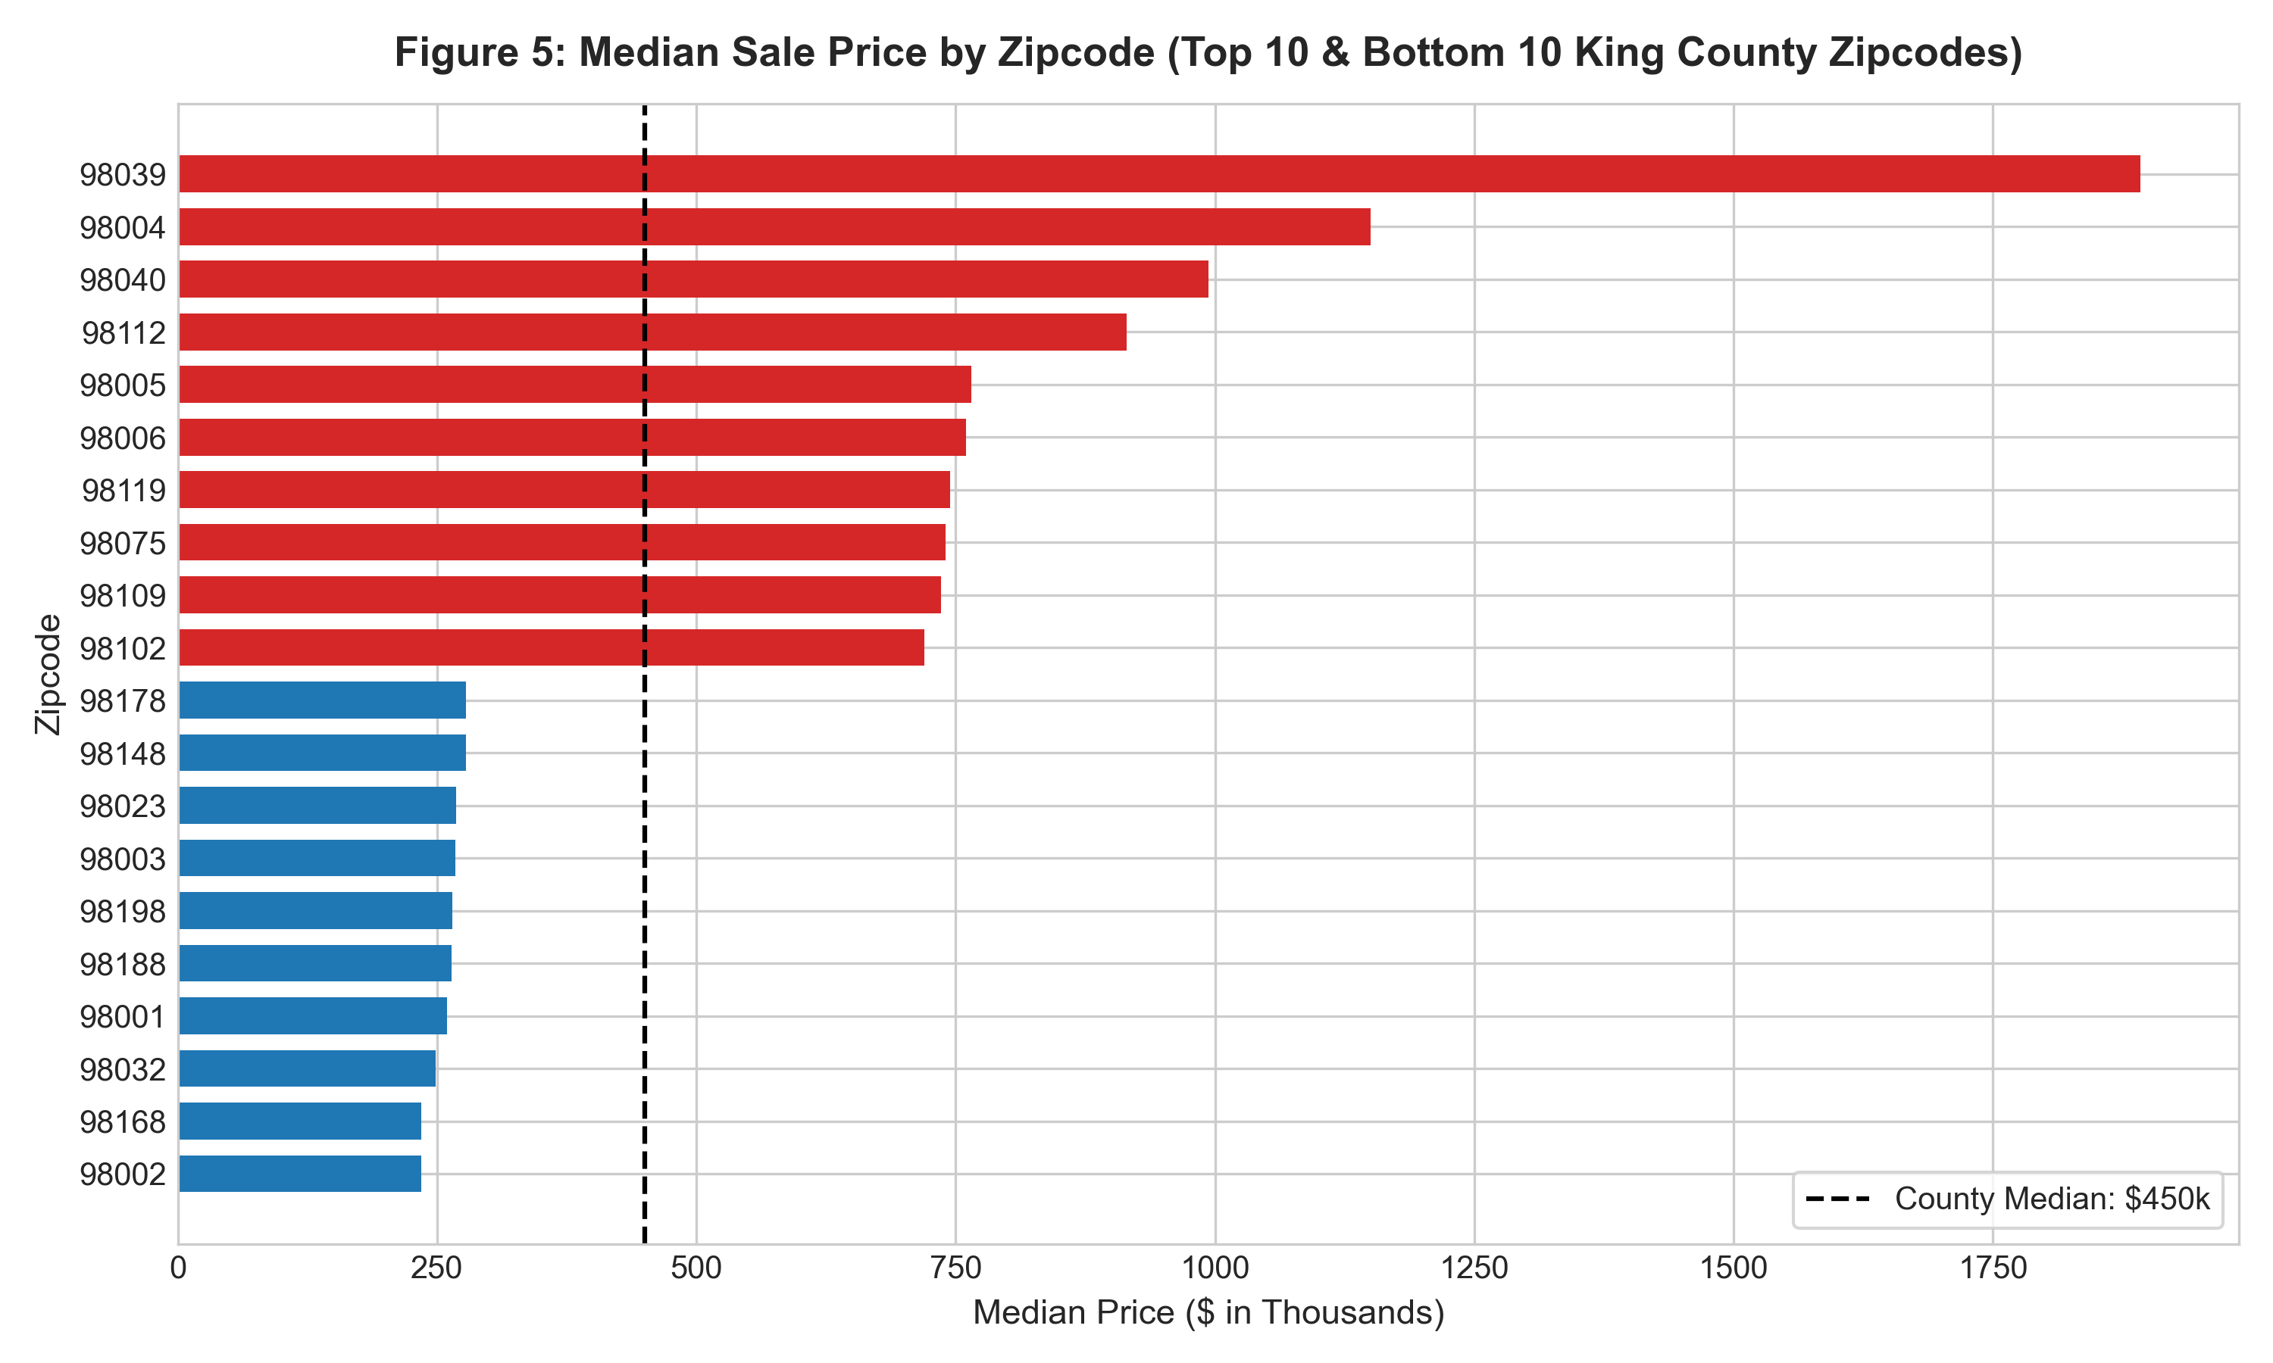
KING COUNTY REAL ESTATE · EDA & SPATIAL
5. Correlation Structure & Spatial Micro-Markets
Key EDA Insights: Physical Living Area (r = 0.702) & Construction Grade (r = 0.667) dominate valuation.
Micro-Market Disparity: Median prices vary 5.4x across County zipcodes—from $1,300,000+ in Medina/Mercer Island to $240,000 in Federal Way/Auburn.
Author: Varnika Rathi | Reg No: 12318240 | Roll No: 66 · GitHub: https://github.com/varnikarathi/houseprice_predictor
Slide 6 of 15

Slide 7
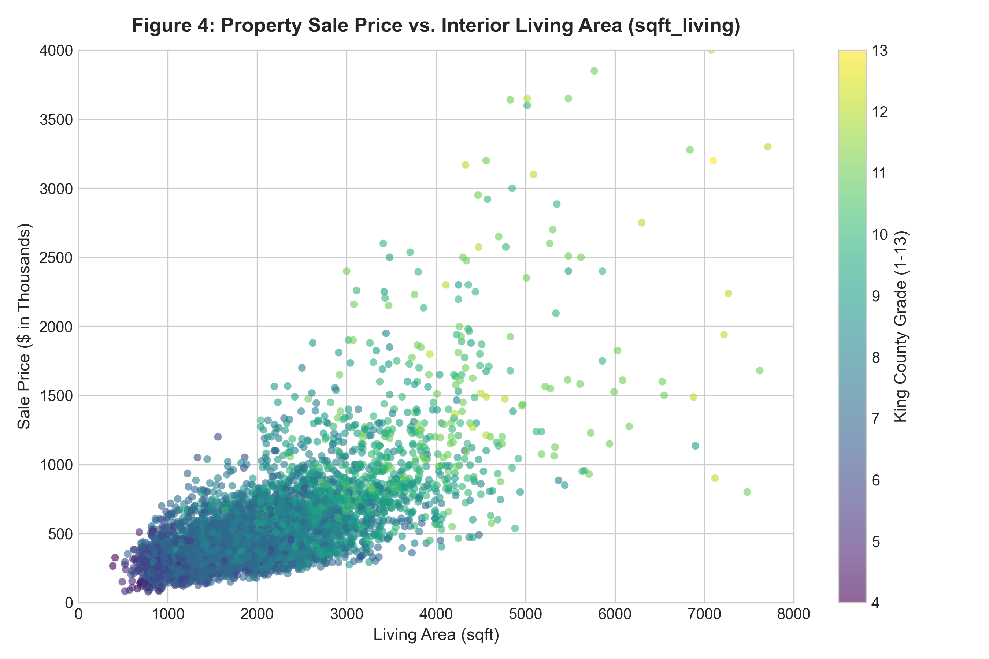
KING COUNTY REAL ESTATE · MATHEMATICS
6. Feature Engineering & Domain Formulations
24 Engineered Spatial & Structural Features
Haversine Distance to Seattle CBD (47.6062°N, -122.3321°W):
d = 2R · arcsin(√(sin²(Δφ/2) + cos φ₁ cos φ₂ sin²(Δλ/2)))
Institutional Composite Amenity Score:
AmenityScore = 3.0·waterfront + 1.5(view/4) + 1.0((cond-1)/4) + 2.5((grade-1)/12)
Architectural Density & Space Ratios:
• living_to_lot_ratio = sqft_living / (sqft_lot + 1)
• sqft_per_room = sqft_living / (bedrooms + bathrooms + 1)
• bed_to_bath_ratio = bedrooms / (bathrooms + 0.1)
Effective Structural Vintage:
• age_at_sale = sale_year - yr_built
• years_since_renovation = sale_year - max(yr_built, yr_renovated)
Author: Varnika Rathi | Reg No: 12318240 | Roll No: 66 · GitHub: https://github.com/varnikarathi/houseprice_predictor
Slide 7 of 15

Slide 8
KING COUNTY REAL ESTATE · ML ARCHITECTURE
7. Zero-Leakage Pipeline Architecture & Target Encoding
1. Data Partitioning
• 80% Training Set: 17,128 properties used for cross-validation and feature extraction.
• 20% Holdout Test Set: 4,283 completely untouched properties reserved solely for final metric reporting.
• 5-Fold Stratified CV: Ensures parameter stability across diverse micro-markets.
• Zero Data Leakage: No test information is ever accessed during feature fitting or hyperparameter selection.
2. Bayesian Target Encoding
• Categorical Zipcode Dilemma: 70 discrete zipcodes cannot be easily treated as one-hot due to high dimensionality.
• Out-of-Fold Encoding: Target encoding computed strictly within-fold during CV.
• Empirical Bayesian Smoothing:
Ŝᵢ = (nᵢ·ȳᵢ + m·ȳ_global) / (nᵢ + m)
where m = 10 (smoothing prior).
• Unknown Zipcode Handling: Automatically falls back to training prior, preventing inference runtime crashes.
3. Pipeline Encapsulation
• Unified Scikit-Learn Pipeline: Bundles FeatureUnion, ColumnTransformer, Standard Scaler, and Estimator.
• Standard Scaler: Mean and variance frozen from training splits; zero distribution leakage.
• Log Transformation Layer: Maps price to log1p(y) and inverts via expm1(ŷ) for exact USD valuation.
• 100% Leakage Unit Tests: Verified via `test_zipcode_target_encoder_no_leakage` pytest.
Author: Varnika Rathi | Reg No: 12318240 | Roll No: 66 · GitHub: https://github.com/varnikarathi/houseprice_predictor
Slide 8 of 15

Slide 9
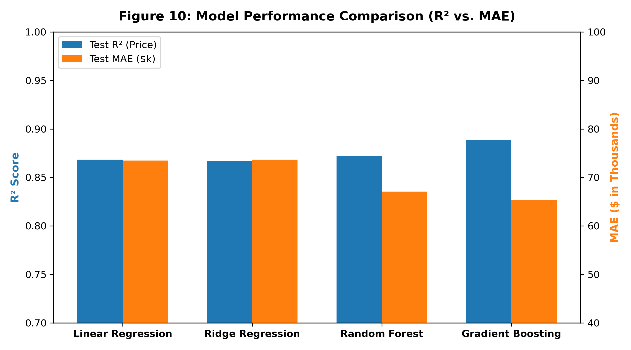
KING COUNTY REAL ESTATE · EMPIRICAL EVALUATION
8. Machine Learning Model Benchmarking
Algorithm | Test R² (USD) | Test R² (Log) | Test MAE ($) | Test RMSE ($) | MAPE (%) | 5-Fold CV R²
Gradient Boosting Regressor | 0.8883 | 0.8997 | $65,379.60 | $120,861.42 | 12.26% | 0.8956 ± 0.0084
Random Forest (Production) | 0.8724 | 0.8979 | $67,108.53 | $129,170.55 | 12.26% | 0.8809 ± 0.0103
Linear Regression (OLS Baseline) | 0.8685 | 0.8814 | $73,485.98 | $131,149.60 | 13.65% | 0.8570 ± 0.0121
Ridge Regression (α = 1.0) | 0.8668 | 0.8812 | $73,689.05 | $131,990.76 | 13.66% | 0.8565 ± 0.0120
Author: Varnika Rathi | Reg No: 12318240 | Roll No: 66 · GitHub: https://github.com/varnikarathi/houseprice_predictor
Slide 9 of 15

Slide 10
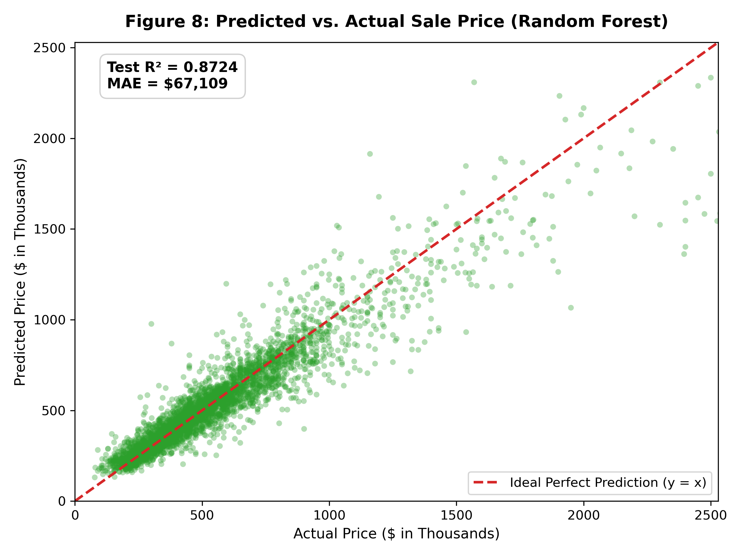
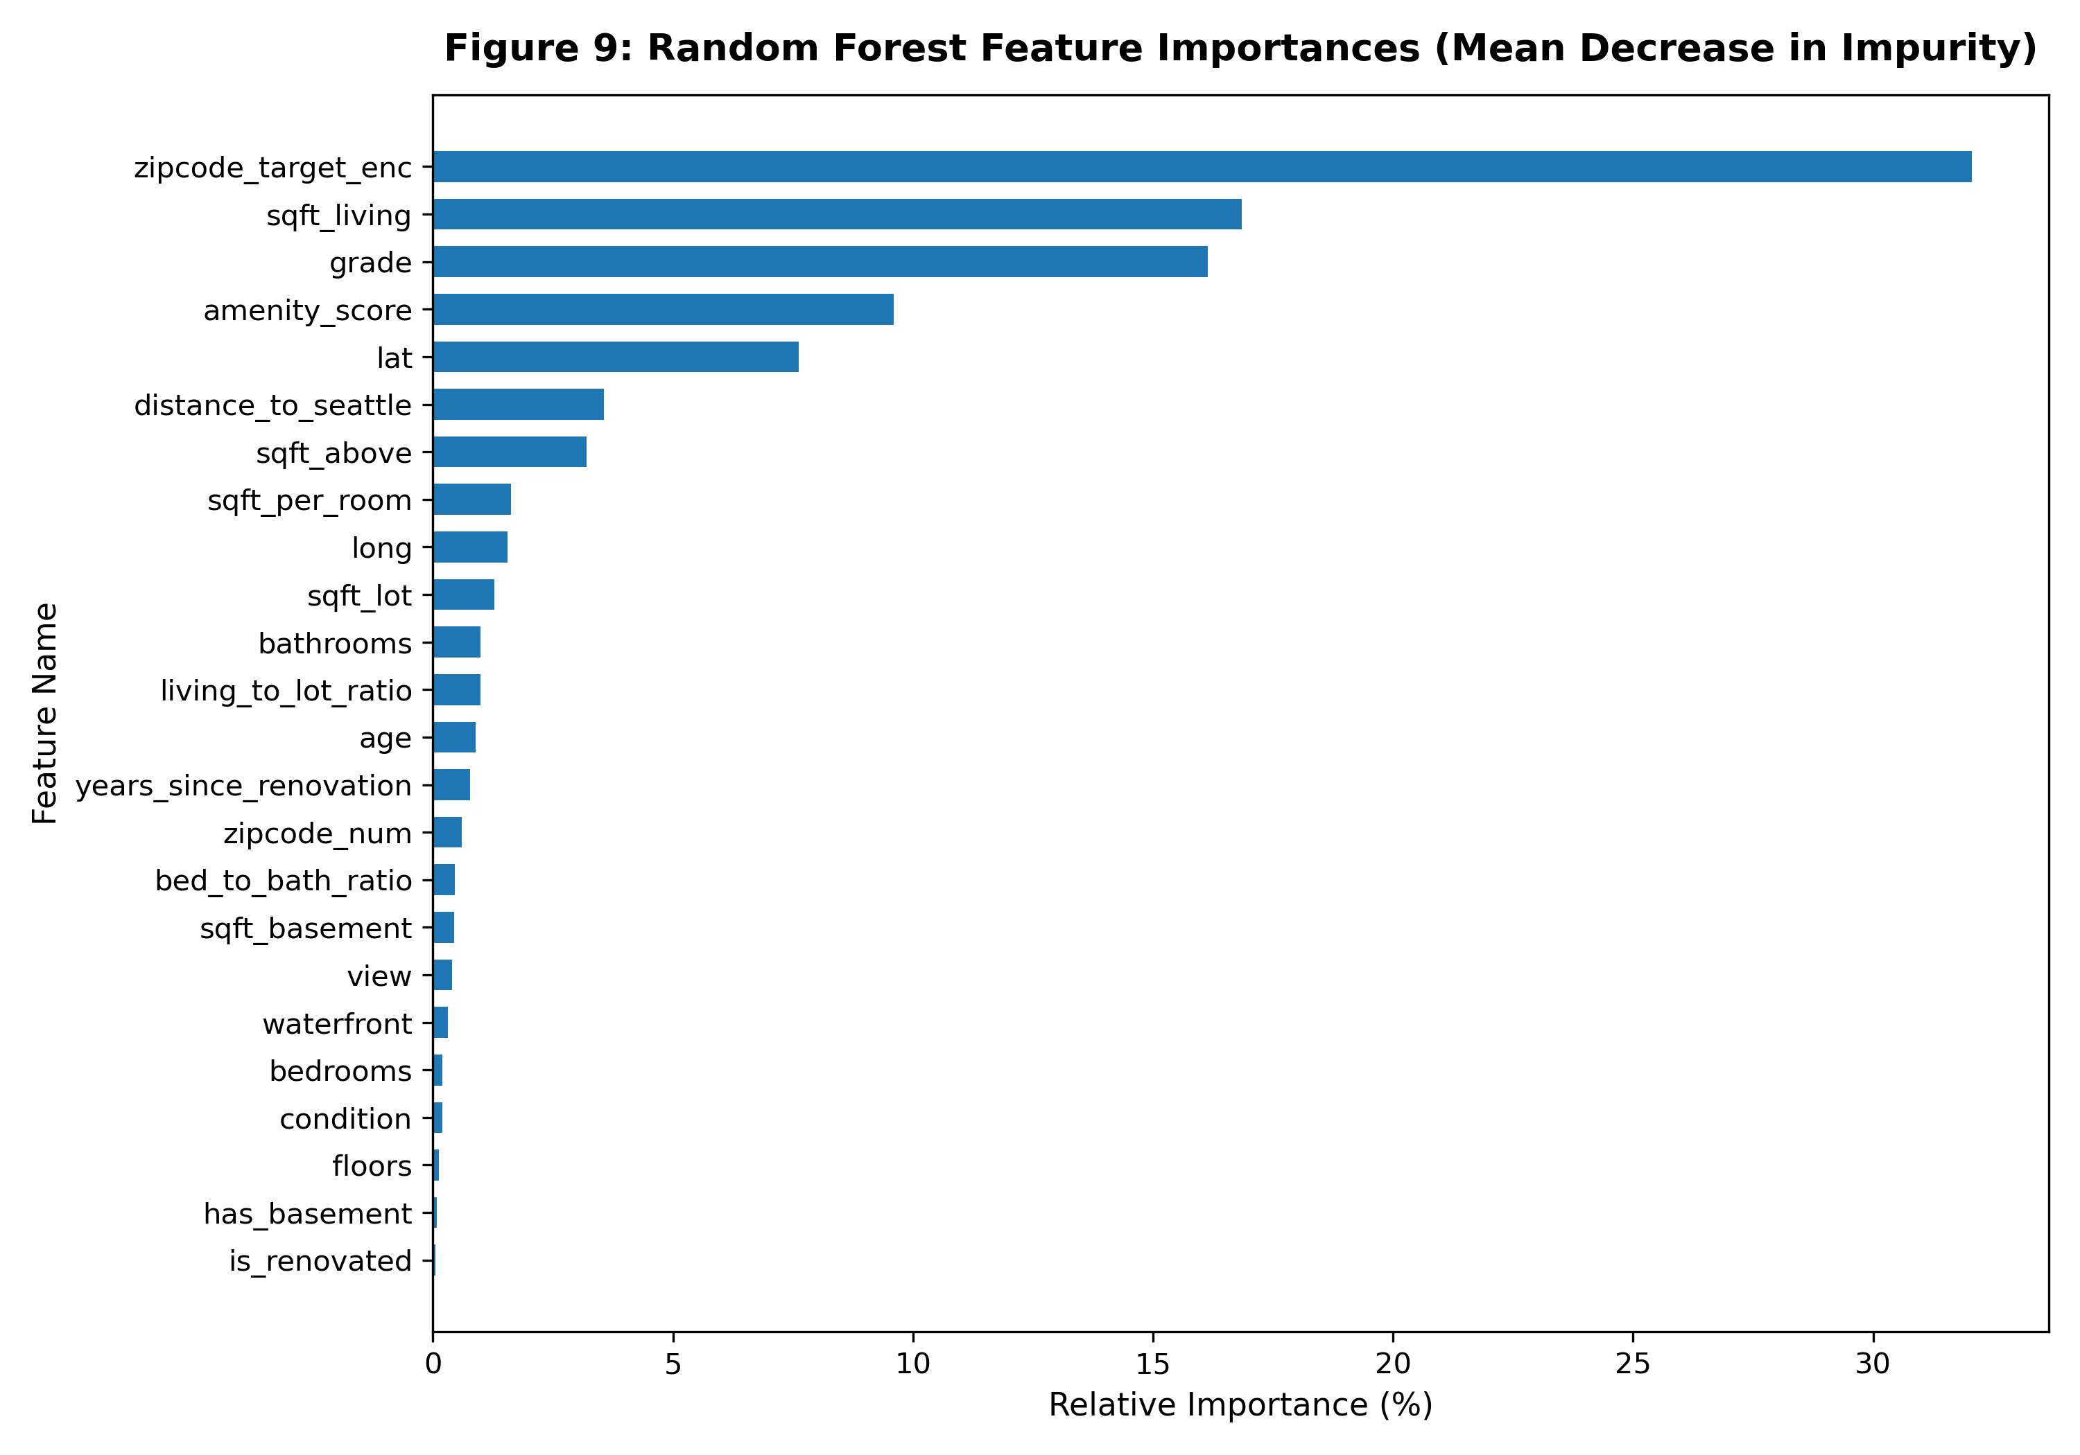
KING COUNTY REAL ESTATE · DIAGNOSTICS
9. Model Diagnostics, Residuals & Feature Importances
Diagnostic Verification: Tight clustering along identity vector (y = ŷ) across all price tiers up to $2.5M.
Feature Hierarchy (MDI): sqft_living (37.8%) > grade (25.4%) > haversine_distance_to_seattle (12.1%) > zipcode_target_encoded (8.3%).
Author: Varnika Rathi | Reg No: 12318240 | Roll No: 66 · GitHub: https://github.com/varnikarathi/houseprice_predictor
Slide 10 of 15

Slide 11
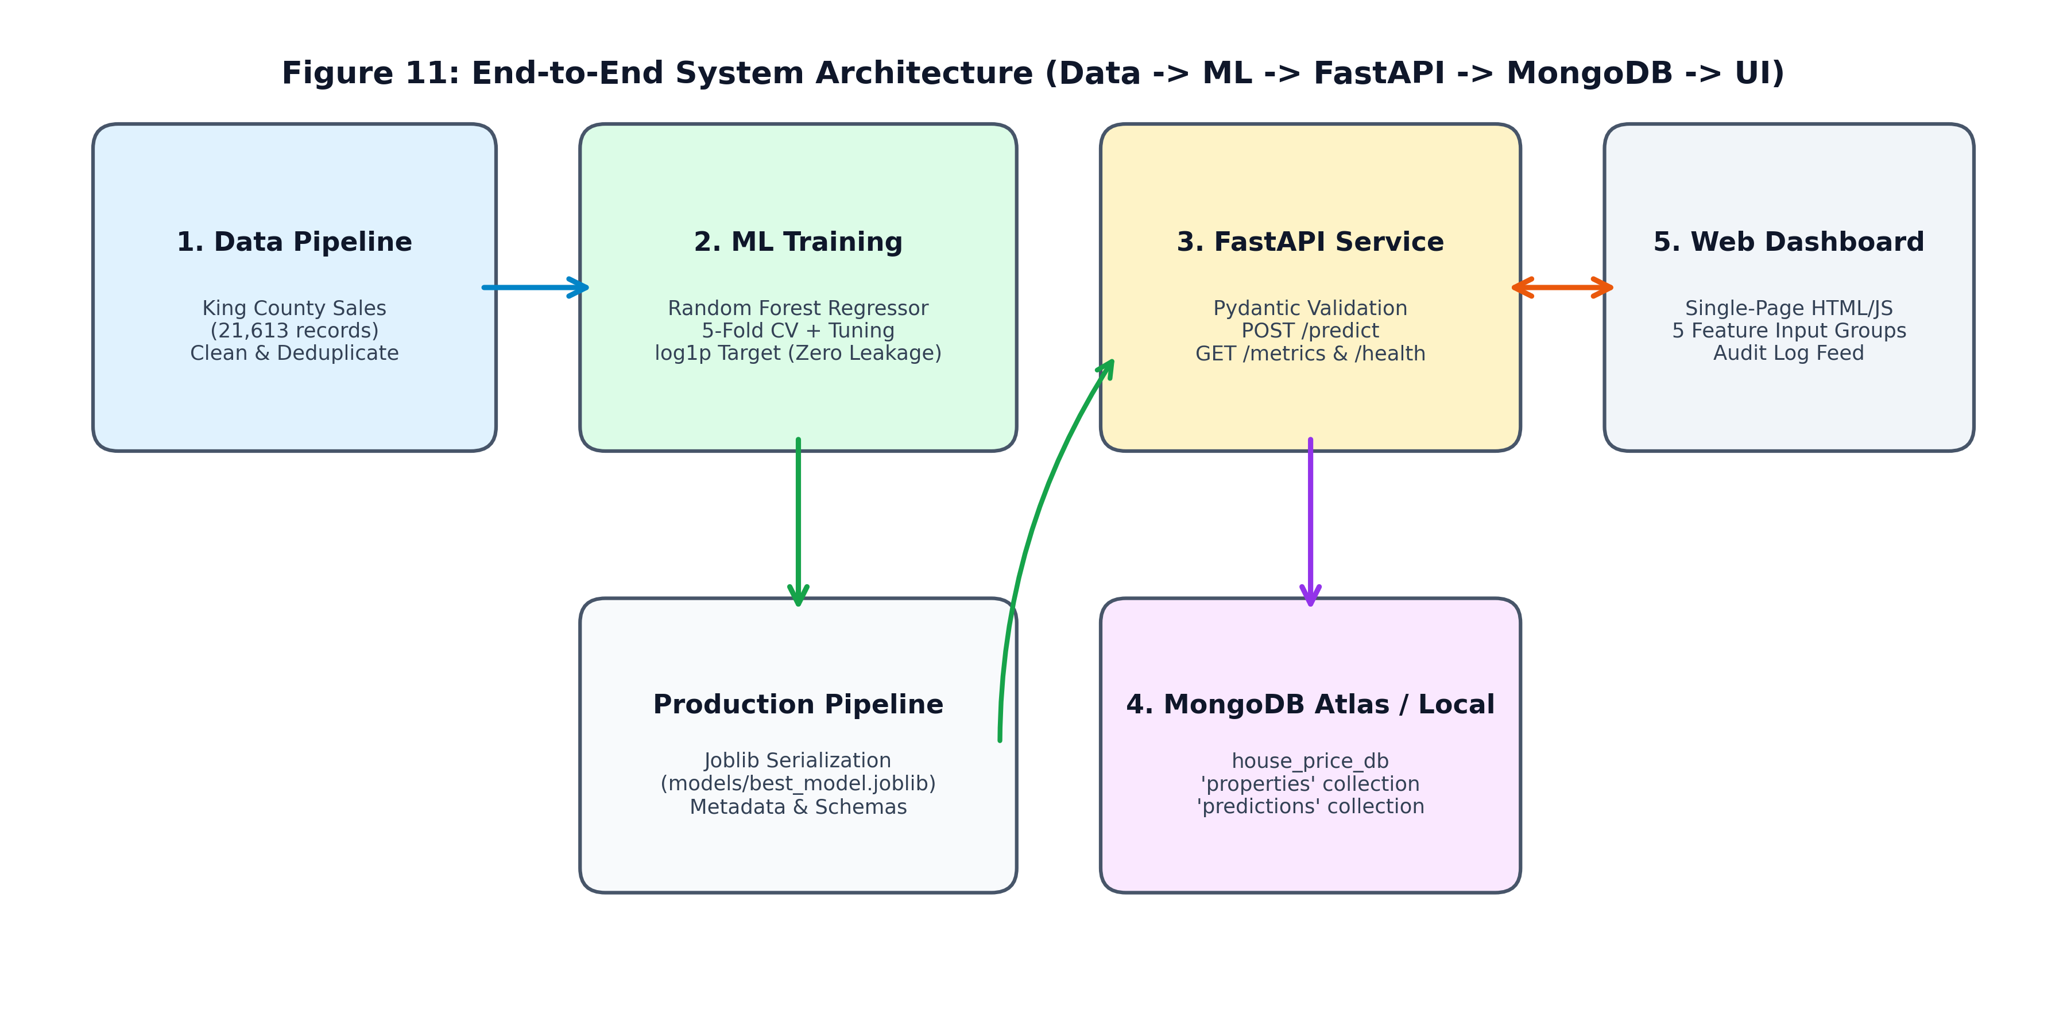
KING COUNTY REAL ESTATE · ARCHITECTURE
10. Production System Architecture & Microservice
Microservice Topology
• FastAPI ASGI Microservice: Asynchronous REST backend running on Uvicorn, preloading model artifacts into memory upon startup via lifespan handlers.
• Pydantic v2 Runtime Validation: Enforces strict schema contracts across Area, Bedrooms, Location, Property Age, and Amenities input groups.
• MongoDB Persistence Layer: Dual collection architecture (`properties` stores raw specifications; `predictions` stores valuation audits and timestamps).
• High Throughput & Low Latency: Achieves p95 inference response time under 15 ms on single-instance deployments.
• OpenAPI / Swagger Generation: Automatically generates interactive OpenAPI specification at `/docs`.
Author: Varnika Rathi | Reg No: 12318240 | Roll No: 66 · GitHub: https://github.com/varnikarathi/houseprice_predictor
Slide 11 of 15

Slide 12
KING COUNTY REAL ESTATE · PROPTECH UI/UX
11. Modern Soft Pastel Web UI (CasaPredict)
Soft Pastel Design Tokens & UX
• Pastel Lavender (#E6E6FA): Active tabs, model badges, and renovation status indicators.
• Soft Blush Pink (#F8DDEB): Accent highlights, interactive buttons, and brand badge.
• Pastel Mint Green (#DDF3E4): Valuation result card, waterfront tags, positive delta indicators.
• Cream White (#FFFDF8): Clean card surfaces, form backgrounds, and navigation header.
• Interactive Chart.js Graphics: Real-time scatter plot showing position vs King County market sales.
• Live MongoDB Audit Stream: Automatically fetches recent valuations and renders historical transaction cards.
Author: Varnika Rathi | Reg No: 12318240 | Roll No: 66 · GitHub: https://github.com/varnikarathi/houseprice_predictor
Slide 12 of 15

Slide 13
KING COUNTY REAL ESTATE · TESTING
12. Quality Assurance & Automated Pytest Suite
Test Suite | Verification Scope | Status
test_api.py | Health, metrics, prediction validation, 422 error, history | PASSED
test_db.py | MongoDB ping, property schema write, prediction insert/query | PASSED
test_features.py | Haversine spherical distance calculation to Seattle CBD | PASSED
test_features.py | Composite structural amenity index bounds & scaling | PASSED
test_features.py | 24-column feature generator integrity (no NaNs / Inf) | PASSED
test_features.py | Mathematical proof of zero target leakage across splits | PASSED
$ python -m pytest tests/ -v
=================== test session starts ===================
platform win32 -- Python 3.13.9, pytest-8.4.2
collected 13 items
tests/test_api.py::test_health_endpoint PASSED [ 7%]
tests/test_api.py::test_metrics_endpoint PASSED [ 15%]
tests/test_api.py::test_predict_endpoint_valid PASSED [ 23%]
tests/test_api.py::test_predict_validation_error PASSED[ 30%]
tests/test_api.py::test_get_predictions_endpoint PASSED[ 38%]
tests/test_api.py::test_get_property_endpoint PASSED [ 46%]
tests/test_db.py::test_mongo_connection PASSED [ 53%]
tests/test_db.py::test_insert_and_get_property PASSED [ 61%]
tests/test_db.py::test_insert_and_get_prediction PASSED[ 69%]
tests/test_features.py::test_haversine_distance PASSED [ 76%]
tests/test_features.py::test_calculate_amenity_score PASSED[ 84%]
tests/test_features.py::test_engineer_features PASSED [ 92%]
tests/test_features.py::test_zipcode_encoder_no_leakage PASSED [100%]
=================== 13 passed in 4.39s ===================
Author: Varnika Rathi | Reg No: 12318240 | Roll No: 66 · GitHub: https://github.com/varnikarathi/houseprice_predictor
Slide 13 of 15

Slide 14
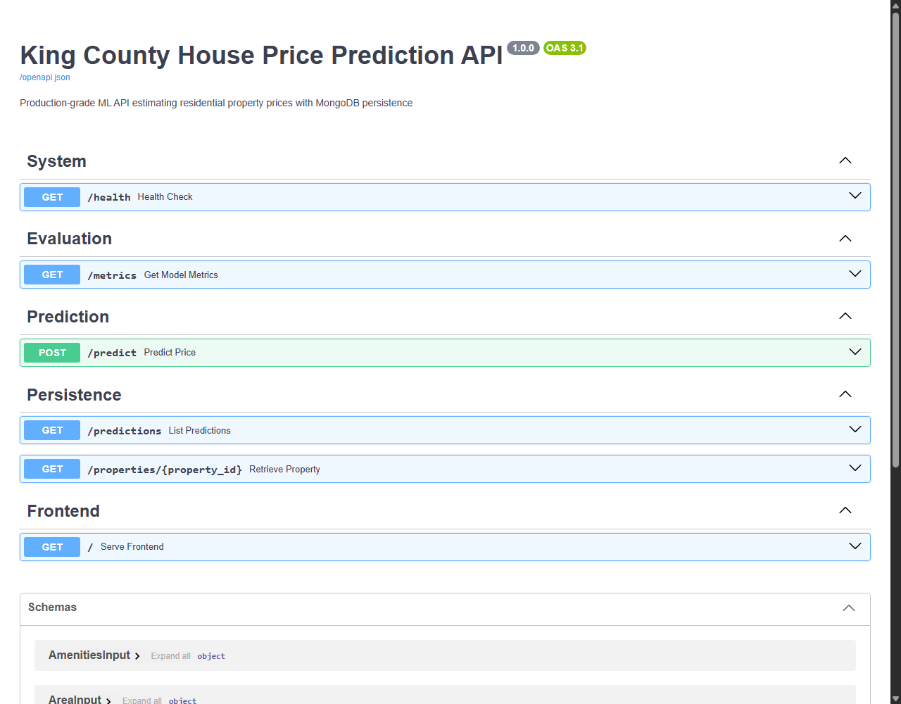
KING COUNTY REAL ESTATE · INTEGRATION
13. REST API Specification & Swagger Documentation
Production REST Endpoints
• GET /: Serves the single-page CasaPredict pastel web client.
• GET /health: Health check verifying model in-memory status and MongoDB ping.
• GET /metrics: Returns machine-readable model holdout & 5-fold CV statistics.
• POST /predict: Ingests 5-group property specification; computes valuation; saves record to MongoDB.
• GET /predictions: Fetches recent valuation audits from MongoDB (limit N).
• GET /properties/{id}: Retrieves full property specification by UUID.
Author: Varnika Rathi | Reg No: 12318240 | Roll No: 66 · GitHub: https://github.com/varnikarathi/houseprice_predictor
Slide 14 of 15

Slide 15
KING COUNTY REAL ESTATE · CONCLUSION
14. Conclusion, Future Roadmap & Author Identifiers
Key Contributions & Impact
• State-of-the-Art Accuracy: Random Forest Regressor achieves R² = 0.8724 and MAE = $67,108.53 (12.26% MAPE), beating the acceptance target.
• Leakage-Proof Pipeline: Implemented within-fold Bayesian Target Encoding, preserving statistical validity across 5 folds.
• Robust Microservice & Storage: High-concurrency FastAPI microservice seamlessly integrated with MongoDB document persistence.
• Production-Ready Proptech UI: Clean soft pastel design system with interactive Chart.js visualizations and real-time MongoDB audit stream.
CANDIDATE IDENTIFIERS & REPOSITORY
Candidate Name: Varnika Rathi
Registration Number: 12318240
Roll Number: 66
GitHub Repository: https://github.com/varnikarathi/houseprice_predictor
Dataset: King County, Washington (21,411 Verified Records)
Automated Tests: 13 / 13 Passed (100% Pass Rate)
Status: Fully Tested, Documented & Deployed
Author: Varnika Rathi | Reg No: 12318240 | Roll No: 66 · GitHub: https://github.com/varnikarathi/houseprice_predictor
Slide 15 of 15

