Slide 1
1. The problem: stuffy rooms, no data
Crowded classrooms and labs run for hours with unknown ventilation quality
Staff find out from complaints, not evidence
No room-level data to decide where to fix first
New monitoring must not create privacy or security risks
Our idea
Low-cost, room-level air-quality monitoring (CO2, PM2.5, temperature, humidity), designed and tested in simulation first.
Simulated data only | 1 / 6
Notes:
Audience: college administration and student innovation teams. Choose air quality because it is useful and low privacy risk, unlike attendance tracking.

Slide 2
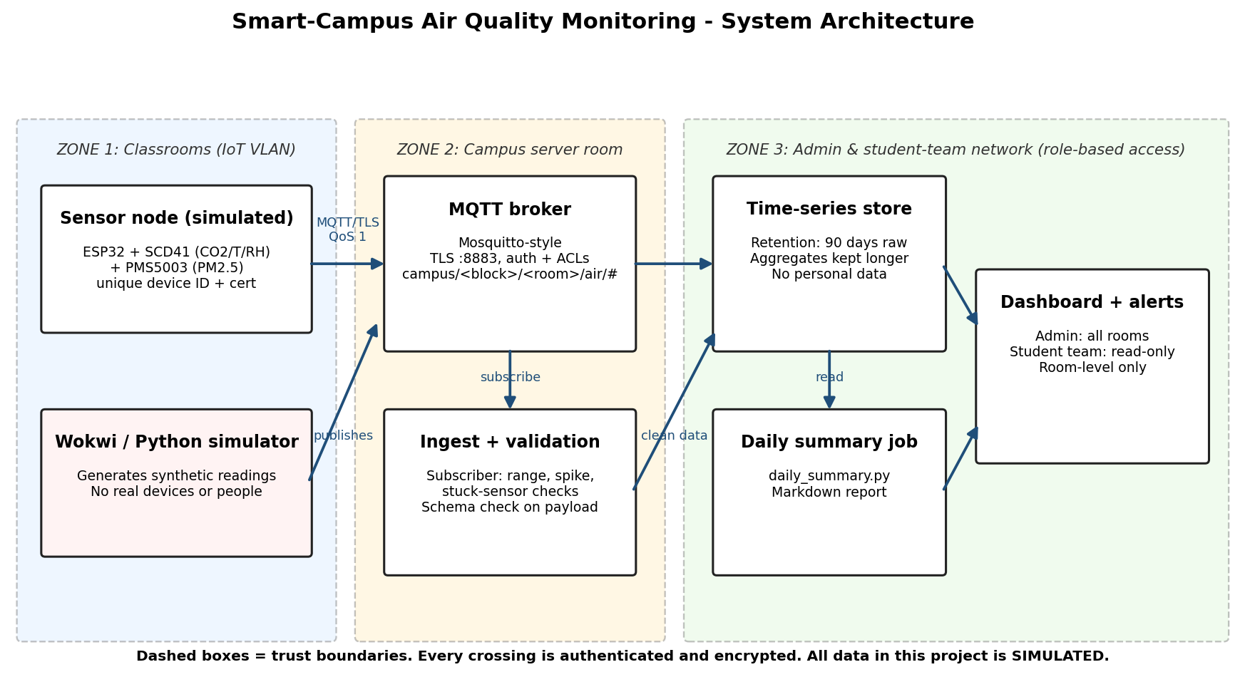
2. Solution: simple, secure architecture
ESP32 sensors publish via MQTT over TLS (port 8883)
Broker: authentication + per-topic ACLs
Ingest validates every reading
Daily summary tells staff what to fix
No hardware needed to prototype: Python (and Wokwi) simulate the sensors.
Simulated data only | 2 / 6

Slide 3
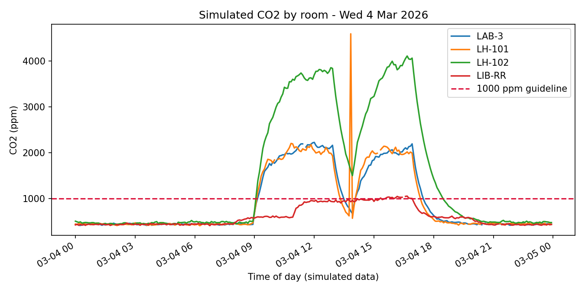
3. Simulated results: where to act first
7 days, 4 rooms, 8,064 readings
LH-102 (simulated poor ventilation) above 1000 ppm for ~99% of class hours
Library mostly under the line
Validation caught spikes, a stuck sensor and missing data
Results show the pipeline works. Room values are simulation assumptions, not measurements.
Simulated data only | 3 / 6

Slide 4
4. Security and privacy by design
Risk (OWASP IoT 2018) | Our control
I1 Weak/hardcoded passwords | Unique credential per device
I7 Insecure data transfer | TLS on 8883, plain port off
I3 Ecosystem interfaces | Topic ACLs, role-based dashboard
I4 No secure updates | Signed firmware, inventory
I6 Privacy | Room-level only, 90-day retention, data notice
Ethics: simulated data only, no cameras or person tracking, no testing on live devices.
Simulated data only | 4 / 6

Slide 5
5. Impact and rollout path
Simulate
Done: model, charts, risk table
Review
Admin + IT approve privacy notice
Pilot
2 rooms, owned devices, written permission
Scale
Decide using pilot data
Success measures: % class hours above 1000 ppm, time to fix, data quality rate, zero privacy complaints. Cost estimate to be added after vendor price check.
Simulated data only | 5 / 6

Slide 6
6. The ask and next steps
Approve a simulated-to-pilot plan for two rooms
Assign a faculty and IT contact for privacy and network review
Student innovation team builds on the open simulator and checklist
Re-verify sources and thresholds before any real deployment
Better air data, fewer complaints, and a safe playground for student innovation.
Simulated data only | 6 / 6

