Slide 1
A PRESENTATION
ON
COMPLAIN MANAGEMENT SYSTEM
Presentation by:
APOORV PANDEY
B.Tech (CSE)
BBDEC,Lucknow

Slide 2
Project Profile
Project Definition
Complaint Management System provides services for
arrived Complaint of people to municipality.
People can knows the currently processing status of their
Complaints.
All the complaints arrived from people are distributed
to the different departments according to Complaint
category.
Administrator can see all Complaints and Individual
Department Complaints.

Slide 3
Software Requirement:
Operating System : Windows 2007 or later version
System Tools : Php With
: MS SQL Server 2005 (Back end)

Slide 4
System Analysis
  About Existing System
Person must goes to municipality for his complaints.
All the arrived Complaints are submit to the Administrator.
Administrator distribute complaints among different
departments according to complaint type.
Employees solve the complaints and note the complaint
status in books manually.
Dispatch officer check the books and reply the solved complaints.
Inquiry officer gives the current status information of complaints
from the books.

Slide 5
  Limitations Of Existing System
No quick data searching facility for useful Information
Employees manually search data about complaints, which
they required to process or in the case of inquiry reply.
No proper management of information
Data and useful application details are capped in physical file, which
itself are stored in data/record room. Record has most of file of
different department.
Redundancy in data
There are possible to one complaint checked by one or more
employee and same status reported by them. So there is
possibility to data redundancy.
Conti…

Slide 6
  Possibility of loss complaint Record
  All complaints handled manually. So, there is possibility to loss of complaints record because of transferring Complaints record betweens different physical levels and also inattention of employees.
  Time consulting problem
  There is no proper management procedure for a complaint inquiry for people.
  Lots of paper work
  For single complaints, many documents are need to be created.
  Customer who come for Inquiry about his/her Application processing, have to Spend time for receive response because of manually check of processing Details.

Slide 7
  Features of Proposed System
Fast & Dynamic Data
Data updating Rights will be provided to Depo
Officers so Latest Data can be fetched.
Automatic Searching as Per Incoming SMS.
Automatic Reply.
Ajax Controls will be used for that Purpose.

Slide 8
Advantage of Proposed System
Faster and various way of Searching :
Record editing facility :
Security :
Automation :
Report Facility :

Slide 9
Project Scope
Public Complaint Management
  Receiving people complaints and Provides people complaint status.
  Higher speed of Receiving complaints.
  Distribution of Related complaints among Different Departments.

Slide 10
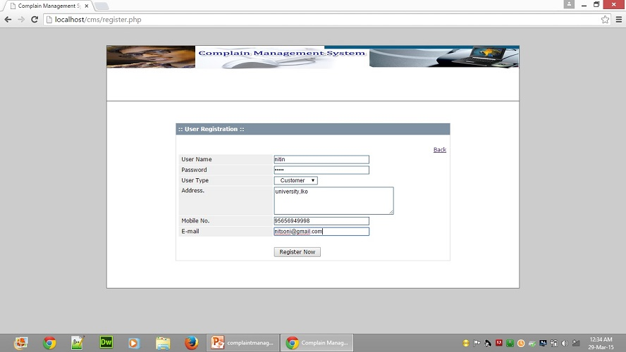
Registration

Slide 11
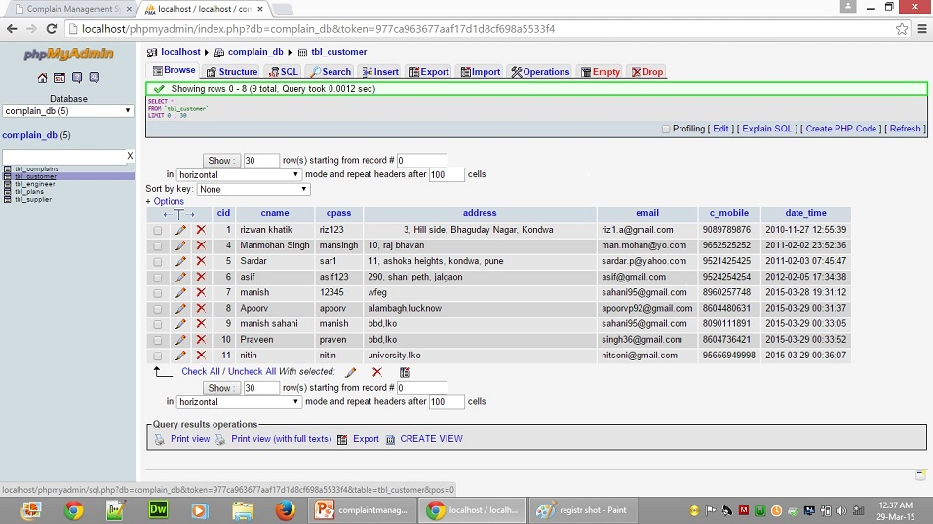
Customer login

Slide 12
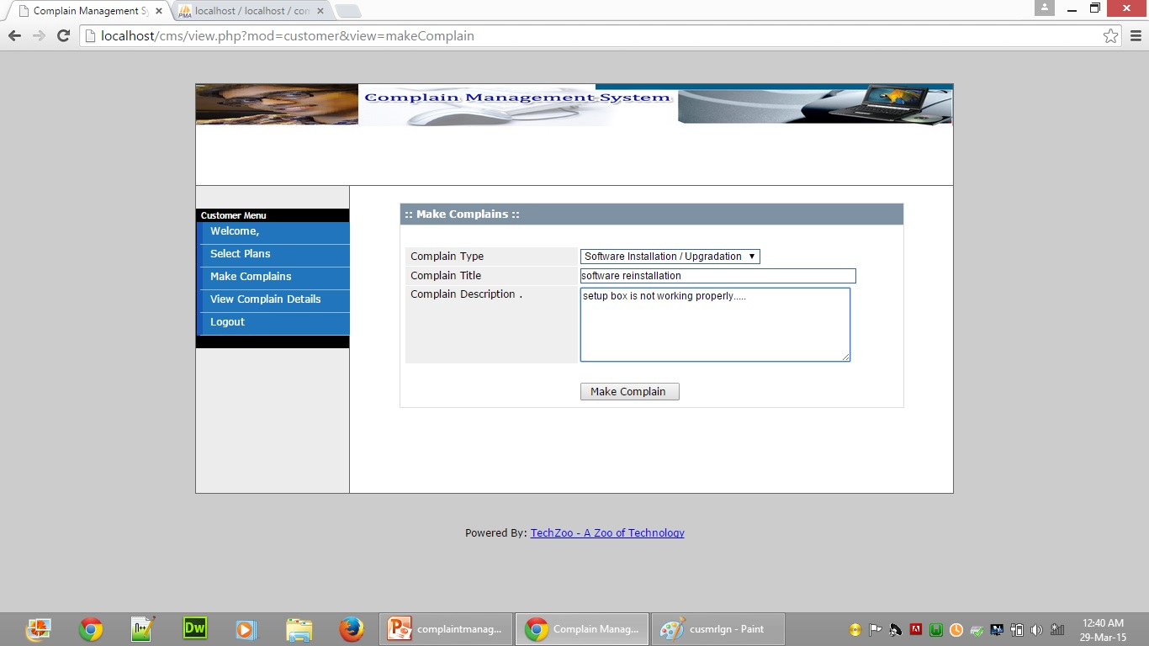
Complain Process

Slide 13
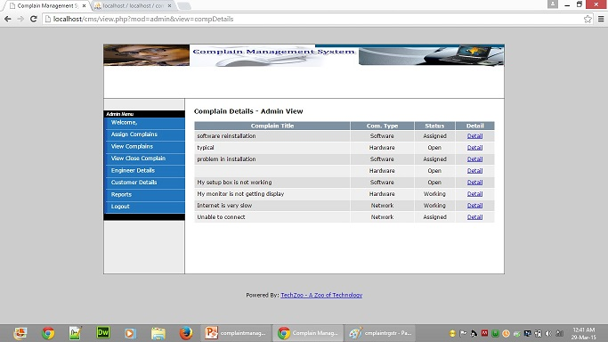
Admin Menu

Slide 14
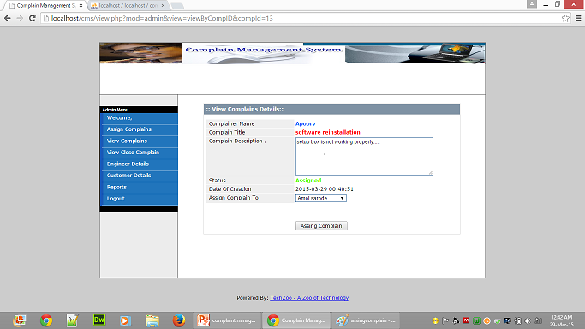
Assigned Complained

Slide 15
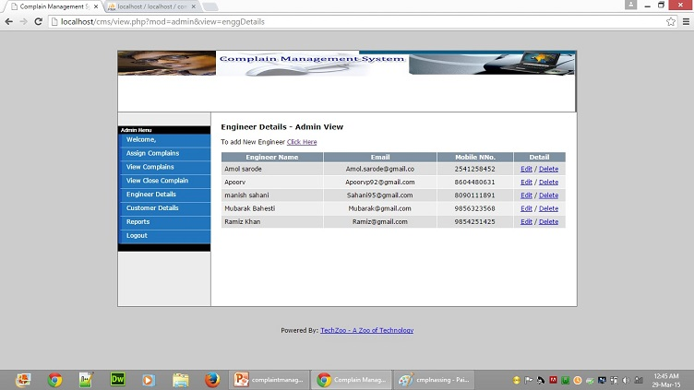
Employee detail

Slide 16
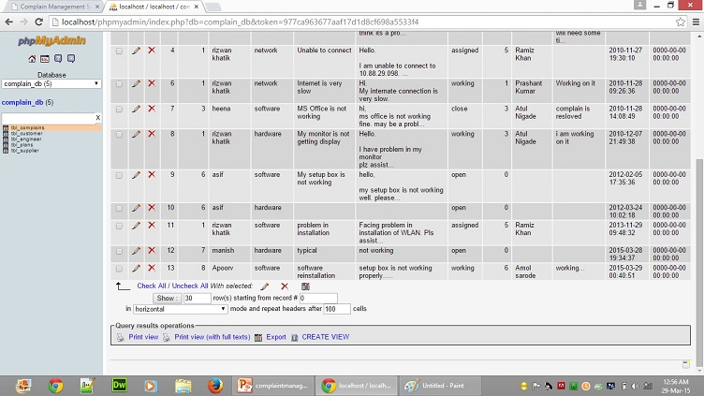
Solved Complain (Admin view)

Slide 17
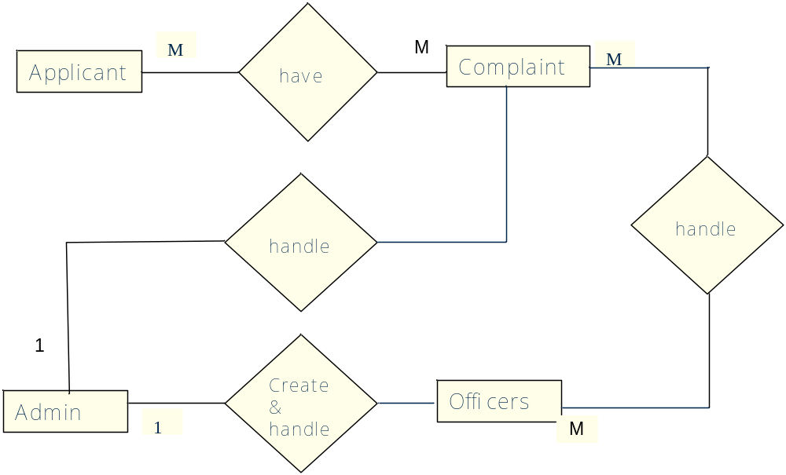
Entity Relationship Diagram

Slide 18
  Limitation
This site not provide validation at a time
Complaint category not provide more detail
This System only for Complaint Registration & Check
Status

Slide 19
Project Scope
Public Complaint Management
  Receiving people complaints and Provides people complaint status.
  Higher speed of Receiving complaints.
  Distribution of Related complaints among Different Departments.

Slide 20
THANK YOU

