Slide 1
Approach Details
Ministry Category : Ministry of HRD(NCERT+CBSE+NIOS)
Problem Statement : Online tracking and alerts system of complain received from the learners as well as visitors and the solution provided is required with SMS alerts.
Problem Code :NIO3
Team Leader Name : Shubham Pandey
College Code:9400

Slide 2
Description
Customer Complaint is important information reflecting customers sound and is a primary measure of customer dissatisfaction.
The presented model for the learners/visitors Complaint Management System will have the ability to minimize learners/visitors’ dissatisfaction and on the other hand it can encourage other learners/visitors to participate in controlling the quality of the service provided.
The Proposed model aims to develop a digitalised framework for e-Complaint Web-based that targets the learners convenience.
This system will be able to handle complaints by recording and giving feedback for each raised complaint effectively.

Slide 3
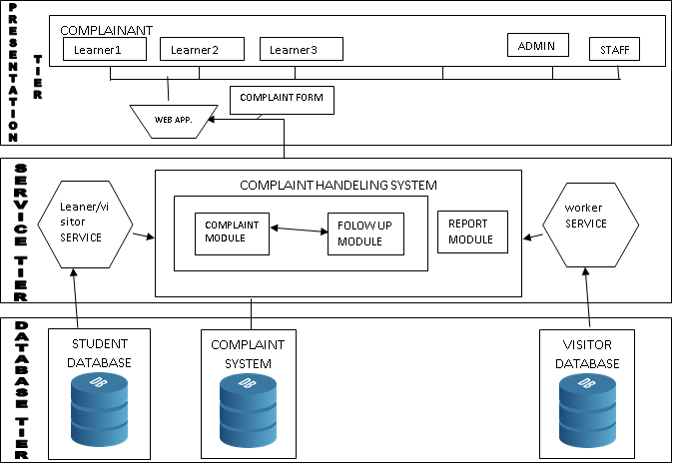
The proposed model is divided into 3-tiers that consist of the following:
Database – tier
It contains data about system users and their Profiles, complaints, learner/visitor details, feedback, and workers detail.
Service – tier
It consists of the core of the system. i.e. complaint and feedback components.
Presentation – tier
It consists of web-based user interface.
The proposed system could be generally Applicable for any web-based e-complaining system .
Proposed Model for e-complaint handling system

Slide 4

Use case diagram
Complaint Registry System
Complaint Registry System
User Authentication
Authentication
Register Complaint
Access Complaint Information
Roles:-
▪ Admin- Create system users and manage their privileges,
▪ Learner- Make Complaints against the provided Services
▪ Agent- Record the Complaint in the web-based then assigns priority
▪ Workers registry- Has all workers, details.
▪ Learner Solidarity- Has learners/visitors details that deserve services,
▪ Staff - Has all staff details who works on Social Solidarity and could be assigned to deal with Complaints.
Complaint Registry Notification
Change Complaint Status
Check Complaint Status
Complaint Resolution
Close Complaint
Complaint Completion Receipt

Slide 5
Show stopper
In this project the concept of e-complaint/feedback management system provides three key benefits to the organisation:
It resolves issues raised by the person who is dissatisfied in the timely and cost effective way.
It provides information that lead to the improvement of the service.
Where complaints are handled properly, a good system can improve the reputation of an organisation & strengthen public confidence in the organisation’s administrative processes.

Slide 6
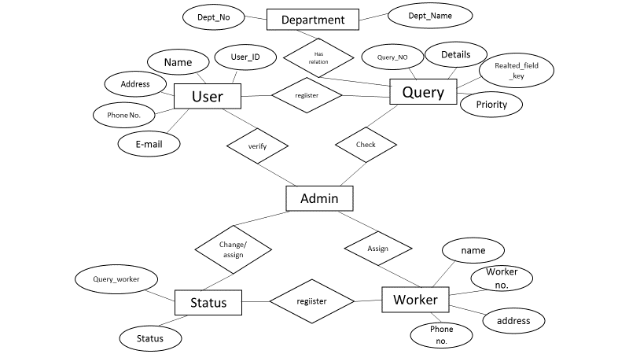
DEPENDENCY: Our dependency on government consists of no hardware dependency, but following data (shown in below diagram) in required.

Slide 7
Register a complaint
2. Forward
User
Reported to Table
Complaint Table
Worker Table
3. Assign
Action Table
Feedback Table
5. Close
4.Feedback

