Slide 1

Databases, advanced
Aggregation
Gergely Lukács
Pázmány Péter Catholic University
Faculty of Information Technology
Budapest, Hungary
lukacs@itk.ppke.hu

Slide 2
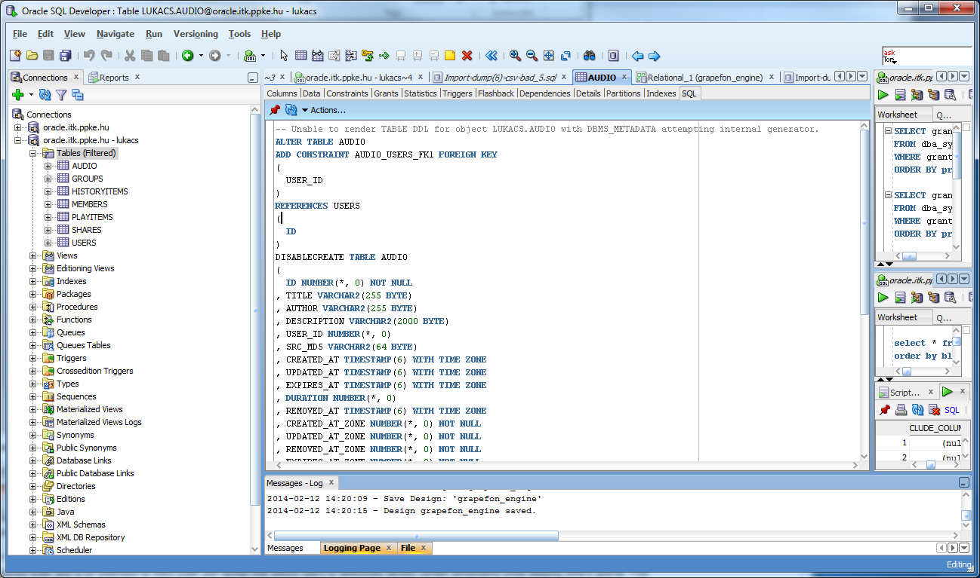
SQL Developer
Starting SQL Developer
Creating connection
Hostname: oracle.itk.ppke.hu
Port: 1521
SID: gyak
Username: ADV16_FAMFIRKER (3-3 characters of family name and christian name)
Jelszó: ******

Slide 3
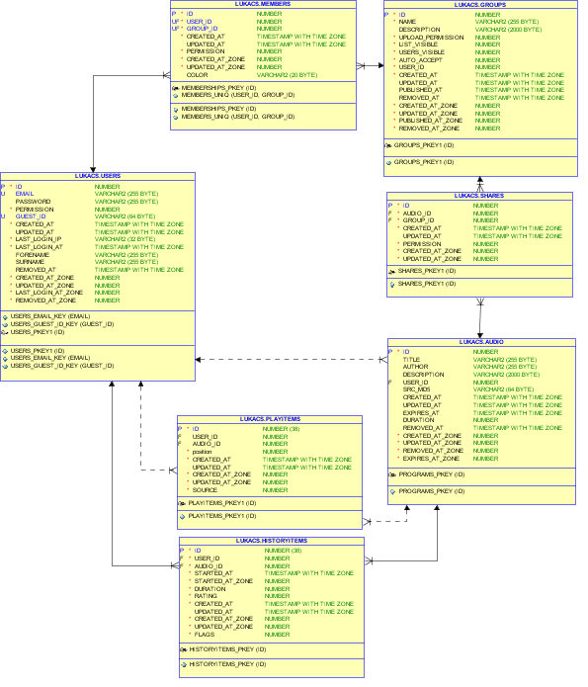
Grapefon - schema
Data modeler
Reverse engineering
+ hand layouting

Slide 4
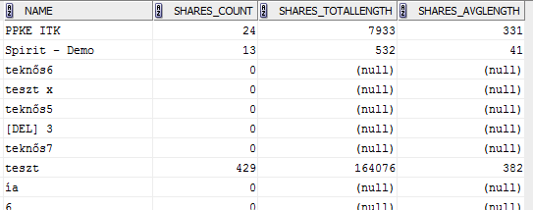
Groups – statistics of shared audio recordings
Create a statistics showing the shared audio content (count + average length, rounded to seconds) per group
  Handle groups not having any shared audio content correctly
  Use column alias names
  Format the SQL command
http://docs.oracle.com/cd/E11882_01/server.112/e26088/functions002.htm#SQLRF51178
Oracle® Database SQL Language Reference 11g Release 2 (11.2) Single-Row Functions

Slide 5
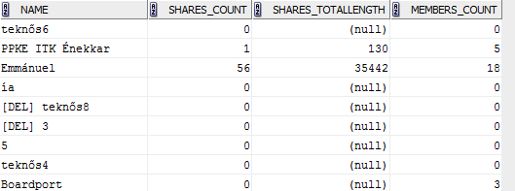
Groups, statistics of shared audio recordings and members
Extend the previous query with an additional column showing the number of the members in the group!

Slide 6

Users statistics based on registration time
Query the number of new user registration per month!

Slide 7
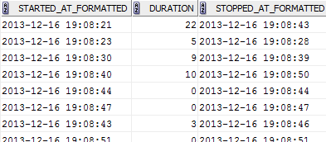
Listenings – with stop time
Query the start time, duration and stop time of historyitems !

Slide 8
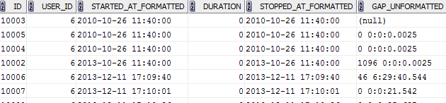
Listenings – with stop time and gap
Extend the previous query with an additional column showing the time gap between the end of the previous historyitem and the beginning of the current historyitems!
  Sort the result by user and starttime!
  (The value in the first row of each user shall be empty „NULL”)
  (The unit of the new column can als seconds)

Slide 9
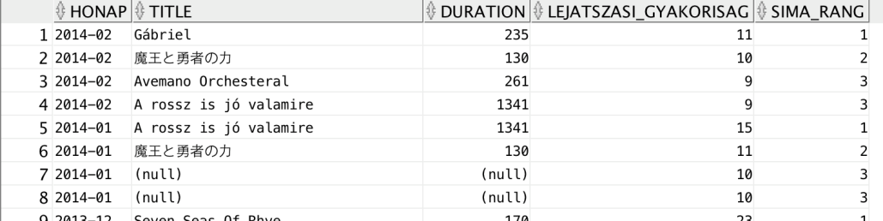
Hit list
Query the top 3 audio recordings per month with title number of listenings and total length of listening!
Test the analytic functions rownum(), rank() és dense_rank(). What is the difference?

Slide 10
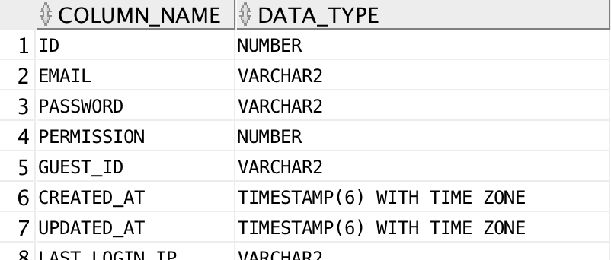
Querying the data dictionary
List the attributes and their datatypes of the grapefon table USERS! (ALL_TAB_COLS metadata view)

