Slide 1

Database management, advanced
Indexes
Gergely Lukács
Pázmány Péter Catholic University
Faculty of Information Technology and Bionics
Budapest, Hungary
lukacs@itk.ppke.hu

Slide 2
DB architecture (fraction)
Logical level (relational model)
Physical data independence
Physical/internal level (storage)

Slide 3
Data access structures,
„Index“ (B+ tree)

Slide 4

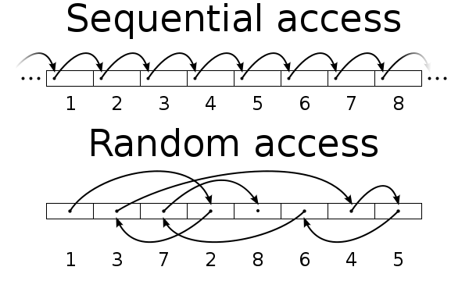
Disk, Data organisation, data access costs
Sequential access much faster, than random access
Block – a contiguous sequence of sectors from a single track
  data is transferred between disk and main memory in blocks
  Sizes e.g, 4/8/16/32 kB,
    Smaller blocks: more transfers from disk
    Larger blocks: more space wasted due to partially filled blocks
    Typical block sizes today range from 4 to 16 kilobytes
Significant cost factor in DBMS: # blocks accessed from disk

Slide 5
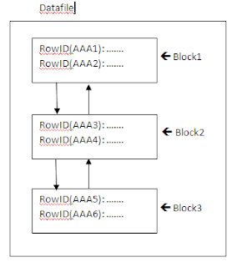
RDBMS: storing tables: blocks on a disk
„Row store”,
record by record

Slide 6
Index Motivation
What about if we want to be able to search quickly along an attribute?
We’ll create separate data structures called indexes to address all these points

Slide 7
Basic Concepts
Indexing mechanisms used to speed up access to desired data.
Search Key - attribute (or set of attributes) used to look up records in a file.
An index (file) consists of index entries of the form
Index files support finding an index entry for a search key efficiently (and are typically smaller than the original file)
Two basic kinds of indices:
  Ordered indices: search keys are stored in sorted order in some kind of a search tree
  Hash indices: search keys are distributed uniformly across “buckets” using a “hash function”.
search-key
pointer

Slide 8
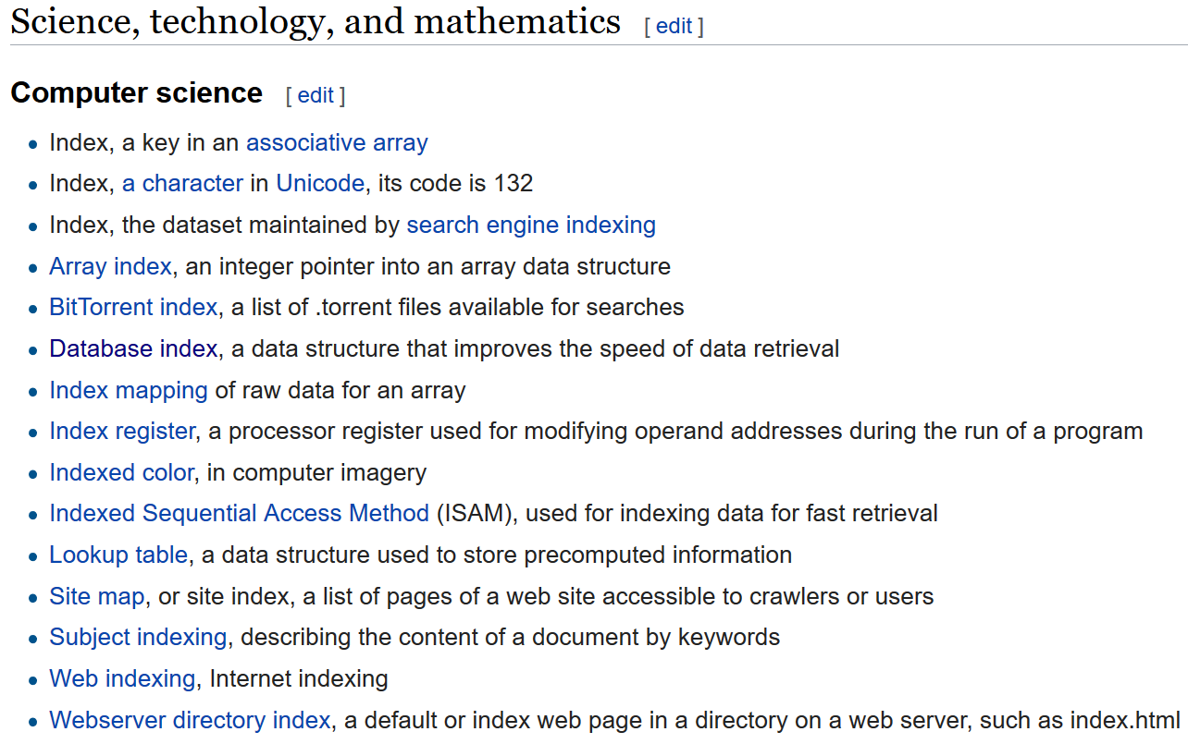
Index
(https://en.wikipedia.org/wiki/Index)

Slide 9

Example of B⁺-Tree

Slide 10

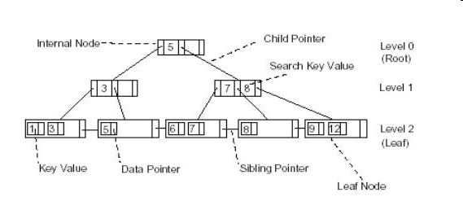
B+ tree
B (balanced) tree
All nodes stored in the leaves
Leaves linked sequentially
Size of node ~ block on disk
Data only in leaf nodes
Leaf nodes chained (for fast sequential traversar)
Pointer on the data (table)

Slide 11
Typical size of index
Node ~ block on disk
(block ~ 4kb,…, 32kb)
Number of children of a node? (order of magnitude?)
Depth of an index?
  How does it change as the number of records increases? (function?)

Slide 12
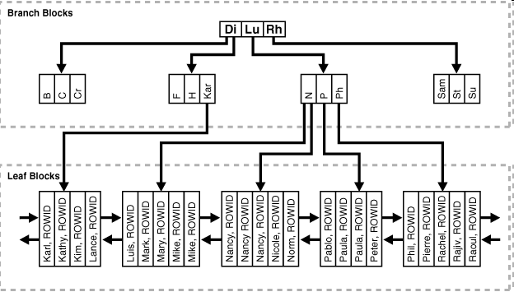
Oracle: Data pointer: ROWID
Table (record)

Slide 13
SQL: CREATE INDEX
CREATE INDEX emp_ename ON emp(ename);
CREATE INDEX ci ON c (c1, c2);

Slide 14
Index useful for
Query conditions
  Exact match query, range query
  Selectivity ! (rule of thumb: 5% selectivity!)
    see later, clustering factor
Sorted result
Join conditions (next lecture)

Slide 15
B⁺-Tree Index Files
Advantages of B⁺-tree index files:
  automatically reorganizes itself with small, local, changes, in the face of insertions and deletions.
  Reorganization of entire file is not required to maintain performance.
  ((compacting,rebuilding … can make sense))
Disadvantages of B⁺-trees:
  extra insertion and deletion overhead
    Finding records to update or delete can be (significantly) faster with an index
  space overhead (size of index comparable to size of table)
B⁺-trees are used extensively

Slide 16
Indexes on Multiple Attributes
Composite search keys are search keys containing more than one attribute
  E.g. (dept_name, salary)
Lexicographic ordering: (a₁, a₂) < (b₁, b₂) if either
  a₁ < b₁, or
  a₁=b₁ and a₂ < b₂

Slide 17
Indexes on Multiple Attributes 2
CREATE INDEX Idx_Emp_Name
ON Employees ("Last Name", "First Name")
Useful for
  ... WHERE "Last Name" = 'Doe'
  ... WHERE "Last Name" = 'Doe' AND "First Name" = 'John'
  ... WHERE "First Name" = 'John' AND "Last Name" = 'Doe'
Can not be used
  ... WHERE "First Name" = 'John'
1
2

Slide 18
Indexes on Multiple Attributes 3
Suppose we have an index on combined search-key (dept_name, salary).
where dept_name = “Finance” and salary = 80000
the index can be used to fetch only records that satisfy both conditions.
Can also efficiently handle
where dept_name = “Finance” and salary < 80000
But cannot efficiently handle
where dept_name < “Finance” and balance = 80000

Slide 19
Covering index (for a specific query)
Add extra attributes to index so (some) queries can avoid fetching the actual records
We say that an index is covering for a specific query if the index contains all the needed attributes- meaning the query can be answered using the index alone!

Slide 20
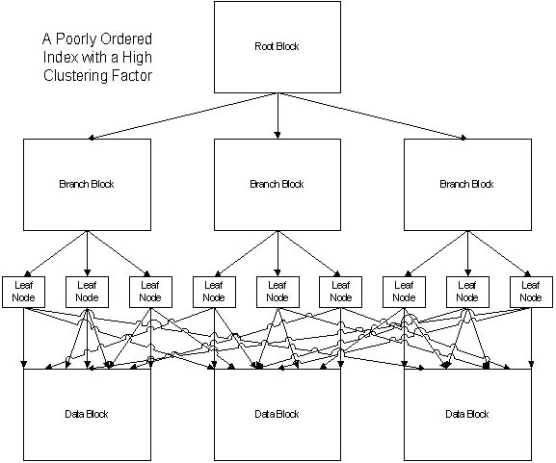
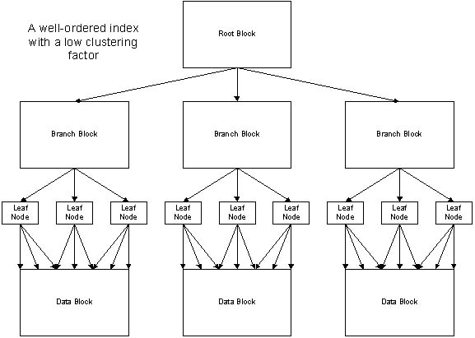
(Clustering factor)
Poorly ordered table related to an index
Oracle: „high clustering factor”;
PostgreSQL: lowcorrelation
Well ordered table related to an index
index is useful for a query condition
with at most ~ ~ 5% selectivity!
(rule of thumb)

Slide 21
Multiple conditions, multiple indices
Use multiple indices for certain types of queries.
Example:
  SELECT id
  FROM instructor
  WHERE dept_name = ”finance”
  AND salary = 80000;
  Possible strategies for processing query using indices on single attributes:
  Using index on dept_name
    Use index on dept_name to find instructors with department name Finance;
    test salary = 80000
  Use index on salary
    to find instructors with a salary of $80000;
    test dept_name = “Finance”.
  Use both indices (Oracle?!)
    dept_name index to find pointers to all records pertaining to the “Finance” department.
    Similarly use index on salary.
    Take intersection of both sets of pointers obtained.

Slide 22
Bulk Loading and Bottom-Up Build
Inserting entries one-at-a-time into a B⁺-tree requires ≥ 1 IO per entry
  assuming leaf level does not fit in memory
  can be very inefficient for loading a large number of entries at a time (bulk loading)
Efficient alternative 1: Bottom-up B⁺-tree construction
  Deactivating, dropping index
  Reactivating, recreating
Efficient alternative 2:
  sort entries first
  insert in sorted order
    insertion will go to existing page (or cause a split)
    much improved IO performance, but most leaf nodes half full

Slide 23
Data dictionary
Home / Database / Oracle Database Online Documentation 12c Release 1 (12.1) / Database Administration
Database Reference
  all_tables
  all_indexes
  (https://docs.oracle.com/database/121/REFRN/GUID-E39825BA-70AC-45D8-AF30-C7FF561373B6.htm#REFRN20088)
  SQL> select value from v$parameter where name = 'db_block_size' ;
  VALUE
  -------------
  8192
Invoicing
CRM
GIS
DBMS
Database
Data dictionary (Catalog, Metadata)
Data

Slide 24
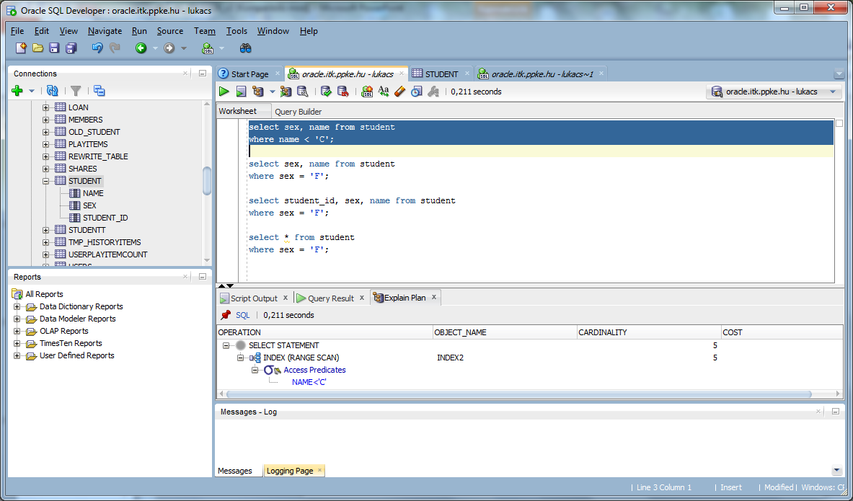
Execution plan

Slide 25
Creating and Dropping an Index
Create the student table using the appropriate script!
Query the ROWID!
Query the names starting with letter “B”!
Check the execution plan!
Create an index on the name attribute (recommended index name: student_name_ix)!
Check the execution plan again!
Drop the index!

Slide 26
(Covering Index for a Query)
Query the attributes NAME and SEX!
Check the execution plan!
Create a covering index for the query and check the execution plan again!
Query the NAME and SEX attributes with the query criterion SEX=”F”!
Check the execution plan! How is the index used?
Query all attributes of the table with the query criterion SEX=”F”!
Check the execution plan!

Slide 27
Size of Index
Background information (only a db administrator can execute this query)
select value from v$parameter where name = 'db_block_size' ;
VALUE
-------------
8192
Check the number of blocks in the HISTORYITEMS_LARGE table! How much space is needed for the table? (Is it OK to count only leaf blocks?!)
Check the indexes on the table, including their sizes!

Slide 28
HISTORYITEMS_LARGE – indexelésének vizsgálata
Query records from the AD18___DB.HISTORYITEMS_LARGE for the first the 10 users without using an index!
(Query hint: SELECT /*+ NO_INDEX(HISTORYITEMS_LARGE) */ * FROM …)
Check the execution plan (cost of query!)!
Execute the same query with index usage! How did the execution cost change?
Query the records with a starttime between Jan. 2014 and March 2015! Check the execution plan!
Extend the previous query with an additional condition, restricting the answer to the first 100 users!
When, how and why are indexes used in the different situations?

Slide 29
Index Usage - Query Selectivity
Check the following query with different constant values in the WHERE condition (i.e., with different selectivities)!
SELECT COUNT(updated_at)
FROM historyitems_large
WHERE user_id < 50
When (at which selectivities) does the DBMS use the index? How does the execution cost changes? (Create a notice in form of a table: paramater value, query selectivity, index usage (yes/no), execution cost.)
What changes, when querying COUNT(duration)? When querying SUM(duration)? Why?

Slide 30
Index Usage - Clustering Factor
The table HISTORYITEMS_LARGE_CF has exactly the same records as the table HISTORYITEMS_LARGE. Please check it!
Check the previous queries with the HISTORYITEMS_LARGE_CF table!
Are there any differences in the index usage you can observe?
Check the clustering factor of the indexes!

Slide 31
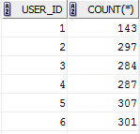
Index usage – data analysis
Query the number of records per user!
Does the DBMS use the index for executing the query?
How (operation)?
Explanation?
Does the index support the query properly?

Slide 32
Statistics
Check the statistics kept on the data by Oracle!
ALL_TABLES and DBA_OBJECT_TABLES
ALL _TAB_STATISTICS and ALL _TAB_COL_STATISTICS
ALL _TAB_HISTOGRAMS
ALL _TAB_COLS
ALL _COL_GROUP_COLUMNS
ALL _INDEXES and ALL _IND_STATISTICS

