Slide 1

Database management II.
Objectrelational Databases
Geographical Databases
Gergely Lukács
Pázmány Péter Catholic University
Faculty of Information Technology
Budapest, Hungary
lukacs@itk.ppke.hu

Slide 2
Object-Relational Databases

Slide 3
Object-oriented databases („object databases”)
Object-oriented concepts
  encapsulation, inheritance, …
Early 1990s: Research on object-oriented databases
Object-oriented DBMS’s failed because they did not offer the efficiencies of well-entrenched relational DBMS’s.
Niche application areas only

Slide 4
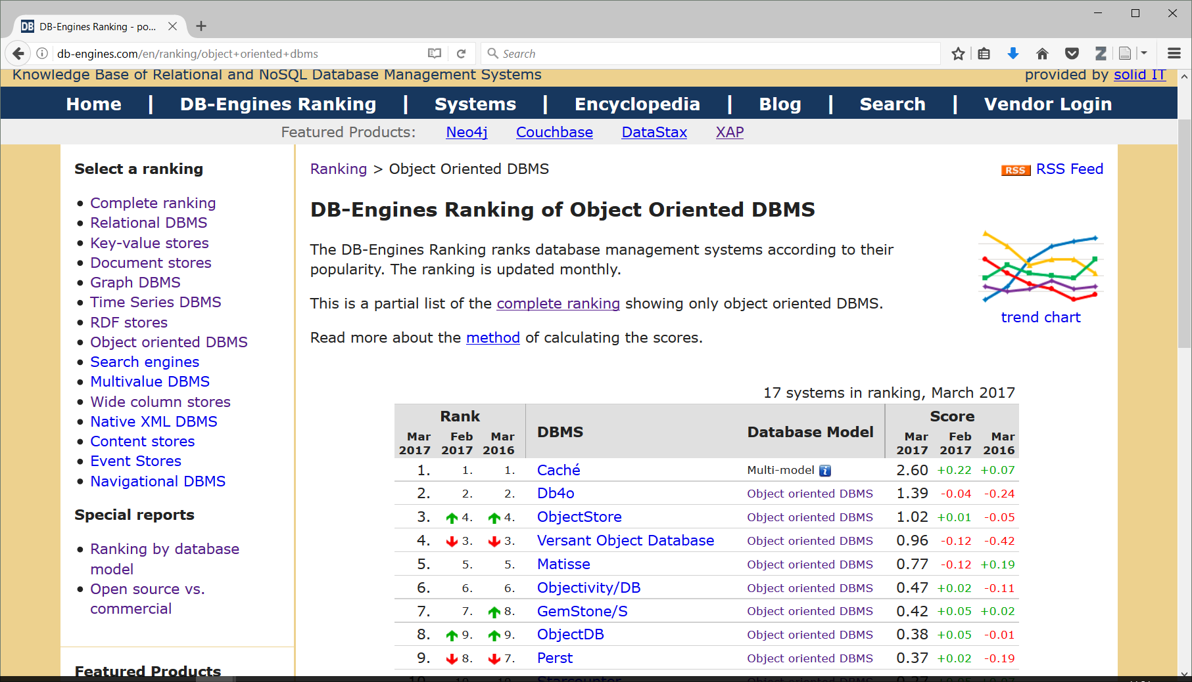
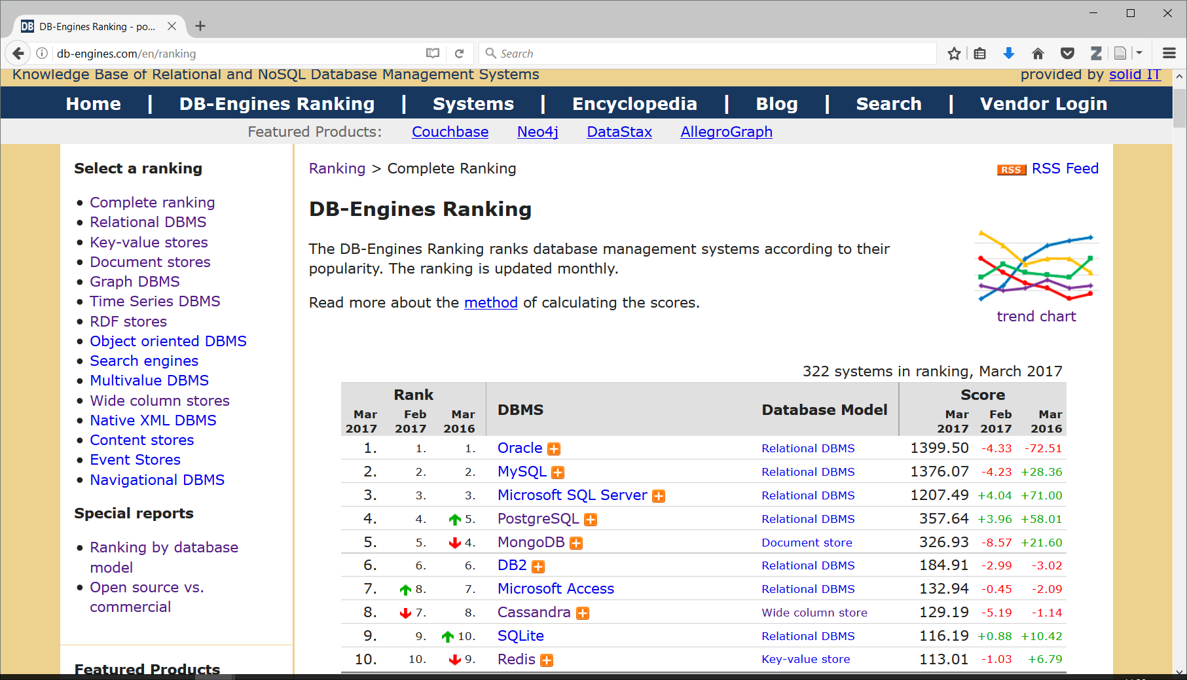
http://db-engines.com/en/ranking

Slide 5
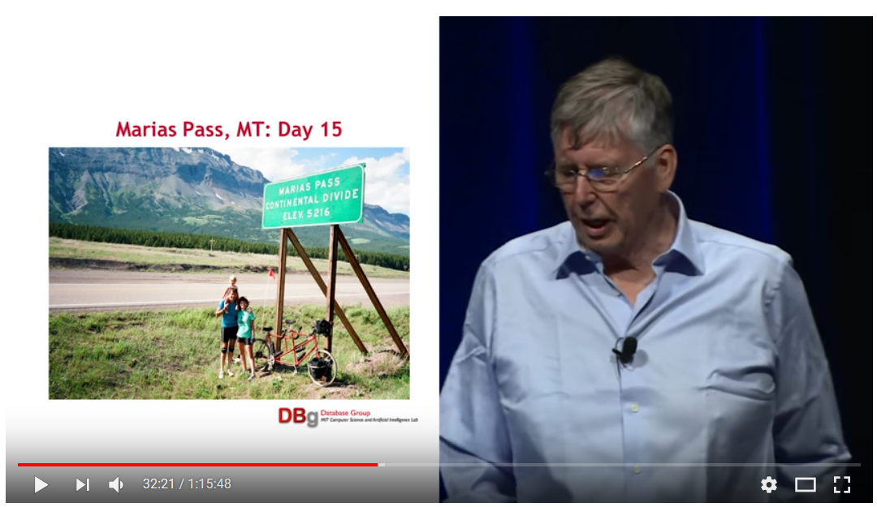
Object-relational databases
Michael Stonebraker: 2014 ACM A.M. Turing Lecture, June 13 2015
https://www.youtube.com/watch?v=BbGeKi6T6QI&t=2867s
https://amturing.acm.org/award_winners/stonebraker_1172121.cfm
https://en.wikipedia.org/wiki/Turing_Award

Slide 6
Object-relational databases
Object-oriented extensions to relational DBMS’s
  advantages of OO, yet retain the relation as the fundamental abstraction.
  Object-oriented models support interesting data types --- not just flat files.
    Maps, XML, multimedia, etc.
  The relational model supports very-high-level queries.

Slide 7
SQL-99 and Oracle Features
SQL-99 includes many of the object-relational features.
However, different DBMS’s use different approaches.

Slide 8
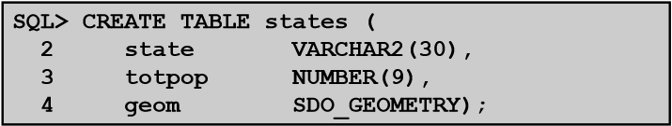
Oracle: User Defined Types
A user-defined type, or UDT, is essentially a class definition, with a structure and methods.
Two uses:
  As the type of an attribute of a relation.
  As a rowtype, that is, the type of a relation.

Slide 9
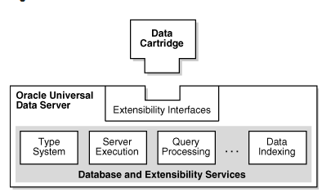
Oracle Types, Data Cartride Developers Guide
In addition to the efficient and secure management of data ordered under the relational model, Oracle provides support for data organized under the object model.
Object types,
large objects (LOBs),
external procedures,
extensible indexing
query optimization
can be used to build powerful, reusable server-based components called data cartridges.

Slide 10
Objectrelational DBMS (!)
Extensible data types
Methods/Operations
Extensible indexing
  Cost-based query optimization

Slide 11
How widely used are Oracle objects? (!)
http://stackoverflow.com/questions/5767200/how-widely-used-are-oracle-objects
some standard Oracle functionality uses Types, for instance XMLDB and Spatial (which includes declaring columns of Nested Table data types)
What is not commonly done, except it would sadly appear in some college courses, is to use object-based tables instead of regular relational tables to hold regular data like employees and departments
  (->object-relational mapper, Hibernate)
While these may be nice simple examples to teach the concepts, I fear they may lead to a new generation of database developers who think this approach is suitable, more modern and therefore better than "old-fashioned" relational tables. It emphatically is not.
Object relational technology adds a huge amount of complexity

Slide 12
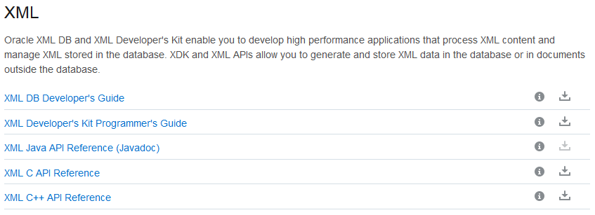
Oracle XML DB

Slide 13
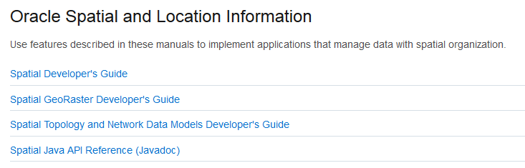
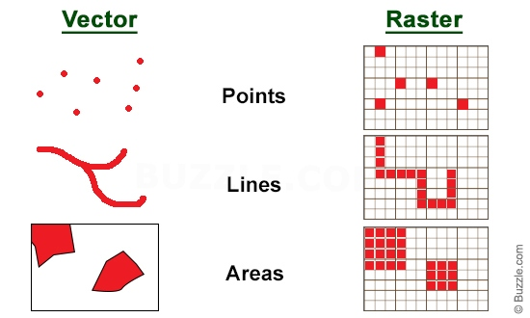
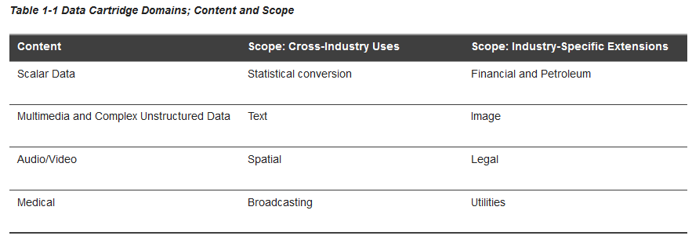
Oracle Spatial, …
Oracle Multimedia
Oracle Text

Slide 14
PostgreSQL vs Oracle
Oracle
  Define type, create table using type
  Methods
  No inheritance between tables
  No multiple parents
  Smart column types
PostgreSQL
  Table inheritance
  …

Slide 15
Spatial Databases

Slide 16
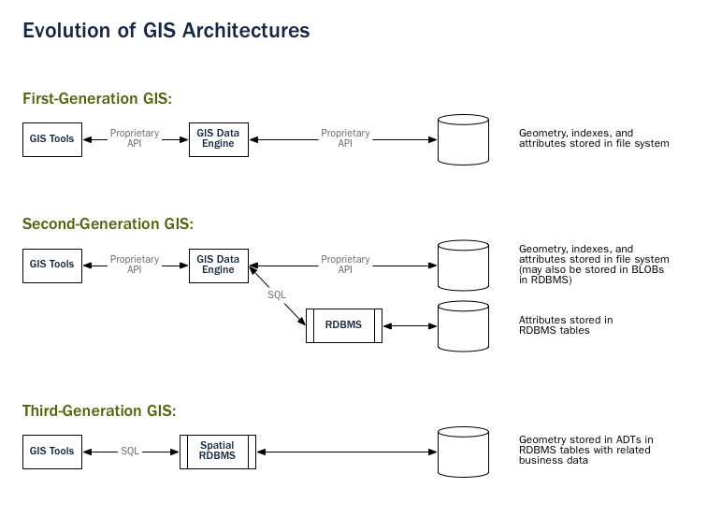

Slide 17


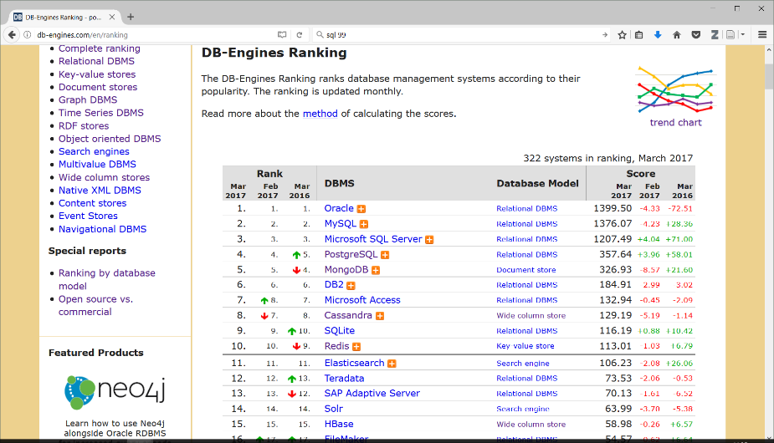
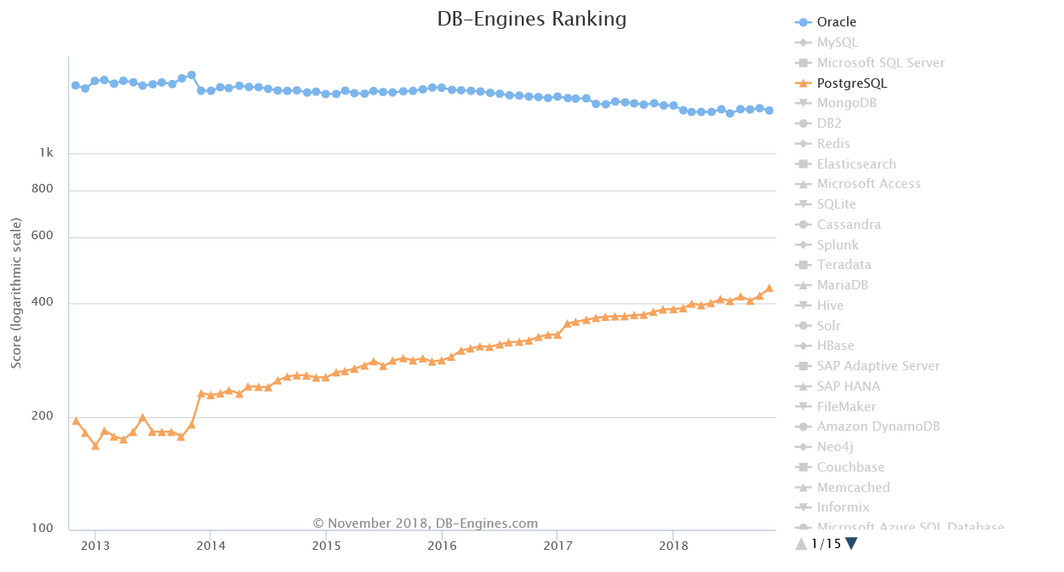
Because the development path for adding types to PostgreSQL was so straightforward, it made sense to start there. When MySQL released basic spatial types in version 4.1, the PostGIS team took a look at their code, and the exercise reinforced the original decision to use PostgreSQL. Because MySQL spatial objects had to be hacked on top of the string type as a special case, the MySQL code was spread over the entire code base. Development of PostGIS 0.1 took under a month. Doing a “MyGIS” 0.1 would have taken a lot longer, and as such, might never have seen the light of day.

Slide 18
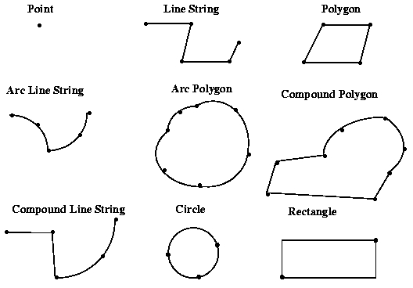
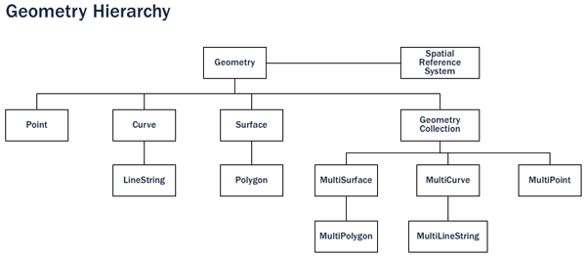
PostGIS geographic data types
CREATE TABLE testgeog (
gid serial PRIMARY KEY,
the_geog geometry( point, 4326 )
);

Slide 19
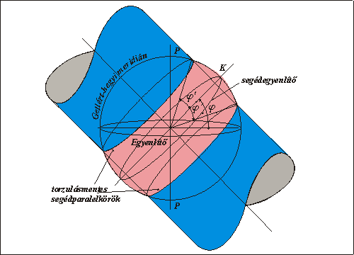
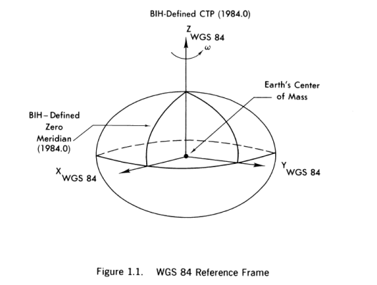
Spatial Reference System, SRID
World Geodetic System
  WGS 1984
  SRID 4326
  Google, KML
Hungary: Egységes Országos Vetület
  SRID 23700
  https://hu.wikipedia.org/wiki/Egys%C3%A9ges_orsz%C3%A1gos_vet%C3%BClet

Slide 20
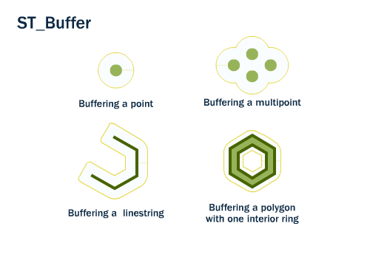
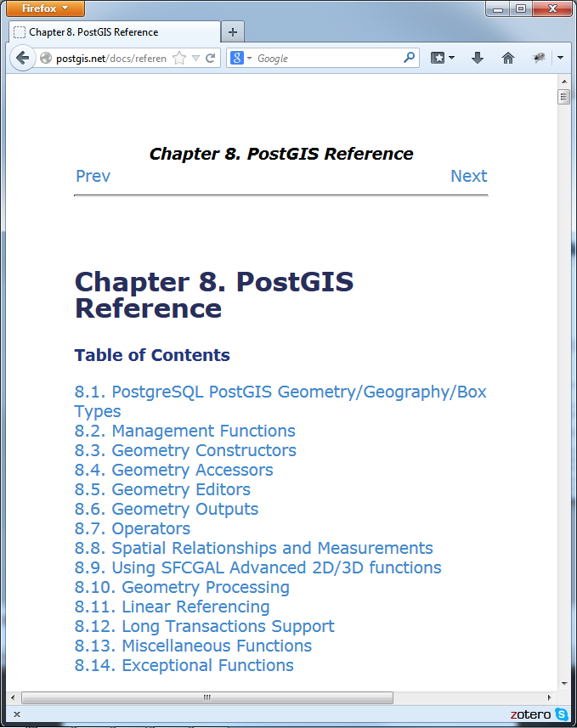
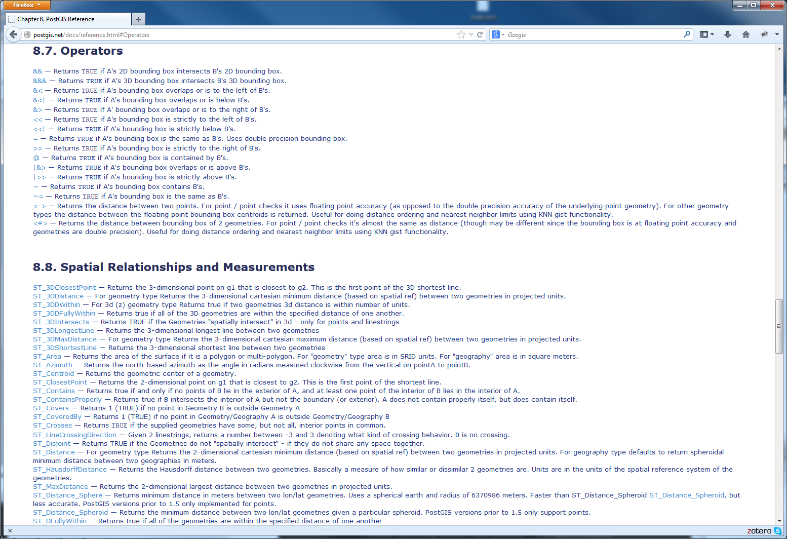
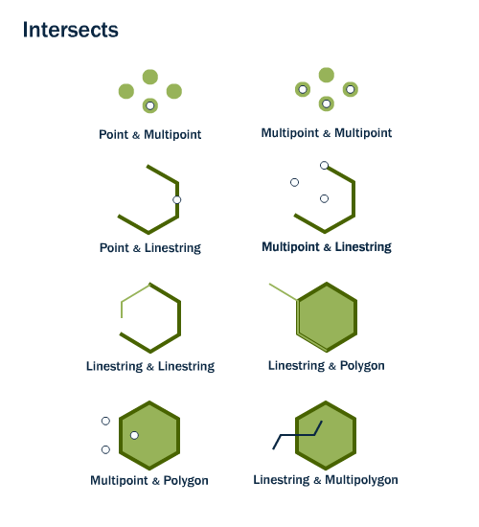

Slide 21

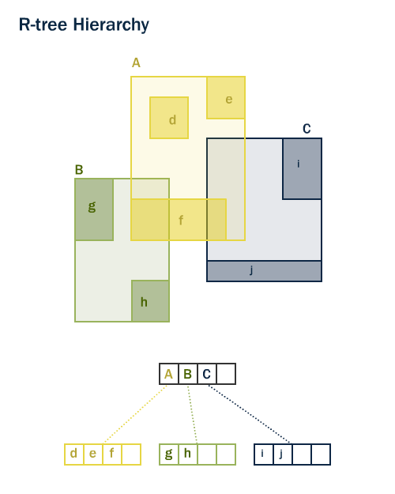
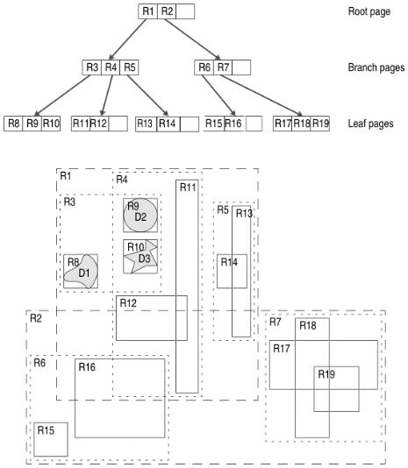
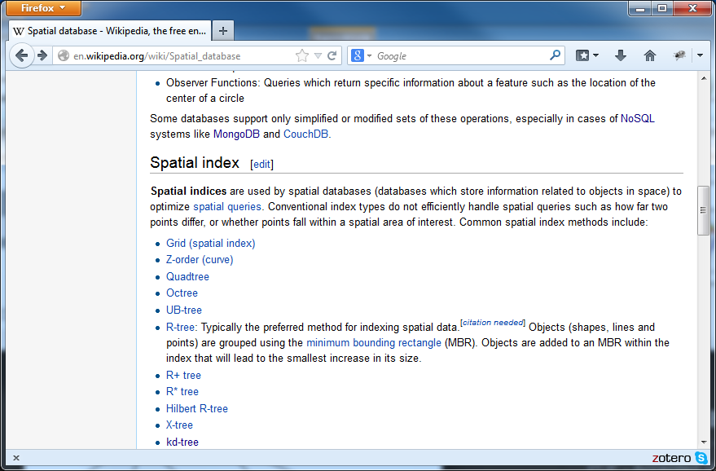
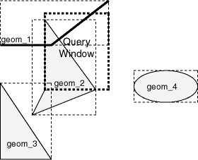
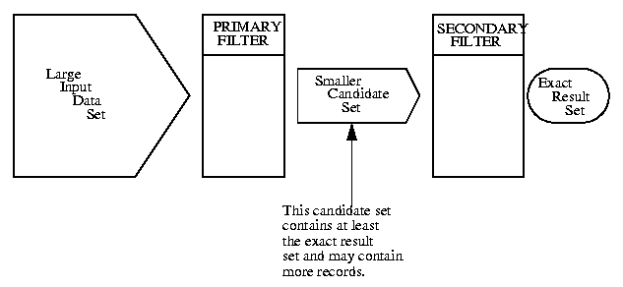
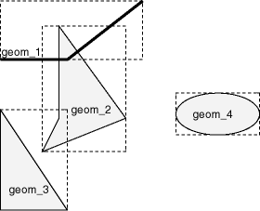
Geographic index (multidimensional index)
Bounding box
Tree
  R-Tree
Query processing
  Multiple filter sets

Slide 22
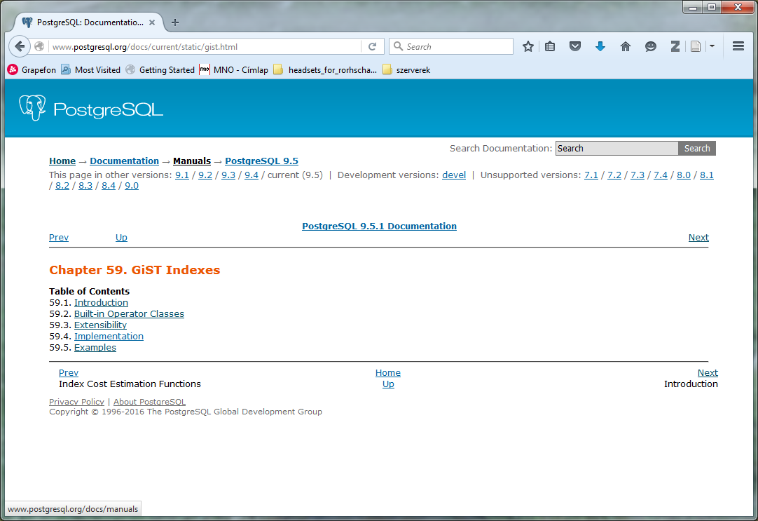
PostgreSQL – Generalized Search Tree
balanced, tree-structured access method
template for implementing indexes: B-tree, R-tree,…
development of custom data types with the appropriate access methods, by an expert in the domain of the data type, rather than a database expert

Slide 23
Spatial Database Offerings
ESRI ArcSDE (on top of several different DBs)
Oracle Spatial
IBM DB2 Spatial Extender
Informix Spatial DataBlade
MS SQL Server (with ESRI SDE)
Geomedia on MS Access
PostGIS / PostgreSQL

Slide 24



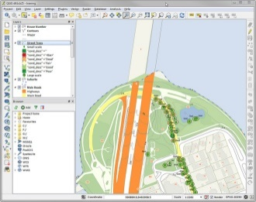

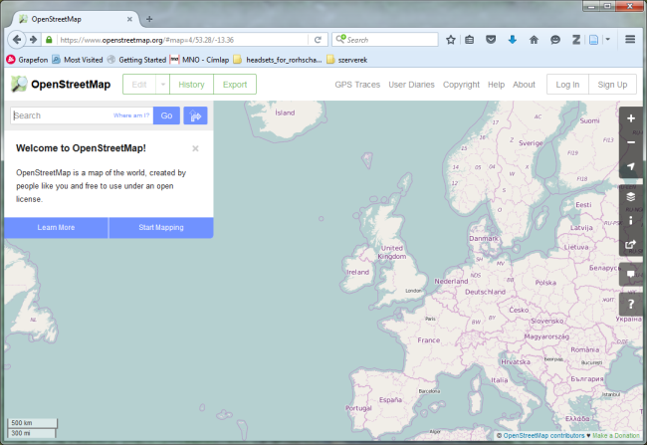
Practical hints
PostgreSQL + PostGIS (+ pgRouting)
Visualization: QGIS - Desktop GIS vagy Google
Data: OpenStreetMap

Slide 25
Oracle: Check the definition of SYS.XMLTYPE, allowing to manage XML data.
What primitive datatypes can be used for XML types?
Notes:
0

Slide 26
Use PostgreSQL (9.1) and PostGIS (1.5) for the following tasks!
Client: pgadmin (locally installed)
Server connection
  Host: csquared2.itk.ppke.hu
  Port: 5432
  Username: csquared2_db2
  Maintenance db: csquared2
It is recommended to use http://sqlformat.darold.net/ for formatting your SQL codes!
Select a point in a Hungarian city and note its cooordinate values, using Google Maps.
Check the location 47.501947, 19.034393 on Google Maps!
Notes:
0

Slide 27
Create a point object with SRID set to 4326, using the coordinates 47.501947, 19.034393 (create == query it with a SELECT without a FROM clause, PostgreSQL allows this, Oracle needs the DUAL table).
  ST_Point
  Coordinate values swapped! SRID: 4326
  ST_SetSRID
Notes:
0

Slide 28
Calculate (=query) the 2500 meters buffer zone (a geometry!) of the point!
  ST_Transform
  ST_Buffer
  Distance can be measured in metes using SRID=23700
Notes:
0

Slide 29
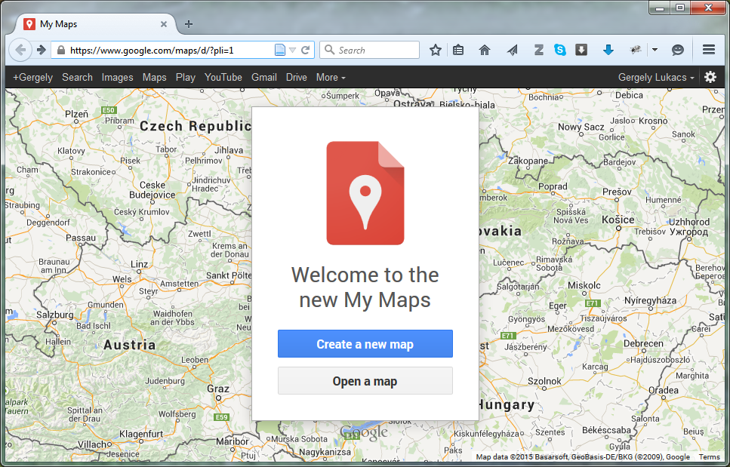
Create a KML file from the previous buffer zone geometry and visualize it with Google Maps!
  Creating the KML fragment with PostGIS: ST_Askml
  KML Header, Footer (KML fragment comes to the place of „…”)
  <?xml version="1.0" encoding="UTF-8"?>
  <kml xmlns="http://www.opengis.net/kml/2.2">
  <Document id="utvonal">
  <name>route</name>
  <Placemark>
  <name>Utvonalnév</name>
  <styleUrl>#LineStyle00</styleUrl>
  <MultiGeometry>
  …
  </MultiGeometry>
  <Style id="LineStyle00">
  <LabelStyle>
  <color>00000000</color>
  <scale>0.000000</scale>
  </LabelStyle>
  <LineStyle>
  <color>ff0098e6</color>
  <width>3.000000</width>
  </LineStyle>
  </Style>
  </Placemark>
  </Document>
  </kml>
Google My Maps, Create a new map, Import
Notes:
0

Slide 30
Query the streets containing in their name „lo” (case-insensitive) and are in the buffer zone calculated previously!
Aggregate the geometry of the streets and visualize it with Google Maps!
  Table with streets: hu_2po_4pgr (Open Street Map adat)
  Attribute
    name: hu_2po_4pgr.osm_name
    geometry: hu_2po_4pgr.geom_way
  ST_Intersects
  ST_Transform
  ST_Collect

Slide 31
Modify the previous query so that the streets (street sections) are ordered accourding to their distance from (47.501947, 19.034393) in increasing order! The result shall also contain the distance in meters!
  ST_Distance (SRID=23700 is required for measuring distances in meters)

