Slide 1

Database management II.
Join Execution
Database optimisation
Gergely Lukács
Pázmány Péter Catholic University
Faculty of Information Technology and Bionics
Budapest, Hungary
lukacs@itk.ppke.hu

Slide 2
Data Access Structures, Indexes

Slide 3
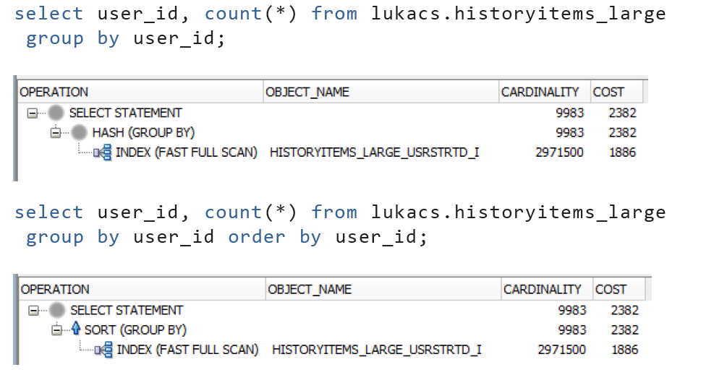

Slide 4
Data warehouse queries
Large number of records
Ad-hoc queries, multiple dimensions
Aggregations
Read operations almost exclusively
Bitmap index
Materialized view + query rewrite

Slide 5
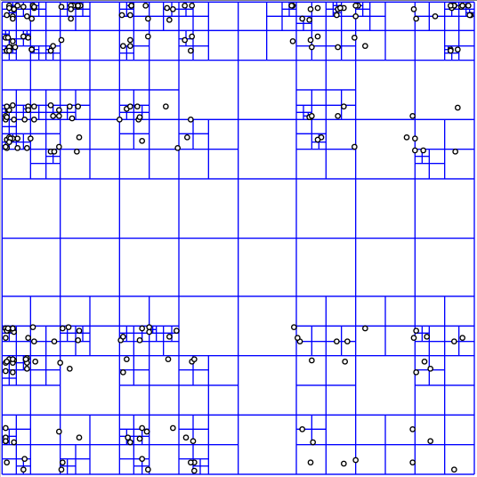
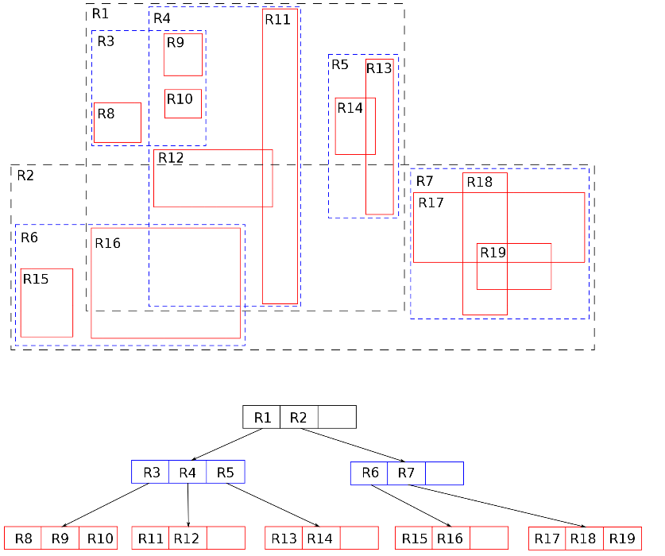
Geographic databases (> 1D data)
Quadtree
R-tree
K-D-B tree
Notes:
Nodes in kd-trees represent separating planes, whereas nodes in R-trees represent bounding boxes.
kd-trees partition the whole of space into regions whereas R-trees only partition the subset of space containing the points of interest.
kd-trees represent a disjoint partition (points belong to only one region) whereas the regions in an R-tree may overlap.

Slide 6
Join execution

Slide 7
Join execution
Relational databases, normalisation
=> large number of joins
Join – very expensive
Several ways to execute

Slide 8
Nested loop join

Slide 9
Notes
We are again considering “IO aware” algorithms: care about disk IO
Given a relation R, let:
  T(R) = # of tuples in R
  P(R) = # of pages in R
Recall that we read / write entire pages with disk IO

Slide 10
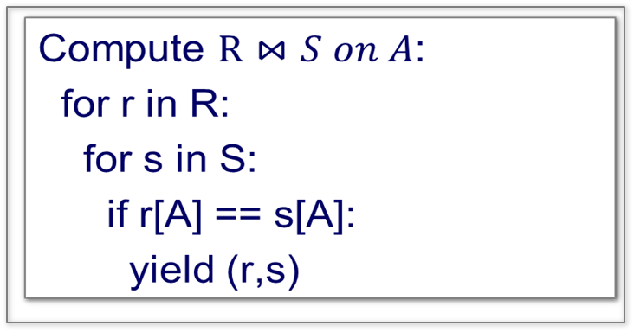
Nested Loop Join (NLJ)

Slide 11
Nested Loop Join (NLJ)
Cost:
P(R)
Loop over the tuples in R
Note that our IO cost is based on the number of pages loaded, not the number of tuples!

Slide 12
Nested Loop Join (NLJ)
Cost:
P(R) + T(R)*P(S)
Loop over the tuples in R
For every tuple in R, loop over all the tuples in S
Have to read all of S from disk for every tuple in R!

Slide 13
Nested Loop Join (NLJ)
Cost:
P(R) + T(R)*P(S)
Loop over the tuples in R
For every tuple in R, loop over all the tuples in S
Check against join conditions
Note that NLJ can handle things other than equality constraints… just check in the if statement!

Slide 14
Nested Loop Join (NLJ)
Cost:
P(R) + T(R)*P(S) + OUT
Loop over the tuples in R
For every tuple in R, loop over all the tuples in S
Check against join conditions
Write out (to page, then when page full, to disk)
What would OUT be if our join condition is trivial (if TRUE)?
OUT could be bigger than P(R)*P(S)… but usually not that bad

Slide 15
Nested Loop Join (NLJ)
Cost:
P(R) + T(R)*P(S) + OUT
What if R (“outer”) and S (“inner”) switched?
P(S) + T(S)*P(R) + OUT
Outer vs. inner selection makes a huge difference- DBMS needs to know which relation is smaller!

Slide 16
Block Nested Loop Join (IO-Aware variant)

Slide 17
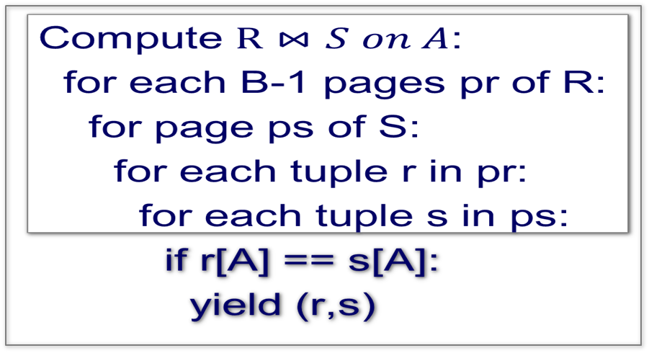

Block Nested Loop Join (BNLJ)
Given B+1 pages of memory
Cost:
Load in B-1 pages of R at a time (leaving 1 page each free for S & output)
Note: There could be some speedup here due to the fact that we’re reading in multiple pages sequentially however we’ll ignore this here!

Slide 18
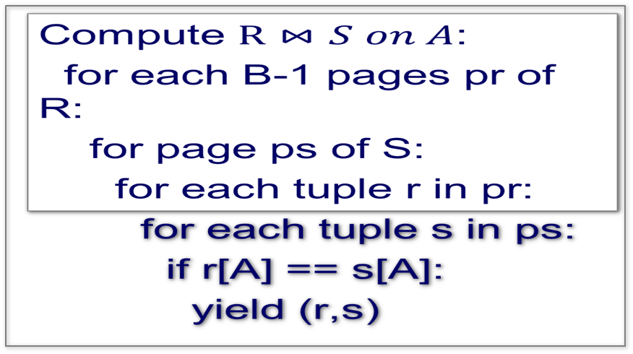
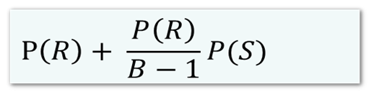
Block Nested Loop Join (BNLJ)
Given B+1 pages of memory
Cost:
Load in B-1 pages of R at a time (leaving 1 page each free for S & output)
For each (B-1)-page segment of R, load each page of S

Slide 19
Block Nested Loop Join (BNLJ)
Given B+1 pages of memory
Cost:
Load in B-1 pages of R at a time (leaving 1 page each free for S & output)
For each (B-1)-page segment of R, load each page of S
Check against the join conditions
BNLJ can also handle non-equality constraints

Slide 20
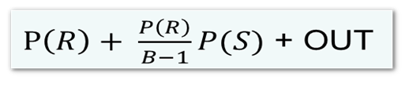
Block Nested Loop Join (BNLJ)
Given B+1 pages of memory
Cost:
Load in B-1 pages of R at a time (leaving 1 page each free for S & output)
For each (B-1)-page segment of R, load each page of S
Check against the join conditions
Write out
Again, OUT could be bigger than P(R)*P(S)… but usually not that bad

Slide 21
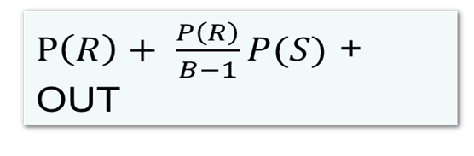
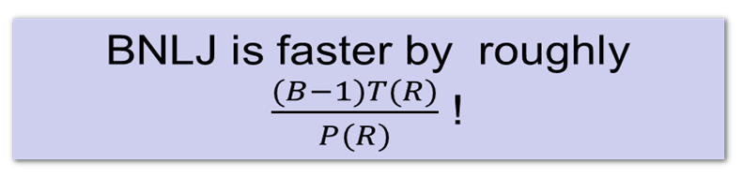
BNLJ vs. NLJ: Benefits of IO Aware
Lecture 14 > Section 2 > BNLJ
In BNLJ, by loading larger chunks of R, we minimize the number of full disk reads of S
  We only read all of S from disk for every (B-1)-page segment of R!
  Still the full cross-product, but more done only in memory
BNLJ
NLJ
P(R) + T(R)*P(S) + OUT

Slide 22
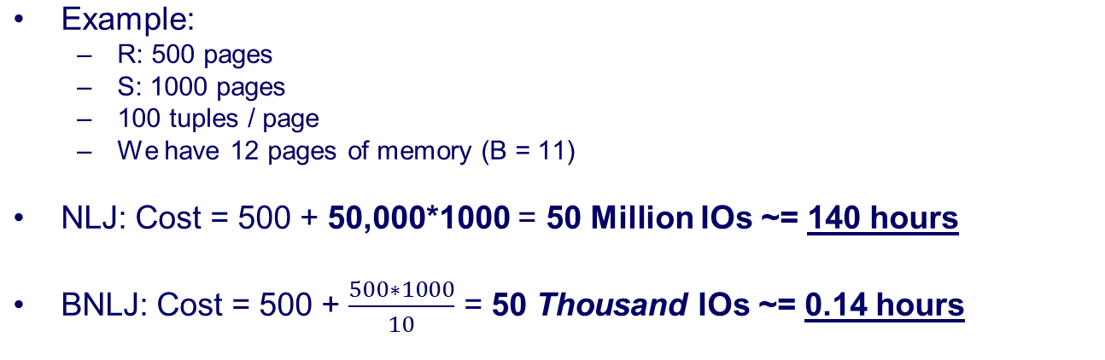
BNLJ vs. NLJ: Benefits of IO Aware
Ignoring OUT here…
A very real difference from a small change (IO-awareness)
in the algorithm!

Slide 23
Nested Loops Join cont.
index nested loops join …
temporary index nested loops join …

Slide 24
Nested Loops Join
Pros: any join condition
Cons: expensive
  Tables fit in memory
  Smaller table fits in memory (-> inner table)

Slide 25
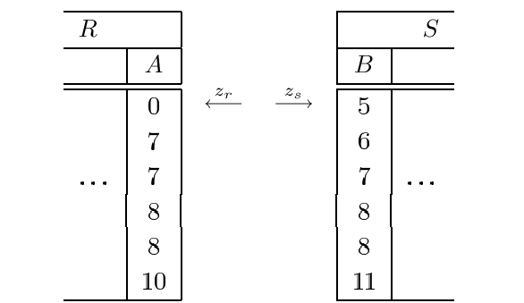
Sort-Merge-Join
Sort relations by join attribute,
Interleaved linear scan

Slide 26
Sort-merge join
function sortMerge(relation left, relation right, attribute a)
var relation output
var list left_sorted := sort(left, a)
var list right_sorted := sort(right, a)
var left_key
var right_key
var set left_subset
var set right_subset
…
Notes:
Sort merge join before
Distinct
Index

Slide 27
Sort-merge join 2
…
advance(left_subset, left_sorted, left_key, a)
advance(right_subset, right_sorted, right_key, a)
while not empty(left_subset) and not empty(right_subset)
if left_key = right_key
add cross product of left_subset
and right_subset to output
advance(left_subset, left_sorted, left_key, a)
advance(right_subset,right_sorted, right_key, a)
else if left_key < right_key
advance(left_subset, left_sorted, left_key, a)
else // left_key > right_key
advance(right_subset, right_sorted, right_key, a)
return output
…
Notes:
Sort merge join before
Distinct
Index

Slide 28
Sort-merge join 3
…
function advance(subset, sorted, key, a)
key = sorted[1].a
subset = emptySet
while not empty(sorted) and
sorted[1].a = key
insert(subset, sorted[1])
remove first element from sorted
Notes:
Sort merge join before
Distinct
Index

Slide 29
Sort-merge join
Join operators
  Also <, <=, >, >=

Slide 30
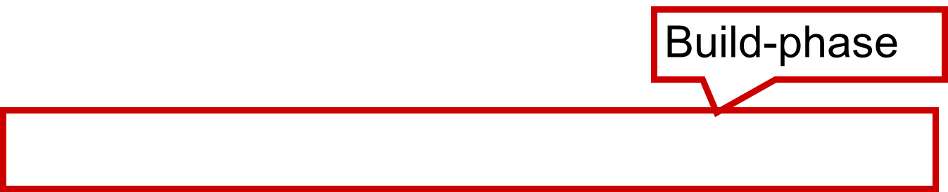
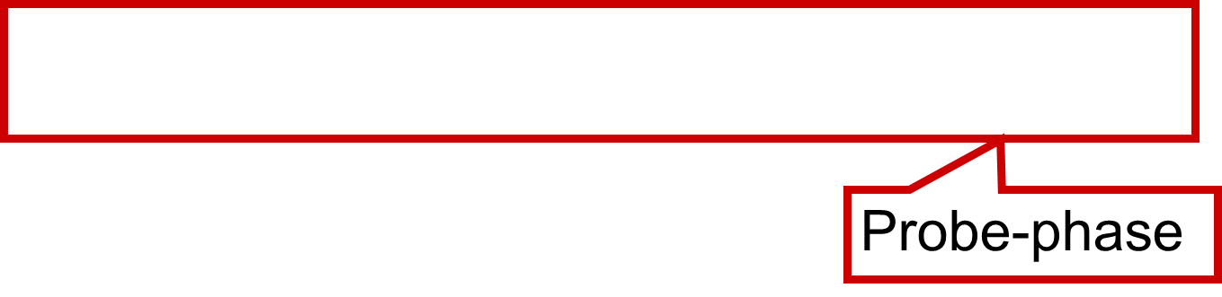
Simple Hash Join (1)
Partition relation R in R₁, R₂, ..., R_{p} with Hash-function h
so that for all tuples r ∈ R_{i} h(r.A) ∈ H_{i}.
Scan relation S, apply for each tuple s ∈ S the hash function h. Is h(s.B) in H_{i}, search there for fitting r
repeat
  begin
  while memory not exhausted do
  insert next(R) into partition[h(next(R).A)];
  foreach s ∈ S do
foreach r ∈ partition[h(s.B)] do
if r.A = s.B Res := Res ∪ (r □ s)
  end
until R exhausted

Slide 31
Hash Join
Size of hash-table > available RAM
  Multiple scans! (Very) slow!
(Grace hash join)
  Partitioning R and S via a hash function
  Join only within partitions
  avoids multiple rescanning of entire S relation

Slide 32
Hash Join
Pros
  quick (if memory sufficient)!
Cons
  Memory requirement
  Join operator: only „=“

Slide 33
Resource requirement, complexity
(comparison step)
Nested-Loop
Merge
Hash
Element comparisons
Successful element comparisons

Slide 34
Comparison
Size and schema of relations in join
Available indices
Other operations (presorted intermediate results)
Available memory
Join-type (natural join, theta-join, equijoin;
outer join?)

Slide 35
Cost based query optimization

Slide 36
Query execution
SQL: very high level, declarative
  What to retrieve, not how!
SQL query is translated by the query processor into a low level program – the execution plan
An execution plan is a program that can be executed to get the answer to the query.

Slide 37
Key Idea: Algebraic Optimization
N = ((n*5)+(n*2)+0)/1
Algebraic laws:
  (+) identity: x+0=x
  (/) identity: x/1=x
  (*) distributes: (y*x)+(z*x)=(y+z)*x
  (*) commutes: y*x=x*y
Rules 1, 3, 4,2:
  N=(5+2)*n

Slide 38
Relational algebra
Equivalences
1. Selection σ_{c1∧c2 ∧...∧ cn} (R) ≡ σ_{c1}(σ_{c2}(…(σ_{cn}(R)) …))
2. σ is commutative σ_{c1}(σ_{c2}((R)) ≡ σ_{c2}(σ_{c1}((R))
3. π -cascades: If L₁ ⊆ L₂ ⊆ … ⊆ L_{n}, then
π_{L1}(π_{L2} (…(π_{Ln}(R)) …)) ≡ π_{L1}(R)
4. Changing σ and π
If the selection only refers to the projected attributes A₁, …, A_{n},
selection and projection can be exchanged
σ_{c}(π_{A1, …, An}(R)) ≡ π_{A1, …, An}(σ_{c}(R))

Slide 39
Equivalences 2
5. , ⋈, ∪ and ∩ are commutative
6. A Cartesic product, followed by a selection referring to both operands can be replaced by a join.
σc(R  S) ≡ R ⋈c S
....

Slide 40
Equivalences - summary
σ_{c1∧c2 ∧...∧ cn} (R) ≡ σ_{c1}(σ_{c2}(…(σ_{cn}(R)) …))
σ_{c1}(σ_{c2}((R)) ≡ σ_{c2}(σ_{c1}((R))
π_{L1}(π_{L2} (…(π_{Ln}(R)) …)) ≡ π_{L1}(R)
σ_{c}(π_{A1, …, An}(R)) ≡ π_{A1, …, An}(σ_{c}(R))
R Φ S ≡ S Φ R (⋈, , ∪, ∩)
σ_{c}(R  S) ≡ R ⋈_{c} S
σ_{c}(R Φ S) ≡ σ_{c}(R) Φ S (⋈, )
σ_{c}(R Φ S) ≡ σ_{c1}(R) Φ σ_{c2}(S) (⋈, )
π_{L}(R ⋈_{c} S) ≡ (π_{A1, …, An}(R)) ⋈_{c} (π_{B1, …, Bn}(S))
π_{L}(R ⋈_{c} S) ≡ π_{L}((π_{A1, …, An, A1', …, An'}(R)) ⋈_{c} (π_{B1, …, Bn, B1', …, Bn'}(S)))
(R ΦS) ΦT ≡ R Φ(S ΦT) (⋈, , ∪, ∩)
σ_{c}(R Φ S) ≡(σ_{c}(R)) Φ (σ_{c}(S)) (∪, ∩ , −)
π_{L}(R Φ S) ≡(π_{L}(R)) Φ (π_{L}(S)) (∪, ∩ , −)

Slide 41
Query optimisation
One SQL query – many (!) different execution plans, execution alternatives
  Index – using, not using
    tendence: selective query – using
    Multiple indices, which index to use?
  Join execution?
    Size of tables, available memory…
  Join order ?
Dramatically different costs!
Query optimizer: choosing a relatively good execution plan

Slide 42
Query execution
SQL
Query parser
Internal query description
Transformation
Internal query description
Query optimizer
Query Execution Plan
Query execution

Slide 43
Query execution (detailed)
Query parser
Parsing
Semantic check (tables, attributes – Data Dictionary)
View expansion
Transformation
Query optimizer
Query execution

Slide 44
Query execution (detailed)
Query parser
Standardized description
(operator tree)
Transformation
Query optimizer
Query execution

Slide 45
Query execution (detailed)
Query parser
Transformation
Optimisation (cost-based):
Setting up execution plans
Estimating their costs
Selecting a cheap execution plan
Query optimizer
Query execution

Slide 46
Query execution (detailed)
Query parser
Transformation
Query optimizer
Execution of selected execution plan
Query execution

Slide 47
Transformation, operator tree
π_{A1, A2,..., An}
select A₁, A₂,..., A_{n}
from R₁, R₂,..., R_{m}
where B
σ_{B}
×
⇒ π_{A1, A2,..., An} (σ_{B} (R₁ × R₂ × ... × R_{m}))
×
R_{m}
×
R₃
R₁
R₂

Slide 48
Example
select FlugNr
from (select F.∗, FT.∗, count (TicketNr)
from FLUG F, FLUGZEUGTYP FT, BUCHUNG B
where B.FlugNr = F.FlugNr
group by F.∗, FT.∗, Datum) as DFT(F.∗,FT.∗,count)
where F.FtypId = FT.FtypId
and FT.First+FT.Business+FT.Economy
< DFT.count

Slide 49
Example
π
F.FlugNr
π_{F.FlugNr} (
σ_{F.FtypId =}
FT.FtypId ∧ FT.First+FT.Business+FT.Economy < count (
ρ_{F.∗,FT.∗,count} (
π_{F.∗, FT.∗, count (TicketNr)} (
γ_{F.∗, FT.∗, Datum} (
σ_{B.FlugNr = F.FlugNr} (FLUG F × FLUGZEUGTYP FT BUCHUNG B))))))
F.FtypId = FT.FtypId ∧
FT.First+FT.Business+FT.Economy < count
σ
ρ
F.∗, FT.∗, count
π
F.∗, FT.∗, count (TicketNr)
γ
F.∗, FT.∗, Datum
σ
B.FlugNr = F.FlugNr
×
×
FLUG F
FLUGZEUGTYP FT
BUCHUNG B

Slide 50
Basic idea
Some transformations always reasonable
Some transformations depend on data
  Optimizing the average case
  Keep intermediate results as small as possible
Executing σ, π early, ⋈, , ∪,… late, as
  σ and π reduces the volume of data,
  ⋈, … result often in large intermediate results.

Slide 51
Example
select Lname
from Employee, WorksOn, Project
where Pname = 'GOM‘
and Pnumber = PNO
and ESSN = SSN
and Bdate > 58.04.16
(Select the lastname of an employee born after 16.04.58 and working on the project „GOM”)

Slide 52
π_{Lname}
σPname=‘GOM‘ ∧ Pnumber = PNO ∧ ESSN= SSN ∧ Bdate > 58.04.16
×
×
PROJECT
EMPLOYEE
WORKS_ON
Selection as early, as possible

Slide 53
π_{Lname}
σ_{Pnumber = PNO}
×
σ_{ESSN=SSN}
σ_{Pname=‘GOM‘}
×
PROJECT
σ_{Bdate>58.04.16}
WORKS_ON
EMPLOYEE
Restrictive joins early

Slide 54
π_{Lname}
σ_{ESSN=SSN}
×
σ_{Pnumber = PNO}
σ_{Bdate>58.04.16}
×
EMPLOYEE
σ_{Pname=‘GOM‘}
WORKS_ON
PROJECT
Cross product and selection => join

Slide 55
π_{Lname}
⋈_{ESSN=SSN}
⋈_{Pnumber = PNO}
σ_{Bdate>58.04.16}
σ_{Pname=‘GOM‘}
EMPLOYEE
WORKS_ON
PROJECT
Projections as early, as possible
(attributes for result and intermediate results kept)

Slide 56
π_{Lname}
⋈_{ESSN=SSN}
π_{ESSN}
π_{SSN,Lname}
⋈_{Pnumber = PNO}
σ_{Bdate>58.04.16}
π_{Pnumber}
π_{ESSN,PNO}
EMPLOYEE
σ_{Pname=‘GOM‘}
WORKS_ON
PROJECT

Slide 57
Join-order
Many joins
Joins expensive
⋈
⋈
⋈
⋈
R₁
⋈
⋈
R₁
⋈
⋈
R₂
R₁
R₂
R₃
R₄
R₂
⋈
R₄
R₃
R₃
R₄
Left oriented join trees, greedy search...

Slide 58
Execution mode
Full calculation
  Node fully calculated before next operator
Pipeline
  Tuple calculated at one node sent immediately to next node

Slide 59
Execution modes (2)
...
...
...
...
...
...
R
S
T

Slide 60
Pipeline breaker
...
...
...
...
...
...
R
S
T

Slide 61
Pipeline-Breaker
Unary operations
  Sort
  Duplicate elimination (unique distinct)
  Aggregation (min, max, sum)
Binary operations
  Set difference
Depending on the implementation
  Join
  Union

Slide 62
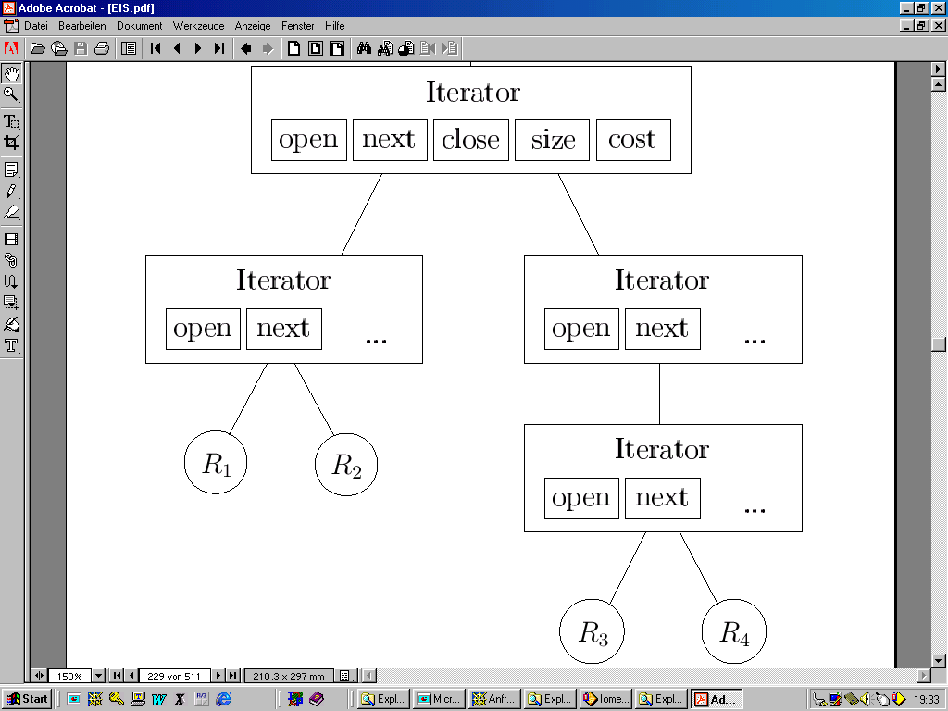
Unified description of operators
Information on costs
Initialisation
Information on selectivity
Clean up (closing iterators, freeing memory, stop blocking if full result required)
Reading next tuple

Slide 63
next
open
Return
result

Slide 64
TOP-N Query
Only the first N rows of the result are required
Execution plan optimized specifically for this
  Hard decisions
  Soft decisions (internal restart of query possible with a low probability)

Slide 65
Cost based selection
Query parser
Transformation
Optimisation (cost-based):
Setting up execution plans
Estimating their costs
Selecting a cheap execution plan
Query optimizer
Query execution

Slide 66
Several operator trees
Declarative SQL-Query
Spanning search space
Logical
optimisation
Physical optimisation
Equivalent execution plans
Execution variations (algorithms)
Search
Cost based selection
„Acceptable (good)“ plan

Slide 67
Cost function
Cost of execution
  One major factor: disk access, number of blocks
Size of intermediate result of fundamental importance
  Estimation on selectivities required
DBMS calculates and stores different statistics on the data

Slide 68
Oracle

Slide 69
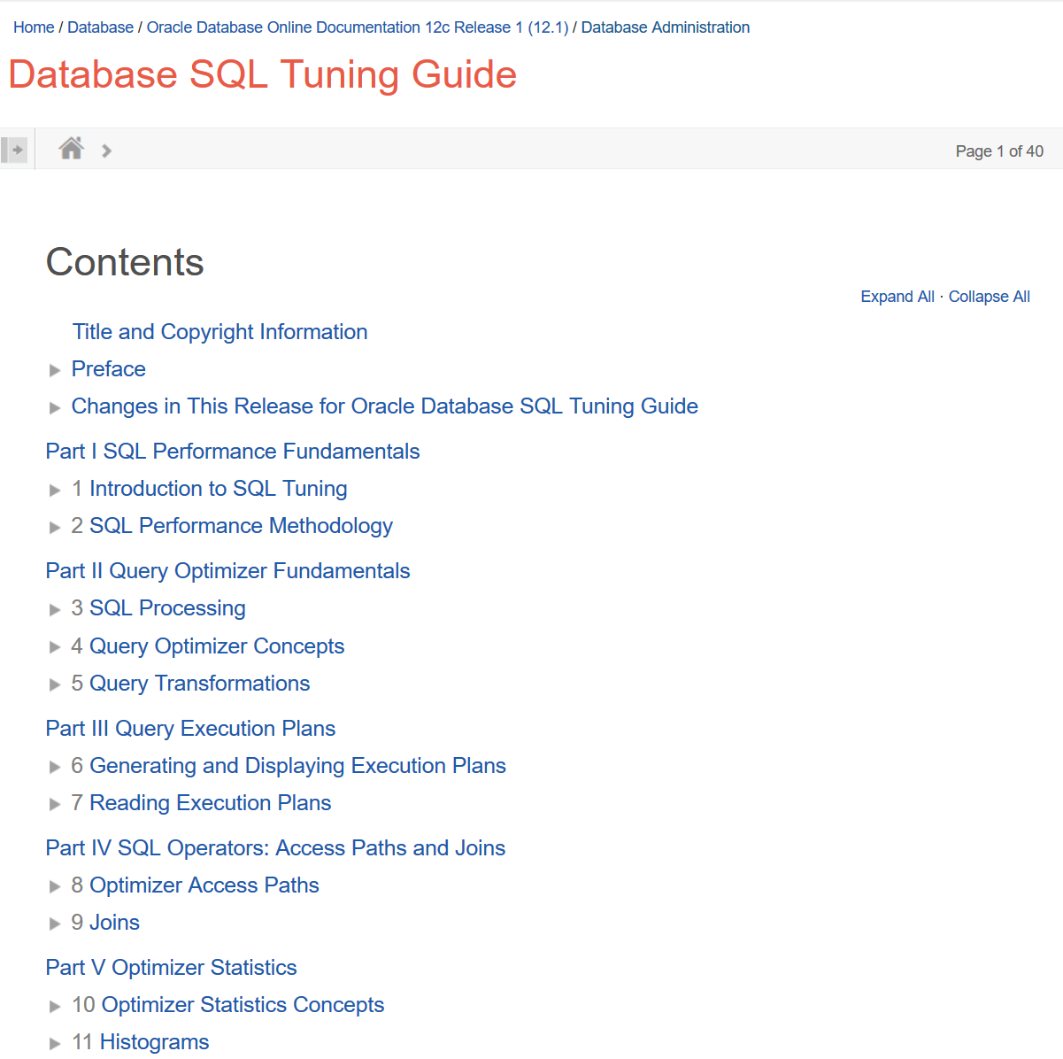

Database SQL Tuning Guide
(Oracle 12c, Database Administration)

Slide 70

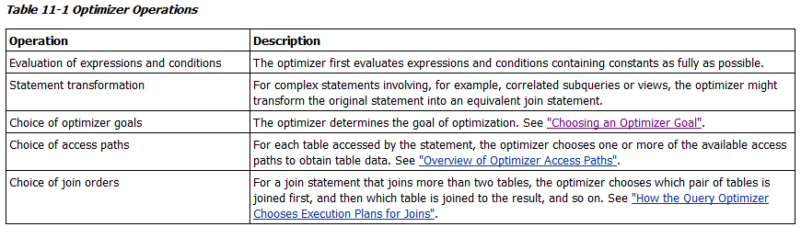
Optimizer Operations
Best throughput
Best response time

Slide 71
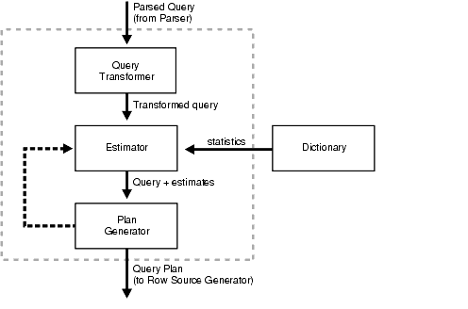
Components of the Query Optimizer

Slide 72
Costs
The cost is an estimated value proportional to the expected resource use needed to execute the statement with a particular plan. The optimizer calculates the cost of access paths and join orders based on the estimated computer resources, which includes I/O, CPU, and memory.

Slide 73
Statistics in databases
Oracle
  TABLES:
    num_rows,
    num_blocks
    avg_row_len
  TAB_COL_STATISTICS
    num_distinct
    num_nulls
    num_buckets
INDEXES
  leaf_blocks
  blevel

Slide 74
Calculation of statistics
Task of database administrator (expensive task!)
analyze table relation
compute statistics for columns attribute,..., attribute size value
analyze table relation
estimate statistics sample value percent

Slide 75
Tasks

Slide 76
Check the execution plan of the earlier query for statistics on groups in Grapefon (number of members, shared audio).
Oracle Documentation: Oracle 12 g Database SQL Tuning Guide, OPERATION and OPTIONS Values Produced by EXPLAIN PLAN

Slide 77
Check the execution plan of the following for queries! Can you find any differences? What are the reasons for the differences?
SELECT COUNT(*)
FROM audio_large
INNER JOIN historyitems_large
ON audio_large.id = historyitems_large.audio_id;
SELECT COUNT(historyitems_large.rating)
FROM audio_large
INNER JOIN historyitems_large
ON audio_large.id = historyitems_large.audio_id;
SELECT AVG(historyitems_large.rating)
FROM audio_large
INNER JOIN historyitems_large
ON audio_large.id = historyitems_large.audio_id;
SELECT COUNT(historyitems_large.updated_at)
FROM audio_large
INNER JOIN historyitems_large
ON audio_large.id = historyitems_large.audio_id;

Slide 78
Check the execution plan of the following queries! (For the 2nd and 3rd queries, please only check the execution plans, without starting the queries.) What are the differences? Why?
SELECT COUNT(audio_large.user_id)
FROM audio_large
INNER JOIN historyitems_large
ON audio_large.id = historyitems_large.audio_id;
SELECT COUNT(audio_large.user_id)
FROM audio_large
INNER JOIN historyitems_large
ON audio_large.id BETWEEN historyitems_large.audio_id - 0.5 AND historyitems_large.audio_id + 0.5 ;
SELECT COUNT(audio_large.user_id)
FROM audio_large
INNER JOIN historyitems_large
ON audio_large.id - historyitems_large.audio_id = 0;

Slide 79
Check changes in the execution plan as the selectivity of the condition in the WHERE clause changes! (Change the condition on the user_id first!)
SELECT *
FROM audio_large
inner join historyitems_large
ON audio_large.id = historyitems_large.audio_id
WHERE To_char(historyitems_large.started_at, 'yyyymmdd') = '20160302'
AND audio_large.user_id < 500;

