Slide 1

Database management, advanced
Procedural languages for relational databases
Gergely Lukács
Pázmány Péter Catholic University
Faculty of Information Technology and Bionics
Budapest, Hungary
lukacs@itk.ppke.hu

Slide 2
SQL Procedural Extension
SQL functionality limited, procedural processing power needed
  (not: PL/SQL functions, loops instead of SQL constructs – optimiser!!)
„Code to data” (rather than „data to code”)
  performance: reducing network traffic.
  security
  transaction management (s. later)
Modular, maintainable, reusable software development
Special features for data processing
  Embedding SQL
  Special data types
  Error handling

Slide 3
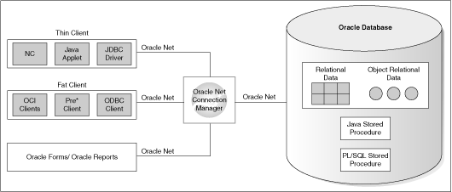
(Application Development)

Slide 4
Standadization ?!
Oracle
  PL/SQL
  Java
PostgreSQL
  PL/pgSQL
  PL/Tcl
  PL/Perl
  PL/Python
IBM DB2 SQL PL
Microsoft MS SQL Server: TSQL
MySQL SQL/PSM
HANA SQLScript
Standard ?
  SQL/PSM; SQL:1999, SQL:2011; IBM DB2, MySQL
3

Slide 5
SQL vs. External application vs. Stored procedure
First try to solve your problem with plain SQL
If you can't do it with sql, then try PL/SQL
Only use other languages like Java externally of your database if you can't do it internally.
  – OR –
2. Keep processing out of the database
3. Only use PL/SQL instead of external application, if needed e.g. for performance reasons

Slide 6
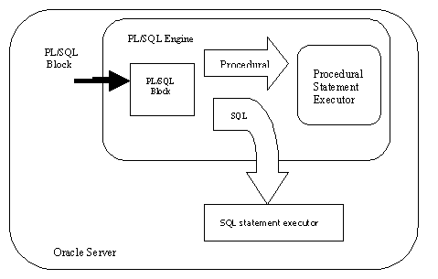
Processing SQL and PL/SQL

Slide 7
PL/SQL Block
variables, constants, records and cursors
programmatic constructs like loops, conditional statement and SQL statements
DECLARE
Variable declaration
BEGIN
Program Execution
EXCEPTION
Exception handling
END;
Anonymous Blocks: have no name (like scripts)
    can be written and executed immediately
      They are not stored in the database and cannot be executed again!
    can be used in a trigger
Named Blocks
  They are stored in the database
    Procedures
    Functions
Graceful error handling

Slide 8
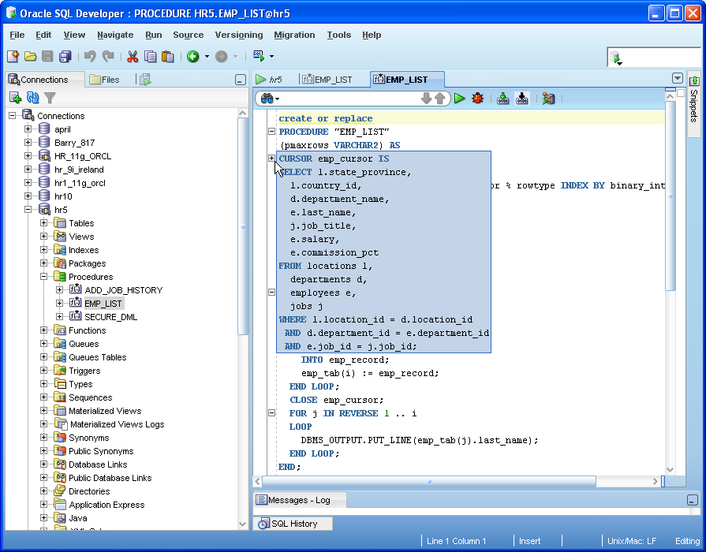
Development Tools
(Oracle SQL Developer)
Full Function Editor
Code Formatter
Syntax Highlighting
Code Insight (auto complete)
Code Folding
Inline Error Reporting
Code Bookmarking
Customizable Quick Keys
Run Procedures, Functions, and Packages
  DBMS_OUTPUT
  Function return values
  OUT parameters
Full functioning debugger
  Control program execution(Step into, over, ...)
  Inspect and modify variables
  Configure breakpoint conditions
…
6

Slide 9
Database PL/SQL Language Reference
(Home / Database / Oracle Database Online Documentation 12c Release 1 (12.1) / Database Administration)
https://docs.oracle.com/database/121/LNPLS/toc.htm
Useful links (couple of slides are from here) :
  http://plsql-tutorial.com/
  http://www.exforsys.com/tutorials/pl-sql.html (detailed, somewhat old: Oracle 9)

Slide 10
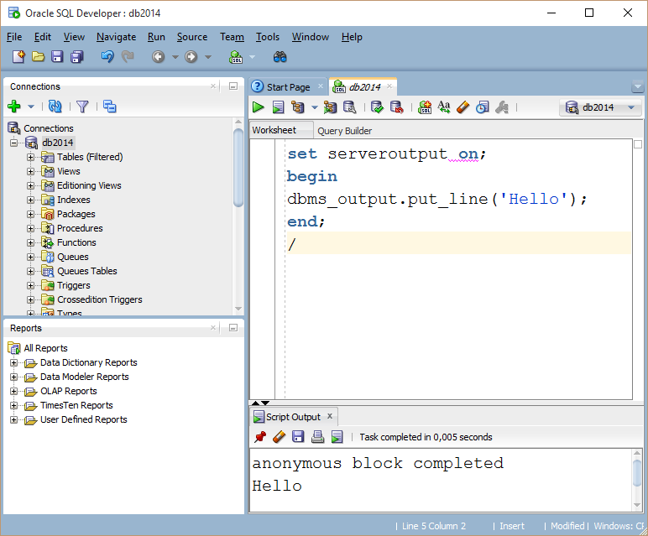
Hello Word Example
set serveroutput on;
dbms_output.putline(string);
dbms_output.put(string)

Slide 11
DECLARE
Syntax
Examples
identifier [CONSTANT] datatype [NOT NULL]
[:= | DEFAULT expr];
Notice that PL/SQL includes all SQL types, and more…
Declare
birthday DATE;
age NUMBER(2) NOT NULL := 27;
name VARCHAR2(13) := 'Levi';
magic CONSTANT NUMBER := 77;
valid BOOLEAN NOT NULL := TRUE;

Slide 12
Declaring Variables with
%TYPE and %ROWTYPE
Examples
This variable can accept one record, same type as
Tuple in the table Emp
DECLARE
v_hold_one_row Emp%ROWTYPE;
v_name Emp.name%TYPE;
v_fav_emp VARCHAR2(30);
Variable for column „name” in table Emp
v_hold_one_row :=987;
v_hold_one_row:=877;

Slide 13
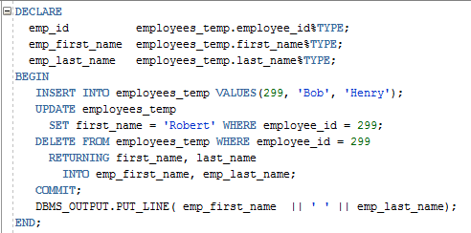
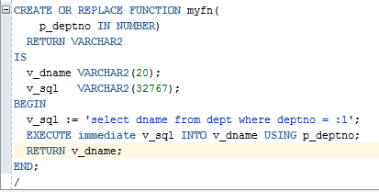
SQL in PL/SQL
INSERT/UPDATE/DELETE directly in PL/SQL
Bind variables

Slide 14
SELECT Statements returning exactly one row (INTO clause)
DECLARE
v_ename VARCHAR2(10);
v_id NUMBER(3);
BEGIN
SELECT ename, id
INTO v_ename, v_id
FROM emp
WHERE id = '112';
END;
/
When not exactly one row is returned:
  NO_DATA_FOUND or TOO_MANY_ROWS exception is thrown

Slide 15
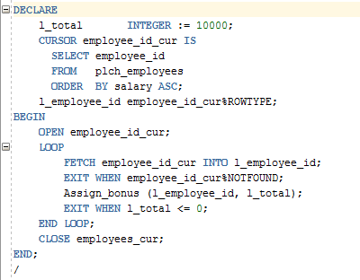
Statements returning more than one row (cursors)
definition
open
fetch
Check, if found
close

Slide 16
Explicit Cursor Attributes
Obtain status information about a cursor.
Attribute Type Description
%ISOPEN Boolean Evaluates to TRUE if the cursor is open.
%NOTFOUND Boolean Evaluates to TRUE if the most recent fetch does not return a row.
%FOUND Boolean Evaluates to TRUE if the most recent fetch returns a row; complement of %NOTFOUND
%ROWCOUNT Number Evaluates to the total number of rows returned so far.
Notes:
Explicit Cursor Attributes
As with implicit cursors, there are four attributes for obtaining status information about a cursor. When appended to the cursor or cursor variable, these attributes return useful information about the execution of a data manipulation statement.
Note: Do not reference cursor attributes directly in a SQL statement.

Slide 17
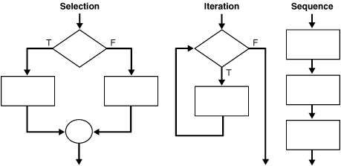
PL/SQL Control structures
http://docs.oracle.com/cd/B28359_01/appdev.111/b28370/controlstructures.htm

Slide 18
Loops: Simple Loop
create table number_table(
num NUMBER(10)
);
DECLARE
i number_table.num%TYPE := 1;
BEGIN
LOOP
INSERT INTO number_table
VALUES(i);
i := i + 1;
EXIT WHEN i > 10;
END LOOP;
END;
Notes:
Basic Loop
The basic loop example shown in the slide is defined as follows: insert the first 10 new line items for order number 101.
Note: A basic loop allows execution of its statements at least once, even if the condition has been met upon entering the loop.

Slide 19
Loops: Simple Loop with cursor
create table number_table(
num NUMBER(10)
);
DECLARE
cursor c is select * from number_table;
cVal c%ROWTYPE;--cursor type!!
BEGIN
open c;
LOOP
fetch c into cVal;
EXIT WHEN c%NOTFOUND;
insert into duplicate values(cVal.num*2);
END LOOP;
close c;
END;
Notes:
Basic Loop
The basic loop example shown in the slide is defined as follows: insert the first 10 new line items for order number 101.
Note: A basic loop allows execution of its statements at least once, even if the condition has been met upon entering the loop.

Slide 20
Loops: FOR Loop
DECLARE
i number_table.num%TYPE;
BEGIN
FOR i IN 1..10 LOOP
INSERT INTO number_table VALUES(i);
END LOOP;
END;
Notice that i is incremented automatically

Slide 21
Loops: For Cursor Loops
DECLARE
cursor c is select * from number_table;
BEGIN
for num_row in c loop
insert into doubles_table
values(num_row.num*10);
end loop;
END;
/
Notice that a lot is being done implicitly: declaration of num_row, open cursor, fetch cursor, the exit condition
Notes:
Cursor FOR Loops
A cursor FOR loop processes rows in an explicit cursor. The cursor is opened, rows are fetched once for each iteration in the loop, and the cursor is closed automatically when all rows have ben processed. The loop itself is terminated automatically at the end of the iteration where the last row was fetched.

Slide 22
Loops: Simple Loop with cursor
DECLARE
v_ename emp.ename%TYPE;
CURSOR c_managers IS
SELECT ename FROM emp WHERE job = 'MANAGER';
BEGIN
OPEN c_managers ;
LOOP
FETCH c_managers INTO v_ename;
DBMS_OUTPUT.put_line(v_ename);
EXIT WHEN c_managers%NOTFOUND;
END LOOP;
END;
/

Slide 23
Loops: WHILE Loop
DECLARE
TEN number:=10;
i number_table.num%TYPE:=1;
BEGIN
WHILE i <= TEN LOOP
INSERT INTO number_table
VALUES(i);
i := i + 100;
END LOOP;
END;
Notes:
WHILE Loop
In the example in the slide, the quantity increases with each iteration of the loop until the quantity is no longer less than the maximum price allowed for spending on the item.

Slide 24
IF-THEN-ELSIF Statements
. . .
IF mark<2 THEN
v_message := 'You failed';
ELSIF mark < 4 THEN
v_message := 'Not bad';
ELSE
v_message := 'Pretty good';
END IF;
. . .
Notes:
IF-THEN-ELSIF Statements
When possible, use the ELSIF clause instead of nesting IF statements. The code is easier to read and understand, and the logic is clearly identified. If the action in the ELSE clause consists purely of another IF statement, it is more convenient to use the ELSIF clause. This makes the code clearer by removing the need for nested END IFs at the end of each further set of conditions and actions.
Example
IF condition1 THEN
statement1;
ELSIF condition2 THEN
statement2;
ELSIF condition3 THEN
statement3;
END IF;
The example IF-THEN-ELSIF statement above is further defined as follows:
For a given value entered, return a calculated value. If the entered value is over 100, then the calculated value is two times the entered value. If the entered value is between 50 and 100, then the calculated value is 50% of the starting value. If the entered value is less than 50, then the calculated value is 10% of the starting value.
Note: Any arithmetic expression containing null values evaluates to null.

Slide 25
Exception handling
-- Reminder: structure of a block
DECLARE (optional)
  /* Here you declare the variables you will use in this block */
BEGIN (mandatory)
  /* Here you define the executable statements (what the block DOES!)*/
EXCEPTION (optional)
  /* Here you define the actions that take place if an exception is thrown during the run of this block */
END; (mandatory)
/

Slide 26
Trapping Exceptions
Runtime errors vs compile time errors
  NO_DATA_FOUND
  TOO_MANY_ROWS
  ZERO_DIVIDE
Exception handling: actions that should happen when an exception is thrown.
When handling an exception, consider performing a rollback
Notes:
Trapping Predefined Oracle Server Errors
Trap a predefined Oracle Server error by referencing its standard name within the corresponding exception-handling routine.
Note: PL/SQL declares predefined exceptions in the STANDARD package.
It is a good idea to always consider the NO_DATA_FOUND and TOO_MANY_ROWS exceptions, which are the most common.

Slide 27
Trapping Exceptions
    EXCEPTION
    WHEN NO_DATA_FOUND THEN
    DBMS_OUTPUT.PUT_LINE
    (‘ There is no student with student id 123 ’);
    END;

Slide 28
DECLARE
num_row number_table%ROWTYPE;
BEGIN
select *
into num_row
from number_table;
dbms_output.put_line(1/num_row.num);
EXCEPTION
WHEN NO_DATA_FOUND THEN
dbms_output.put_line('No data!');
WHEN TOO_MANY_ROWS THEN
dbms_output.put_line('Too many!');
WHEN OTHERS THEN
dbms_output.put_line(‘Error’);
end;
Notes:
Trapping Predefined Oracle Server Exceptions
In the slide example for each exception, a message is printed out to the user.
Only one exception is raised and handled at any time.

Slide 29
User-Defined Exception
DECLARE
e_number1 EXCEPTION;
cnt NUMBER;
BEGIN
select count(*)
into cnt
from number_table;
IF cnt = 1 THEN RAISE e_number1;
ELSE dbms_output.put_line(cnt);
END IF;
EXCEPTION
WHEN e_number1 THEN
dbms_output.put_line('Count = 1');
end;
Notes:
Trapping User-Defined Exceptions
You trap a user-defined exception by declaring it and raising it explicitly.
1. Declare the name for the user-defined exception within the declarative section.
Syntax
exception EXCEPTION;
where: exception is the name of the exception.
2. Use the RAISE statement to raise the exception explicitly within the executable section.
Syntax
RAISE exception;
where: exception is the previously declared exception.
3. Reference the declared exception within the corresponding exception handling routine.
In the slide example: This customer has a business rule that states a that a product can not be removed from its database if there is any inventory left in-stock for this product. As there are no constraints in place to enforce this rule, the developer handles it explicitly in the application. Before performing a DELETE on the PRODUCT table, the block queries the INVENTORY table to see if there is any stock for the product in question. If so, raise an exception.
Note: Use the RAISE statement by itself within an exception handler to raise the same exception back to the calling environment.

Slide 30
Functions and Procedures
Up until now, our code was in an anonymous block
It was run immediately
It is useful to put code in a function or procedure so it can be called several times
Once we create a procedure or function in a Database, it will remain until deleted (like a table).

Slide 31
Functions and Procedures
The header specifies
: name and parameter list
  : return type (function headers)
  : any of the parameters can
  have a default value
  : modes - IN, OUT, IN OUT
Function example
Procedure example
CREATE FUNCTION get_department_no
( p_dept_name IN VARCHAR2 := null)
RETURN NUMBER
IS
DECLARE
- - - - - - - -
BEGIN
- - - - - - - - -
RETURN(l_dept_no);
EXCEPTION
- - - - - - - - -
END;
CREATE PROCEDURE department_change
(p_dept_number IN NUMBER, p_new_name IN OUT VARCHAR2)
AS
DECLARE
BEGIN …………..
END;

Slide 32
Creating Procedures
CREATE [OR REPLACE] PROCEDURE procedure_name
[(parameter1 [mode1] datatype1,
parameter2 [mode2] datatype2,
. . .)]
IS|AS
PL/SQL Block;
Modes:
  IN: procedure must be called with a value for the parameter. Value cannot be changed
  OUT: procedure must be called with a variable for the parameter. Changes to the parameter are seen by the user (i.e., call by reference)
  IN OUT: value can be sent, and changes to the parameter are seen by the user
Default Mode is: IN

Slide 33
Example- what does this do?
Table mylog
create or replace procedure
num_logged
(person IN mylog.who%TYPE,
num OUT mylog.logon_num%TYPE)
IS
BEGIN
select logon_num
into num
from mylog
where who = person;
END;
/
who | logon_ num
Pete | 3
John | 4
Joe | 2

Slide 34
Calling the Procedure
declare
howmany mylog.logon_num%TYPE;
begin
num_logged(‘John',howmany);
dbms_output.put_line(howmany);
end;
/

Slide 35
Creating a Function
Almost exactly like creating a procedure, but you supply a return type
CREATE [OR REPLACE] FUNCTION
function_name
[(parameter1 [mode1] datatype1,
parameter2 [mode2] datatype2,
. . .)]
RETURN datatype
IS|AS
PL/SQL Block;

Slide 36
Creating a function
create or replace function squareFunc(num in number)
return number
is
BEGIN
return num*num;
End;
/
Using the function:
BEGIN
dbms_output.put_line(squareFunc(3.5));
END;
/

Slide 37
Packages
Logically connected Functions, Procedures, Variables can be put together in a package
In a package, you can allow some of the members to be "public" and some to be "private"
There are also many predefined Oracle packages

Slide 38
Packages
Many PL/SQL packages are provided within the Oracle Server
Extend the functionality of the database
Some example of such packages:
  : DBMS_JOB - for scheduling tasks
  : DBMS_OUTPUT - display messages to the session output device
  : UTL_HTTP - makes HTTP(S) callouts
  Note: can be used for accessing a web-service from the database
: PL/SQL web toolkit (HTP, HTF, OWA_UTIL, etc.)
Note: can be used for building web-based interfaces
e.g. https://edms.cern.ch

