Slide 1

Databases, advanced
Aggregation
Gergely Lukács
Pázmány Péter Catholic University
Faculty of Information Technology
Budapest, Hungary
lukacs@itk.ppke.hu

Slide 2
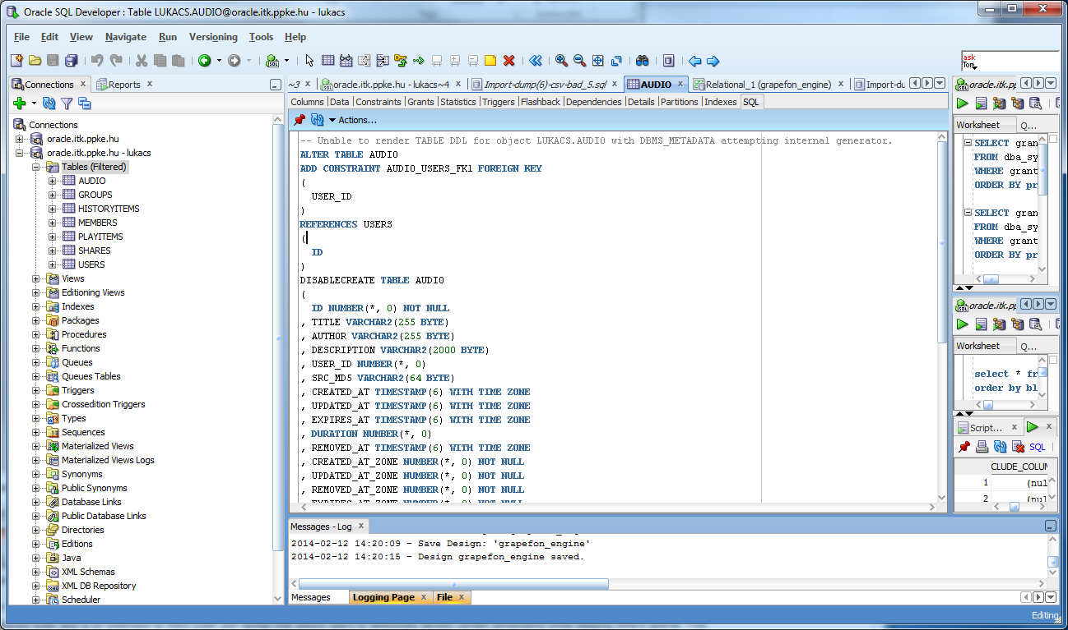
SQL Developer
Starting SQL Developer
Creating connection
Hostname: dboracle.itk.ppke.hu
Port: 1521
Service name: lab.itk.ppke.hu
Username: AD18_FAMFIRKER (3-3 characters of family name and christian name)
Jelszó: ******

Slide 3
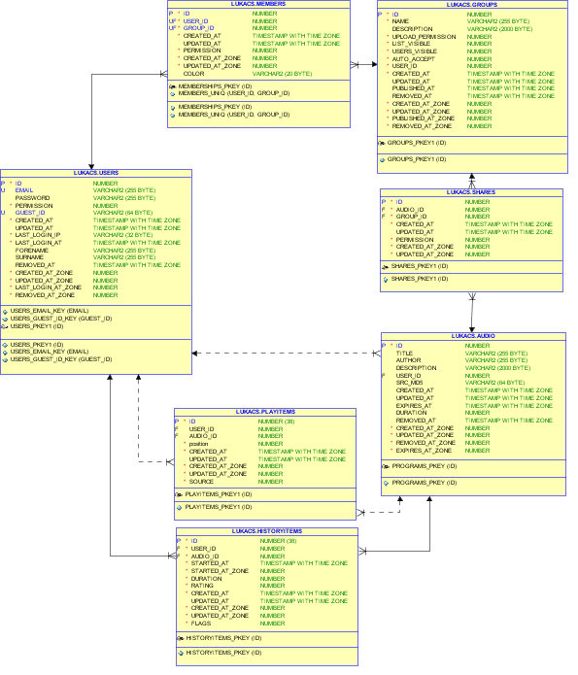
Grapefon - schema
Data modeler
Reverse engineering
+ hand layouting

Slide 4
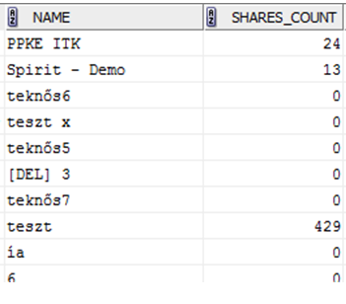
Groups – statistics of shared audio recordings
0: Create a statistics showing the shared audio content (count only) per group
  Handle groups not having any shared audio content correctly
  Use column alias names
  Format the SQL command

Slide 5
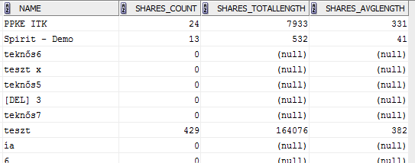
Groups – statistics of shared audio recordings
1. Create a statistics showing the shared audio content (count + average length, rounded to seconds) per group
  Handle groups not having any shared audio content correctly
  Use column alias names
  Format the SQL command
http://docs.oracle.com/cd/E11882_01/server.112/e26088/functions002.htm#SQLRF51178
Oracle® Database SQL Language Reference 11g Release 2 (11.2) Single-Row Functions

Slide 6
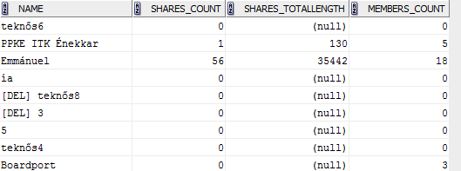
Groups, statistics of shared audio recordings and members
2. Extend the previous query with an additional column showing the number of the members in the group!

Slide 7

Users statistics based on registration time
3. Query the number of new user registration per month!

Slide 8
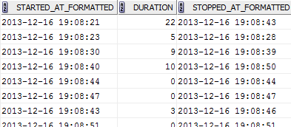
Listenings – with stop time
4. Query the start time, duration and stop time of historyitems !

Slide 9
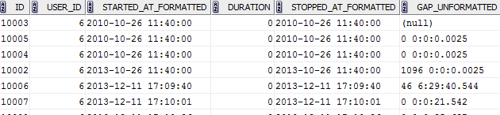
Listenings – with stop time and gap
5. Extend the previous query with an additional column showing the time gap between the end of the previous historyitem and the beginning of the current historyitems!
  Sort the result by user and starttime!
  (The value in the first row of each user shall be empty „NULL”)
  (The unit of the new column can als seconds)

Slide 10
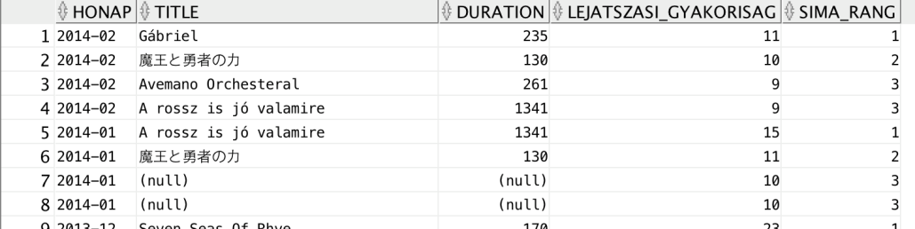
Hit list
6. Query the top 3 audio recordings per month with title number of listenings and total length of listening!
Test the analytic functions rownum(), rank() és dense_rank(). What is the difference?

Slide 11
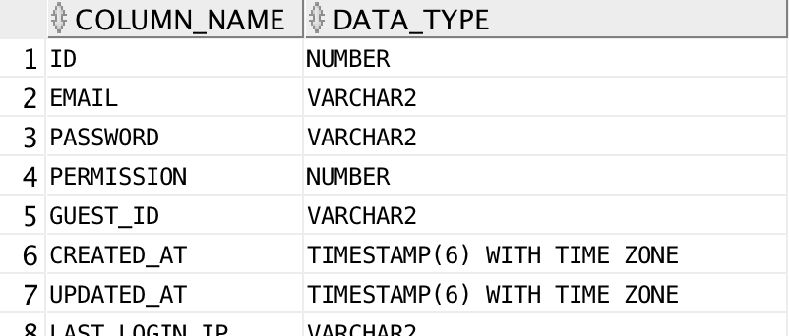
Querying the data dictionary
7. List the attributes and their datatypes of the grapefon table USERS! (ALL_TAB_COLS metadata view)

