Slide 1

Database management, advanced
SQL tasks
Aggregation, Analytic functions, pivoting
Gergely Lukács
Pázmány Péter Catholic University
Faculty of Information Technology and Bionics
Budapest, Hungary
lukacs@itk.ppke.hu

Slide 2
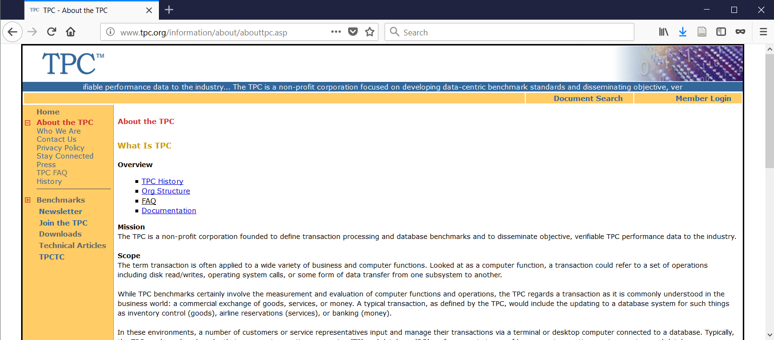
Complex SQL commands ;-)
TPC benchmarks
TPC Benchmark DS (TPC-DS) is a decision support benchmark
http://www.tpc.org/tpc_documents_current_versions/pdf/tpc-ds_v2.10.0.pdf
query: page 52-

Slide 3
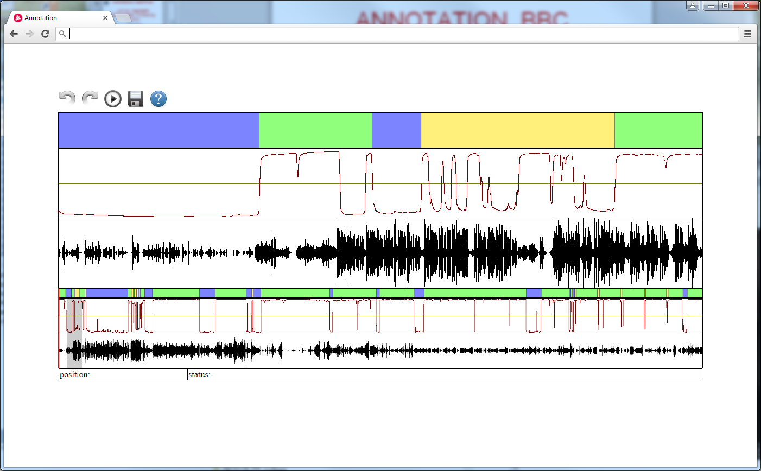
Background: Speech-music playlist generation

Slide 4

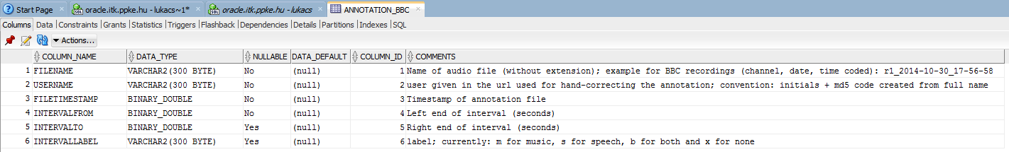
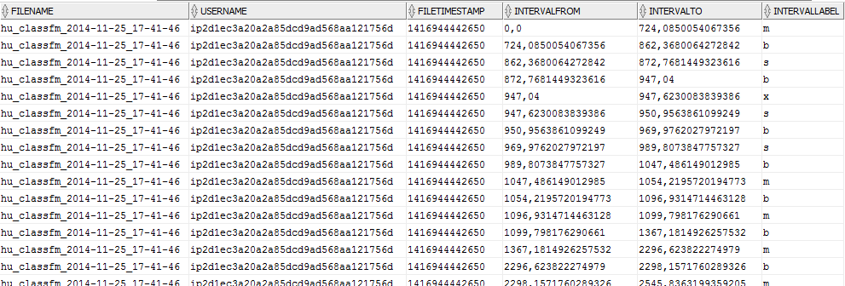
ANNOTATION_BBC
Speech-music annotation; recorded BBC streams; results of the annotation

Slide 5
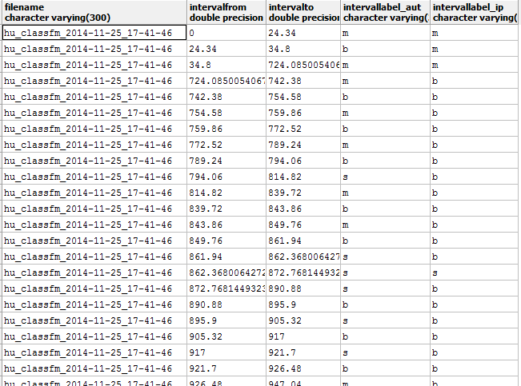
Comparing automatic and hand labelling
1. Compare the annotation by the neural network (‘automata’) and a specific user (LIKE ‘ip2d1ec3a20a2a85dcd9ad568aa%’)!
The query should produce one line per interval (similarly to the original table)’
However, the intervals have a finer resolution: every time, when any of the two labels change, a new interval is needed.
Sort the result by filename and intervalfrom
(Hints: self-join of table; tricky conditions for selecting overlapping intervals; Oracle sql functions for limits of newly created intervals)

Slide 6
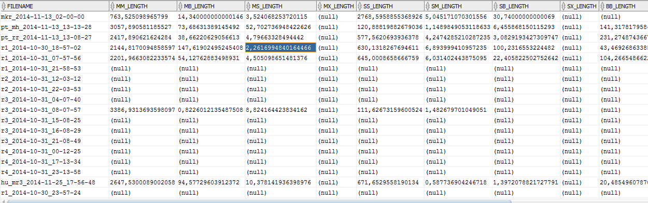
Statistical aggregation by file and user
2. Aggregate the values in a pivot table
  It is helpful to define a view with the previous query
  For pivoting: check background information on homepage

