Slide 1

GIC Tax Update Classification and Summarisation
Sprint Review #5
POC Results Report
24th April 2019

Slide 2

Overall Project Progress (as at 24-Apr-2019)
 | 2019
 | JAN | FEB | MAR | APR | MAY | JUN | JUL | AUG | SEP | OCT
PROJECT
AIAP INVOLVEMENT
S1
S2
S3
S4
S5
S6
S7
S8
S9
RS
Planned Sprints
Completed Sprints
POC Ready
Planned Events | Project Kickoff Meeting | Sprint 1 Review | Sprint 2 Review | Sprint 3 Review | Sprint 4 Review | Sprint 5 Review | Sprint 6 Review | Sprint 7 Review | Sprint 8 Review | Sprint 9 Review | Release Sprint Review
Date / Time | 25 Jan 2019 (Fri) 10-11 am | 12 Feb 19 (Tue) 10-11am | 05 Mar 19 (Tue) 10-11am | 26 Mar 19 (Tue) 10-11am | 16 Apr 19 10-Apr 19 (Wed) 11-12pm | 24 Apr 19 (Tue) 10-11am | 28 May 19 (Tue) 10-11am | 18 Jun 19 (Tue) 10-11am | 09 Jul 19 (Tue) 10-11am | 30 Jul 19 (Tue) 10-11am | 13 Aug 19 (Tue) 10-11am

Slide 3
Overview
High-level summary of POC results and implications
Detailed summary of POC results and implications
Examples of correct and incorrect model predictions
Planned tasks for Sprint #6

Slide 4

High-level summary
The model’s accuracy matches that of a human analyst for the 27 subcategories and 10 countries. The model’s results also matches results reported in peer-reviewed journals
The performance has been consistent across all 3 rounds.
Based on this performance, AISG recommends extending the POC model towards development of a minimum viable product.
Phase I: Investigate
Decision Point
Phase II: Develop or Pivot
~3 months of exploratory sprints to understand problem and data, then tackle initial solution
Based on phase I results, decide on phase II approach
~6 months of development or exploratory sprints
Option 1 (illustrative)
Proceed to build the full MVP solution with feedback loop for continuous model-training
Problem
Framing
Initial
Results
Option 2 (illustrative)
Explore the use of other data sources (e.g. data from proactive search), other techniques to improve performance (e.g. classifying updates based on tax guide entities or applying unsupervised techniques) or build better feedback loop for model learning
Research & Modeling
Exploratory Data Analysis
Option 3 (illustrative)
Reshape problem statement to fit in time frame, and start collecting useful data for future efforts

Slide 5
Model benchmarked against human analyst
The best performance a machine learning model can achieve would be the performance of a human analyst. Therefore, we benchmark our model's *F1 score against an intra-analyst F1 score.
*F1 score : Balances precision and recall to give a measure of the model’s accuracy. Ranges between 0 and 1, with 1 being perfect accuracy.

Slide 6
F1-Score Comparison for Tax category
Analysts in superset | F1 of Analyst not in superset | F1 of Machine
Analysts 2&3 | 0.6941 (Analyst 1) | 0.6274
Analysts 1&3 | 0.5622 (Analyst 2) | 0.5714
Analysts 1&2 | 0.6974 (Analyst 3) | 0.6062
Average | 0.6512 | 0.6017
Notes:
Conclusion: The performance of the machine and analysts are comparable
(i.e. Difference in average F1 scores are not statistically significant at 95% confidence level).
p-value 0.3

Slide 7
F1-Score Comparison for Country
Analysts in superset | F1 of Analyst not in superset | F1 of Machine
Analysts 2&3 | 0.8159 (Analyst 1) | 0.7504
Analysts 1&3 | 0.7697. (Analyst 2) | 0.7857
Analysts 1&2 | 0.8488 (Analyst 3) | 0.7940
Average | 0.8115 | 0.7767
Notes:
Conclusion: The performance of the machine and analysts are comparable
(i.e. Difference in average F1 scores are not statistically significant at 95% confidence level).

Slide 8
Additional model metrics for tax category
 | Machine | Analyst
F1 Score | 0.7252 | 0.6512
Precision | 0.7757 | 0.6273
Recall | 0.7329 | 0.8004
Hamming Loss | 0.1475 | 0.1029
Total number of categories identified per doc: 12.9
Notes:
Mean F1 for unweighted superset @0.6=0.6017

Slide 9
Additional model metrics for country
 | Machine | Analyst
F1 Score | 0.7517 | 0.8115
Precision | 0.9205 | 0.7629
Recall | 0.6567 | 0.9010
Hamming Loss | 0.0900 | 0.0622
Total number of categories identified per doc: 2.2
Notes:
Precision scores are high while recall scores are low. F1 is pulled down because model is under-predicting number of countries present in the document.

Slide 10
Model results benchmarked against results from peer-reviewed journals
Dataset | Number of documents | Number of labels | Hamming loss | F1 | Precision | Recall
Medical | 978 | 45 | 0.016² | 0.554¹ | 0.580² | 0.553²
Chemical exposure assessment | 3661 | 32 | NA | 0.724² | 0.778¹ | 0.677¹
Slashdot | 3782 | 22 | 0.017² | 0.829² | 0.892² | 0.799²
The model’s F1 scores of 0.6017 for tax category and 0.7767 for countries falls within the range reported in the literature (0.554 - 0.829).
¹ Du, Chen, Peng, Xiang, Tao & Lu. ML-Net: multi-label classification of biomedical texts with deep neural networks. ArXiv (2018).
² Kashef, S., Nezamabadi‐pour, H. & Nikpour, B. Multilabel feature selection: A comprehensive review and guiding experiments. Wiley Interdiscip Rev Data Min Knowl Discov 8, e1240 (2018).
Notes:
https://arxiv.org/ftp/arxiv/papers/1811/1811.05475.pdf
domain-level will have overlaps between categories. this overlap will translate over to a machine learning model meaning some subcategories will be more difficult to separate.
reasonable score to aim for 0.6 - 0.8
In Sprint 3, we conducted a literature review of research papers that reported F1 scores for a problem similar to ours. From this literature review, we focused on the Medical dataset, Chemical Exposure dataset and Slashdot dataset (highlighted below) since the size and number of labels of those datasets were similar to ours. Based on the range of F1 scores reported for these datasets (0.554, 0.724 and 0.829 respectively), we estimated that the best performance a machine learning model might expect to achieve on our data would be within the range of 0.6 to 0.8. To further refine this estimate, we conducted an exploratory analysis of our dataset. We found that tax categories can be subjective and can overlap with each other, which would decrease the F1 score. Hence, we estimated that a reasonable F1 score would fall towards the lower end of 0.6-0.8.

Slide 11
Example of correct tax category predictions
Machine picked up all the human labels.
Article 8: “[...] Like most other organisational functions, more tax functions are now undergoing major changes in order to help organisations adjust to technology-driven disruption. A highly dynamic and challenging regulatory environment is also driving the need for this transformation. The sector is currently being characterised by sweeping US tax reform, the European Commission’s proposal for a historic overhaul of value-added tax rules, and a rising number of country-specific rules on real-time tax reporting. [...]”
Analyst labels: (Management of a) Tax function, Digital Tax, Tax Governance Framework, Tax audit, Tax Compliance, Value-Added Tax
Machine prediction: (Management of a) Tax function, Digital Tax, Goods and services tax (GST), Tax Governance Framework, Tax audit, Tax Compliance, Value-Added Tax

Slide 12
Examples of incorrect tax category predictions
Article 17
Summary: French government’s tax policies for large corporations
Analyst label: “Tax Governance Framework”
Model prediction: None

Slide 13
Examples of incorrect tax category predictions
Article 12:
Summary: French government responds to anti-avoidance sentiment by redefining strategies.
Analyst label: Tax Governance Framework
Model prediction: None

Slide 14
Examples of correct country predictions
Article 39
'hmrc wins £1bn lehman brothers battle the supreme court has ruled to reject the appeal of the lehman brothers’ administrators, ending a more-than-three-year dispute involving nearly £1bn in taxes”
Analyst label : UK
Model prediction : UK based on mention of hmrc
Article 54
'kpmg offers insights for corporate tax directors in 2019 new york, march 26, 2019 /prnewswire/ -- regulatory change, enhanced scrutiny, rapidly evolving technology and new staffing paradigms will transform and reimagine tax departments this year, according to u.s. audit, tax and advisory firm kpmg llp.”
Analyst label : US
Model prediction : US (explicit mention of “u.s.” inside the article)

Slide 15
Examples of incorrect country predictions
Article 32
'china tax alert new economic substance requirements for key offshore centres regulations discussed in this issue: council conclusions on the criteria for and process leading to the establishment of the eu list of noncooperative jurisdictions for tax purposes, published by council of the european union in official journal of the european union (2016/c 461/02) on 10 december 2016’
Analyst label: China, France, Spain, UK
Model prediction: China, UK (France and Spain not mentioned explicitly but European Union is mentioned).
Article 48
'a national perspective: tp controversy in france, india, and the us france tax audits in france can take a considerable time, with questions raised by auditors often branded as difficult.”
Analyst label: France, India, US
Model prediction: France, India (lowercase form of US interpreted as the pronoun “us”)

Slide 16
Planned tasks for Sprint #6 week 1
Sprint #6 week 2
Refactor pipelines for extracting raw text from tax updates
Refactor pipelines for pre-processing raw text
Convert model code into automated scripts
Technical review with GIC Data Science Team
Additional statistical tests for model
Model improvements
Conduct user story mapping in preparation for MVP development
Design product to be extensible, see if collaborations with other GIC projects are possible.

Slide 17
Supplementary Figures

Slide 18
The final predictive model is an ensemble of the following models
BERT
Logistic Regression
Support Vector Machine
Gradient Boosting
Random forest

Slide 19
Round #1 – #3 Scores broken down by tax category and country

Slide 20
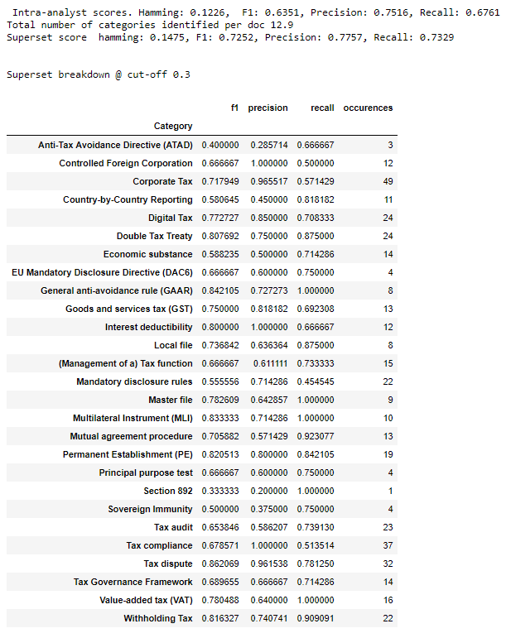

Slide 21
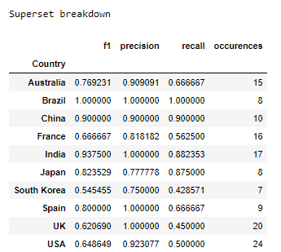

Slide 22
Round #1 Scores broken down by tax category and country

Slide 23
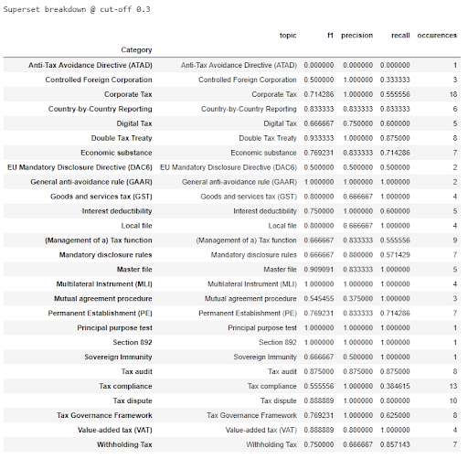

Slide 24
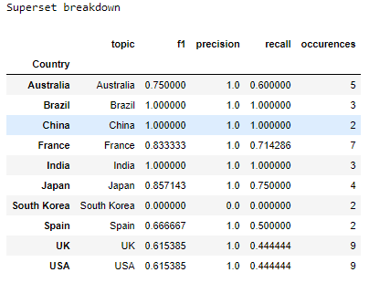

Slide 25
Round #2 Scores broken down by tax category and country

Slide 26
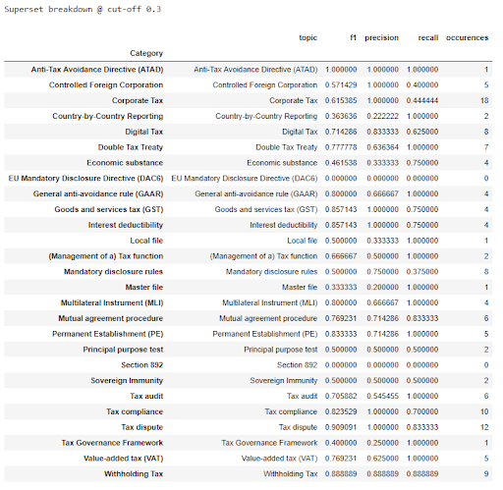

Slide 27
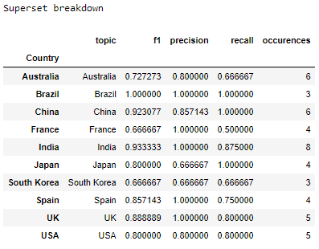

Slide 28
Round #3 Scores broken down by tax category and country

Slide 29
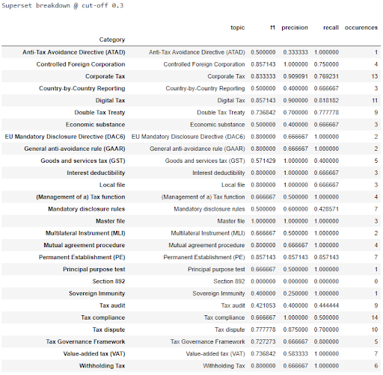

Slide 30
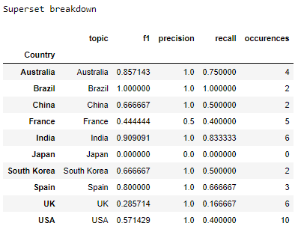

Slide 31
Round 1 – 3 Tax category scores for machine and analyst
 | Round 1 Machine | Round 1 Analyst | Round 2 Machine | Round 2 Analyst | Round 3 Machine | Round 3 Analyst
F1 Score | 0.7560 | 0.6417 | 0.7214 | 0.647 | 0.7190 | 0.6413
Precision | 0.8726 | 0.7598 | 0.7960 | 0.7759 | 0.7612 | 0.7312
Recall | 0.7124 | 0.6759 | 0.7481 | 0.6752 | 0.7410 | 0.6882
Hamming Loss | 0.1296 | 0.1333 | 0.1537 | 0.1123 | 0.1593 | 0.1222

Slide 32
Round 1 – 3 Country scores for machine and analyst
 | Round 1 Machine | Round 1 Analyst | Round 2 Machine | Round 2 Analyst | Round 3 Machine | Round 3 Analyst
F1 Score | 0.7266 | 0.8214 | 0.8356 | 0.8442 | 0.6400 | 0.8051
Precision | 0.9656 | 0.8495 | 0.8877 | 0.8804 | 0.9375 | 0.8578
Recall | 0.6087 | 0.8333 | 0.8125 | 0.8531 | 0.5250 | 0.8149
Hamming Loss | 0.0900 | 0.0667 | 0.075 | 0.0600 | 0.1050 | 0.0600

