Slide 1
Smart Home Electricity Consumption Prediction System
STUDENT NAME
COLLEGE NAME
[Placeholder]
[Placeholder]
ROLL NUMBER
PROJECT GUIDE
[Placeholder]
[Placeholder]
DEPARTMENT
ACADEMIC YEAR
ECE
2026–2027
Notes:
Introduce the project title, department, guide, and academic year 2026-2027 during the viva opening.

Slide 2
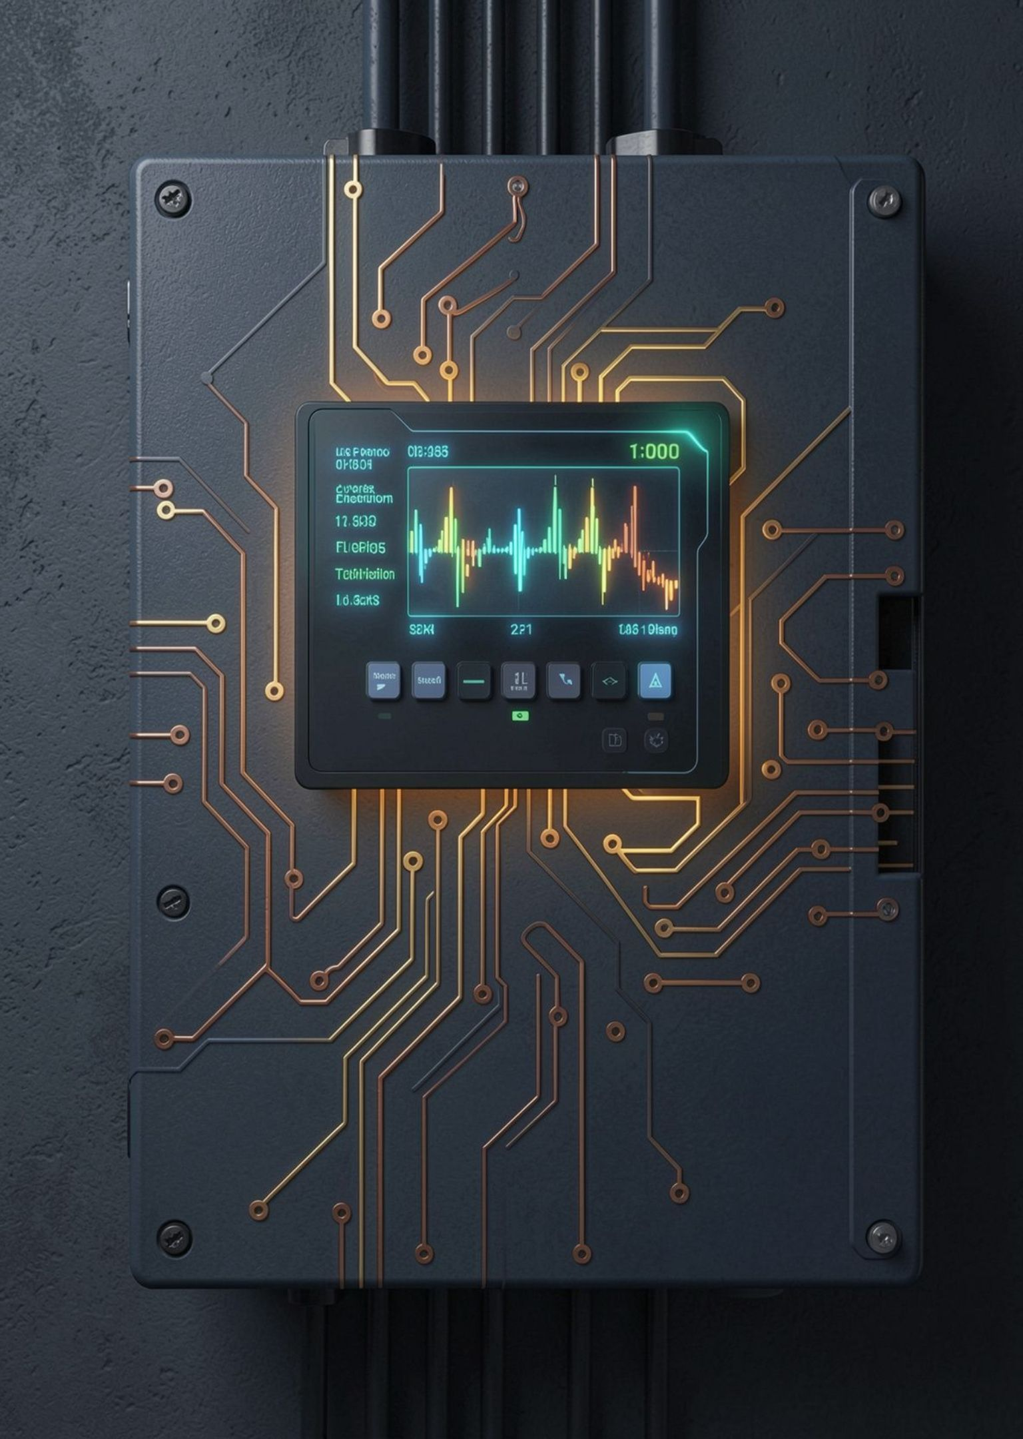
PROBLEM STATEMENT
Future demand is harder to see than current usage
01
Surging household load
Demand is rising with appliance density and electrification.
02
Reactive monitoring limit
Monitoring mainly shows current or past consumption, not future demand.
03
Multi-variable dependencies
Future load depends on appliance duty cycles, occupancy, weather, hour, and season.
04
Predictive ML solution
Historical energy data plus machine-learning regression forecasts demand.
Notes:
Emphasize why conventional submetering is insufficient: passive monitoring shows past usage, while regression anticipates upcoming peaks.

Slide 3










PROJECT OBJECTIVES
The system turns usage history into actionable forecasts
Analyze usage history
Usage patterns
Feature engineering
Analyze historical electricity consumption.
Identify household energy-usage patterns.
Process smart-home energy data and engineer useful features.
Regression models
Multi-horizon trends
Sustainable management
Compare regression models to predict future consumption.
Display daily, weekly, and monthly trends.
Support lower energy usage, lower costs, and sustainable energy management.
Notes:
Walk through the core project goals: data collection, pattern discovery, feature pipeline, multi-model evaluation, and user-facing intelligence.

Slide 4
Multiple signals feed one prediction pipeline
INPUT SIGNALS
Historical energy data
Appliance usage
Occupancy
Weather
Date/time signals
↓
PREDICTION PIPELINE
1
2
3
4
5
Data preprocessing
Feature extraction
Machine-learning regression model
Future electricity prediction
Dashboard and reports
Notes:
Walk through the architecture: the five input signals converge into preprocessing, feature extraction, regression, future electricity prediction, and dashboard and reports.

Slide 5



DATA PREPARATION PIPELINE
Clean, contextual data makes the model usable
Raw Data → Cleaned Data → Feature Engineering → Model Input
01
02
03
04
Ingest Raw Inputs
Clean & Impute
Engineer Features
Scale & Partition
Aggregated smart-meter readings, active appliance loads, ambient temperature, occupancy states, and calendar attributes.
Deduplicate sensor timestamps, handle dropped telemetry via interpolation, and detect abnormal voltage/wattage spikes.
Decompose timestamps into cyclical sine/cosine hours, compute rolling consumption averages, and encode seasonal indicators.
Apply standard min-max scaling across numerical features, then split chronological records into strict training and testing partitions.
RAW DATA
TRANSFORMATION
MODEL INPUT
Noisy meter ticks, missing weather records, unaligned timestamps
Interpolation, z-score filtering, periodic trigonometric transformations
Normalized feature matrix partitioned chronologically for zero lookahead
Notes:
Explain the data pipeline: cleaning handles dropped packets and sensor anomalies; feature engineering extracts cyclical signals; temporal split prevents data leakage.

Slide 6





MODELING SUITE
Model comparison keeps the choice evidence-based
BASELINE
RULES
ENSEMBLE
KERNEL
BOOSTING
Linear Regression
Decision Tree Regression
Random Forest Regression
Support Vector Regression
Gradient Boosting / XGBoost
Baseline relationship between inputs and demand.
Rule-based estimates.
Combines trees for stable predictions.
Models complex relationships.
Suited to structured energy datasets.
Do not declare a best model until project testing is complete.
Notes:
Compare candidate regression models without declaring a winner before testing is complete.

Slide 7
WORKFLOW EXECUTION
Training converts historical patterns into a forecast
01
02
03
04
Historical dataset
Data preprocessing
Feature selection
Train/test split
05
06
07
08
Model training
Model testing
Future energy-consumption prediction
Dashboard
Sample/demo output only: Predicted Energy Usage — 12.5 kWh/day
Notes:
Walk through the eight-step operational pipeline. Clarify that 12.5 kWh/day represents an illustrative demo output and not final experimental claims.

Slide 8



ENERGY ANALYTICS DASHBOARD
The dashboard makes model output easy to interpret
ACTUAL VS PREDICTED CONSUMPTION
EVALUATION METRICS
Time period | Actual consumption | Predicted consumption
[Period 1] | [Value] | [Value]
[Period 2] | [Value] | [Value]
[Period 3] | [Value] | [Value]
[Period 4] | [Value] | [Value]
MAE | [Insert value]
MSE | [Insert value]
RMSE | [Insert value]
R² Score | [Insert value]
Project results reserved for verified laboratory readings
Placeholder comparison · Replace with measured test period data
CURRENT
DAILY FORECAST
WEEKLY TREND
MONTHLY USAGE
[Value] kW
[Value] kWh
[Value] kWh
[Value] kWh
Notes:
Point out the dashboard telemetry: actual vs predicted plot, evaluation metrics table awaiting final test values, and real-time load summaries.

Slide 9
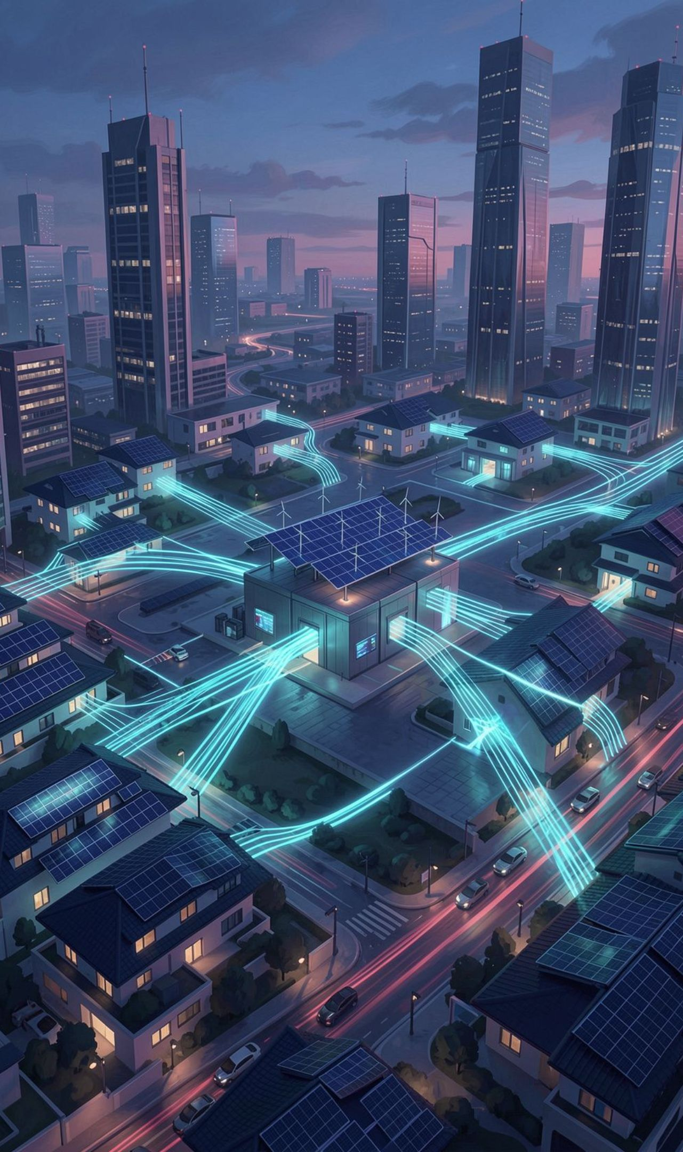
IMPACT & HORIZONS
From smart homes to smarter energy systems
Key Advantages
Applications
Forecast demand, reduce wastage and lower costs, and support informed decisions.
Smart homes, smart buildings, utilities, energy-management systems, smart cities, and research.
Future Scope
IoT smart-meter integration, real-time prediction, bill prediction, automatic appliance control, solar integration, mobile app, and AI energy-saving recommendations.
Notes:
Discuss scalability: benefits expand from single households to enterprise microgrids and smart-city utilities through IoT and renewable integration.

Slide 10

CONCLUSION
Prediction supports more efficient everyday energy use
The system uses historical energy data and machine-learning techniques to forecast household electricity consumption.
By combining appliance usage, occupancy, weather, time, and seasonal patterns, it helps users understand trends, reduce unnecessary usage, lower costs, and improve energy efficiency.
Thank You
Questions?
Notes:
Conclude the presentation by summarizing how predictive ML turns passive metering into proactive energy efficiency, then open the floor for committee questions.

