Slide 1

“Business Process Automation” (BPA)
Internal Guide:
Aniruddhkumar G. Fataniya
(Assistant Professor)
Dipsi Dave
(Assistant Professor)
External Guide:
Mr. Nilesh Shah
(Assistant Vice President, Technology)
Prepared by:
Varshkumar Patel (14CE107)

Slide 2
Contents
What is BPA
Simple Understanding
About BPA
Need for BPA
Project Plan
System Specification
Functional Requirement
Report Generation Description
Demo
UML Diagrams
Conclusion
Bibliography

Slide 3
What is BPA
Definition by World Technology Forum:
Business Process Automation (BPA) is the technology-enabled automation of activities or services that accomplish a specific function or workflow. Business processes can be determined for many different segments of company activities, including sales, management, operations, supply chain, human resources and information technology.
Definition by Wikipedia:
Business Process Automation (BPA) is the technology-enabled automation of business processes. It is performed to achieve digital transformation or to increase service quality or to improve service delivery or to contain costs. It consists of integrating applications, restructuring labor resources and using software applications throughout the organization.

Slide 4
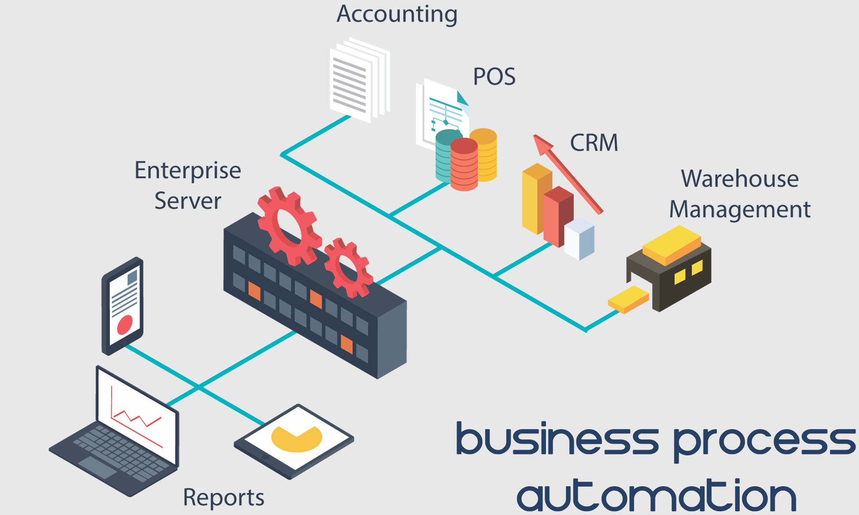
Simple Understanding

Slide 5
About BPA
Maintain and analyze all the work done in company with few simple clicks.
Automate to generate Daily/Monthly/Quarterly/Yearly revenue report and other reports to give detail insight to the multiple stakeholders.
Generate reports on real time basis:
Based on daily work carried out by the company.
Based on the profit they make per project.
More than 25 such types of report can be generated.
Generated reports can then be saved as pdf file or can be mailed directly via SMS Portal (Company’s intranet portal).

Slide 6
Need for BPA
At present, the company was working on offline files(i.e. Excel sheets)
Sharing of the files was also required every time they make some change.
Everything can be available on real time basis.
Efficiency of any department and employee can easily be tracked.
Scheduling of projects within the company can be done easily.

Slide 7
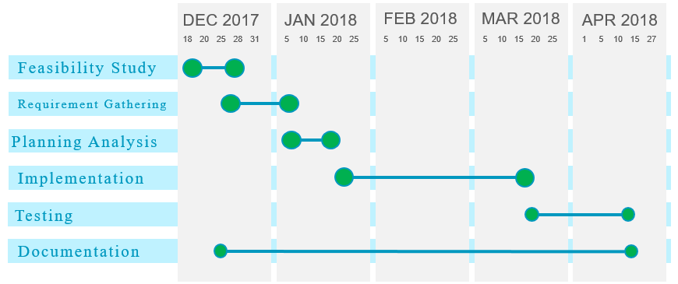
Project Plan

Slide 8
System Specifications
Software Specification:
Visual Studios 2013 Ultimate.
.NET Framework 3.0
MYSQL Workbench.
SMS Portal(Company’s intranet portal).
Hardware Specification:
Windows OS 64-bit system, 8GB RAM, 1TB HDD.
Azure B+ OS(Linux Based), 64-bit system, 6GB RAM, 1TB HDD.

Slide 9
Functional Requirements
New Project Entry.
Daily Work Entry.
View Project Details.
Excel 2 DB.
Report Generation.
More than 25 different types of report on real time basis.

Slide 10
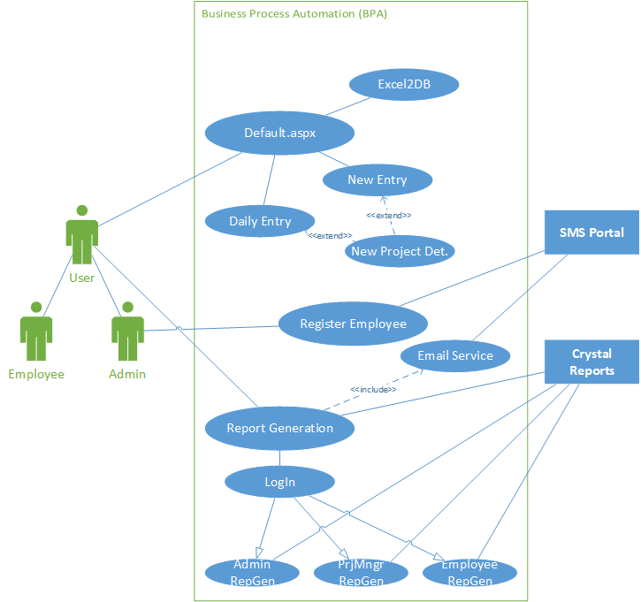
Use Case

Slide 11
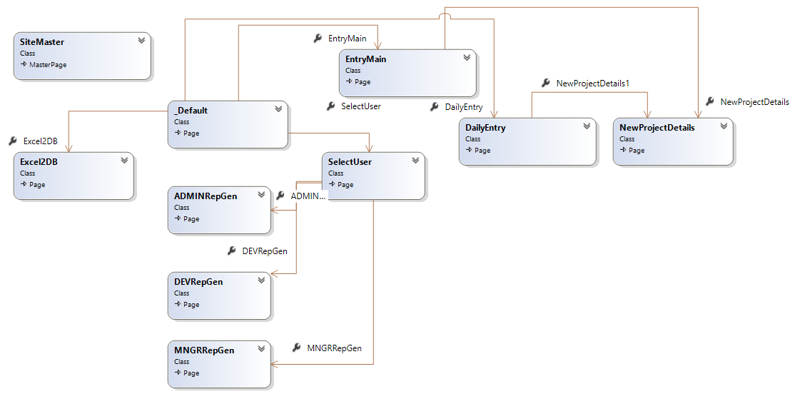
Class Diagram

Slide 12
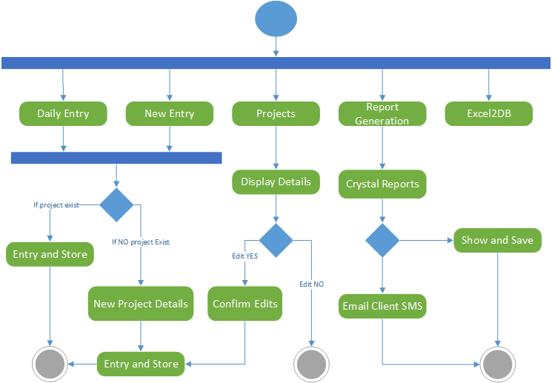
Activity Diagram

Slide 13
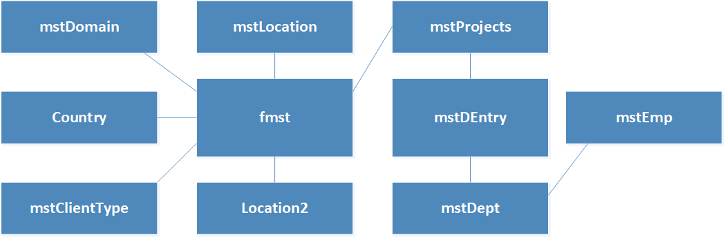
ER Diagram

Slide 14



Report Generation Description
Total Profit By
RYear
PrjID/PrjName
Project Manager
Country/Location
Partner Name
Domain
Efficiency By
Department
Type of Work
PrjID/Name
EmpID/Name
All Project Details
Efficiency By
Department
Type of Work
PrjID/Name
EmpID/Name
All Project Details
His/hers Details
Total Work Hours
EmpID/Name
PrjID/Name
Employee of the WEEK
Employee of the MONTH
All Project Details
His/hers Details
Total Work Hours
Total Quality Work
Most Active Day
Most Lazy Day

Slide 15
Demo

Slide 16
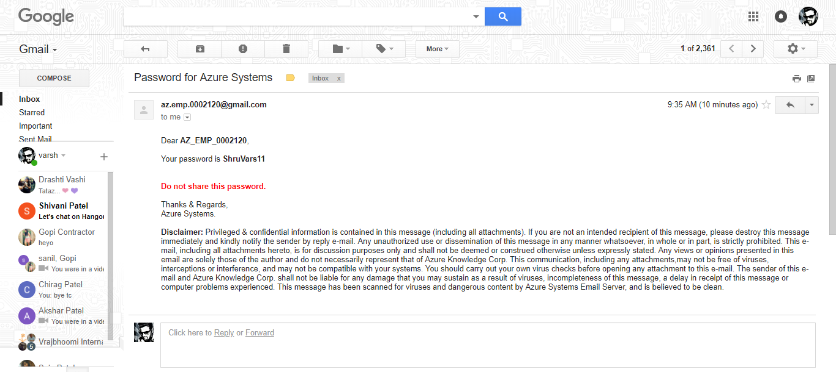
Email that was sent in video

Slide 17
Conclusion
It is a web based portal that will help the company to automate every single process carried out in the company.
From sharing excel files to creating new project on company’s portal will be handled by the BPA portal itself.
It has the capability to merge with current portal for communication i.e. SMS Portal on company premises.

Slide 18
Bibliography
https://docs.microsoft.com/en-us/dotnet/csharp/getting-started/introduction-to-the-csharp-language-and-the-net-framework
http://csharp.net-informations.com/crystal-reports/csharp-crystal-reports-stepbystep.htm
https://dev.mysql.com/doc/
https://www.codeproject.com/Questions/1169094/Crystal-report-in-Csharp-windows-application
http://azureknowledge.com/

Slide 19
THANK YOU !

