Slide 1


E-Blood Bank Management System
CHAROTAR UNIVERSITY OF SCIENCE AND TECHNOLOGY
For technology to serve humanity...
Submitted as part of : CE324 - Software Group Project
Of 6th Semester of B.Tech
Presented By: Varsh Patel (14CE107)
Drashti Vashi (14CE145)
Under Guidance Of:
Prof. Ronak Patel

Slide 2

Why an E-Blood Bank ?
Web portal for social services to play a best part for the society and humanity.
Most of the death occurs due to unavailability of blood at the right place at the right time.
CE324 - Software Group Project
U. & P. U Patel Dept. of Computer Engineering
CHAROTAR UNIVERSITY OF SCIENCE AND TECHNOLOGY

Slide 3

Requirement Gathering.
Discussion with hospital management regarding the unavailability of blood at the time of emergency.
Information about the present blood banks and scarcity of adequate blood banks in the area.
Questionnaire with the doctors related to the compatibility of blood and blood transfusion process.
CE324 - Software Group Project
U. & P. U Patel Dept. of Computer Engineering
CHAROTAR UNIVERSITY OF SCIENCE AND TECHNOLOGY

Slide 4
Services…
The major function includes:
Providing a web portal for blood bank services.
Donors can easily donate blood with nearest collection center.
Donor can reach nearest blood center via help of google maps.
Hospitals can request for blood online with form readily available.
We ensure the delivery of blood within an hour or less.
Informative data on blood group and awareness of the same.
CE324 - Software Group Project
U. & P. U Patel Dept. of Computer Engineering
CHAROTAR UNIVERSITY OF SCIENCE AND TECHNOLOGY

Slide 5
Development Tools...
Front End : Microsoft Visual Studios 2013
Back End : SQL Server Management Studio 2016
Team Collaboration : Team Foundation Server 2016
CE324 - Software Group Project
U. & P. U Patel Dept. of Computer Engineering
CHAROTAR UNIVERSITY OF SCIENCE AND TECHNOLOGY

Slide 6
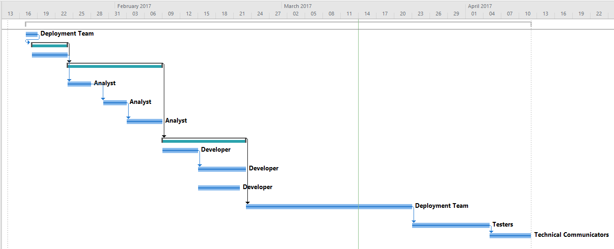
Designing…
Gantt chart
CE324 - Software Group Project
U. & P. U Patel Dept. of Computer Engineering
CHAROTAR UNIVERSITY OF SCIENCE AND TECHNOLOGY

Slide 7
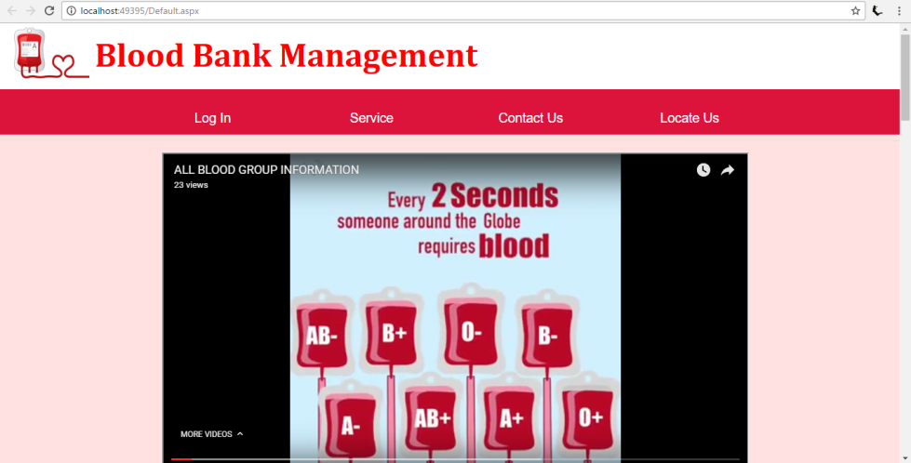
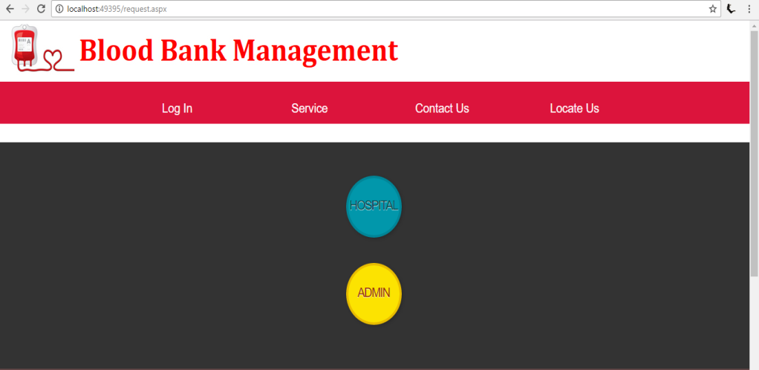
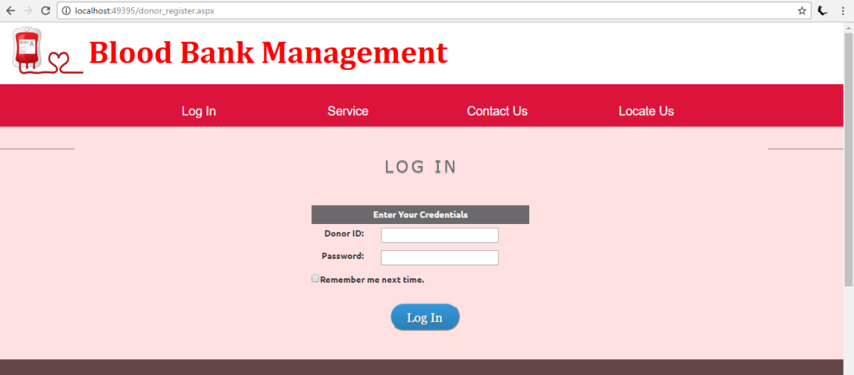
GUI…
CE324 - Software Group Project
U. & P. U Patel Dept. of Computer Engineering
CHAROTAR UNIVERSITY OF SCIENCE AND TECHNOLOGY

Slide 8
Bibliography…
http://images.google.com
http://www.charusat.ac.in
http://www.msdn.microsoft.com
http://www.youtube.com
CE324 - Software Group Project
U. & P. U Patel Dept. of Computer Engineering
CHAROTAR UNIVERSITY OF SCIENCE AND TECHNOLOGY

Slide 9
Thank You..!
CE324 - Software Group Project
U. & P. U Patel Dept. of Computer Engineering
CHAROTAR UNIVERSITY OF SCIENCE AND TECHNOLOGY

