Slide 1

OC Launcher
Just one click is all it takes.
Presented By: Varsh Patel (14CE107)
Drashti Vashi (14CE145)
Under Guidance Of:
Prof. Rutu Ataliya
CE319 : Software Group Project

Slide 2
Why A Launcher ?
Most launchers today are resource hungry and crashes frequently killing the performance of our smartphones.
This home launcher is easy-to-use with its fast functioning and sleek design.
CE319 : Software Group Project

Slide 3
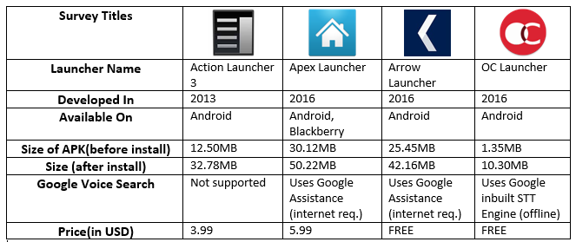
Simple Thing !
CE319 : Software Group Project

Slide 4
OC Launcher
The major function includes:
Providing a home launcher with no risk of crashing.
Direct access to applications, direct message, toggle.
Provide speech recognition/voice search.
Direct display of last 15 queries fired.
Direct access to the favourite app list.
7 different themes for comfort.
CE319 : Software Group Project

Slide 5
Aim Achieved ?
Indeed, OC Launcher is the only launcher among others in the android family that uses up to 10.30MB of space with 0% chance of crashing while you are using it.
CE319 : Software Group Project

Slide 6
Assurance
OC Launcher is tested under the new and secure feature i.e. Compatible Test Suite (CTS), an inbuilt testing and verifying tool for android applications inside Android Studio 2.0 itself.
CE319 : Software Group Project

Slide 7
How ?
The CTS runs on a desktop machine and executes test cases directly on attached devices or an emulator. The CTS is a set of unit tests designed to be integrated into the daily workflow (such as via a continuous build system) of the engineers building a device. Its intent is to reveal incompatibilities early on, and ensure that the software remains compatible throughout the development process.
The CTS is an automated testing harness that includes two major software components:
The CTS trade fed test harness runs on your desktop machine and manages test execution.
Individual test cases are executed on the Device Under Test (DUT). The test cases are written in Java as JUnit tests and packaged as Android .apk files to run on the actual device target.
CE319 : Software Group Project

Slide 8
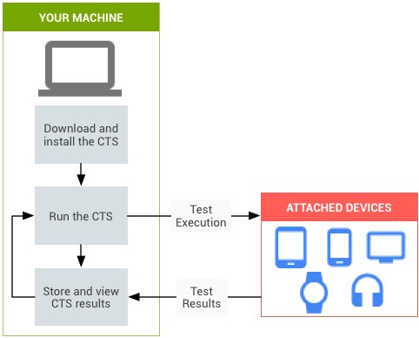
Simple To Understand !
CE319 : Software Group Project

Slide 9
Limitations
User cannot change the icons.
Has to manually activated as default launcher from settings since it is not system launcher.
Limited to Android Device only.
CE319 : Software Group Project

Slide 10
Future Scope
This app can be provided to Blackberry and other devices.
Can be collaborated with other device making companies to provide OC as default Launcher.
CE319 : Software Group Project

Slide 11
Thank You..!
Also extending my thanks to the rising technology in android that made me to select this project with great passion.
CE319 : Software Group Project

