Slide 1
Disaster relief in flood affected areas using Drones
-By Varsha Jain
001266742

Slide 2
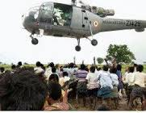
Traditional Method-
Problem-
Not everybody gets necessary relief assistance
Few packets are even wasted, hence results in economic loss

Slide 3
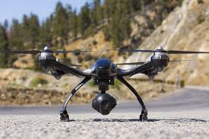
Solution-
To solve the problem we can use drone for delivering the packets
It is assumed that drone delivers the packets at the doorstep
However we need to find the shortest path that the drones should follow to deliver packets.

Slide 4
Particle Swarm Optimization to find the optimal path for Drones
PSO can be used to find the optimal path for drones
Particles represent all the possible candidate solutions
In this case all the possible candidate solutions are paths from source to all the other nodes
Hence one particle is one path

Slide 5
Constraints
Source is fixed for every particle
Also, every drone has it’s maximum flight time and maximum velocity with which it can fly
Hence the drone can cover only certain distance
Our aim is to find the shortest route that covers all the buildings in flood affected area within the target value

Slide 6
APPROACH
First Particle initialization is done
Every particle has velocity, weight, pBest, data which is a collection of all the cities
Data is randomly arranged
Hence paths are randomly arranged
Initial velocity is set to 0.0
Evaluate the fitness function of each particle
Initial pBest and weight are same which is the total distance covered by a particle
Initial gBest is calculated based on the minimum of all the pBests.

Slide 7
Second step is to start the iteration and perform the following-
Calculate the pBest of every particle
Calculate the gBest of the swarm
Update velocity
Update position
We then check for the stopping criteria i.e either all the iterations are finished or the target is reached.
If the stopping criteria is not met we perform the algorithm again with next iteration

Slide 8
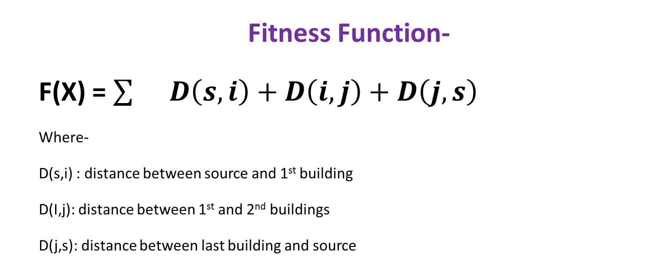
Fitness Function-
F(X) = $\sum{}D\left(s,i\right)+D\left(i,j\right)+D\left(j,s\right)$
Where-
D(s,i) : distance between source and 1st building
D(I,j): distance between 1st and 2nd buildings
D(j,s): distance between last building and source

Slide 9
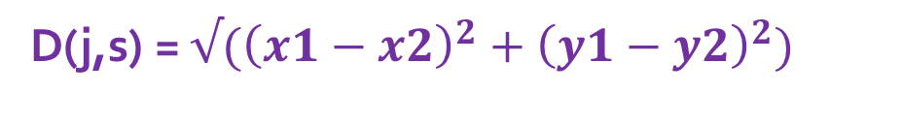
D(I,j) is calculated by using the euclidean distance formula-
D(j,s) = $√({\left(x1−x2\right)}^{2}+{\left(y1−y2\right)}^{2})$
Velocity-
V_{id =w} V_{id} + C₁*R₁*(P_{best} - X_{id}) + C₂*R₂*(G_{best} – X_{id} )
Where C1 , C2 represent the acceleration coefficients
R1 and R2 represent the random values
w is inertia
Distance-
Xid = Xid + Vid

Slide 10
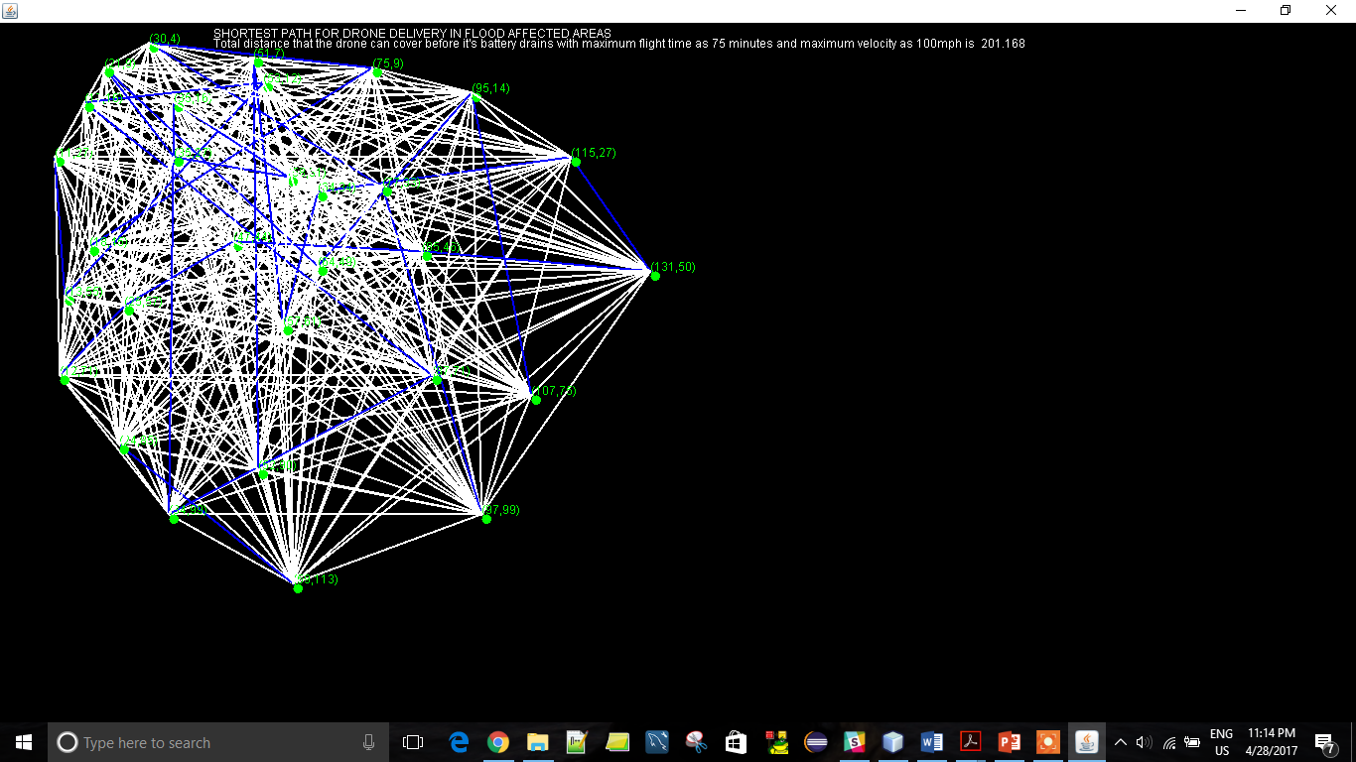
OUTPUT-

Slide 11
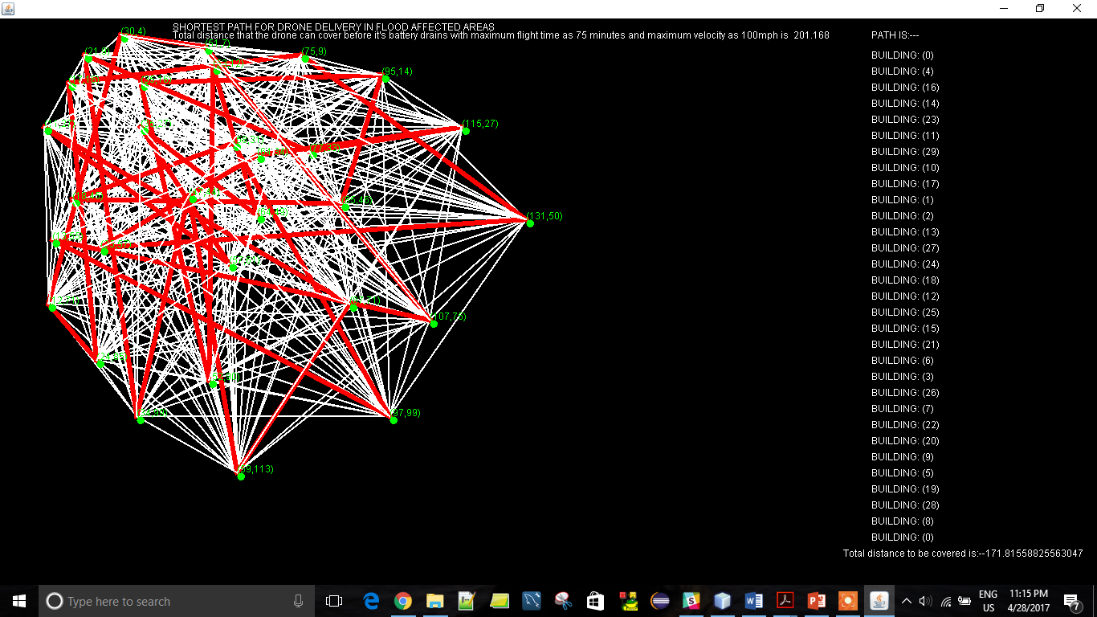

Slide 12
Conclusion
PSO was successfully employed to find the shortest route for the drone to deliver packets.

