Slide 1

SMART INDIA HACKATHON 2026
Problem Statement ID - 26100
Problem Statement Title- AI-Powered Integrated Bid Compliance Verification Platform for GeM Procurement
Theme- Smart Automation
PS Category- Software
Team ID- PIET-194
Team Name - Nexora

Slide 2
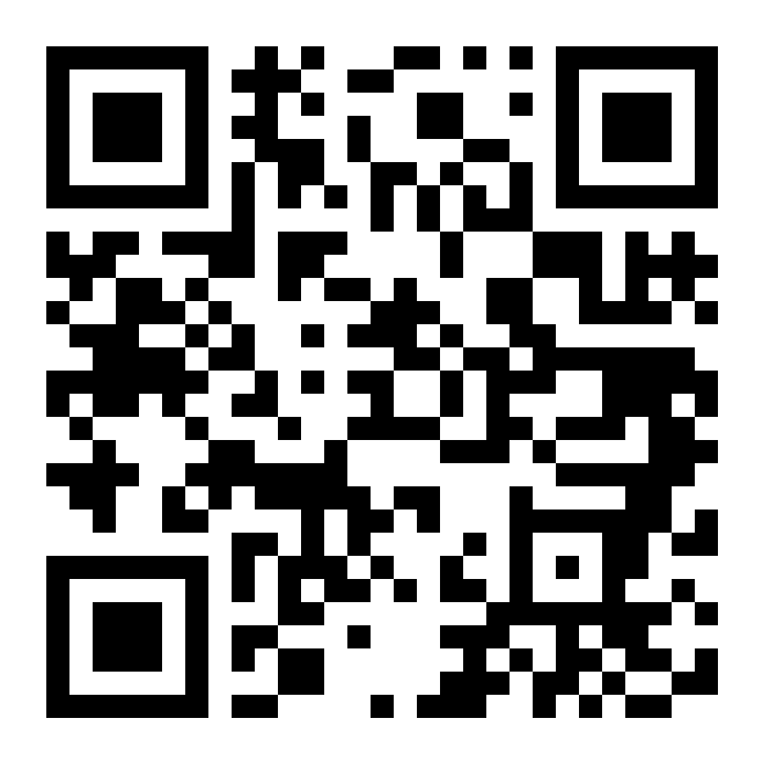
सत्यबिड – SATYABID
Nexora
An AI-Powered Bid Compliance Verification Platform for GeM Procurement
SYSTEM CAPABILITIES
Requirement Extraction – Converts tender clauses into structured, checkable requirement
Document Intelligence – Extracts bidder data using OCR and NLP.
Source Verification – Cross-checks data against authorized government sources.
Compliance Validation – Applies AI-based and deterministic rule checks.
Risk Classification – Generates compliance status, score, and risk level.
Evidence Reporting – Presents requirement-wise results with supporting evidence.
GAPS ADDRESSED
Manual Verification – Reduces repetitive document checking.
Data Fragmentation – Unifies bidder documents and multi-source verification.
Compliance Gaps – Flags missing, expired, or inconsistent information.
Data Inconsistency – Detects conflicting bidder information across sources.
Decision Uncertainty – Routes unclear cases for manual review.
Limited Traceability – Links results to evidence, rules, and sources.
WHAT SETS IT APARTS
Intelligent Verification- AI + rule-based checks.
Multilingual Access- Available in 22 Indian languages.
Evidence-Based- Requirement-to-evidence mapping.
Explainable AI & Risk-Aware- Clear reasons and confidence+ Prioritizes critical cases.
Human-Centric- Officer controls the final decision.
FOR PROTOTYPE
Scan QR :->
or
[click here]
70% FUNCTIONAL END-TO-END PROTOTYPE COMPLETED

Slide 3
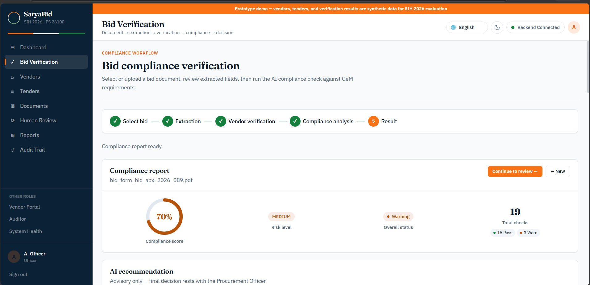
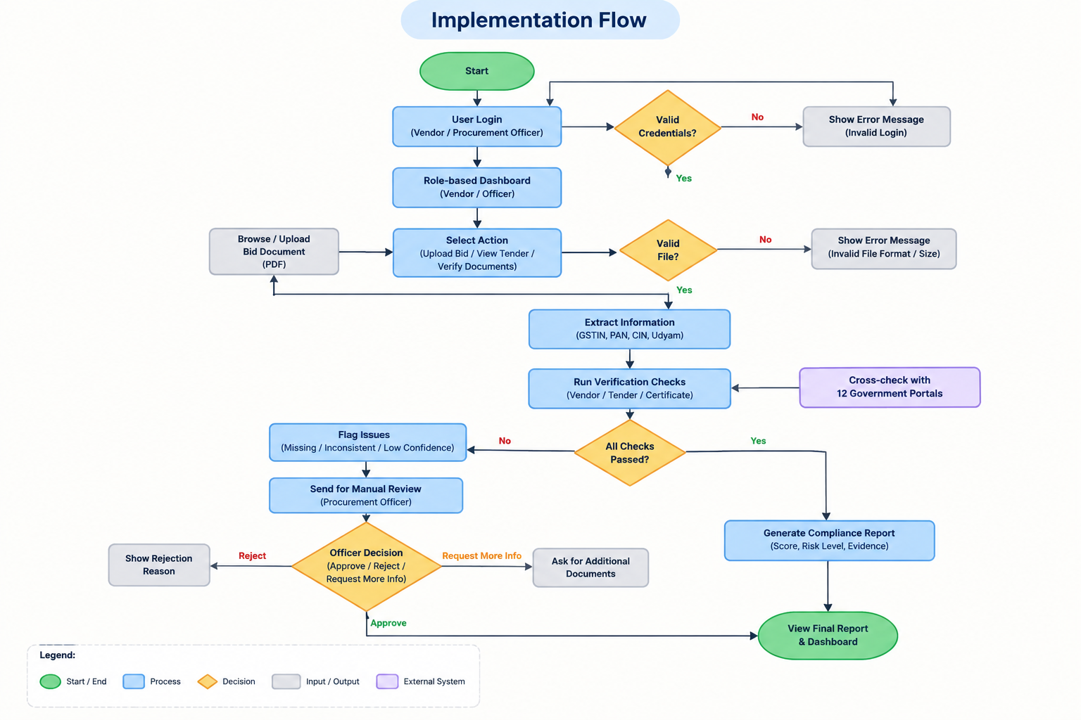
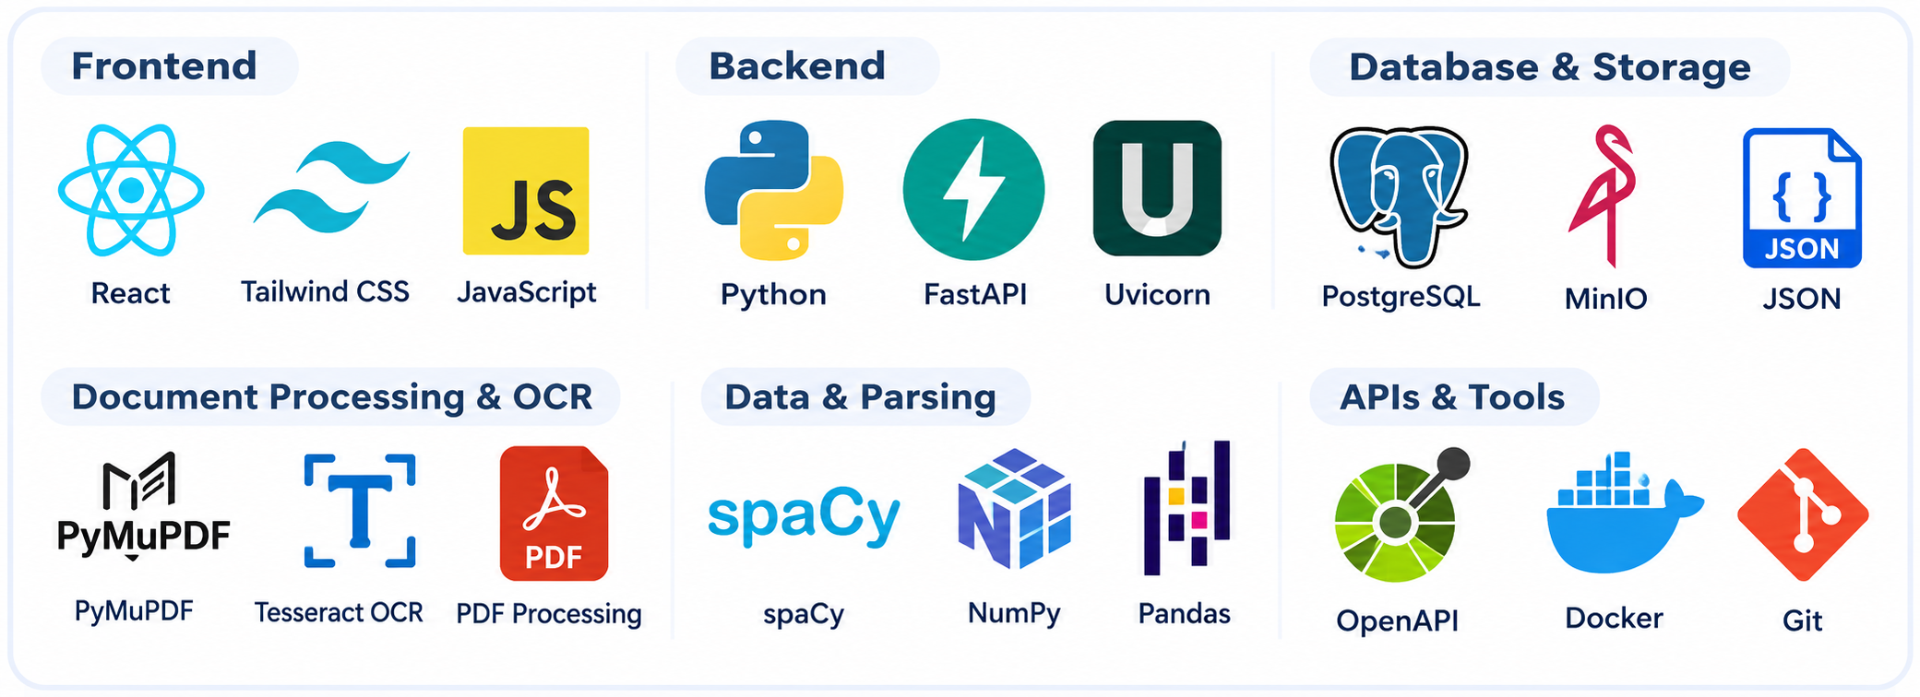
TECHNICAL APPROACH
Nexora
METHODOLOGY
USER INTERFACE
IMPLEMENTATION FLOW
Bid Document Extraction — Extracts GSTIN, PAN, CIN and Udyam details from bid PDFs.
Vendor Verification — Cross-checks identity, GST, PAN, CIN, legal name and debarment.
Tender Eligibility — Validates turnover, MSME exemption, local content and country of origin.
Multi-Source Compliance — Cross-references data across 12 simulated government portals.
Compliance Scoring — Generates a 0–100 score, risk level and overall status.
Human Decision Layer — Routes critical or uncertain cases for officer review.
TECH STACK

Slide 4
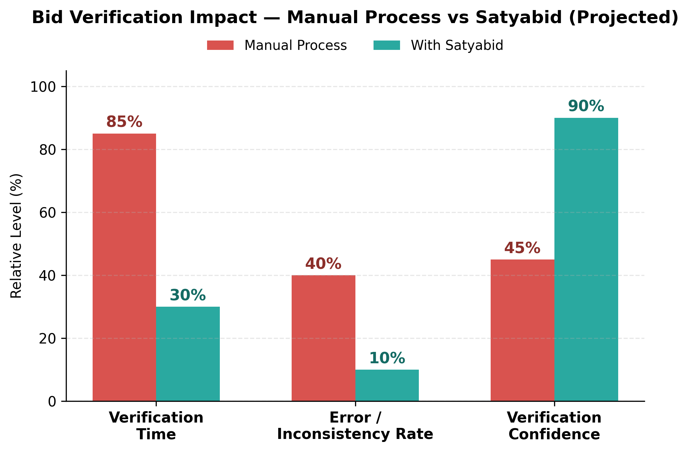
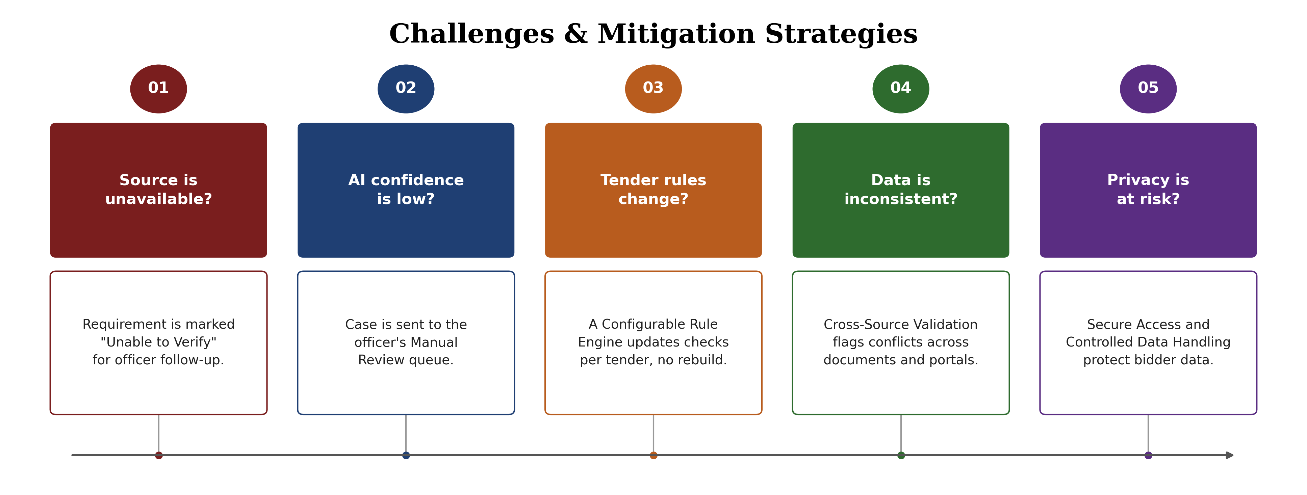
FEASIBILITY AND VIABILITY
Nexora
TECHNICAL FEASABILITY
Proven & Modular Technology – OCR, NLP, AI + Rules.
Data & Integration – Synthetic data + authorized sources.
Human Oversight – Officer review for uncertain cases.
DEPLOYMENT VIABILITY
Cost Efficiency – Reduces manual effort.
Operational Flexibility – Cloud or institutional deployment.
Future Scalability – Supports new sources and rules.
WHAT IFs...?
CHALLENGES AND MITIGATIONS
Source Unavailable - Marks the requirement “Unable to Verify.”
Low-Confidence AI - Sends cases for Manual Review.
Changing Rules - Uses a Configurable Rule Engine.
Inconsistent Data - Performs Cross-Source Validation.
Data Privacy - Applies Secure Access and Controlled Data Handling.

Slide 5
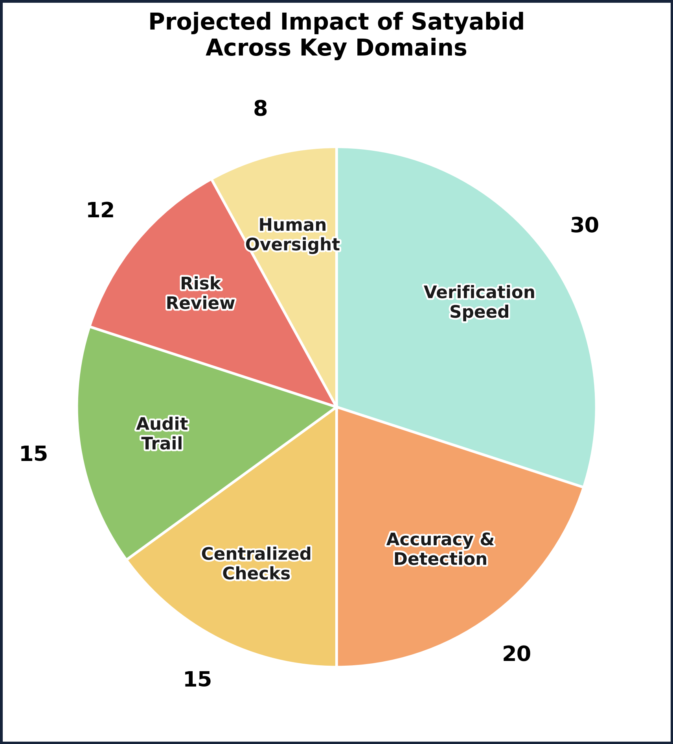
IMPACT AND BENEFITS
Nexora
IMPACT ON PROCUREMENT OFFICERS
Faster Verification – Reduces repetitive manual checking.
Better Accuracy – Detects missing, expired, and inconsistent data.
Centralized Evaluation – Brings documents, rules, and source data together.
Clear Decisions – Provides evidence-backed compliance results.
Focused Review – Highlights high-risk and uncertain cases.
OPERATIONAL BENEFITS
Reduced Workload – Automates routine verification tasks.
Multi-Source Checks – Cross-verifies bidder information across sources.
Early Issue Detection – Flags compliance gaps before final evaluation.
Transparent Process – Shows evidence, rules, and verification status.
Human Oversight – Keeps final decision with the procurement officer.
ECONOMIC AND STRATEGIC BENEFITS
Time Efficiency – Speeds up the bid evaluation process.
Resource Optimization – Reduces effort spent on repetitive checks.
Scalable Solution – Supports different tenders and compliance rules.
Improved Accountability – Maintains traceable verification records.
Digital Transformation – Strengthens AI-driven procurement workflows

Slide 6
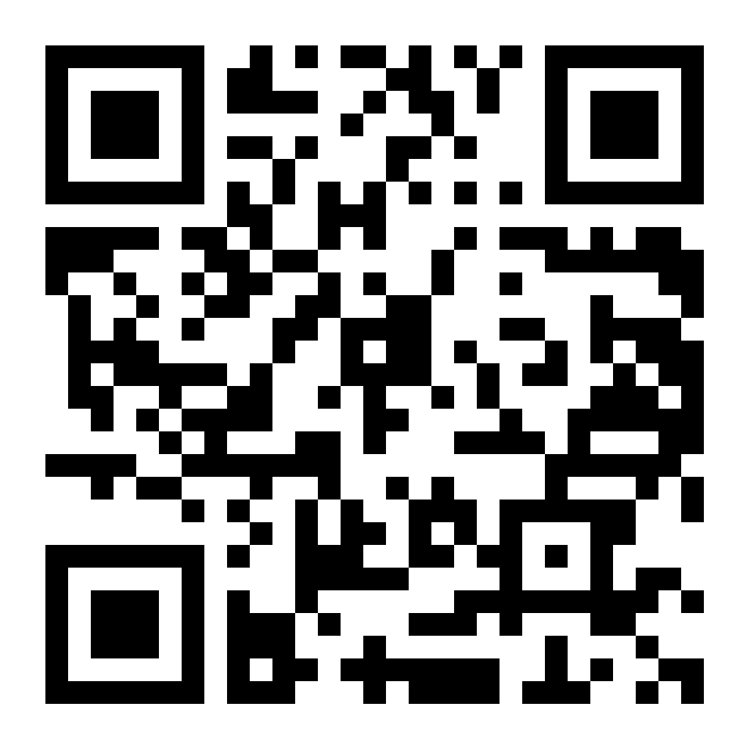
RESEARCH AND REFERENCES
Nexora
RESEARCH WORK
Research Focus
Studied existing GeM procurement and bid-verification workflows.
Reviewed AI, OCR, NLP and rule-based document verification approaches.
Identified gaps in manual and fragmented compliance verification.
Proposed a human-in-the-loop architecture for explainable decision support.
Scan QR To Read :
Click On Link To View Research Paper :
link: https://qrfy.io/tIspljMvRO
REFERENCES
GeM Official Website : Procurement ecosystem & bidding framework
[Visit Reference]
GeM Handbook : Procurement framework & guidelines
[View Reference ]
GeM Overview : GeM ecosystem & stakeholder structure
[View Reference]
GeM Bid Documents : Tender structure & compliance requirements
[View Reference]

