Slide 1
Ideate and Implement a System to Enhance the Quality of Education in Rural Areas
CSE7101- Capstone Project
Review-1
Batch Number:
Roll Number | Student Name
20221IST0009 | YASHWITHA T
20221IST0011 | GUDDITI YASHWANTH KUMAR
20221IST0036 | VARSHA B
Under the Supervision of,
Mrs. Monisha Gupta
Professor / Associate Professor / Assistant Professor
School of Computer Science and Engineering
Presidency University
Name of the Program: B.TECH
Name of the HoD: Dr. Pallavi R
Name of the Program Project Coordinator: Ms. Benitha Christinal J
Name of the School Project Coordinators: Dr. Sampath A K , Dr. Geetha A

Slide 2
Problem Statement Number: PSCS_32
Organization: Government of Kerala
Category (Hardware / Software / Both) : Software
Problem Description:
Ideate and implement a system to enhance the quality of education in rural areas. The aim of the system is not only to improve literacy rates but also to strengthen the overall learning experience for rural students. This includes developing their communication skills, enhancing subject knowledge, and providing access to modern educational resources. The system will focus on bridging the gap between urban and rural education by offering both online and offline learning opportunities. It will also promote skill development, mentorship, and awareness about government schemes, ultimately contributing to the personal and professional growth of the targeted community.

Slide 3
Objectives
To develop a web-based learning system for rural students.
To provide educational content offline without internet dependency.
To allow teachers to upload lessons and quizzes easily.
To enable students to access lessons and take tests on any device.
To track student progress and show reports through charts.
To make the system low-cost, simple, and easy to use.
To support learning even in areas with limited electricity and network.

Slide 4
Background and Related work for title Selection
Background
Lack of access to quality study material
Limited availability of skilled teachers and mentors
Poor internet connectivity
Low awareness about government schemes and employment opportunities
SDG 4: Ensure inclusive and equitable quality education for all
SDG 8: Promote sustained, inclusive economic growth and employment
.

Slide 5
Background and Related work for title Selection (contd….)
Related Work
DIKSHA (Govt. of India)
Provides digital resources for teachers and students, but lacks personalized mentoring and offline support.
Khan Academy
Offers high-quality video lessons, but requires strong internet connectivity and does not support regional languages.
Digital Kerala Mission
Aims for digital literacy, but is not fully integrated with career guidance, scholarships, or mentorship systems.

Slide 6
Analysis of Problem Statement
Challenges in Rural Education:
Lack of qualified teachers and mentors.
Poor internet connectivity and limited electricity supply.
Shortage of updated study materials and learning resources.
Low awareness of scholarships, grants, and job opportunities.

Slide 7
Analysis of Problem Statement (contd...)
Proposed Solution:
Develop a web-based platform (with offline mode) for rural learners.
Provide study materials, videos, and interactive quizzes accessible without constant internet.
Include a mentorship module for personalized guidance.
Enable progress tracking and analytics for teachers and students.
Add a job and government schemes section to increase career awareness.

Slide 8
Analysis of Problem Statement (contd...)
Technology Stack:
Frontend: React.js (web) / Flutter (mobile)
Backend: Django (Python) or Node.js
Database: MySQL or MongoDB
AI/ML: For personalized learning (optional advanced feature)
Offline Mode: Service Workers & local caching for poor connectivity
Hosting: AWS / Azure (if deploying online)

Slide 9
Analysis of Problem Statement (contd...)
Core Components:
User Interface: Web portal + Mobile app
Mentor Module: Assign mentors, schedule sessions
Learning Module: Upload and access digital content
Progress Tracker: Track and visualize student performance
Offline Mode: Download lessons for no-internet access
Job & Scheme Portal: Share employment and scholarship details

Slide 10
Innovation or Novel Contributions
1. Digital Integration for Personalized Learning
Introducing a web-based platform that adapts learning materials to each student’s pace and level, making education more personalized and effective.
2. Data-Driven Performance Tracking
Implementing analytics to track student performance, identify weak areas, and provide actionable insights for teachers and parents.
3. Gamification of Learning
Applying game elements like rewards, quizzes, and challenges to motivate students and increase engagement.

Slide 11
Innovation or Novel Contributions(contd..)
4. Efficient Communication Channels
Creating seamless communication between teachers, students, and parents through notifications, progress reports, and feedback systems.
5. Resource Optimization
Reducing administrative workload and optimizing classroom resources with automated scheduling and digital content management.
6. Accessibility & Inclusivity
Ensuring that students with special needs or remote learners can access education equally through the platform.

Slide 12
Github Link
The Github link provided should have public access permission.
Github Link
https://github.com/varsha12345170/rural-education-project

Slide 13
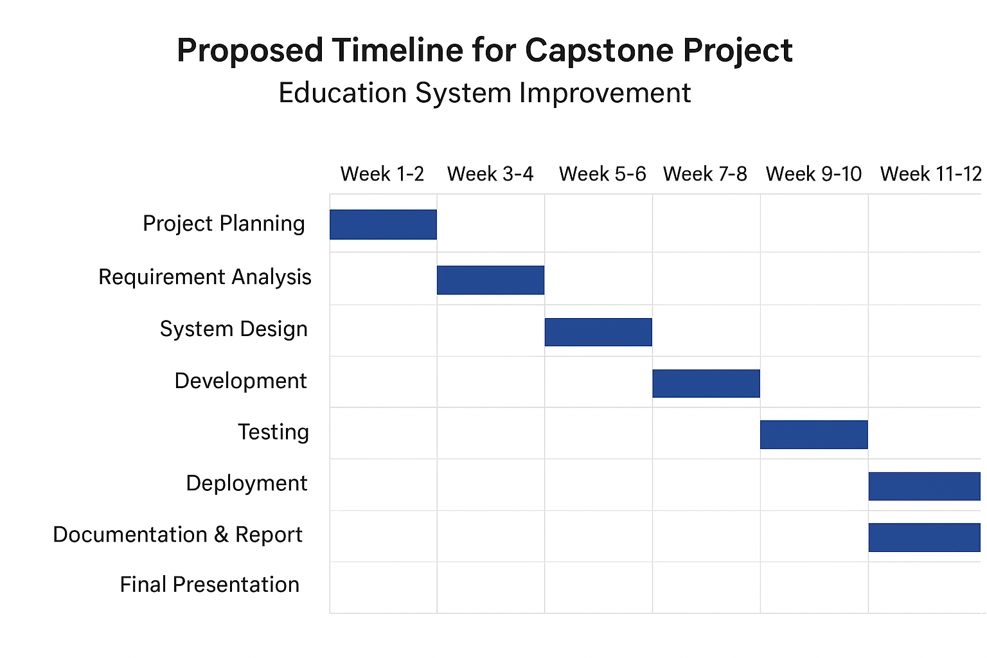
Timeline of the Project (Gantt Chart)

Slide 14
References (IEEE Paper format)
1] M. A. Ganie, et al., “Impact of e-learning on child education and development in rural areas of India,” IC5E, London, 2014.
[2] A. Bardia and A. Agrawal, “MindCraft: Revolutionizing education through AI-powered personalized learning,” arXiv:2502.05826, Feb. 2025.
[3] S. Grewal, “Scrutinizing E-Learning in Rural India,” 2023.

Slide 15


