Slide 1

WIT – All Women Hackathon 2024
Team Name : GenZCoders
AI Theme Alignment | Biz Relevance | Uniqueness/Creativity | Time/Cost Savings | Ideation Completed? | Solution Feasible? | Solution Completed?
✓ / X | ✓ / X | ✓ / X | ✓ / X | ✓ / X | ✓ / X | ✓ / X
Team Members :
Varsha Venkataraman – Z036324
Rithi Natchatra – Z041677
Motivation
Solution Walkthrough
At RNTBCI, our teams have universally adopted a code review process, which traditionally operates at the team level.
For instance, when one team successfully implements initiatives such as OKTA migration or version upgrades, neighboring teams, led by their leads or interested members, take the initiative to learn about the implementation.
They seek to understand the intricacies and consider applying similar solutions to their specific projects. Additionally, knowledge sharing occurs at the EQUIP IS level, facilitating cross-functional communication and learning.
To further enhance these collaborative practices and broaden the dissemination of knowledge, we are exploring the idea of conducting code reviews at the vertical level. This strategic shift aims to extend the reach of insights gained from individual projects to a wider audience within the vertical. By adopting this approach, we aspire to foster a more comprehensive sharing of cross-functional knowledge, enabling teams to benefit from a collective understanding of best practices, implementations, and innovations across the entire vertical.
How :
We've introduced an innovative approach to elevate this process and enrich developers' insights. Utilizing a dataset containing chapter leaders, assistant managers, and developers, our application now suggests and notifies the most suitable individuals for a given merge request. This not only streamlines the review process but also fosters cross-functional knowledge transfer, allowing anyone within the vertical to contribute. Consequently, best practices and new implementations become widely known, enhancing the overall coding environment.
When initiating a Merge Request on GitLab, there's an option to designate the reviewer for the request. Currently, the default setting assigns reviewers randomly. However, based on our exploratory data analysis (EDA) of the dataset, we've identified that the Merge Request benefits from a more targeted review by someone with expertise in the field, as it has shown improved accuracy in such cases.
Tools : Google colab
Git location
isit-hackathon / WIT-AllWomenHackathon-2024 / GenZCoders / Knowledge_Code_Share · GitLab (renault.com)

Slide 2
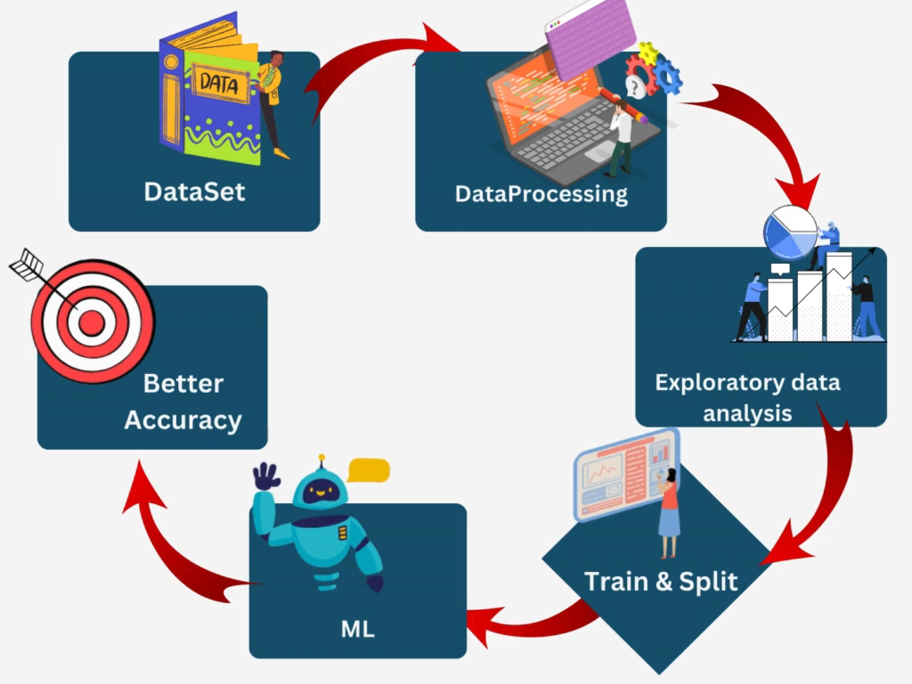
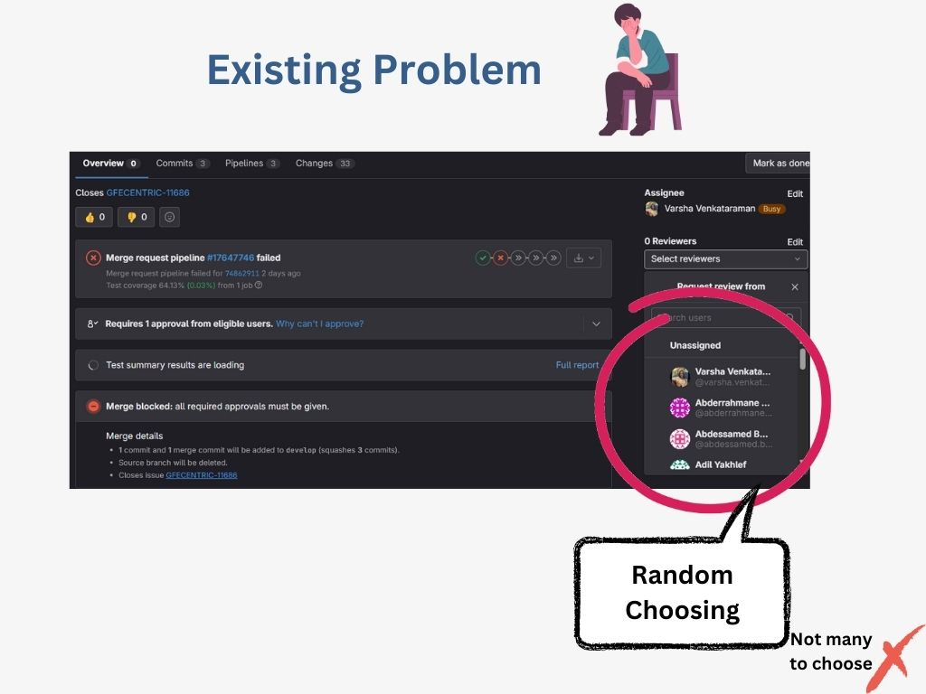
WIT – All Women Hackathon 2024
Output / Demo / Screenshots / Links

Slide 3
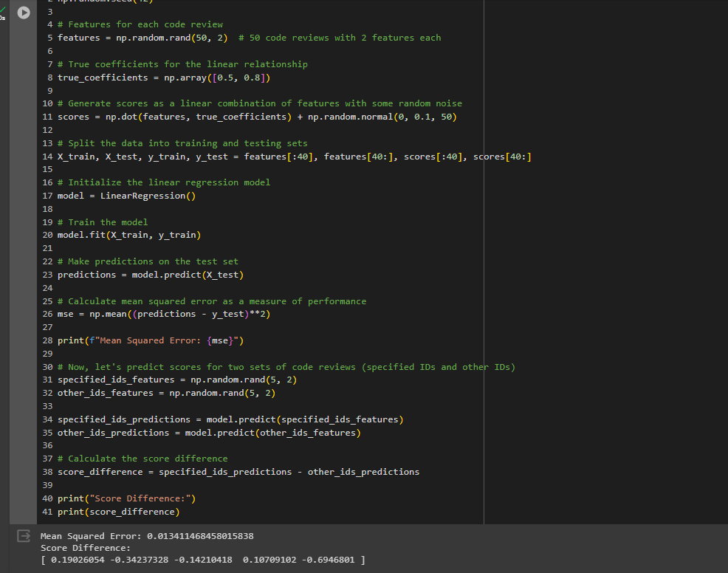
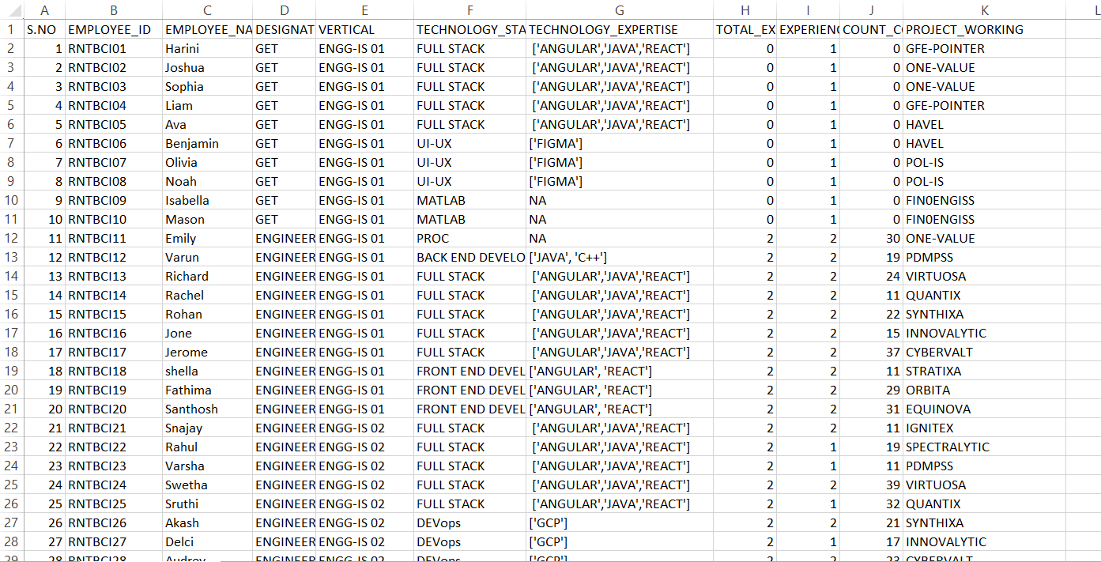
WIT – All Women Hackathon 2024
Output / Demo / Screenshots / Links

Slide 4
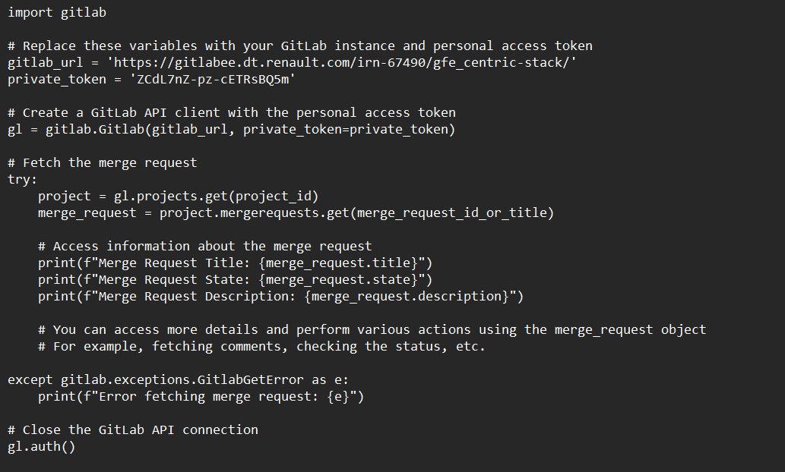
WIT – All Women Hackathon 2024

Slide 5
WIT – All Women Hackathon 2024
Appendix Details
Key Features :
Specific code reviewer
In the context of version control systems like Git, a specific code reviewer is an individual designated to review and approve or suggest improvements to a particular set of code changes, fostering collaboration and knowledge sharing among team members during the software development lifecycle.
Cross functional knowledge transfer
Cross-functional knowledge transfer involves sharing expertise and skills across different departments or teams within an organization, fostering a collaborative environment and enabling individuals to contribute effectively outside their primary areas of specialization
Maintain same level of coding standard in all the projects
Maintaining the same level of coding standards across all projects is crucial for consistency, collaboration, and long-term sustainability. This practice involves establishing and adhering to a set of predefined coding guidelines, conventions, and best practices that are consistently applied throughout various software development projects within an organization.
Assign reviewer who are experienced in that particular field.
Assigning reviewers with expertise in a specific field is a strategic approach to enhance the quality and effectiveness of code reviews. This practice involves selecting individuals who possess in-depth knowledge and experience in the particular domain or technology associated with the code changes. By doing so, it ensures that the review process is not only focused on general coding standards but also addresses domain-specific nuances, potential risks, and best practices.

