Slide 1
Effectiveness of Direct marketing campaign of Banco De Portugal
Waingankar Varsha

Slide 2
Presentation Overview
Problem Statement
Dataset Overview
Strategy Explained
Analysis and Findings
Best Model Identified
Conclusion

Slide 3
Problem Statement
Accurately predict the effectiveness of marketing campaigns at Banco De Portugal.
The marketing campaigns were based on phone calls. Often, more than one contact to the same client was required, in order to access if the product (bank term deposit) would be ('yes') or not ('no') subscribed.

Slide 4
Business Case
The increasing number of marketing campaigns over time has reduced their effects on the general public. First, due to competition, positive response rate to mass campaigns are typically very low, according to a recent study, less than 1% of the contacts will subscribe a term deposit.
Second, direct marketing has drawbacks, such as causing negative attitude towards banks due to intrusion of privacy. In order to save costs and time, it is important to filter the contacts but keep a certain success rate.

Slide 5
Purpose & Goal
Objective is to build a classifier to predict whether or not a client will subscribe a term deposit.
If the classifier has high accuracy, the banks can arrange a better management of available resources by focusing on the potential customers “picked” by the classifier, which will improve their efficiency a lot.
Besides, plan to find out which factors are influential to customers’ decision, so that a more efficient and precise campaign strategy can be designed to help to reduce the costs and improve the profits.

Slide 6
Dataset Overview
Column Definitions
Dataset Values
Categorical variables
Continuous variables

Slide 7
Column Definitions
Age (numeric)
Job : type of job
Marital : marital status
Education
Default: has credit in default?
Housing: has housing loan?
Loan: has personal loan?
Contact: contact communication type
Month
Day_of_week:
Duration: last contact duration, in seconds (numeric).
Campaign: number of contacts performed during this campaign and for this client (numeric, includes last contact)
Pdays: number of days that passed by after the client was last contacted from a previous campaign

Slide 8
Column Definitions (cont.)
Previous: number of contacts performed before this campaign and for this client (numeric)
Poutcome: outcome of the previous marketing campaign ('failure', 'non existent', 'success')
Emp.var.rate: employment variation rate - quarterly indicator (numeric)
Cons.price.idx: consumer price index - monthly indicator (numeric)
Cons.conf.idx: consumer confidence index - monthly indicator (numeric)
euribor3m: euribor 3 month
nr.employed: number of employees - quarterly indicator (numeric)

Slide 9
Column Definitions (cont.)
Output variable (desired target):
y - has the client subscribed a term deposit? (binary: 'yes‘ , 'no')

Slide 10
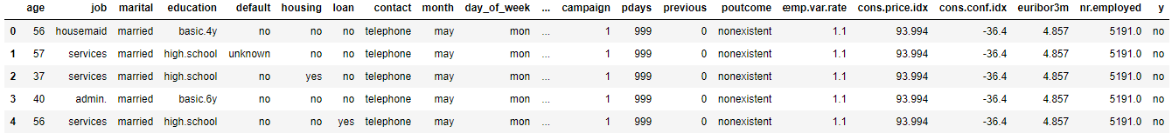
Dataset Values (Breakdown of Data Frame)

Slide 11
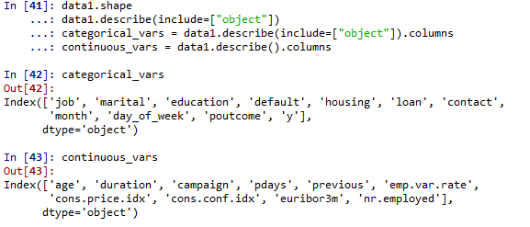
Code Snippet for Categorical/ continuous variable

Slide 12
Visualizations of Dataset
Splitting the data set into continuous and categorical variables
Plotting histograms for continuous variables
Plotting count plots for categorical variables
Correlation matrix between continuous variables
Transforming the categorical variable

Slide 13
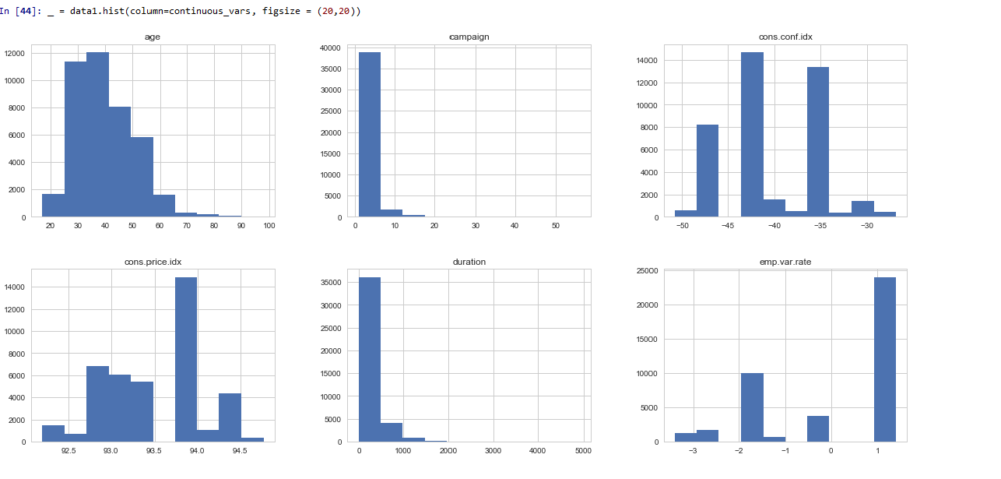
Histograms for the continuous variables

Slide 14
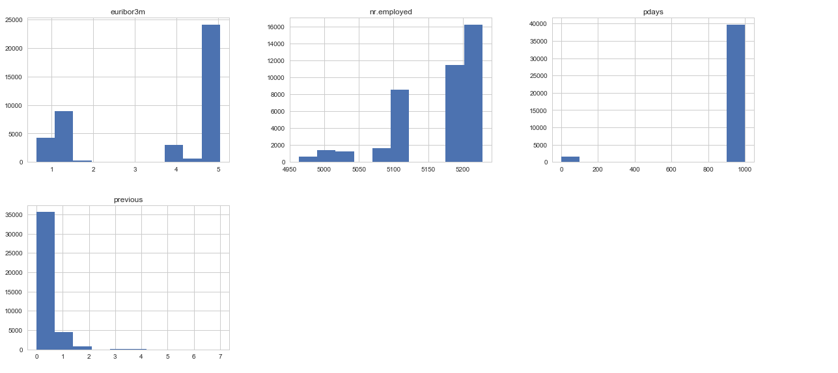
Histograms for the continuous variables (contd…)

Slide 15
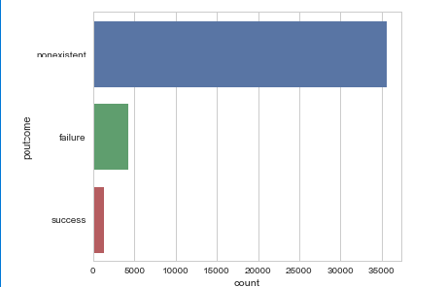
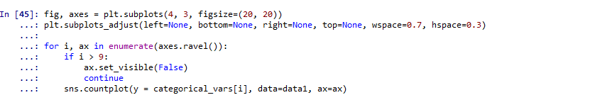
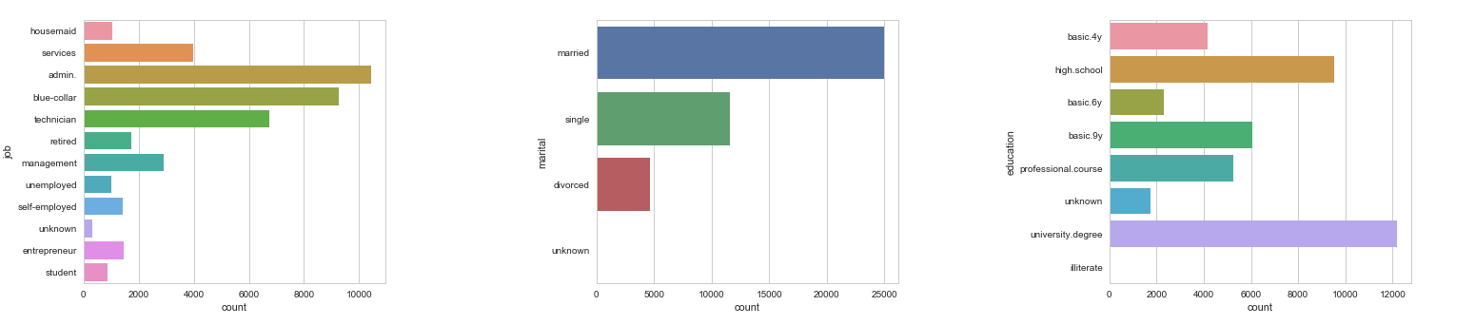
Count plots for the categorical variables

Slide 16
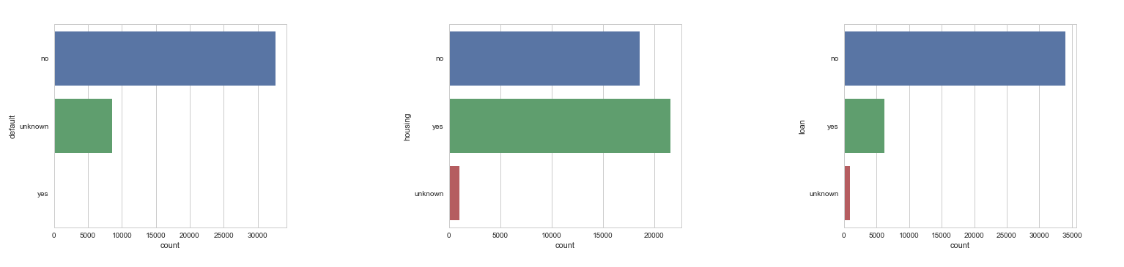
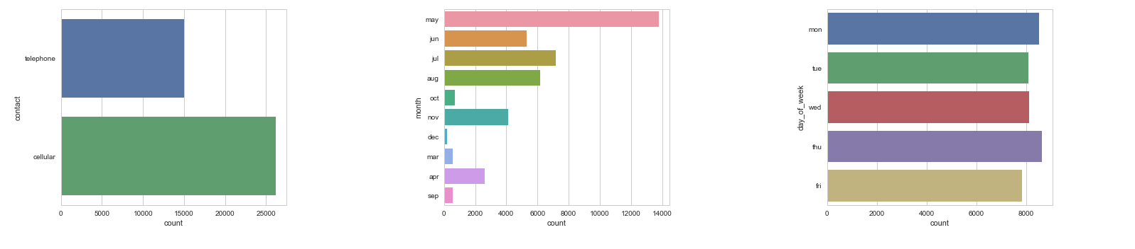
Count plots for the categorical variables (contd.)

Slide 17
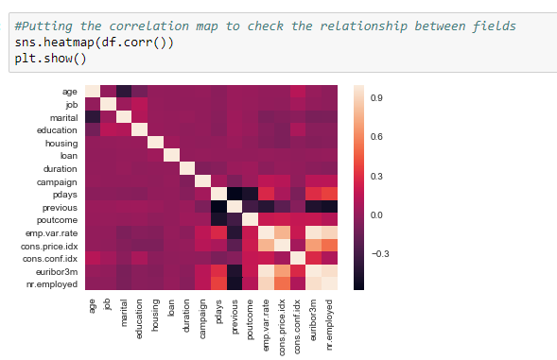
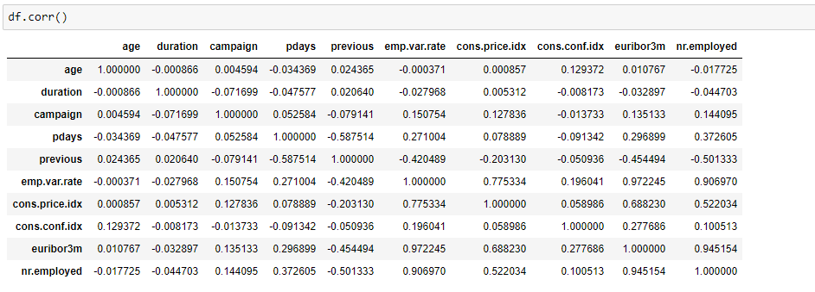
Correlation between various variables

Slide 18
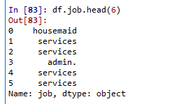

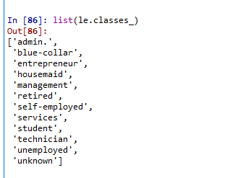
Transforming variables to numbers
Job values of a Data Frame
Encoder
Checking for the occurrence of unique values
After transformation
Transformed values

Slide 19

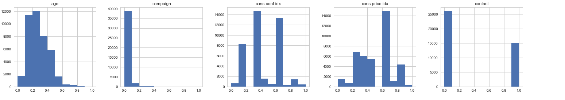
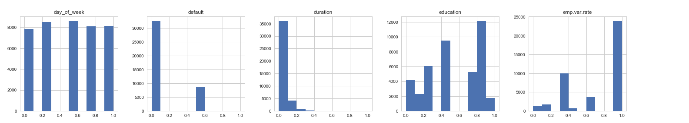
Applying scaling to the features (MinMaxScaler)

Slide 20
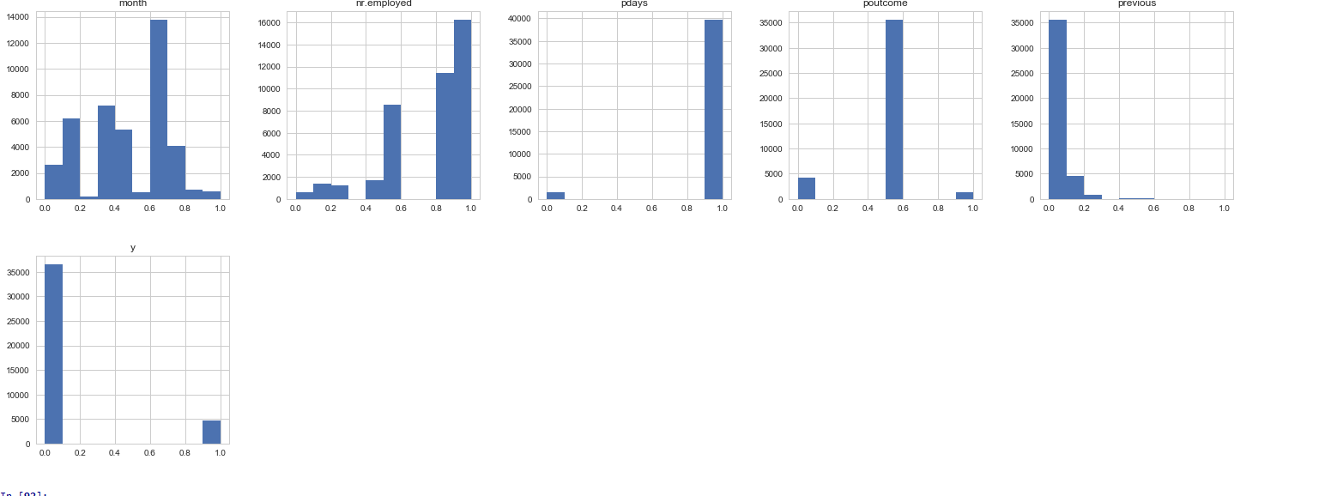
Applying scaling to the features (MinMaxScaler)contd.

Slide 21
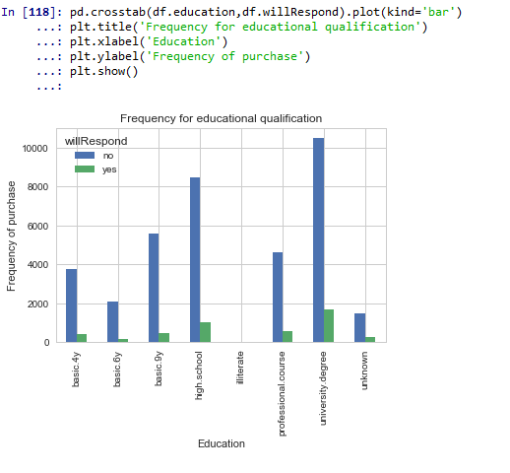
Plot- Frequency of Education to purchase

Slide 22
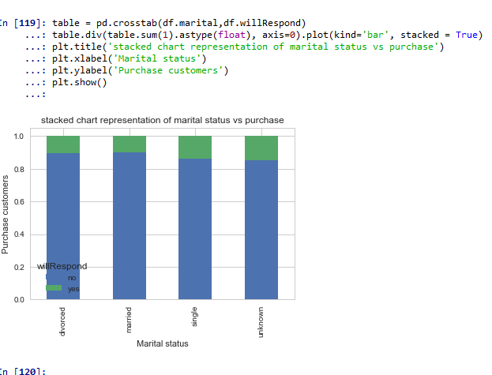
Plot- Frequency of Marital status to purchase

Slide 23
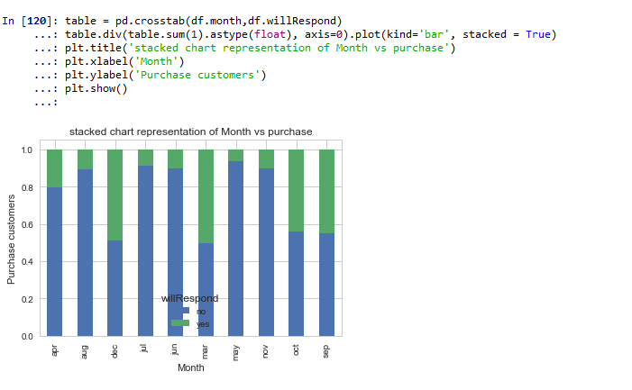
Plot- Frequency of Month to purchase

Slide 24
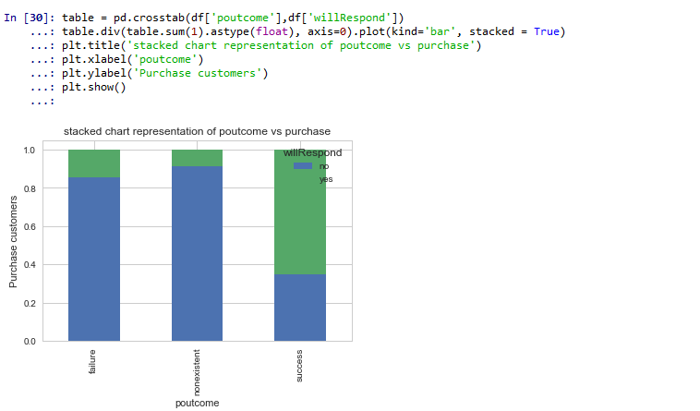
Plot- Frequency of poutcome to purchase

Slide 25
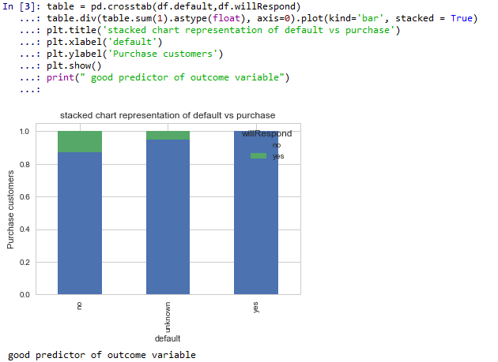
Plot- Frequency of default to purchase

Slide 26
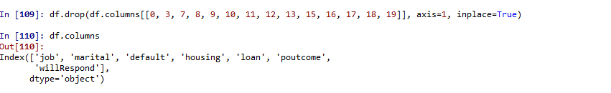
Feature Selection
Checking for all the columns of the data frame
Dropping irrelevant columns

Slide 27
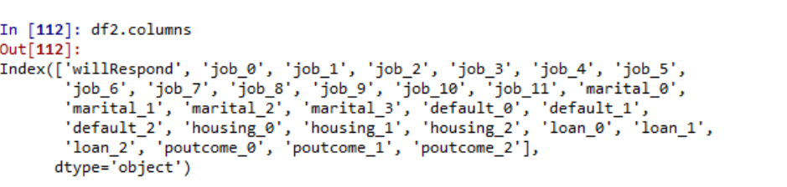
Feature Selection
Creating dummies
Dropping unwanted columns

Slide 28
Strategy Overview
Tried two different models
Logistic Regression
K nearest neighbors classifier
Score Measure used is Accuracy and AUC

Slide 29

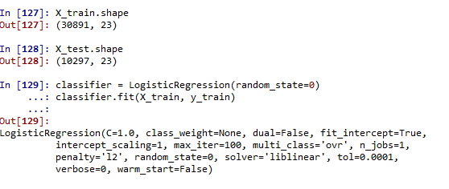
Logistic Regression Analysis

Slide 30
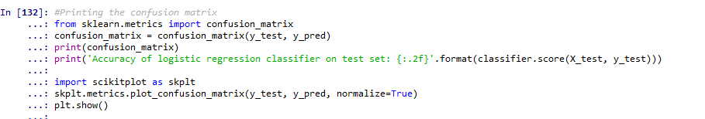
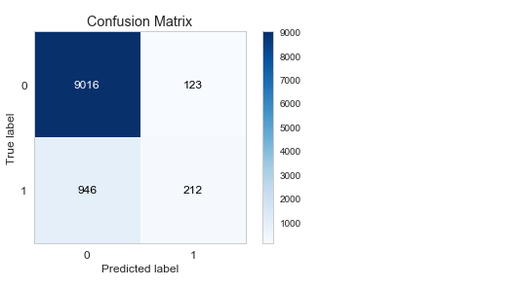
Logistic Regression
Accuracy for the model is 90%

Slide 31
ROC
Area under the curve

Slide 32
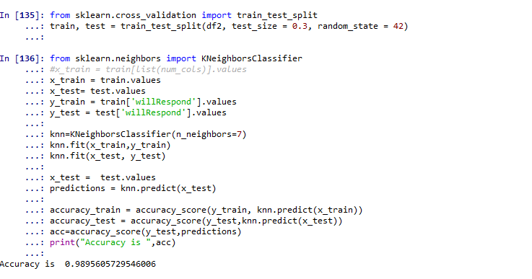
KNN Predictive Modeling

Slide 33
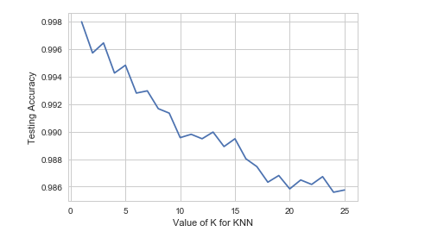
Area under curve/ Best value for K

Slide 34
Comparison of the metrics
Logistic Regression
KNN Classifier

Slide 35
Predictive Model Comparison
Model | Accuracy | Area under curve
Logistic Regression | 90 | 0.54
(KNN) | 98 | 0.94
KNN provides better accuracy and AUC as compared to that of Logistic regression

Slide 36
Conclusion
The classifier built using KNN is able to classify the ‘bank term deposit’ as subscribed or not with an accuracy score of 98 percent and the AUC as 0.94.
Based on this classifier accuracy, banks can focus on potential customers that will subscribe in the future.
The most influential factors that determine the customer’s decision are job, marital status, loan, housing, default and poutcome.

Slide 37
Background/Reference Slides
Website https://www.bportugal.pt/en-US/Pages/inicio.aspx

