Slide 1
Sentiment analysis of online product reviews using NLP
Waingankar Varsha

Slide 2
Presentation Overview
Problem Statement
Dataset Overview
Strategy Explained
Analysis and Findings
Best Model Identified
Conclusion

Slide 3
Data Collection
This is a list of over 71,045 reviews from 1,000 different products provided by Datafiniti's Product Database.
The dataset includes the text and title of the review, the name and manufacturer of the product, reviewer metadata, and more.
Note that this is a sample of a large data set

Slide 4
Problem Statement
Purpose of this project is to build a recommendation system that will accurately predict the sentiment , review title, review text as positive or negative
Also predict the ratings from 1 to 5
Find the best model with highest performance metric, that will yield appropriate text classification

Slide 5
Business Case
Technological advances over the past decade have led to the proliferation of consumer review websites such as Walmart, target, where consumers can share experiences about product quality. These reviews provide consumers with information about the goods, and the quality that is observed only after consumption.
With the click of a button, one can now acquire information from countless other consumers products ranging from food, personal care, medicine, household goods etc.

Slide 6
Dataset Overview
Column Definitions
Dataset Values
Data Analysis

Slide 7
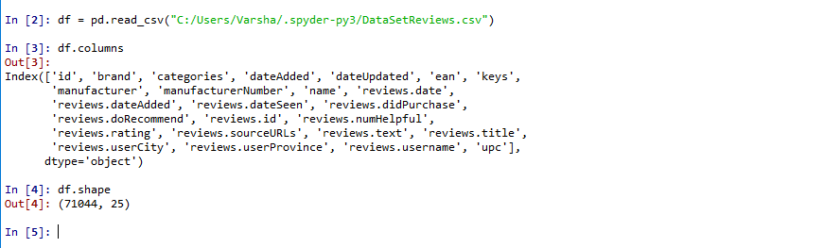
Dataset Values (Breakdown of Data Frame)

Slide 8
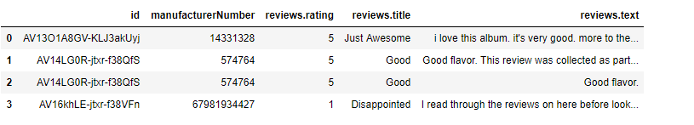
Breakdown of Data Frame

Slide 9
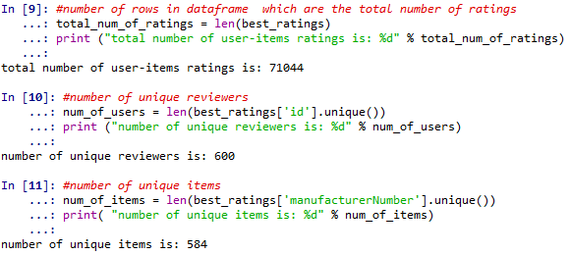
Data Analysis

Slide 10
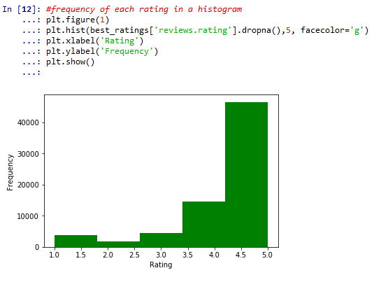
Histogram –Frequency of Rating

Slide 11
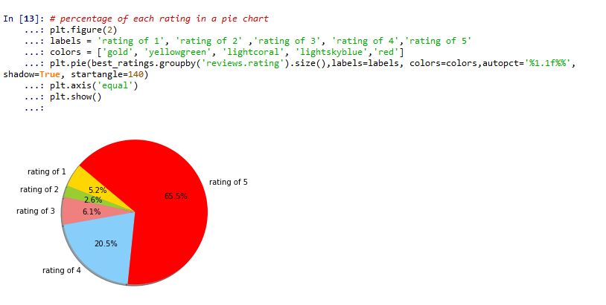
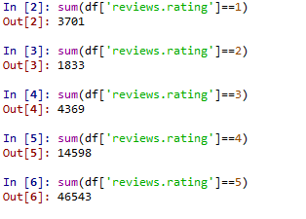
Distribution of Rating

Slide 12
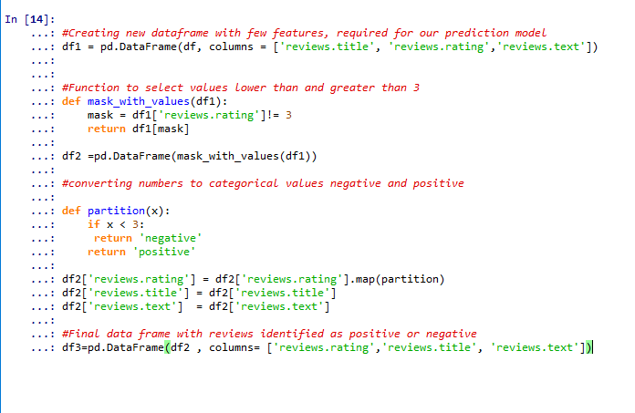
Converting the ratings into binary factors (positive/negative)

Slide 13
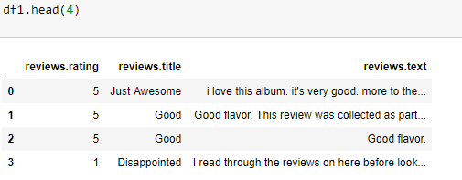
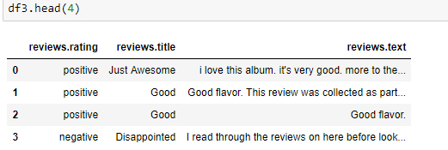
Before and after conversion

Slide 14
Text Processing
Tokenization
Stemming
Stop words removal
Count Vectorization
Term Frequency –Inverse Document Frequency

Slide 15
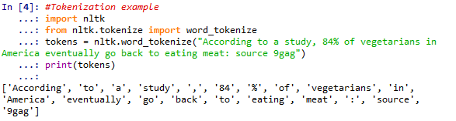
Step 1 : Tokenization
Tokenization is a method of breaking up a piece of text into many pieces, such as sentences and words

Slide 16
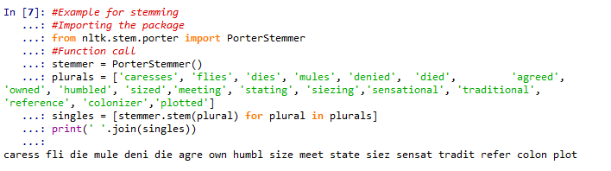
Step 2 : Stemming
Stemmers remove morphological affixes from words, leaving only the word stem.

Slide 17
Step 3 : Count Vectorization
The text must be parsed to remove words, called tokenization. Then the words need to be encoded as integers or floating point values for use as input to a machine learning algorithm, called feature extraction (or vectorization).
The CountVectorizer provides a simple way to both tokenize a collection of text documents and build a vocabulary of known words, but also to encode new documents using that vocabulary.
How to use it??
Create an instance of the CountVectorizer class.
Call the fit() function in order to learn a vocabulary from one or more documents.
Call the transform() function on one or more documents as needed to encode each as a vector.
An encoded vector is returned with a length of the entire vocabulary and an integer count for the number of times each word appeared in the document.

Slide 18
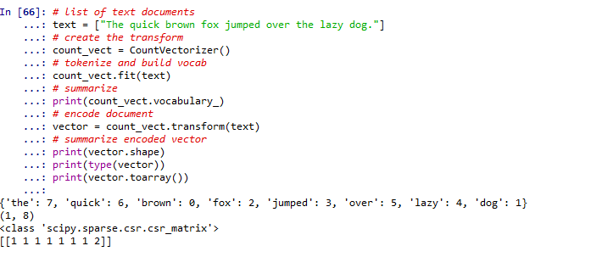
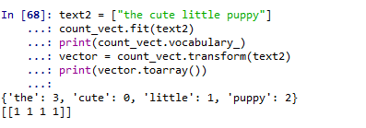
Example of CountVectorizer

Slide 19
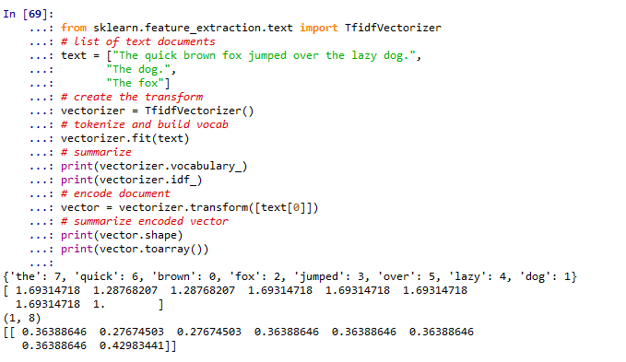
Step 4 :Term frequency – inverse document frequency
Term Frequency: This summarizes how often a given word appears within a document.
Inverse Document Frequency: This downscales words that appear a lot across documents.

Slide 20
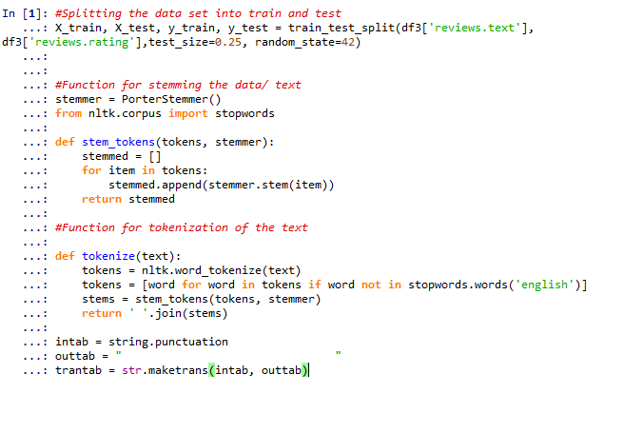
Text processing on the Train and Test Data
Stops words hold importance in reviews.
So they were not removed, as accuracy reduced.

Slide 21
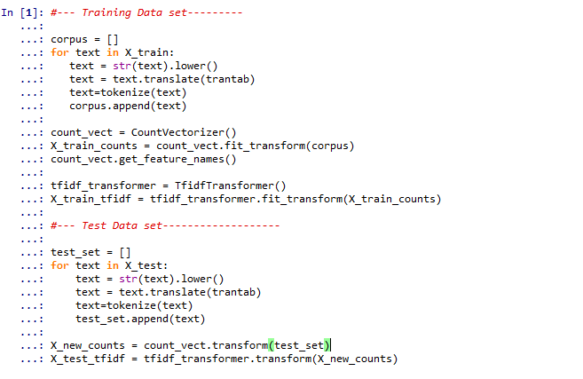
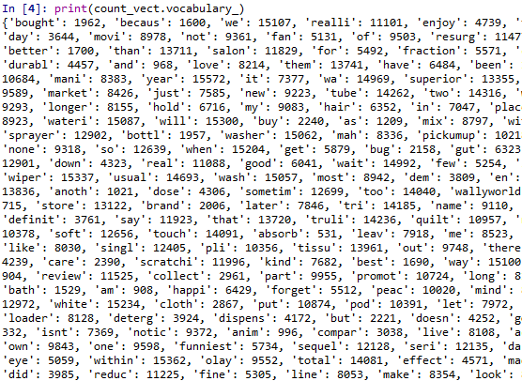
Training and Testing Modules

Slide 22
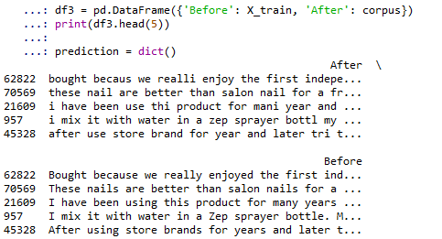
Text after Transformation
Classification works by learning from labeled feature sets, or training data, to later classify an unlabeled feature set
A feature set is basically a key-value mapping of feature names to feature values

Slide 23
Strategy Overview
Predicting sentiment as positive/negative on reviews title and reviews text
Predicting ratings from 1 to 5 (very poor, poor, average, good, very good)
Five different models implemented as follows:
Naïve Bayes – Multinomial
Naïve Bayes – Bernoulli
SVC – Support Vector Classification
Logistic Regression
Decision Tree Classifier
Score Measure used is Accuracy and AUC

Slide 24
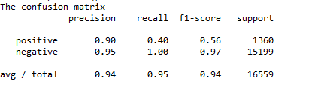
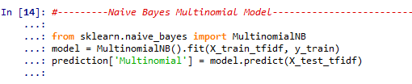
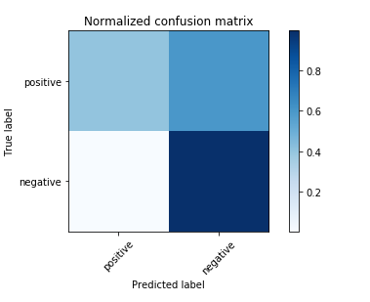
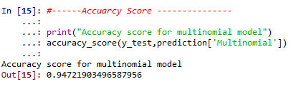
Naïve Bayes Multinomial Analysis

Slide 25
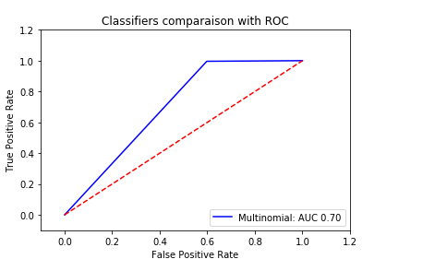
ROC
Area under the curve

Slide 26
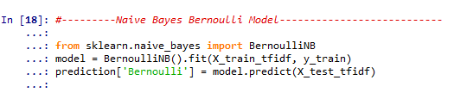
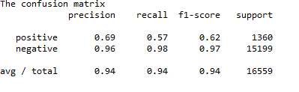
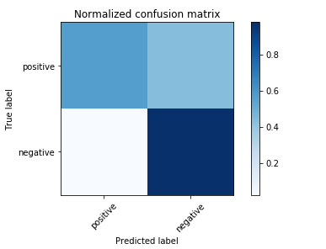
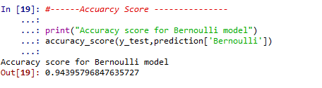
Naïve Bayes Bernoulli Analysis

Slide 27
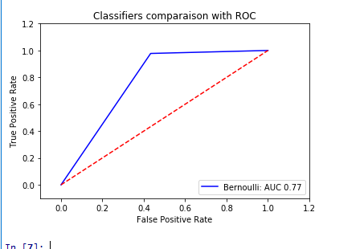
ROC
Area under the curve

Slide 28
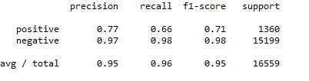
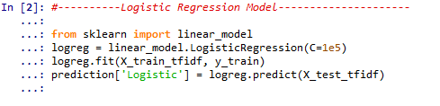
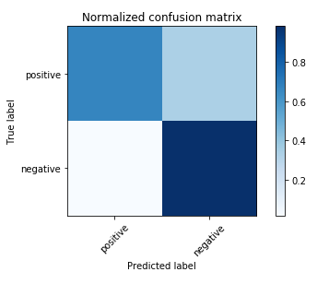
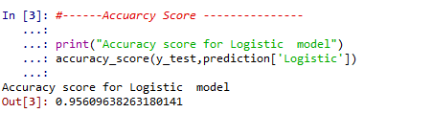
Logistic Regression Analysis

Slide 29
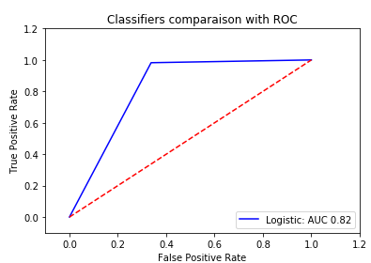
ROC
Area under the curve

Slide 30
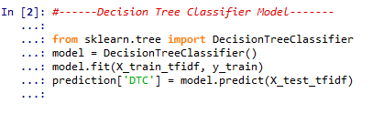
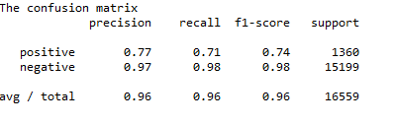
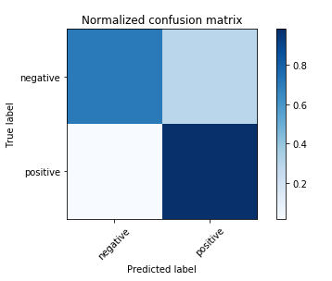
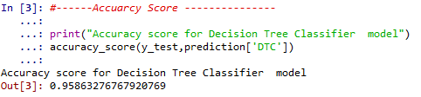
Decision Tree Analysis

Slide 31
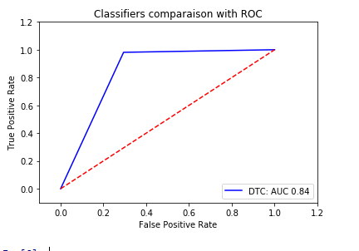
ROC
Area under the curve

Slide 32

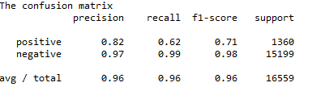
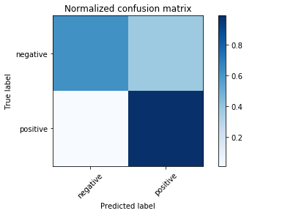
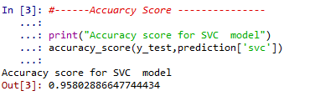
SVC Analysis

Slide 33
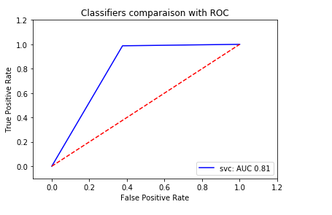
ROC
Area under the curve

Slide 34
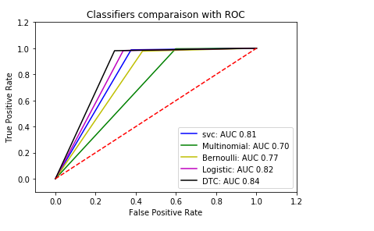
Comparison of the metrics Receiver Operator Characteristic – Area Under the Curve

Slide 35
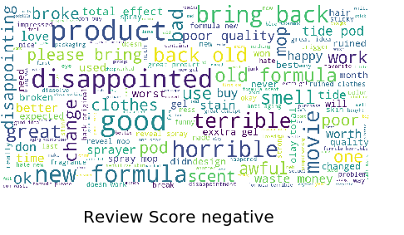
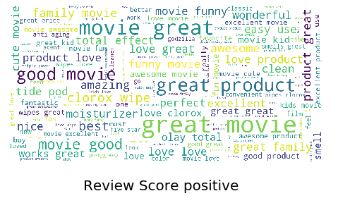
Word cloud for Reviews - Title

Slide 36
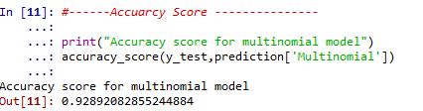
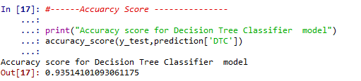
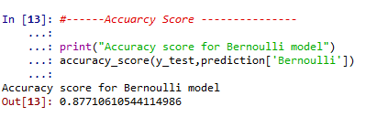
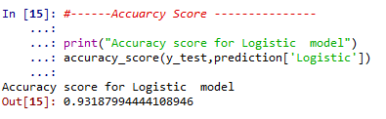
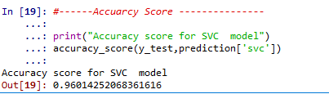
Analysis of Review Text - Accuracy Score

Slide 37

Reviews Text – Area Under the Curve (ROC)

Slide 38



Word Cloud – Reviews Text

Slide 39

Multi-Label classification

Slide 40



Confusion Matrix for SVC – Best Model

Slide 41



Confusion Matrix for Logistic – Best Model

Slide 42




Word cloud for Multi - class

Slide 43
Predictive Model Comparison for Review title
Model | Accuracy | Area under curve
Multinomial | 94.72 | .70
Bernoulli Support Vector Classification Logistic Regression Decision Tree Classifier | 94.39 95.8 95.6 95.86 | .77 .82 .81 .84
Decision Tree Classifier yields the best performing model in terms of both accuracy and AUC

Slide 44
Predictive Model Comparison for Reviews text
Model | Accuracy | Area under curve
Multinomial Bernoulli Support Vector Classifier | 92.8 87.7 96.0 | 0.54 0.76 0.83
Logistic Regression Decision Tree Classifier | 93.1 93.5 | 0.81 0.77
SVC provides an accuracy of 96% and AUC of 0.83

Slide 45
Predictive Model Comparison for multi class
Model | Accuracy
Multinomial Bernoulli Support Vector Classifier | 69.4 68.7 70.9
Logistic Regression Decision Tree Classifier | 70.1 68.9
Support Vector Classifier and Logistic Model provide better accuracy

Slide 46
Conclusion
Our model is more biased towards positive reviews compared to negative ones.
Tried under sampling the majority class, ROC improves for sentiment classification. Accuracy reduces for multi label classification.
In conclusion, although our data was biased towards positive reviews, (SVC) model was fairly accurate with its predictions, achieving an accuracy ,precision and recall of 96% on the test set. [Binary classification]
For Multi- label classification , the best model (SVC) achieved an accuracy of 71 % , with precision of 66% and recall of 67%

Slide 47
Background/Reference Slides
https://data.world/datafiniti/grammar-and-online-product-reviews
https://www.lexalytics.com/lexablog/machine-learning-vs-natural-language-processing-part-1
https://www.marcoaltini.com/blog/dealing-with-imbalanced-data-undersampling-oversampling-and-proper-cross-validation
https://www.reviewtrackers.com/online-review-bias/

