Slide 1

INTELLIGENT TRANSPORTATION SYSTEM WITH AUTONOMOUS DRIVING SCHEMES FOR TRAFFIC CONTROL
ECE2010
CONTROL SYSTEMS
REVIEW-3
CHARAN S-19BEC1114
VARSHA JAYAPRAKASH-19BEC1233
POOJAA C-19BEC1432
ANSU ANNA MONCY-19BEC1320

Slide 2

ABSTRACT
The rapid advance of urbanization leads to overloaded urban roads and causes traffic congestion, which in turn increase overall energy use, emissions and travel time.
An intelligent transportation systems (ITS) is a typical cyber-physical system (CPS) in which physical components, for example, Connected Automated Vehicles (CAVs), are monitored and controlled through a network of cyber and physical components. A decision logic for negotiating the state of traffic lights and surrounding vehicles is developed. The decision logic then provides the controller with a definite velocity and path. The safety and performance evaluation of an ITS at signalized intersections is tested.
TOOLS USED: MATLAB, SIMULINK, SIMEVENTS

Slide 3
INTRODUCTION
Decision logic for negotiating traffic lights is a fundamental component of an automated driving application.
The decision logic must react to inputs like the state of the traffic light and surrounding vehicles .
The decision logic then provides the controller with the desired velocity and path.
Since traffic light intersections are dangerous to test, simulating such driving scenarios can provide insight into the interactions of the decision logic and the controller using a closed loop control system.

Slide 4
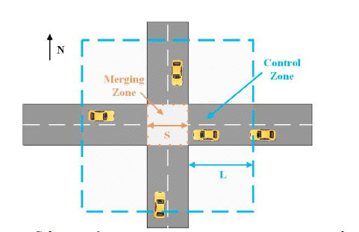
SIGNALIZED INTERSCTION

Slide 5
OBJECTIVE
DEVELOP TEST BENCH MODEL
Traffic light sensors, environment & vehicle dynamics
Vehicle control
MODEL TRAFFIC LIGHT DECISION LOGIC
Senses the presence of lead vehicle and signal
Provides a reference path for ego vehicle to follow in the absence of lanes.
SIMULATE MOVEMENT WITH TRAFFIC LIGHT & LEAD VEHCILE
Test the traffic light decision logic based on the distance & state of light & control of ego vehicle in the presence of lead vehicle.
Traffic light decision logic
SIMULATE MOVEMENT WITH TRFFIC LIGHT & CROSS TRAFFIC
Test the traffic light decision logic & control of ego vehicle in the presence of cross traffic based on the path and its distance.
PLOT OF SIMULATION RESULTS
Traffic light state as function of time.
Relative distance between ego and MIO.
Ego acceleration and yaw angle.

Slide 6
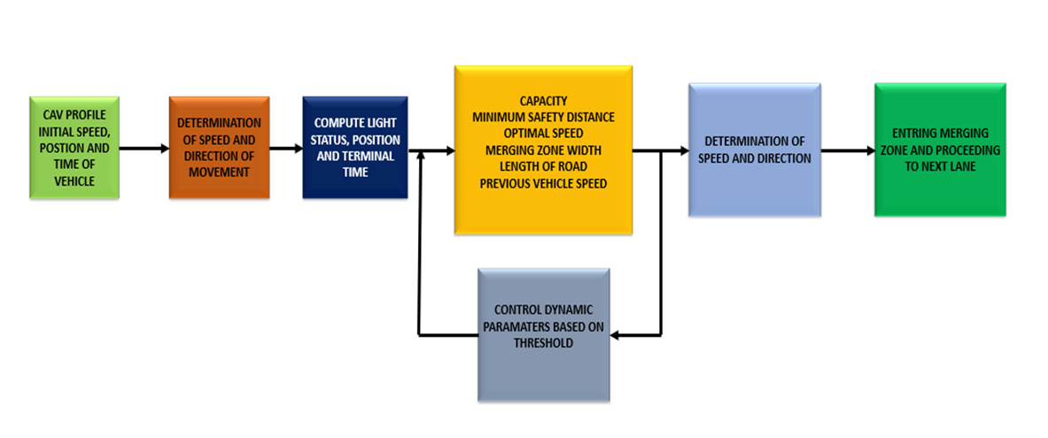
BLOCK DIAGRAM

Slide 7
ASSUMPTIONS
There is no delay and communication errors in the decision and control logic.
The length of the schedule zone is sufficiently large so that the go vehicle can accelerate up to the speed limit and decelerate to complete stop.
The CAVs within the communication range from stable platoons, i.e., all the vehicles in the scenario move at a consensual speed and maintain the desired space between vehicles

Slide 8
REQUIRED SUBSYTEMS
SENSORS & ENVIRONMENT
Actors and sensors
TRAFFIC LIGHT DECISION
Identify lead car
LANE FOLLOW CONTROL
Analyze curvature of road.
Traffic light sensor
Scenario information
Compute Distance To Intersection
Lane decision.
MPC controller to yield steering angle and acceleration.
Braking controller to apply brakes or deceleration.
VEHICLE DYNAMICS
Driven based non linear Bicycle model.
Driveline model for gear, brakes, acceleration, deceleration.
Calculate position, yaw angle and rate and velocity.
Update pose of vehicle.
VISULIZATION
Realtime simulation of scenario based on light status, ego pose.\
Actors move accordingly.

Slide 9
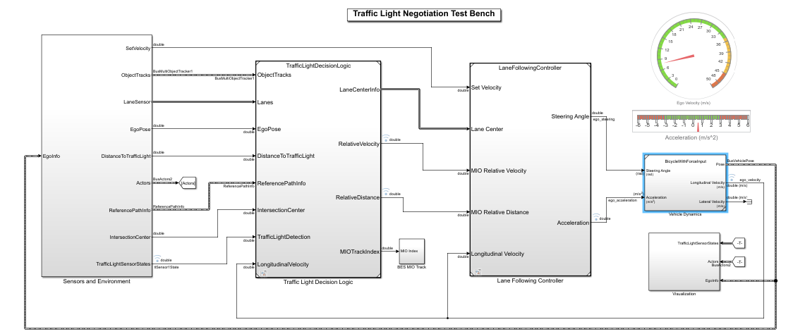
MAIN TEST BENCH

Slide 10
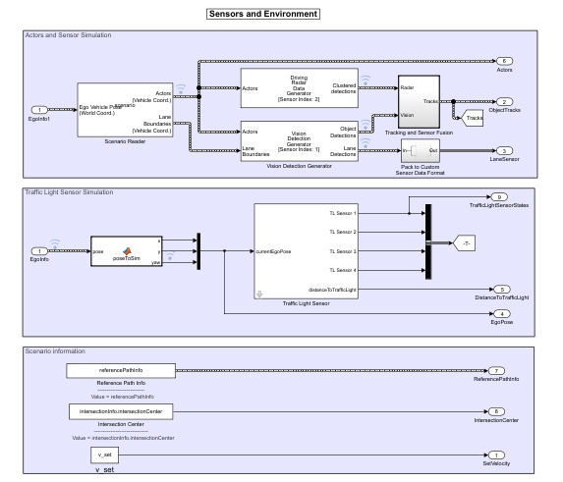
SENSORS & ENVIRONMENT

Slide 11
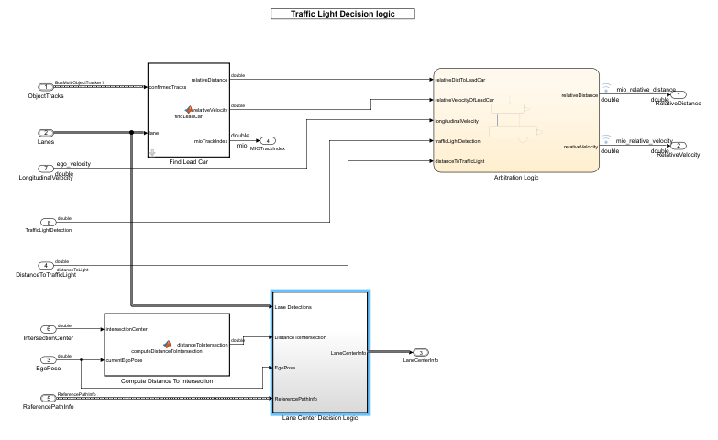
TRAFFIC LIGHT DECISION LOGIC

Slide 12
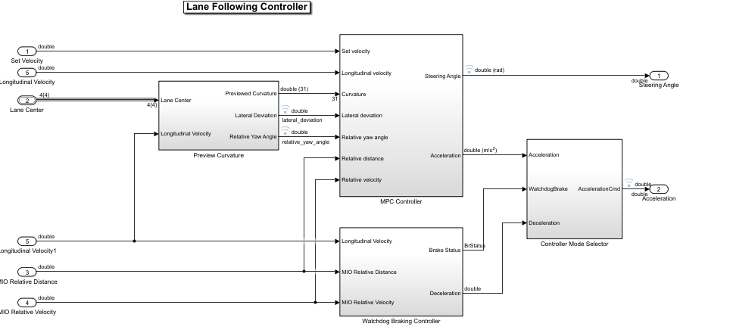
LANE FOLLOW CONTROL

Slide 13
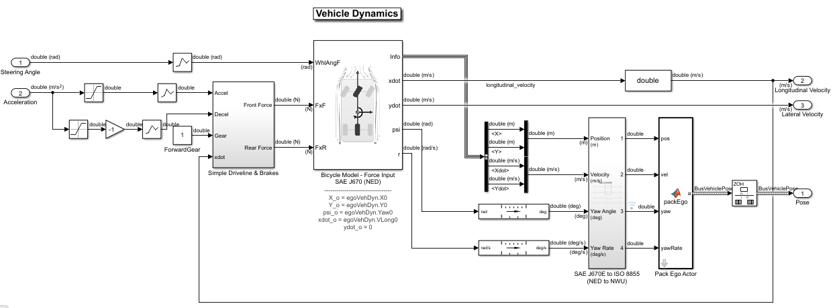
VEHICLE DYNAMICS

Slide 14
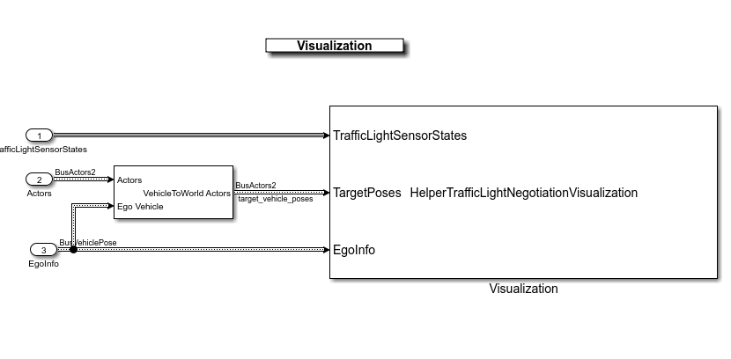
VISUALIZATION

Slide 15
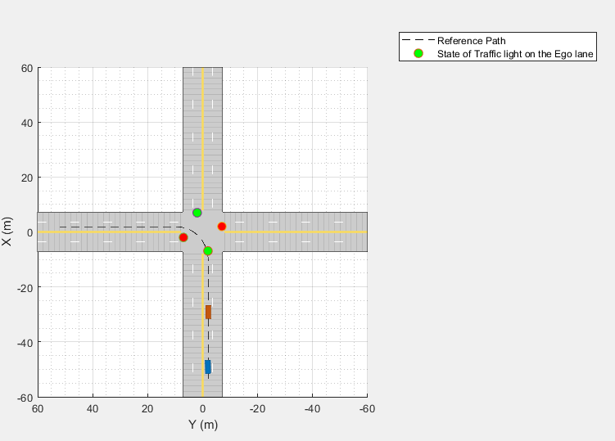
SIMUATION WITH TRAFFIC LIGHT & LEAD VEHICLE

Slide 16
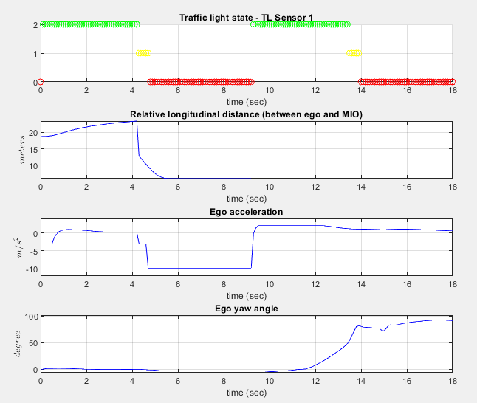
PLOT OF EGO DYNAMICS

Slide 17
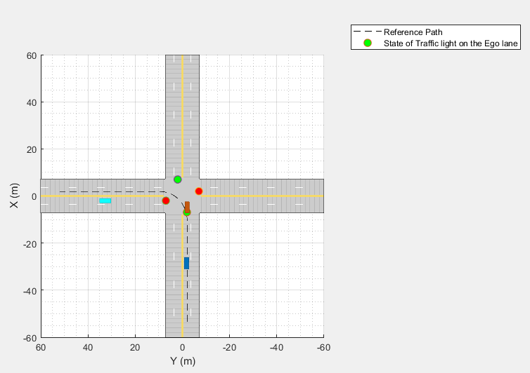
SIMULATION WITH TRAFFIC LIGHT AND CROSS TRAFFIC

Slide 18
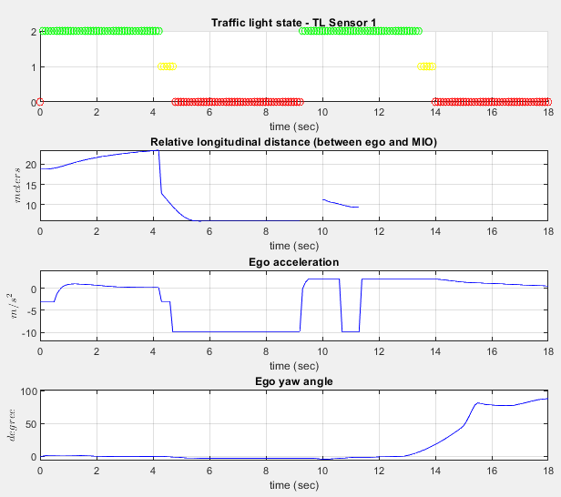
PLOT OF VEHICLE DYNAMICS

Slide 19
THANK YOU

