Slide 1


PUF BASED AUTHENTICATION FOR RESOURCE CONSTRAINED IOT DEVICES
09th November 2021
ECE4003 - EMBEDDED SYSTEMS AND DESIGN
Review-3
19BEC1432 - C.POOJAA
19BEC1233 - VARSHA JAYAPRAKASH
19BEC1114 - S.CHARAN

Slide 2

CONTENT
ABSTRACT
INTRODUCTION
RELATED WORK
DESRIPTION OF PROPOSED METHOD
BLOCK DIAGRAM
SIMULATION PARAMETERS
OBJECTIVE
RESULTS
APPLICATION OF PUF
ADVANTAGES OF PUF
SECURITY ATTACKS IN PUF

Slide 3
ABSTRACT
The unlimited use of IoT exposes the various sensors and devices to security issues.
Standard security techniques are not suitable due to resource constraints and also prone to attacks.
Memory
Speed
power consumption.
PUF based authentication system is developed using XOR Arbiter PUF and is implemented using MATLAB
KEY WORDS: IoT, security, resource constraints, XOR Arbiter PUF, authentication, uniformity, uniqueness.
Uniqueness and uniformity of PUF is evaluated.

Slide 4
INTRODUCTION
The Internet of Things (IoT) is one of the emerging technology in today’s world to connect billions of electronic devices
Security of data is necessary to preserve its
IoT devices are smaller and consume less power.
PUF based technique is advantageous due to the unique physical structure of device and ease in large scale production.
Confidentiality
Integrity
privacy
Protection
Conventional security algorithms are complex with its computations and not suitable for IoT environments.

Slide 5
PUF-PHYSICAL UNCLONABLE FUNCTION PROPERTIES
PUF are physical devices that contain certain components.
Output cannot be determined using mathematical expressions.
Output depends on manufacturing properties & defects in device & cannot be predicted.
The input(challenge) is given to the PUF IC to determine the output (response).
Due to the randomness of the devices it makes it unclonable.
The obtained response cannot be used to traceback the corresponding challenge.

Slide 6
CLASSIFICATION OF PUFS
PUF
FABRICATION
SECURITY
SILICON
NON-SILICON
STRONG
WEAK
DELAY-BASED
ARBITER PUF INTERPOSE PUF GLTCH PUF LUTCH BASED PUF
MEMORY BASED
SRAM PUF LATCH PUF BUTTERFLY PUF
OPTICAL PUF MAGNETIC PUF ACCOUSTICAL PUF
ARBITER PUF OPTICAL PUF IP PUF
SRAM PUF LATCH PUF RO PUF

Slide 7
Literature Review
Title of the Paper | Authors | Year of Publishing | Abstract
FPGA Implementation of Some Second Round NIST Lightweight Cryptography Candidates [1] MDPI | Brisbane Ovilla-Martínez Cuauhtemoc Mancillas-López Alberto F. Martínez-Herrera and José A. Bernal-Gutiérrez | 2020 | Analysis of costs and performance in Xilinx Artix-7 Techniques used - COMET, ESTATE-AES/Gift, LOCUS, LOTUS, and Oribatida. Reduction of each solution below 2000 LUTs and 2000 slices. Values below 850 LUTs and 600 FF that were included.
SIT: A Lightweight Encryption Algorithm for Secure Internet of Things [2] ARXIV | Muhammad Usman, Irfan Ahmed, M. Imran Aslam, Shujaat Khan and Usman Ali Shah | 2017 | The 64-bit block cipher & 64-bit key. Mixture of FEISTEL and a uniform substitution-permutation network. Hardware implementation was done on a 8-bit micro-controller. Memory utilization and encryption/decryption execution cycles are compared with benchmark encryption algorithms.

Slide 8
Title of the Paper | Authors | Year of Publishing | Abstract
ASIC and FPGA Comparative Study for IoT Lightweight Hardware Security Algorithms [3] World Scientific | Nagham Sami Abdelrahman Sobeih Hussein Mohaned Khaled Ahmed N. El-Zeiny Mahetab Osama Heba Yassin Ali Abdelbaky Omar Mahmoud Ahmed Shawky and Hassan Mostafa | 2018 | 8 encryption and decryption algorithms - ACORN, ASCON, CLOC, JOLTIK,MORUS, PRIMATEs, SCREAM and SILC FPGA and ASIC implementations of the eight algorithms. Power, area, latency and throughput are measured.
LEA-SIoT: Hardware Architecture of Lightweight Encryption Algorithm for Secure IoT on FPGA Platform [4] (IJACSA) International Journal of Advanced Computer Science and Applications | Bharathi R, Parvatham | 2020 | Hardware architecture of the new Lightweight encryption algorithm (LEA) Hybrid combination of the FEISTEL & Substitution- permutation Network. The encryption/decryption architecture is a combination of Logical operations and substitution of transformations 64-bit data input with a 64-bit key input. The key generation process is designed using KHAZAD block cipher algorithm.

Slide 9
Title of the Paper | Authors | Year of Publishing | Abstract
Lightweight Hardware Architectures for the Present Cipher in FPGA [5] IEEE | Carlos Andres Lara-Nino Arturo Diaz-Perez and Miguel Morales-Sandoval | 2017 | Hardware implementations of PRESENT CIPHER model reviewed and two novel designs were presented The two new proposals and three state-of the-art designs are evaluated and compared, with respect to area, performance, energy, and efficiency.
Efficient FPGA Implementation of Lightweight Authenticated Encryption and Authenticated Key Distribution Methods for IoT Security [6] International Journal of Digital Information and Wireless Communications | Abiy Tadesse Adebe | 2019 | Encryption and key distribution methods are implemented using reconfigurable computing for end-devices, Fog nodes, and the Cloud. The sensitive data's are protected in the transit level, to ensure end-to-end addressing in terms of security requirement in IoT. Small FPGA resource utilization with high throughput with high-speed optimizations.

Slide 10
Title of the Paper | Authors | Year of Publishing | Abstract
RAM-Based Ultra-Lightweight FPGA Implementation of PRESENT [7] IEEE Computer Society | Elif Bilge Kavun and Tolga Yalcin | 2018 | Two different ways of implementing the FPGA lightweight cipher PRESENT model discussed. Design strategy for both designs is the usage of existing RAM blocks in FPGA for the storage of internal states to reduce the slice count. First design, S-boxes are realized within the slices Second design it is integrated into the same RAM block which is used for state storage. Both applications are compared, and low-cost FPGA device is reviewed.
An FPGA-Based Advanced Lightweight Cryptography Architecture for IoT Security and Its Cryptanalysis [8] Taylor & Francis Group | Rajdeep Chakraborty, Jyotsna Kumar Mandal | 2021 | Advanced lightweight cryptography - BLOCK cipher method. One round block cipher consisting of a Rotational Conical Cipher (RCC) and a Substitution Permutation Network (SPN). Encryption of multiple blocks is done using the Cipher Block Chaining (CBC) mode. Proposed block cipher gets 128 bits of plaintext and gives the final ciphertext of 128 bits. The multiple blocks are encrypted with CBC mode while keeping above structure intact.

Slide 11
Title of the Paper | Authors | Year of Publishing | Abstract
PUF Based Authentication Protocol for IoT [9] MDPI | An Braeken | 2018 | Key agreement scheme of a PUF based protocol, for security implementation in IoT domain. Alternative method is proposed, where this provides a more efficient key agreement and a communication phase between two IoT devices connected in the same server. The technique offers identity-based authentication and repudiation, using elliptic curve multiplications and additions.
Four Q on FPGA: New Hardware Speed Records for Elliptic Curve Cryptography over Large Prime Characteristic Fields [10] Springer | Kimmo Järvinen Andrea Miele Reza Azarderakhsh Patrick Longa | 2016 | Fast and compact implementation of FourQ on FPGA. Demonstration of ECC on reconfigurable hardware Xilinx Zynq-7020 FPGA, with a represent factor of 2.5 comparison with speed of device Exhibit regular constant time Protects timing and side channel attacks

Slide 12
OBJECTIVE
Develop XOR Arbiter PUF and authentication system using MATLAB.
Analyze performance
Parameters
Uniqueness
Uniformity

Slide 13
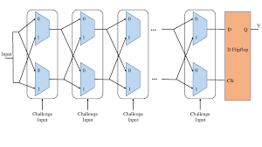
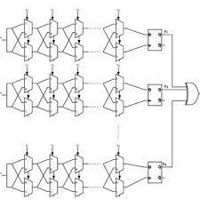
XOR ARBITER PUF
Arbiter PUF introduces a race condition between inputs using delay elements and uses a D-flip flop to decide the output.
A N-bit arbiter PUF contains N delay elements.
If multiple arbiter PUFs are combined, then the resultant output is obtained using XOR gate.
AR
ARBITER PUF XOR ARBITER PUF

Slide 14
PUF FOR AUTHENTICATION
FALSE
TRUE
ACCESS DENIED
ACCESS GRANTED
VERIFIER
CLIENT
==
CORRESPONDING
RESPONSE
FROM
DATABASE
RESPONSE
FROM PUF
CRP DATABASE
XOR ARBITER PUF
CHALLENGE

Slide 15
PERFORMANCE EVALUATION
UNIQUENESS
Uniqueness is a measure of the independence of PUF responses to the same challenge.
The PUF uniqueness is the ratio of HD to the total response bit number.
The most important metric for estimating PUF performance is the Hamming distance (HD).
The intra-HD represents the uniqueness between different chips. It is the distance between two evaluations on one single PUF instantiation is the distance between the two responses, resulting from applying this challenge twice to one PUF.
UNIFORMITY
It is defined as the distribution of data of 1’s and 0’s in the response bits.
It is calculated as a percentage of 100.
It tells the percentage of 1’s and 0’s present in the response data.
A uniformity of 50% makes the binary string unique and makes it difficult to trace.

Slide 16

PROPOSED METHOD

Slide 17
DESCRIPTION
128 bit XOR Arbiter PUF based authentication is developed and the challenge response pairs are obtained in the client side
The challenge response pairs are stored in a database.
A randomly generated challenge and response is used to compare with CRP database at verifier side.
On the basis of comparison access is granted or denied. If the ID of the device doesn’t match then access is denied.
Further, the uniqueness and uniformity of generated CRP database is evaluated.

Slide 18
SIMULATION PARAMETERS
128 bit challenge to XOR Arbiter PUF
Response obtained
Uniformity
Uniqueness

Slide 19
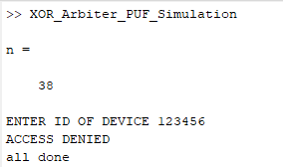
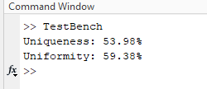
RESULTS

Slide 20
ADVANTAGES OF PUF BASED AUTHENTICATION
Even when the key material is extracted, an attacker cannot take over the identity of the tampered device.
Can easily change its functionality after a product has been designed.
Extremely lightweight hence suitable for IoT devices with lower computational resources.
Unclonable: Difficult to develop a similar to device to generate same challenge-response behavior.

Slide 21
APPLICATIONS
Secure key card with RFID chips used in healthcare, transportation & logistics etc.
Secret key generation so that it can be used as key for RSA, AES, ECC algorithms to increase complexity.
Key zeroization: Used for deleting certain keys once its used by overwriting a new key to increase complexity.

Slide 22
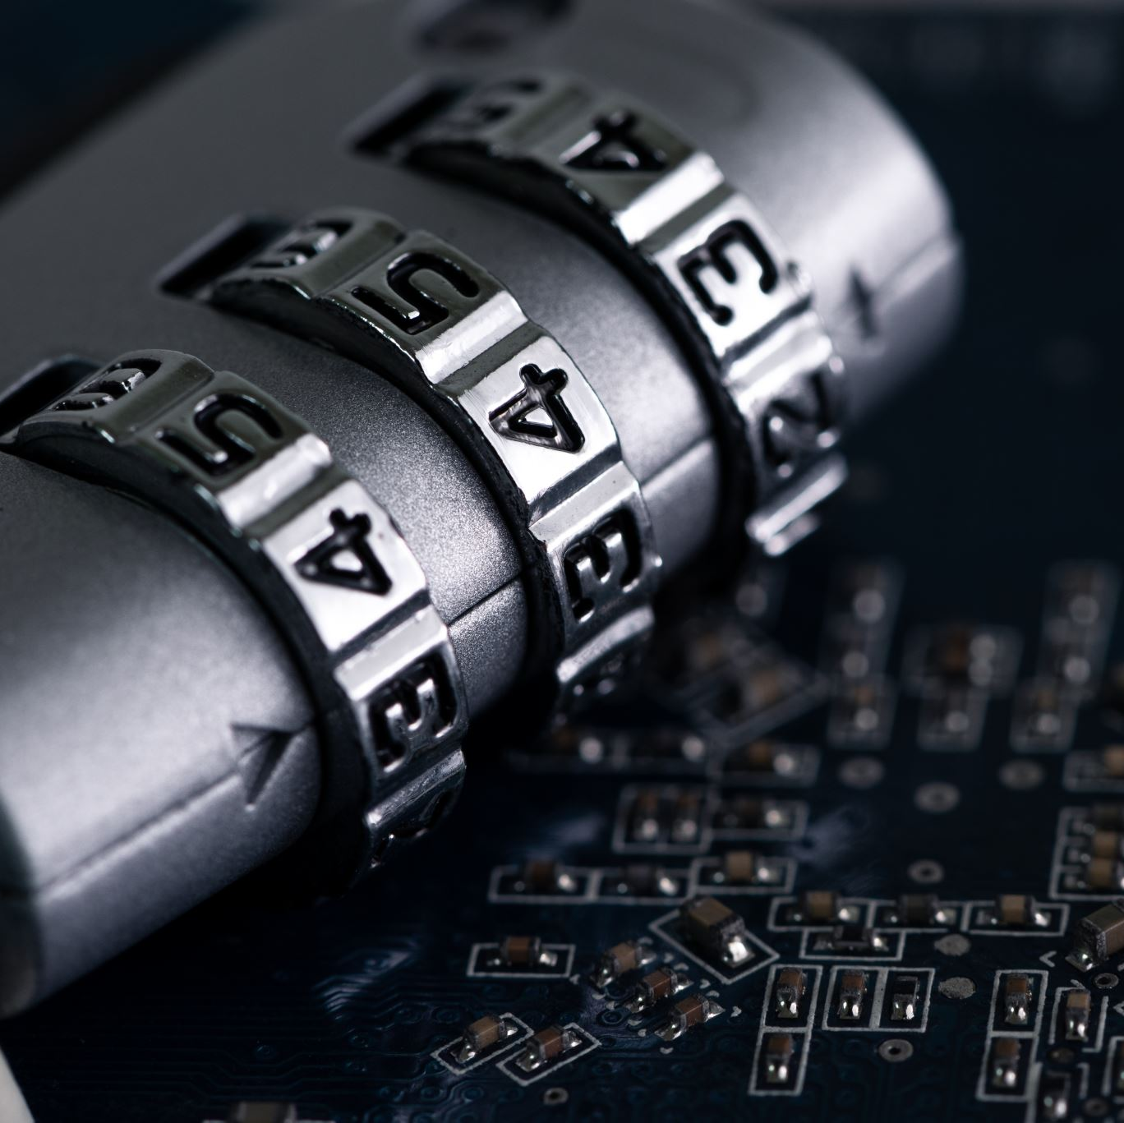
SECURITY ATTACKS

Slide 23
MODELLING AND MACHINE LEARNING ATTACKS
Due to the large number of challenge response pairs generated in PUFs, it can be used to develop a machine learning model to predict the behavior of the PUF.
FUNCTION FOR PUF
Input is challenge, fabrication parameters
Obtained responses are also recorded.
LEARNING & PREDICTION
Use CRP to train any suitable ML algorithm like logistic regression, SVM etc.
Predict the response by finding the best fit and determine accuracy of prediction.

Slide 24
INVASIVE ATTACK
Damaging the chips and gaining access to the components
The device should be taken to labs, to use expensive techniques to study the chip parameters.
Reports that prove that PUFs are in fact vulnerable against invasive attacks

Slide 25
ACTIVE AND PASSIVE ATTACKS
ACTIVE ATTACKS
Tamper the system
Modify the supply voltage & operational temperature
PASSIVE ATTACKS
Observe the data such as energy, power consumption and report it.
Can be used to develop an attack using these reports.

Slide 26
MAN-IN-THE-MIDDLE ATTACK
Attacker can overhear the communication between device and server and obtain CRP database.
Can be further fed into ML models to predict response.
Can be easily performed as device connects dynamically to other unknown networks.

Slide 27
SUMMARY
Software analyses based on the CRP and uniqueness and uniformity is obtained.
IoT devices are various prone to attacks.
Common attacks are man-in-the-middle, Dos, Eavesdropping etc.
Lightweight authentication and security schemes are required to protect IoT devices.
Development of PUF based authentication technique is proposed.

Slide 28
REFERNCES
Ovilla-Martínez, Brisbane, Cuauhtemoc Mancillas-López, Alberto F. Martínez-Herrera, and José A. Bernal-Gutiérrez 2020. "FPGA Implementation of Some Second Round NIST Lightweight Cryptography Candidates" Electronics 9, no. 11: 1940. https://doi.org/10.3390/electronics9111940
Muhammad Usman, Irfan Ahmed, M. Imran Aslam, Shujaat Khan, Usman Ali Shah, “SIT: A Lightweight Encryption Algorithm for Secure Internet of Things”. DOI: 10.14569/IJACSA.2017.080151
Nagham Samir, Abdelrahman Sobeih Hussein, Mohaned Khaled, Ahmed N. El-Zeiny, Mahetab Osama, Heba Yassin, Ali Abdelbaky, Omar Mahmoud, Ahmed Shawky and Hassan Mostafa, “ASIC and FPGA Comparative Study for IoT Lightweight Hardware Security Algorithms”.DOI: https://doi.org/10.1142/S0218126619300095
Chowdary, G. Rishika, Sheetal Neeraj, and Sai Sparsha. "MACHINE LEARNING APPROACHES FOR DIFFERENT CYBERTHREATS."
Lara-Nino, Carlos Andres, Arturo Diaz-Perez, and Miguel Morales-Sandoval. "Lightweight hardware architectures for the PRESENT cipher in FPGA." IEEE Transactions on Circuits and Systems I: Regular Papers 64, no. 9 (2017): 2544-2555.

Slide 29
REFERNCES
6. Abebe, Abiy Tadesse. "Efficient FPGA Implementation of Lightweight Authenticated Encryption and Authenticated Key Distribution Methods for IoT Security." International Journal of Digital Information and Wireless Communications 9, no. 3 (2019): 165-187.
7. Kavun, Elif Bilge, and Tolga Yalcin. "RAM-based ultra-lightweight FPGA implementation of PRESENT." In 2011 International Conference on Reconfigurable Computing and FPGAs, pp. 280-285. IEEE, 2011.
8. Chakraborty, R. and Mandal, J.K., 2020. An FPGA-Based Advanced Lightweight Cryptography Architecture for IoT Security and Its Cryptanalysis. In Information Security and Optimization (pp. 93-105). Chapman and Hall/CRC.
9. Braeken, A., 2018. PUF based authentication protocol for IoT. Symmetry, 10(8), p.352.
10. Järvinen K., Miele A., Azarderakhsh R., Longa P. (2016) Four Q on FPGA: New Hardware Speed Records for Elliptic Curve Cryptography over Large Prime Characteristic Fields. In: Gierlichs B., Poschmann A. (eds) Cryptographic Hardware and Embedded Systems – CHES 2016. CHES 2016. Lecture Notes in Computer Science, vol 9813. Springer, Berlin, Heidelberg. https://doi.org/10.1007/978-3-662-53140-2_25

Slide 30

THANK YOU

