Slide 1
Kids Screen Time-
2025 Insights
Unplugging the Facts Behind Kids’ Screen Time
By: Varsha Maurya
Notes:
This slide covers 2025 insights on kids’ screen time.
We’ll reveal the facts behind how much time kids spend on screens.
It sets the stage for understanding the impact on their lives.

Slide 2
Introduction
In today's increasingly digital world, screens are an inseparable part of children's lives. From online learning and entertainment to gaming and social media, screen exposure begins early and escalates rapidly.
While digital tools offer immense benefits, excessive or poorly managed screen time may negatively impact:
Mental development
Academic performance
Sleep quality
Physical health and activity
Notes:
Kids today spend a lot of time on screens—for school, games, and social media. While screens offer great benefits, too much can affect their mental health, school work, sleep, and physical activity. This presentation looks at the latest insights on these impacts.

Slide 3
Project Objectives
This project aims to analyze screen time patterns among Indian children in 2025 to:
Quantify daily screen usage and its main purposes (education, entertainment, social media, etc.).
Identify key influencing factors such as age, device type, time of day, exceeding limits usage.
Highlight potential risks like overuse, screen use near bedtime, or lack of physical activity.
Provide actionable insights for parents, educators, and policymakers to encourage healthier digital habits.
Notes:
This project studies how Indian kids use screens in 2025—their daily time, purposes, and factors like age and device type. We’ll also look at risks like overuse and screen time before bed, aiming to give practical tips for healthier habits.

Slide 4
Challenges
Entity-Relationship diagram
Balancing Detail & Clarity
Splitting Dataset
Creating an ER diagram that accurately aligns with the project goals and hypotheses was a key challenge.
I needed to split the dataset into three parts based on criteria like age groups or device types.
A challenge was sharing enough info to explain results clearly without causing confusion.
Notes:
A key challenge was creating the ER diagram to match our goals, especially handling many-to-many relationships with a junction table. This was important to keep the data accurate and support meaningful analysis.
I divided the dataset into three parts—child data, health status impacts, and impacts—to organize the analysis better. Using Python, I carefully separated these tables while ensuring consistency and easy integration for later analysis.
challenge was sharing enough info to explain results clearly without causing confusion.

Slide 5
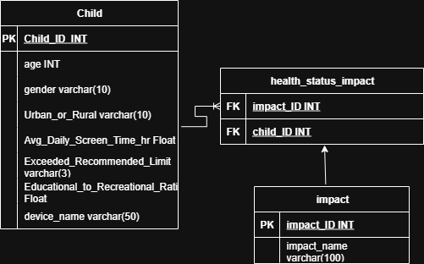
Dataset Overview
Dataset Summary:
Source: Kaggle – Indian Kids Screentime 2025
Sample Size: 9,712 children
Year of Focus: 2025
Age Range: 8 to 18 years
ER Diagram:
Notes:
This data comes from a Kaggle dataset focused on Indian kids’ screen time in 2025. It includes responses from 9,712 children aged 8 to 18, giving us a broad and detailed view of their screen habits and this is the ER diagram, showing the key entities and their relationships.

Slide 6




4h 35m
Average time spent per day(in hours)
Average time spent per day(in hours)
Rural | Urban
4.37 | 4.34
Average time spent per day(in hours)
Educational | Recreational
1.84 | 2.50
Notes:
Average daily time: 4h 35m.
By location: Rural – 4.37h, Urban – 4.34h (minimal difference).
By activity: Educational – 1.84h, Recreational – 2.50h. More time spent on recreation than education.

Slide 7
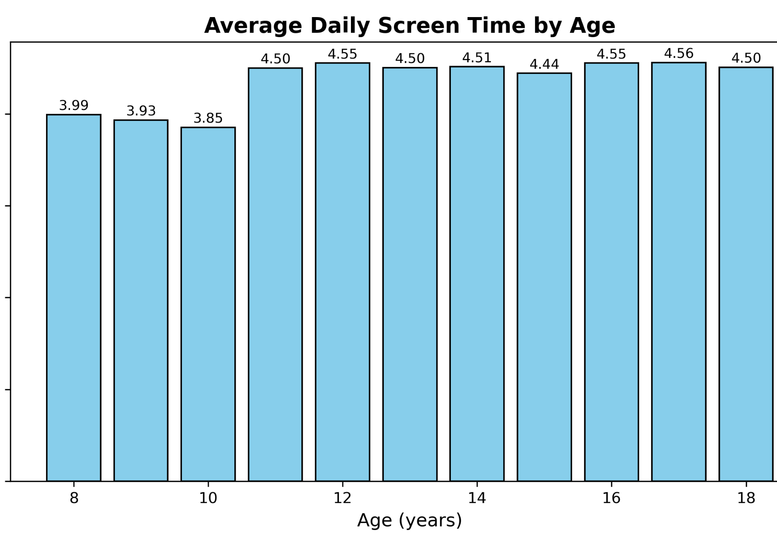
Average Daily Screen Time by Age
Average daily screen time increases as children get older.
Ages 8 to 10: Around 3.85 to 4 hours daily
Sharp increase starting at age 11
Ages 11 to 18: Consistently around 4.5 hours daily
Screen time peaks around ages 16-17
Notes:
Screen time is about 4 hours a day for younger kids and rises sharply around age 11. From 11 to 18, kids spend roughly 4.5 hours daily on screens, showing a steady pattern through their teen years.

Slide 8
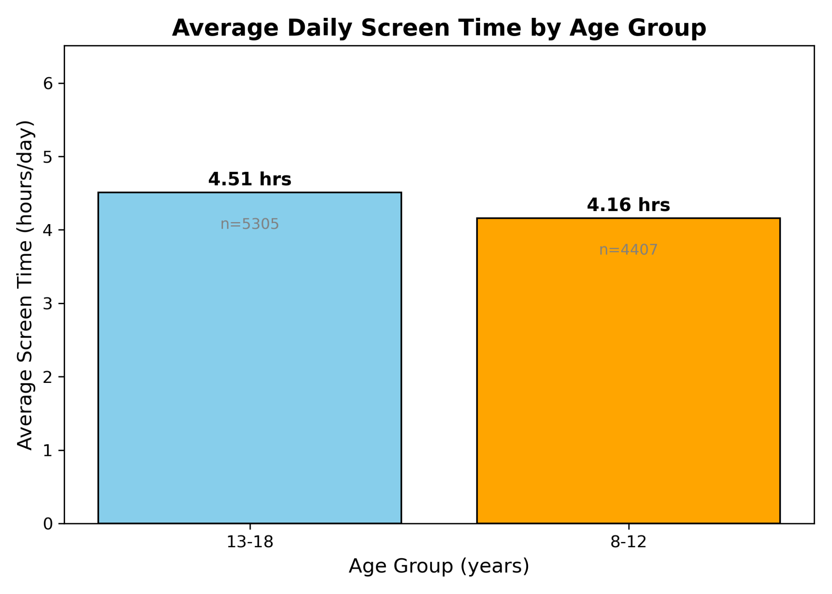
Daily Screen Time: Kids vs. Teens
Teens (13-18) spend more time on screens than younger kids (8-12).
Both groups average over 4 hours daily, highlighting significant screen exposure across ages.
n= number of children
Notes:
Teens spend more screen time—4.5 hours daily—compared to 4.16 hours for younger kids.

Slide 9
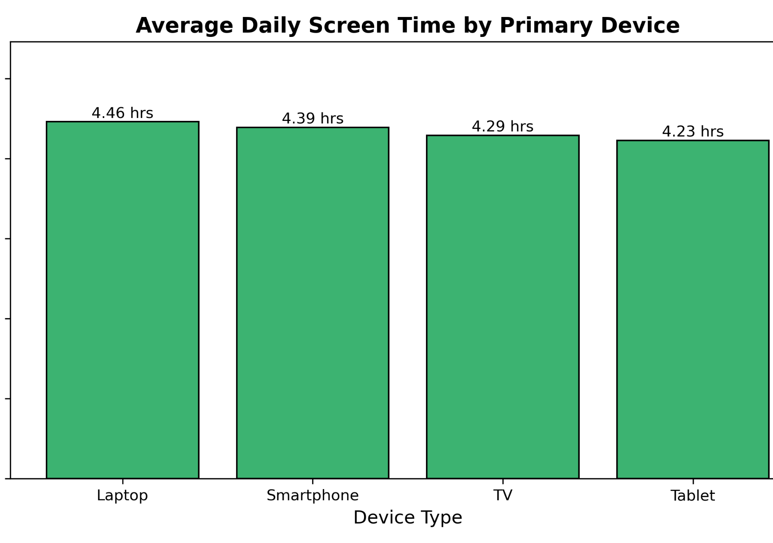
Screen Time Across Different Devices
Laptops are the most used device on average, followed closely by smartphones.
TVs and tablets see slightly lower average screen time.
Notes:
Laptops have the highest average screen time, just over 4.4 hours daily. Smartphones follow closely, while TVs and tablets have slightly less usage.

Slide 10
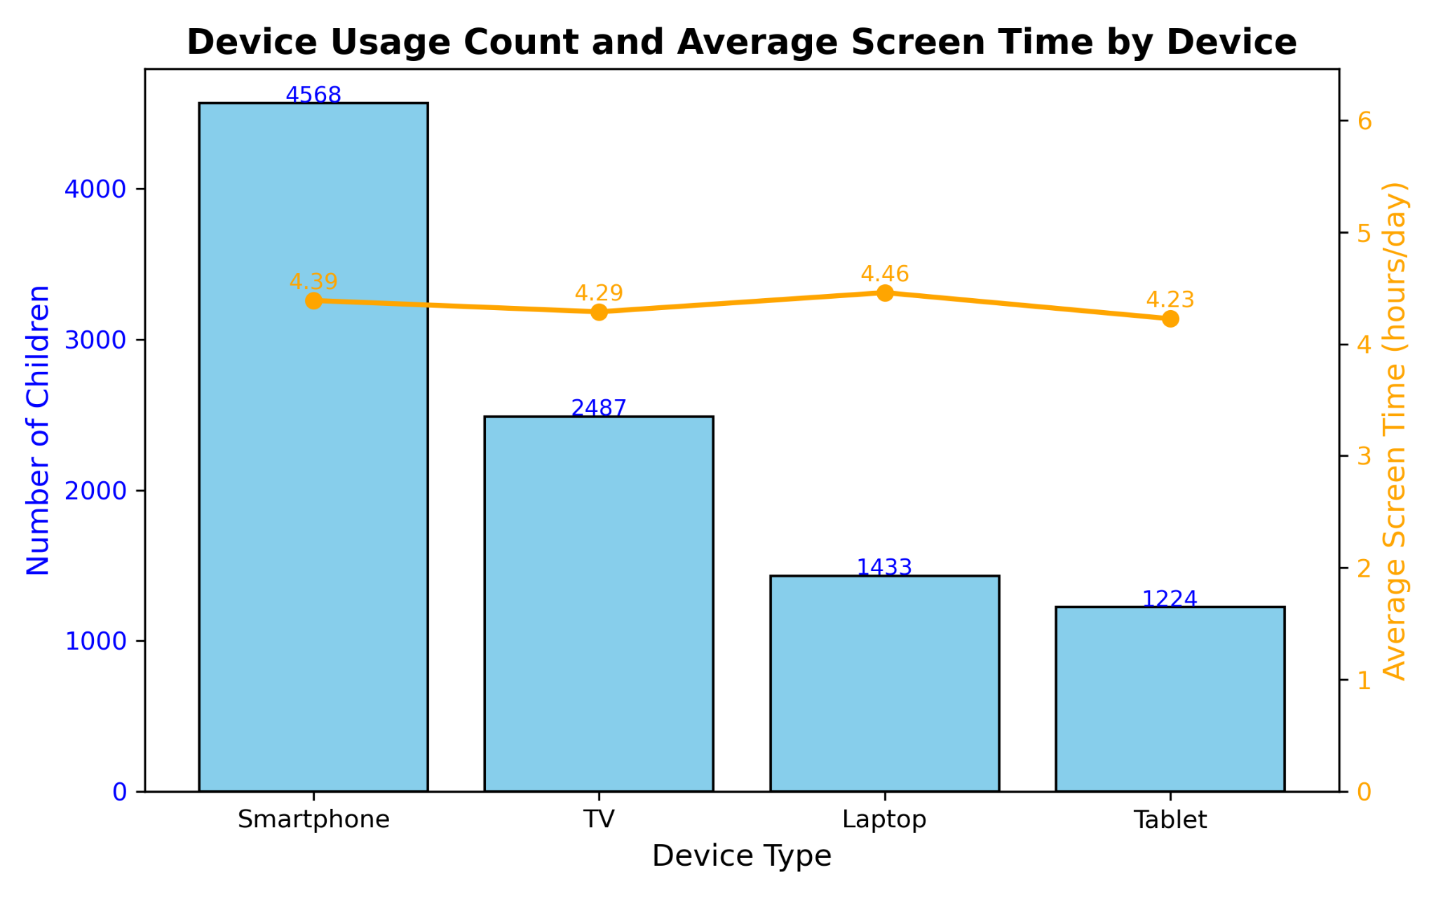
Device Popularity and Average Screen Time
Notes:
Most kids use smartphones, followed by TVs, laptops, and tablets. Even though fewer kids use laptops, they spend the most time on them daily. TVs and tablets have fewer users and slightly less screen time.

Slide 11
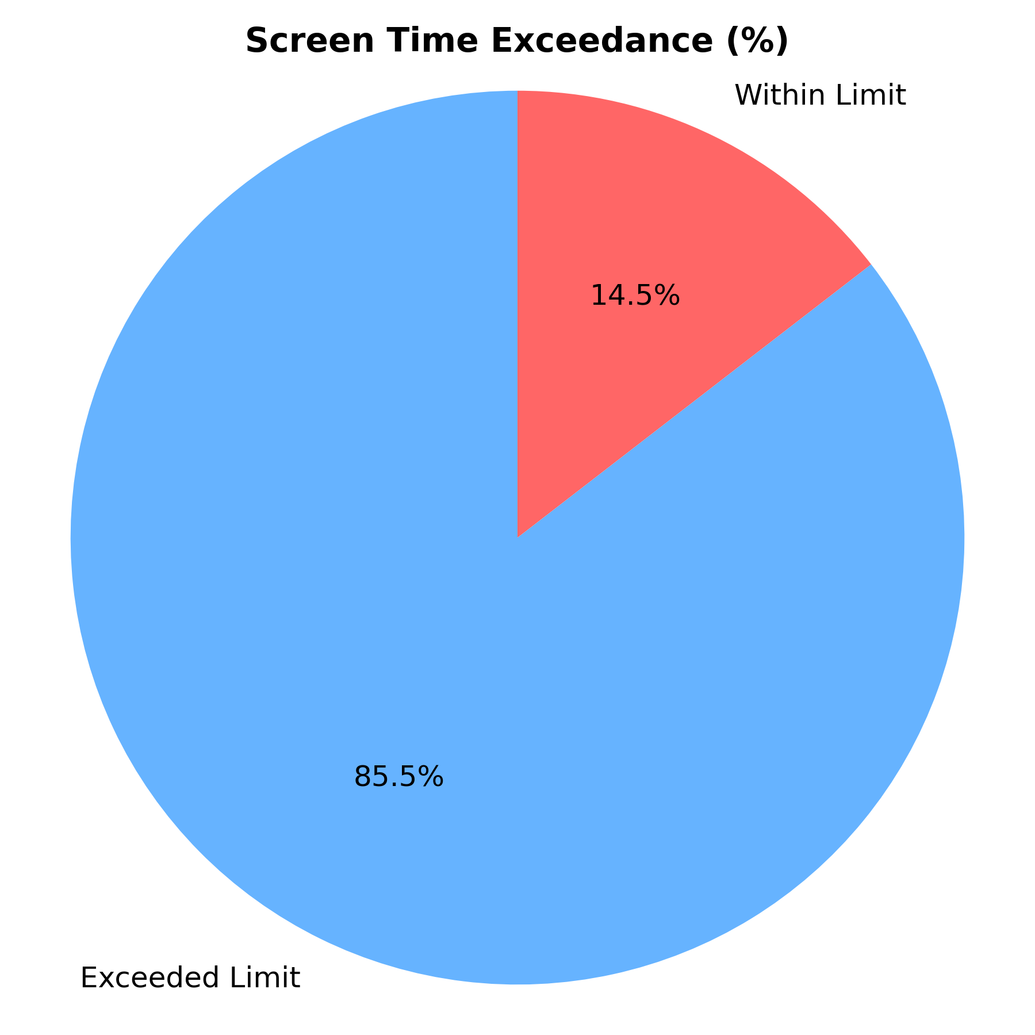
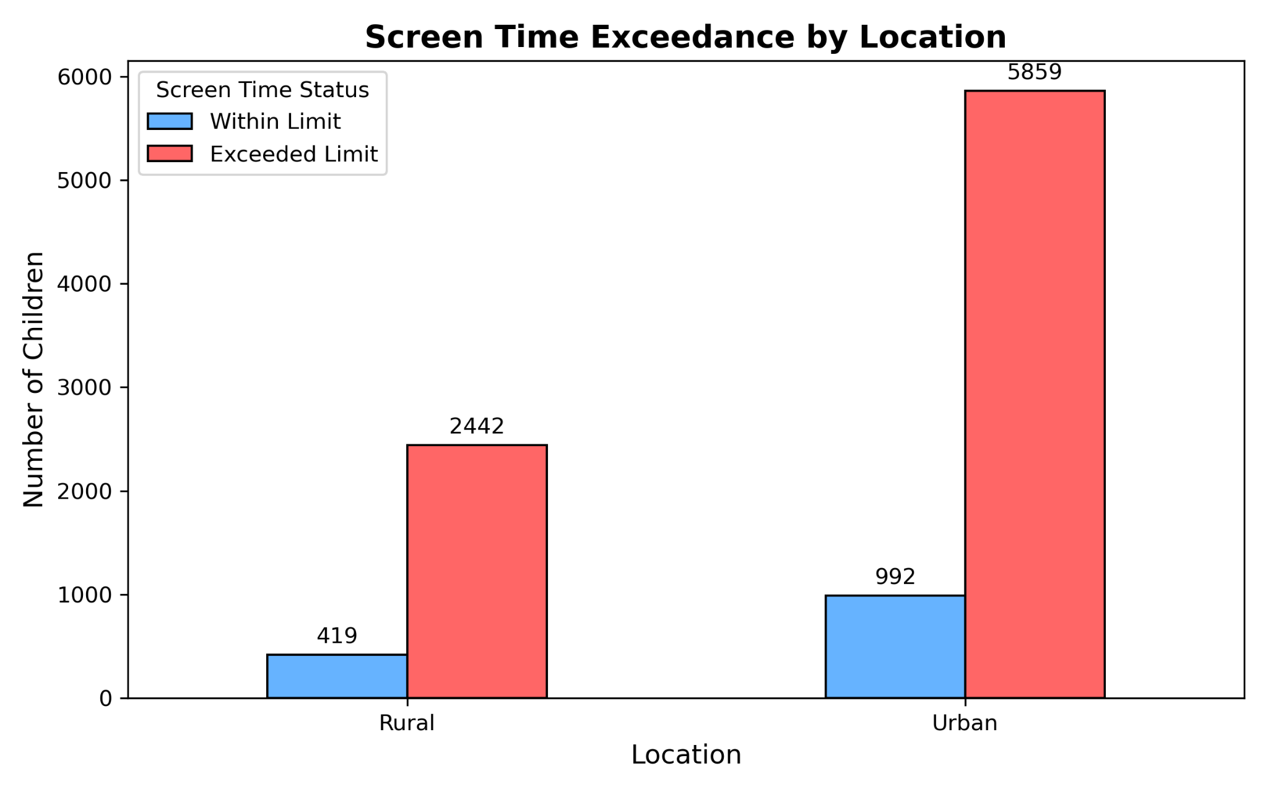
Screen Time Exceedance Overview
Over 85% of children exceed the daily screen time limit, with urban children slightly higher than rural.
Notes:
Most kids—about 85%—exceed the recommended screen time limits. This trend is consistent across both urban and rural areas, where a large majority of children spend more time than recommended on screens

Slide 12
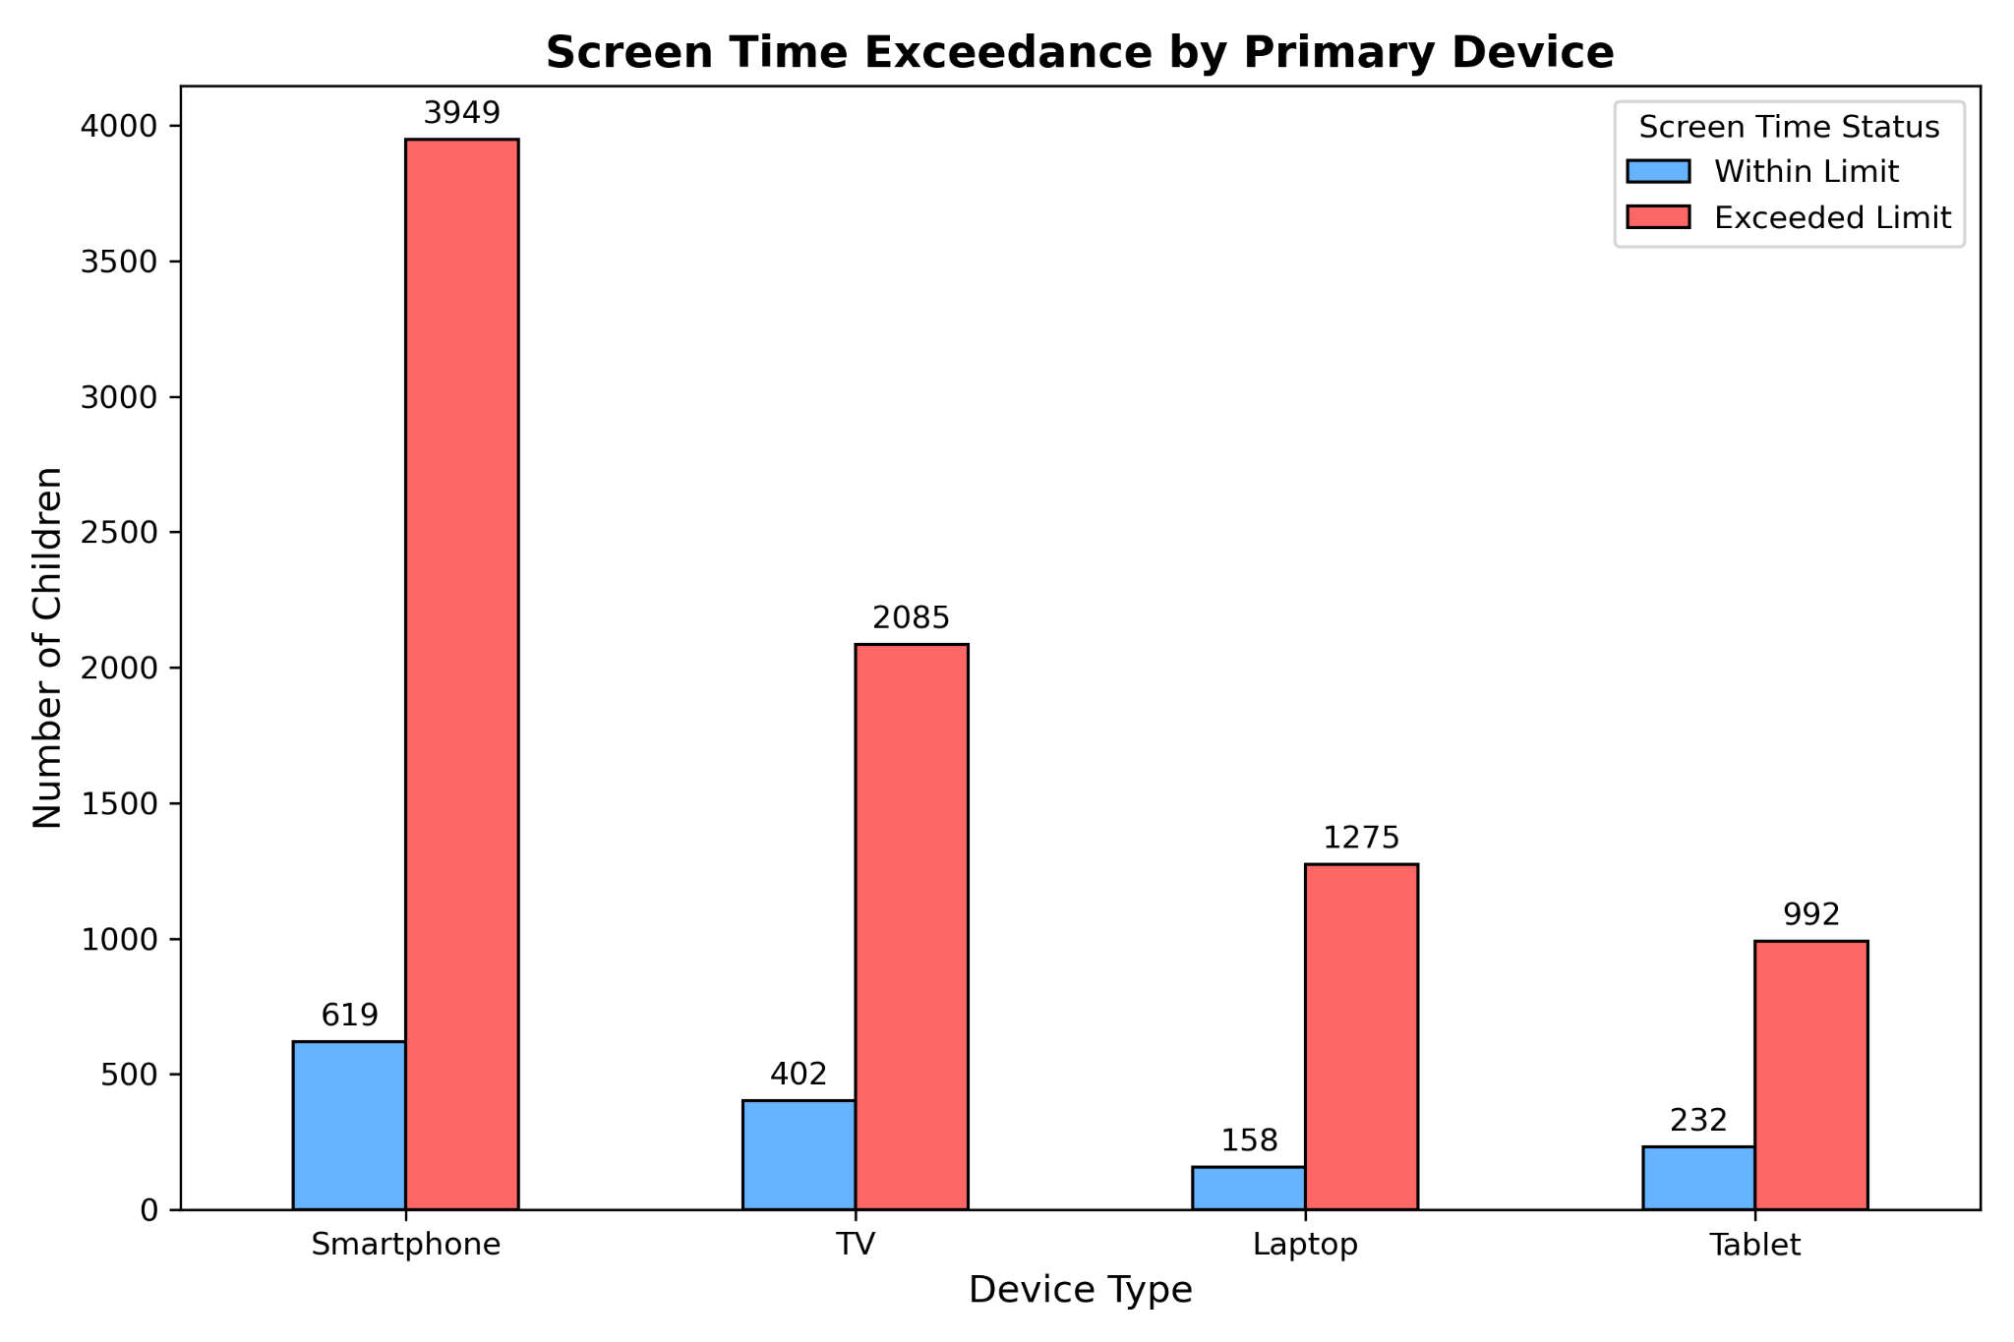
Screen Time Exceedance by Device
Smartphones lead in screen time overuse, followed by TVs and laptops.
Notes:
Looking at device types, most kids who exceed screen time limits use smartphones, followed by TVs and laptops. Tablets have the smallest user group but still show many kids exceeding limits. Only a smaller portion of kids on each device stay within recommended usage

Slide 13
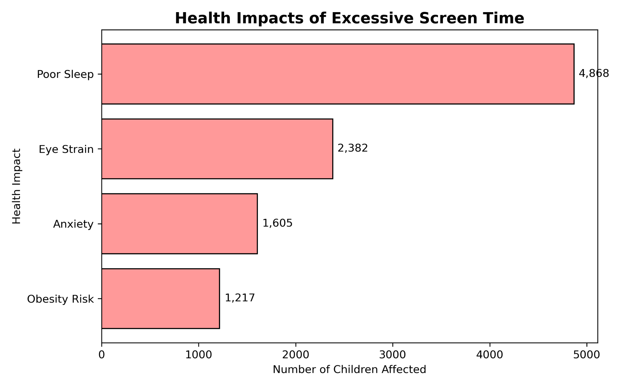
Screen Time’s Effect on Child Health
Eye strain, poor sleep, and headaches are the most common issues.
Many children experience multiple health effects due to excessive screen use.
Notes:
The most common health impact linked to screen time is poor sleep, affecting nearly 4,900 children. Eye strain is also significant, impacting about 2,400 kids. Other issues like anxiety and obesity risk affect smaller but still notable numbers.

Slide 14
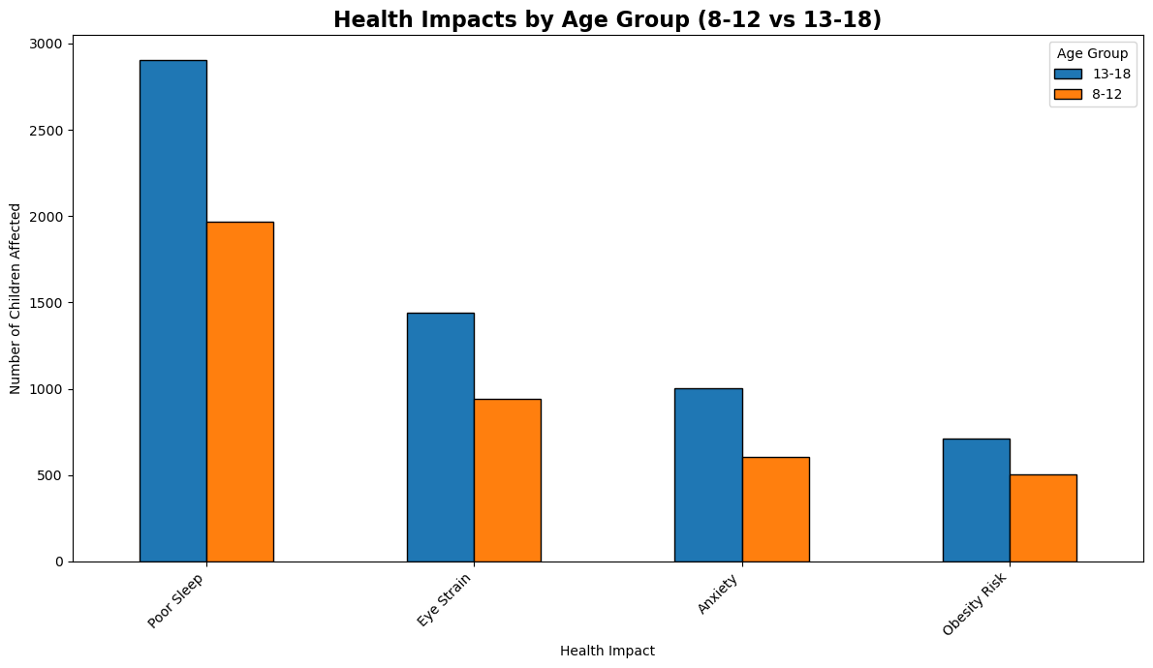
Health Impacts by Age Group
Notes:
Poor sleep is the most common health issue across both age groups, affecting more teens than younger kids. Eye strain, anxiety, and obesity risk also impact many children, with older kids generally experiencing higher numbers

Slide 15
Conclusions & Business Implications
Indian kids in 2025 spend a lot of time on screens, mostly exceeding recommended limits, especially teens.
Smartphones and laptops are the main devices contributing to high usage.
Excessive screen time links to health issues like poor sleep and eye strain, affecting both urban and rural children.
Implications:
Parents and educators need better tools to manage screen time.
Healthcare providers can raise awareness of screen-related health risks.
Device makers and app developers should build features promoting healthy usage.
Policymakers can support initiatives encouraging balanced screen habits and physical activity.
EdTech companies have an opportunity to integrate screen time management with learning.
Notes:
Our study shows that kids in India are spending a lot of time on screens, often more than recommended, especially teenagers. Smartphones and laptops are the main devices used. This high screen time is linked to health problems like poor sleep and eye strain, affecting children across both urban and rural areas.
These findings suggest several business opportunities: parents and educators need better tools to manage screen time; healthcare providers can promote awareness about risks; device makers should include features that encourage healthy habits; policymakers can back initiatives for balanced screen use; and EdTech companies can blend learning with screen management.

Slide 16
By: Varsha Maurya
Thank You!

