Slide 1

Activity Recognition from Single Chest-Mounted Accelerometer Data Set
Varsha Chandrasekhar Bendre
s3831858

Slide 2
Goal
The activities are predicted based on the movements traced by the accelerometer for 15 Users.

Slide 3
Dataset Description
The dataset has 4 features, namely
X-acceleration
Y-acceleration
Z-acceleration
Labels
The data from 15 users are merged, making a new column with the ID for the Users.

Slide 4
Data Preparation
Null values
There are no null values in the dataset. As data.isnull().sum() returns 0 for all the columns
Sanity check
Minimum and maximum values of each of the column is investigated.
Values with label 0 are deleted in the Label column, by changing 0 to NaN values.

Slide 5
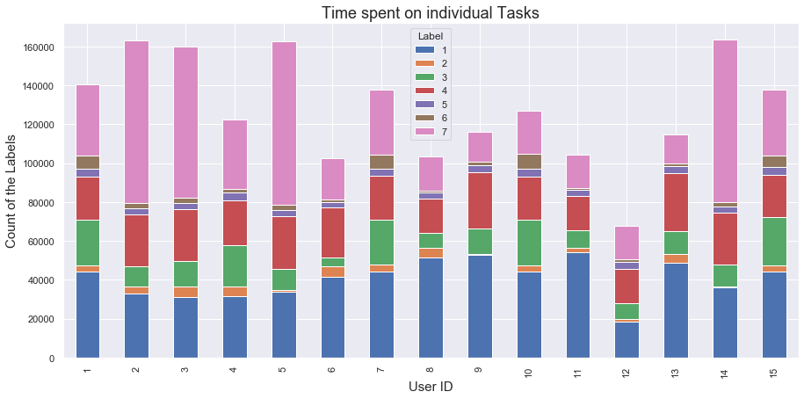
Data exploration
Time spent by each individual on task 1 (Working on Computer) is the maximum. As the Task 1 is being seen 608667 times in the data, and it is the highest.

Slide 6
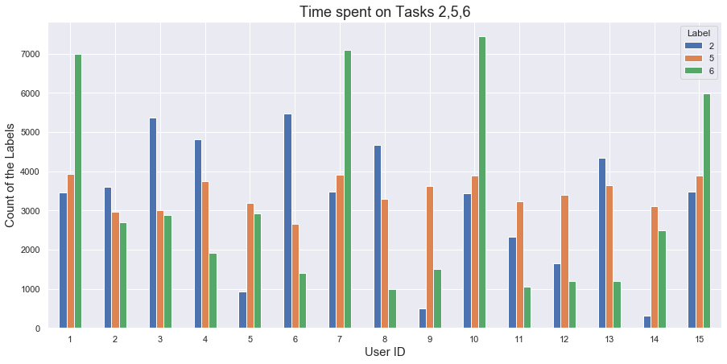
Data exploration
Time spent on Task 6 (Walking and Talking with Someone) by the individuals is minimum. Tasks 2,5,6 have the approximately a smaller number of observations on the whole data but task 6 has the least

Slide 7
Data modelling and results
Decision tree
Features: x-acceleration, y-acceleration, z-acceleration, User_ID
Target: Label
Hill climbing technique: No change in accuracy
KNN classifier
Features: x-acceleration, y-acceleration, z-acceleration, User_ID
Target: Label
Hill climbing technique: No change in accuracy
Parameter Tuning effect: the accuracy was increased by 0.4%

Slide 8
Data modelling and results
Decision tree
KNN Classifier
 | precision | Recall | F1-score | support
1 | 0.92 | 0.93 | 0.92 | 182570
2 | 0.35 | 0.31 | 0.33 | 14392
3 | 0.46 | 0.50 | 0.48 | 64972
4 | 0.66 | 0.64 | 0.65 | 106804
5 | 0.22 | 0.23 | 0.23 | 15475
6 | 0.24 | 0.25 | 0.25 | 14459
7 | 0.80 | 0.78 | 0.79 | 178282
Accuracy |  |  | 0.73 | 576954
Macro avg | 0.52 | 0.52 | 0.52 | 576954
Weighted avg | 0.73 | 0.73 | 0.73 | 576954
 | precision | Recall | F1-score | support
1 | 0.91 | 0.94 | 0.92 | 182570
2 | 0.48 | 0.25 | 0.32 | 14392
3 | 0.56 | 0.49 | 0.52 | 64972
4 | 0.66 | 0.74 | 0.70 | 106804
5 | 0.32 | 0.15 | 0.21 | 15475
6 | 0.40 | 0.24 | 0.30 | 14459
7 | 0.79 | 0.84 | 0.82 | 178282
Accuracy |  |  | 0.76 | 576954
Macro avg | 0.59 | 0.52 | 0.54 | 576954
Weighted avg | 0.75 | 0.76 | 0.75 | 576954

Slide 9
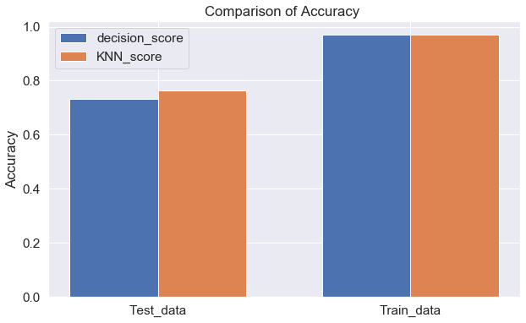
Conclusion and Recommendation
K-Nearest Neighbours is a better classifier on the Accelerometer dataset

Slide 10
Thank You

