Slide 1

Clearview AI and its Ethical Implications
Varsha Chandrasekhar Bendre
S3831858

Slide 2
Introduction
Clearview AI
Hoan Ton-That and Richard Schwartz
Manhattan, New York City, U.S
The start-up has claimed to identify a person based on a single photo, revealing their real name, general location, and other identifiers

Slide 3
Background
The three main reasons for the start-up were
An increase in the sexual abuse imagery by 100x
Victims having a 25% higher risk of suicide
78.3% of images show children under 12.
Clearview database includes more than 3 billion images taken from the publicly available images from the web, including social media sites such as Facebook, YouTube.

Slide 4
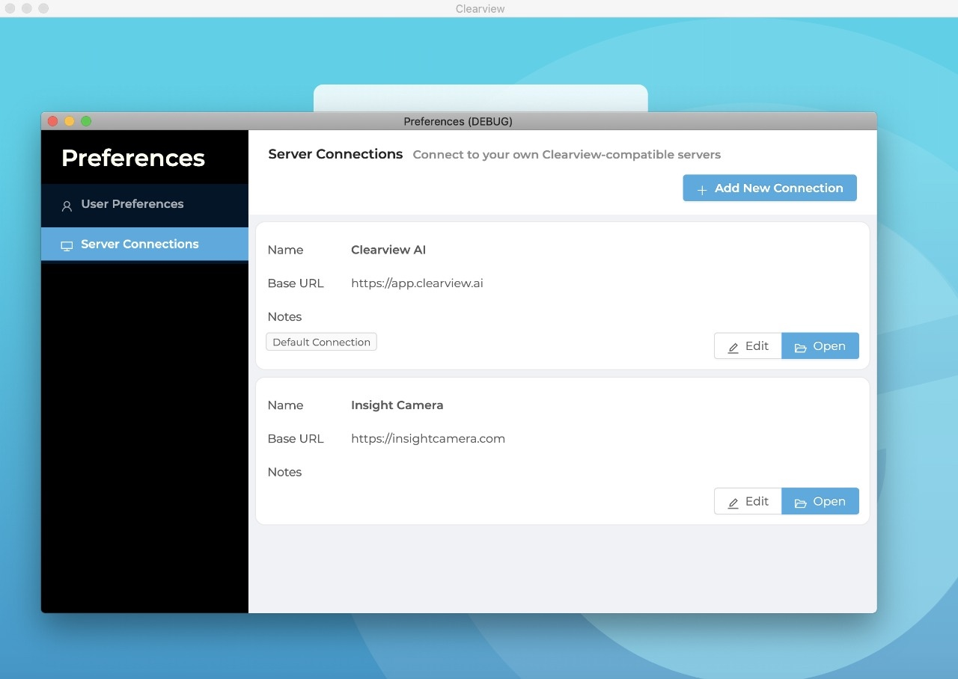
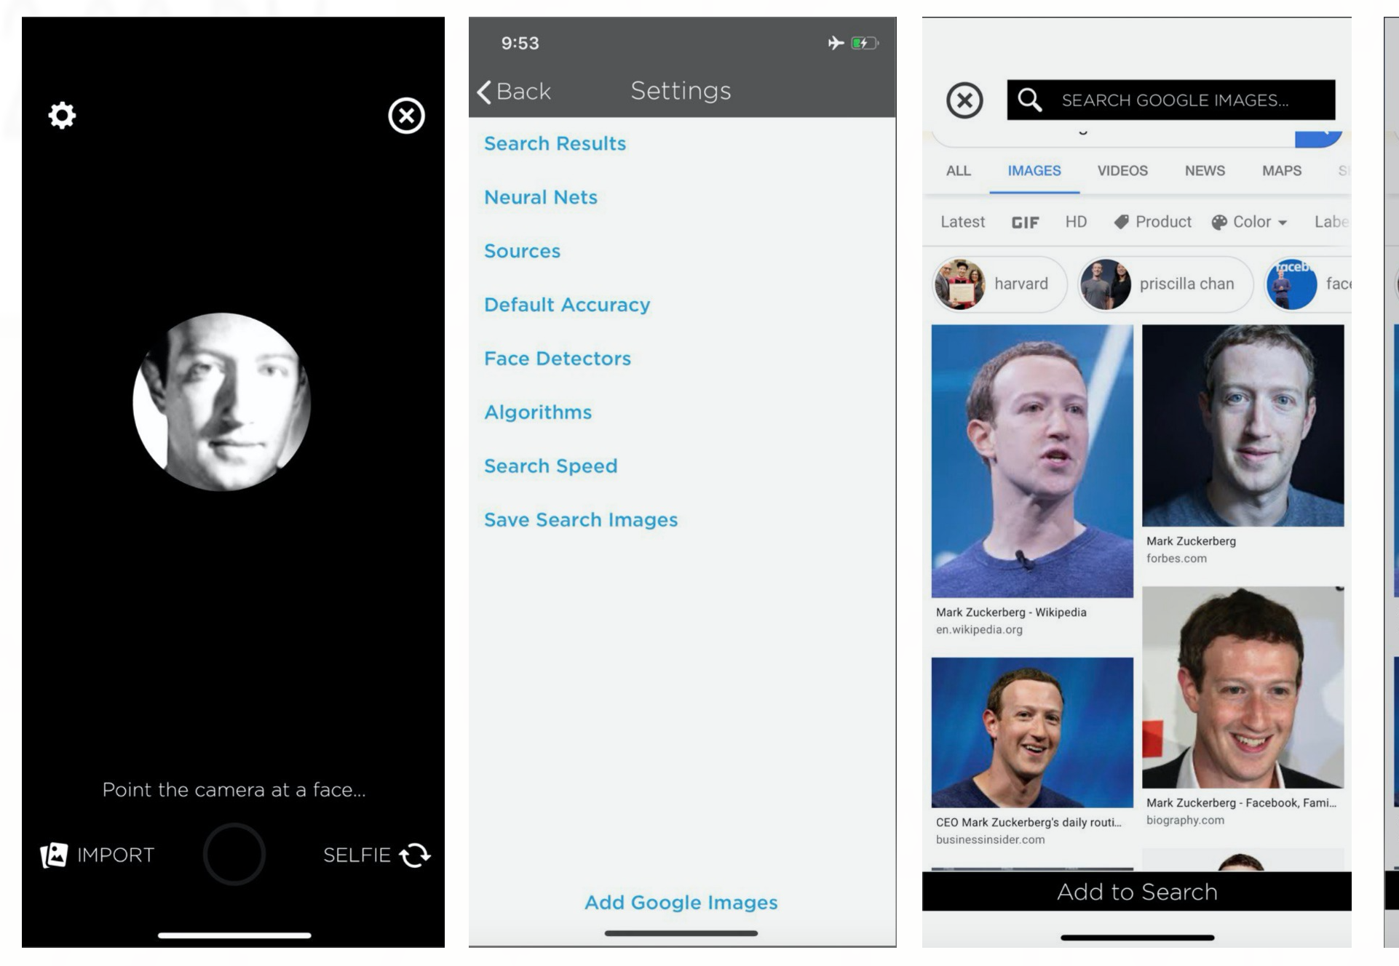
Potential ethical concerns
Privacy and Security

Slide 5
Transparency and Explainability
When 19 men in New Jersey who tried to lure children into sex were arrested, Clearview took partial credit in the arrests and added this in their promotional video.
But the revealing of the investigation techniques caused the state attorney general of New Jersey to send a cease and desist letter to stop the usage of the footage in their video.

Slide 6
Accountability and responsibility
Australian police agencies denied using the Clearview A.I. service initially. But when the company's list of customers was breached, it was revealed that the users included the Australian Federal Police.
The technology should be tested by the standard body to be assured that it is fit, in order to be used by law enforcement.
But Clearview's software report was generated by three people chosen by the company, and the test was conducted on Politian's whose images were of high quality.
But in reality, it is not the case. Law enforcement has to work with the poor-quality images from the surveillance of CCTV cameras. There is no clear understanding of who should be held responsible in case of false identification.

Slide 7
Social impact and human well-being
There are six lawful bases under GDPR that Clearview should abide by. Legitimate interest is a potential fitting lawful ground.
Even if a company can establish a lawful basis, some explicit content like race, religion, health data should not be scrapped.

Slide 8
Best possible practices or Legal codes of Practice
First lawsuit was filed by the representative of the Chicago civil rights firm.
Illinois BIPA (Biometric Information Privacy Act)
Insidious encroachment and act of pure Greed.
CCPA (California Consumer Privacy Act)
Vermont Consumer Protection Act and the Data Broker Law
Apart from these laws, the tech giants YouTube, Facebook, LinkedIn, and Twitter asked Clearview to stop scraping the images from their sites

Slide 9
Existing and potential technologies
Regulating both the creation and the use of technology might be one of the best option.
A temporary ban on the use of the technology will help the laws to be updated and catch up with the technology.
Privacy tools like data mapping and privacy impact assessments are good starting points to identify the company's footprint.
The results of data mapping and PIAs should be shared with the security and legal teams.
A strict code review
Unit tests to ensure the ability to share data.
operational cybersecurity program acts as a defence in case of accidental breaches.

Slide 10
Conclusion
Every new technology has perspectives and promises for the future. There are several pros of biometric facial recognition technology, including criminal identification, healthcare, and others. It is quite clear that there is a line of difference between national security and invading people's privacy that should not be crossed, which the progress in the technology. rm them.
The entire business model of Clearview A.I. relies on collecting sensitive and personal information, and the breach of such data is a sign that the potential benefits of the company's technology do not outweigh the grace privacy risks that it poses.

Slide 11

Thank You May Your Data be with you ☺

Slide 12

Bibliography
Clearview AI 2020, Technology to help solve the hardest crimes, Clearview AI, viewed 2 April 2020, < https://clearview.ai/>
Cimpanu, C 2020, ‘Class-action lawsuit filed against controversial Clearview AI startup’, Zero Day, 24 January 2020, viewed 2 April 2020, <https://www.zdnet.com/article/class-action-lawsuit-filed-against-controversial-clearview-ai-startup/>
Goldenfein, J 2020, ‘Australian police are using the Clearview AI facial recognition system with no accountability’, The Conversation Media Group Ltd, 4 March 2020, viewed 2 April 2020, <https://theconversation.com/australian-police-are- using-the-clearview-ai-facial-recognition-system-with-no-accountability-132667>
Wikipedia 2020, Clearview AI, viewed 2 April 2020, <https://en.wikipedia.org/wiki/Clearview_AI>
Whittaker, Z 2020, ‘Security lapse exposed Clearview AI source code’ TechCrunch, blog post, 17 April, viewed 20 May 2020, <https://techcrunch.com/2020/04/16/clearview-source-code-lapse/>
Nelson,B 2020, ‘New Jersey cops told to halt all use of controversial facial-recognition technology’, nj, blog post, 24 Jan, viewed 21 May 2020, <https://www.nj.com/news/2020/01/new-jersey-cops-told-to-halt-all-use-of-controversial-facial-recognition-technology.html>
Scroxton, A 2020, ‘Clearview hack fuels debate over facial recognition’, Computer Weekly, blog post, 27 Feb, viewed 20 May 2020, <https://www.computerweekly.com/news/252479248/Clearview-hack-fuels-debate-over-facial-recognition>
Ng, A 2020, ‘Clearview AI says the First Amendment lets it scrape the internet. Lawyers disagree’, c|net, blog post, 6 Feb, viewed 20 May 2020, < https://www.cnet.com/news/clearview-says-first-amendment-lets-it-scrape-the-internet-lawyers-disagree/>
Reichert, C 2020, ‘Clearview AI facial recognition company faces another lawsuit’ c|net, blog post, 13 Feb, viewed 20 May, <https://www.cnet.com/news/clearview-ai-facial-recognition-company-faces-another-lawsuit/>
Statt, N 2020, ‘ACLU sues facial recognition firm Clearview AI, calling it a ‘nightmare scenario’ for privacy’ , The Verge, blog post, 28 May, viewed 29 May 2020, <https://www.theverge.com/2020/5/28/21273388/aclu-clearview-ai-lawsuit-facial-recognition-database-illinois-biometric-laws>
Shreve, J & Sosnicki, L 2020, ‘Clearview AI class-action may further test CCPA’s private right of action’, JDSUPRA, blog post,12 March, viewed 20 May, <https://www.jdsupra.com/legalnews/clearview-ai-class-action-may-further-14597/
Davis, W 2020, ‘Clearview AI Hit With Biometric Privacy Lawsuit’, PolicyBlog, blog post,23 January,viewed 20 May,<https://www.mediapost.com/publications/article/346121/clearview-ai-hit-with-biometric-privacy-lawsuit.html>
Porter, J 2020, ‘Vermont attorney general is suing Clearview AI over its controversial facial recognition app’, The Verge, blog post, 11 May, viewed 20 May 2020, <https://www.theverge.com/2020/3/11/21174613/clearview-ai-sued-vermont-attorney-general-facial-recognition-app-database>
Pringle, R 2020, ‘Controversial Clearview AI app could 'end privacy.' So, what now?’, CBC, 1 Feb, viewed 20 May 2020,<https://www.cbc.ca/news/technology/clearview-app-privacy-1.5447420>
Bhatti, R 2020,‘Breaches at our front door: What we can learn from Clearview AI’, IAPP, blog post, 19 March, viewed 20 May 2020, <https://iapp.org/news/a/breaches-at-our-front-door-what-we-can-learn-from-clearview-ai/>
Alba, D 2020, ‘A.C.L.U. Accuses Clearview AI of Privacy ‘Nightmare Scenario’’, The New York Times, 28 May, viewed 30 May 2020, <https://www.nytimes.com/2020/05/28/technology/clearview-ai-privacy-lawsuit.html>
Snider, M 2020, ‘Clearview AI, which has facial recognition database of 3 billion images, faces data theft’, USA Today , 27 Feb, viewed 20 May, <https://www.usatoday.com/story/tech/2020/02/26/clearview-ai-data-theft-stokes-privacy-concerns-facial-recognition/4883352002/>

