Slide 1
RAILWAY FOOD ORDER APP

Slide 2
Presented By Varsha m (MES21MCA-2058) Product Owner nowshad c v Asst. Professor MES College Of Engineering, Kuttippuram Date : 01.02. 2023, Wednesday

Slide 3
CONTENTS
INTRODUCTION
EXISTING SYSTEM
PROPOSED SYSTEM
MODULE DESCRIPTION
SYSTEM REQUIREMENTS
DATA FLOW DIAGRAM
USER STORY
PRODUCT BACKLOG
PROJECT PLAN

Slide 4
INTRODUCTION
The Train Food Order App is a project aimed at simplifying the process of ordering food while traveling on a train. With the increasing number of train travelers in India, there is a growing need for a reliable food ordering system that can cater to the diverse food preferences of passengers. The Train Food Order App is designed to address this need by providing a user-friendly platform that enables travelers to order food from their preferred restaurants.
It will eliminate the need to carry food during long train journeys. The app will also benefit food vendors and restaurants, as it will provide them with a new avenue to reach out to a wider customer base.
4
DEPARTMENT OF COMPUTER APPLICATIONS

Slide 5
INTRODUCTION
The app will enable users to browse through a wide range of food options, select their preferred meal, and place an order with just a few clicks. The app will also provide real-time updates on the status of the order, ensuring that passengers are always informed about the delivery time of their food.
The Train Food Order App is a project that aims to simplify the process of ordering food while traveling on a train, and provide a convenient and reliable food ordering system to train passengers.
5
DEPARTMENT OF COMPUTER APPLICATIONS

Slide 6
EXISTING SYSTEM
The existing system of train food ordering involves passengers purchasing food from vendors who board the train at different stations during the journey. This system is often inconvenient for passengers as they may not have access to their preferred food options, and the quality and hygiene of the food may not be up to their standards. Additionally, vendors may not accept all modes of payment, which can cause inconvenience for passengers.
In the existing system, there is no such restaurant food ordering service for providing food services for passengers on the train. Railway catering is the only option for passengers to get food.
Passengers face several problems in trains with unhygienic food. There are several cases where passengers faced health problems due to unhygienic food provided in trains.
6
DEPARTMENT OF COMPUTER APPLICATIONS

Slide 7
PROPOSED SYSTEM
Our Food Order in Train System provide to see the restaurant near the railway station. Also check the food history and make food recommendation according to the restaurant menu ,so railways will provide relevant food items that will be preferred by the user. Passengers can access the menu which will be available.
With a train food order app, passengers can choose from a variety of food options and order what they prefer.
Train food order app can ensure timely delivery of food to the passengers without them having to leave their seats. This ensures that passengers can enjoy their meals without worrying about missing their next stop or train.
Ordering food on a train can be challenging, especially if the passenger doesn't have cash on hand. Train food order app provides easy payment options through multiple modes such as net banking, credit card, debit card, UPI, etc.
7
DEPARTMENT OF COMPUTER APPLICATIONS

Slide 8
MODULE DESCRIPTION
RESTAURANT
Registration
Login
Menu Management
View Order &Updates Status
Delivery Updates
ADMIN
Login
Train Service Management
Approve/Reject Restaurant
Add & Manage Station
View Feedback
8
DEPARTMENT OF COMPUTER APPLICATIONS

Slide 9
MODULE DESCRIPTION
TRAIN SERVICE
Login
View Orders
Update Order Status
Update Delivery Info
USER
Registration
Login
View Next Station
View Restaurant
Order Food & Track
Payment
Send Feedback
9
DEPARTMENT OF COMPUTER APPLICATIONS

Slide 10
SYSTEM REQUIREMENTS
HARDWARE REQUIREMENTS
INPUT DEVICE :MOUSE,KEYBOARD
OUTPUT DEVICE :MONITOR
MEMORY :512 MB RAM(MINIMUM)
PROCESSOR :PENTIUM III PROCESSOR
10
DEPARTMENT OF COMPUTER APPLICATIONS

Slide 11
SOFTWARE REQUIREMENTS
OPERATING SYSTEM :WINDOWS 7/8 for better performance
FRONT END :Python and Android
BACK END :SQL server 2008
WEB BROWSER :Internet Explorer/Google Chrome/firefox(for web application)
DEPARTMENT OF COMPUTER APPLICATIONS

Slide 12
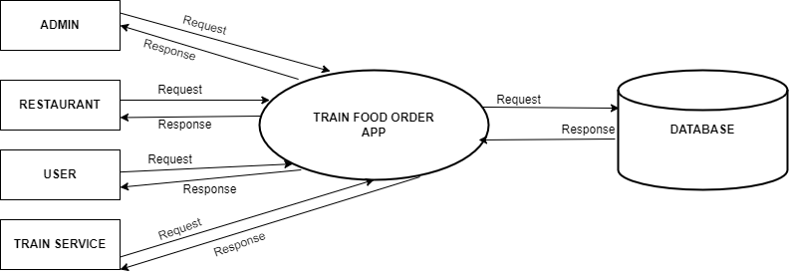
DATA FLOW DIAGRAM
Level 0:
LEVEL – 0
12
DEPARTMENT OF COMPUTER APPLICATIONS

Slide 13
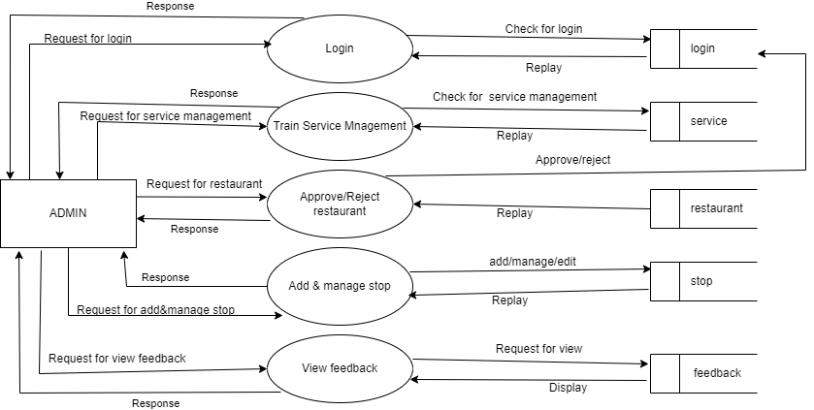
Level 1
13
DEPARTMENT OF COMPUTER APPLICATIONS

Slide 14
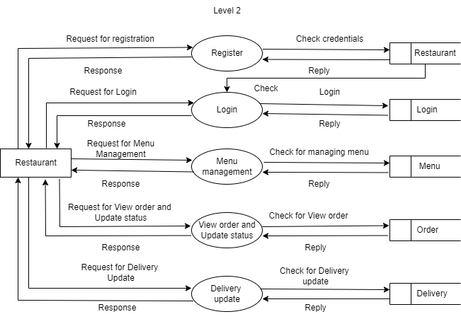
Level 2
14
DEPARTMENT OF COMPUTER APPLICATIONS

Slide 15
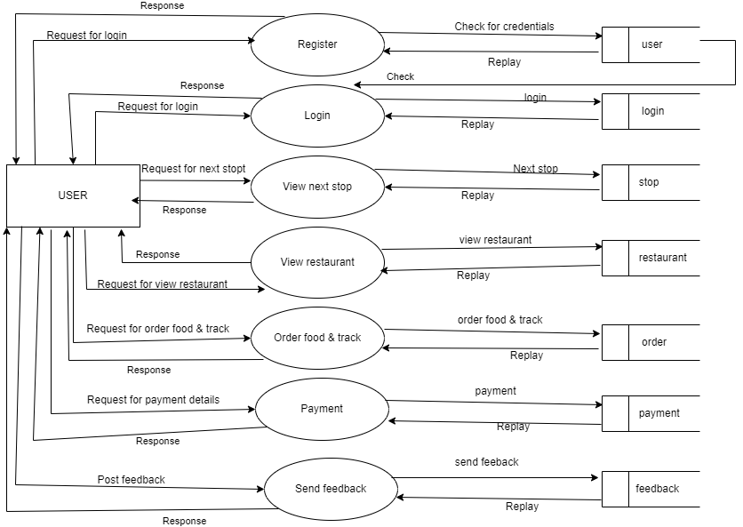
Level 3
15
DEPARTMENT OF COMPUTER APPLICATIONS

Slide 16
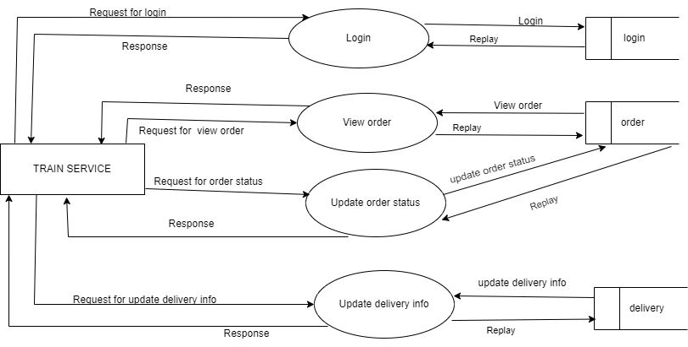
Level 4
16
DEPARTMENT OF COMPUTER APPLICATIONS

Slide 17
USER STORIES
USERSTORY_ID | As a <type of user> | I want to | So that I can
1 | Admin | Login | Login successful with correct username and password
2 | Admin | Train service management | Manage train services
3 | Admin | Approve/reject restaurant | Manage restaurants
4 | Admin | Add & manage station | Manage different stations
17
DEPARTMENT OF COMPUTER APPLICATIONS

Slide 18
5 | Admin | View feedbacks | Admin can view the feedbvacks related to restaurant
6 | Restaurant | Registration | Create a profile
7 | Restaurant | Login | Login successful with correct username and password
8 | Restaurant | Menu Management | Manage food items & their price
18
DEPARTMENT OF COMPUTER APPLICATIONS

Slide 19
9 | Restaurant | View orders & update status | Restaurant can view the details of orders
10 | Restaurant | Delivery updates | Restaurant updates the details of delivery
11 | User | Registration | Create a profile
12 | User | Login | Login successful with correct username and password
19
DEPARTMENT OF COMPUTER APPLICATIONS

Slide 20
13 | User | View next station | View different stations
14 | User | View restaurant | View different restaurants nearby the stop
15 | User | Order food & track | User can order food and can check the status
16 | User | Payment | User can make payment through online or offline
17 | User | Send Feedback | User can give feedback to the restaurant
20
DEPARTMENT OF COMPUTER APPLICATIONS

Slide 21
18 | Train Service | Login | Login successful with correct username and password
19 | Train Service | View orders | They can view orders done by different users
20 | Train Service | Update order status | They can update the status of order
21 | Train Service | Update delivery info | They can update the informations related to the delivery
21
DEPARTMENT OF COMPUTER APPLICATIONS

Slide 22
Product backlog
ID | NAME | PRIORITY
1 | Admin Login | High
2 | Train Service Management | High
3 | Approve/Reject Restaurant | Medium
4 | Add & Manage Station | High
5 | View Feedback | Medium
6 | Restaurant Registration | High
22
DEPARTMENT OF COMPUTER APPLICATIONS

Slide 23
Product backlog
7 | Restaurant Login | High
8 | Menu Management | Medium
9 | View Order & Update Status | Medium
10 | Delivery Updates | High
11 | User Registration | High
12 | User Login | High
13 | View Next Station | High
23
DEPARTMENT OF COMPUTER APPLICATIONS

Slide 24
Product backlog
14 | View Restaurant | Medium
15 | Order Food & Track | High
16 | Payment | Medium
17 | Send Feedback | High
18 | Train Service Login | High
24
DEPARTMENT OF COMPUTER APPLICATIONS

Slide 25
Product backlog
19 | View Orders | Medium
20 | Update Order Status | High
21 | Update Delivery Info | Medium
25
DEPARTMENT OF COMPUTER APPLICATIONS

Slide 26
PROJECT PLAN
ID | SPRINT | START DATE | END DATE | DAY | STATUS
1 2 3 4 5 6 | Sprint 1 | 07/02/2023 | 28/02/2023 | 21 | Ongoing
7 8 9 10 | Sprint 2 | 01/03/2023 | 15/03/2023 | 15 | Ongoing
26
DEPARTMENT OF COMPUTER APPLICATIONS

Slide 27
PROJECT PLAN
11 12 13 14 15 16 | Sprint 3 | 16/03/2023 | 16/04/2023 | 31 | Planned
17 18 19 20 21 | Sprint 4 | 17/04/2023 | 15/05/2023 | 28 | Planned
TOTAL |  |  |  | 95
27
DEPARTMENT OF COMPUTER APPLICATIONS

Slide 28
SPRINT 1 PLAN
Backlog item | Status and completion date | original Estimate (hours) | Day 1 07/02 | Day 2 08/02 | Day 3 09/02 | Day 4 10/02 | Day 5 13/02 | Day 6 14/02 | Day 7 15/02 | Day 8 16/02 | Day 9 17/02 | Day 10 20/02 | Day 11 21/02 | Day 12 22/02 | Day 13 23/02 | Day 14 24/02 | Day 15 27/02 | Day 16 28/02 | Day 17 01/03 | Day 18 02/03 | Day19 03/03
UI designing | 10/02/23 | 4 | 2 | 1 | 1 | 0 | 0 | 0 | 0 | 0 | 0 | 0 | 0 | 0 | 0 | 0 | 0 | 0 | 0 | 0 | 0
Coding | 21/02/23 | 8 | 0 | 0 | 0 | 0 | 1 | 2 | 0 | 2 | 0 | 2 | 1 | 0 | 0 | 0 | 0 | 0 | 0 | 0 | 0
Testing | 03/02/23 | 6 | 0 | 0 | 0 | 0 | 0 | 0 | 0 | 0 | 0 | 0 | 0 | 1 | 0 | 1 | 0 | 2 | 2 | 0 | 0
Total |  | 18 | 2 | 1 | 1 | 0 | 1 | 2 | 0 | 2 | 0 | 2 | 1 | 1 | 0 | 1 | 0 | 2 | 2 | 0 | 0
DEPARTMENT OF COMPUTER APPLICATIONS
28

Slide 29
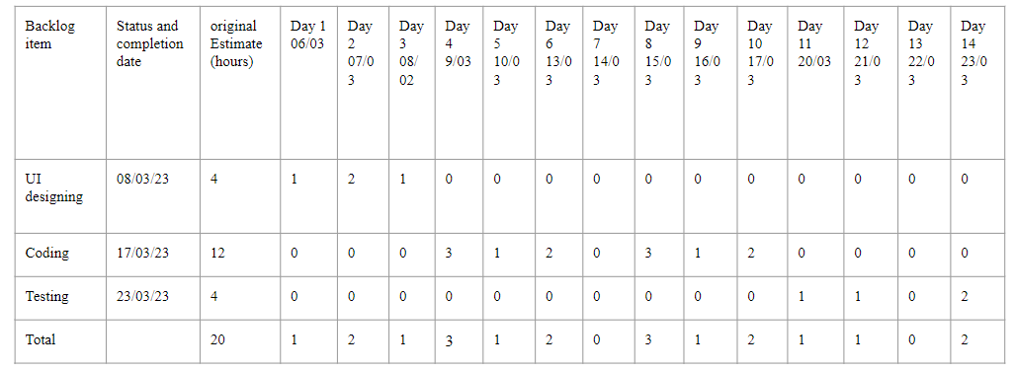
SPRINT 2 PLAN
DEPARTMENT OF COMPUTER APPLICATIONS
29

Slide 30
THANK YOU

