Slide 1
Achariya College of Engineering and Technology
Programming for Problem Solving
PROJECT : STUDENT MARK PREDICTION
Submitted to:
Dr.S.JEEVIDHA
Team Members:
K.VARSHAA

Slide 2
Introduction
Student performance analysis is an important part of the education system.
Predicting student marks helps teachers identify weak and strong students.
This project uses Machine Learning to predict student academic performance.

Slide 3
Purpose of the System and Dataset:
PURPOSE:
The main purpose of this project is to predict student academic performance using Machine Learning.
The system helps in analyzing student study behavior and academic factors.
DATASET:
The dataset helps the model learn the relationship between student activities and academic performance.
It is used for:
Training the model
Testing the model
Predicting future student marks
The dataset improves prediction accuracy by providing sample student records

Slide 4
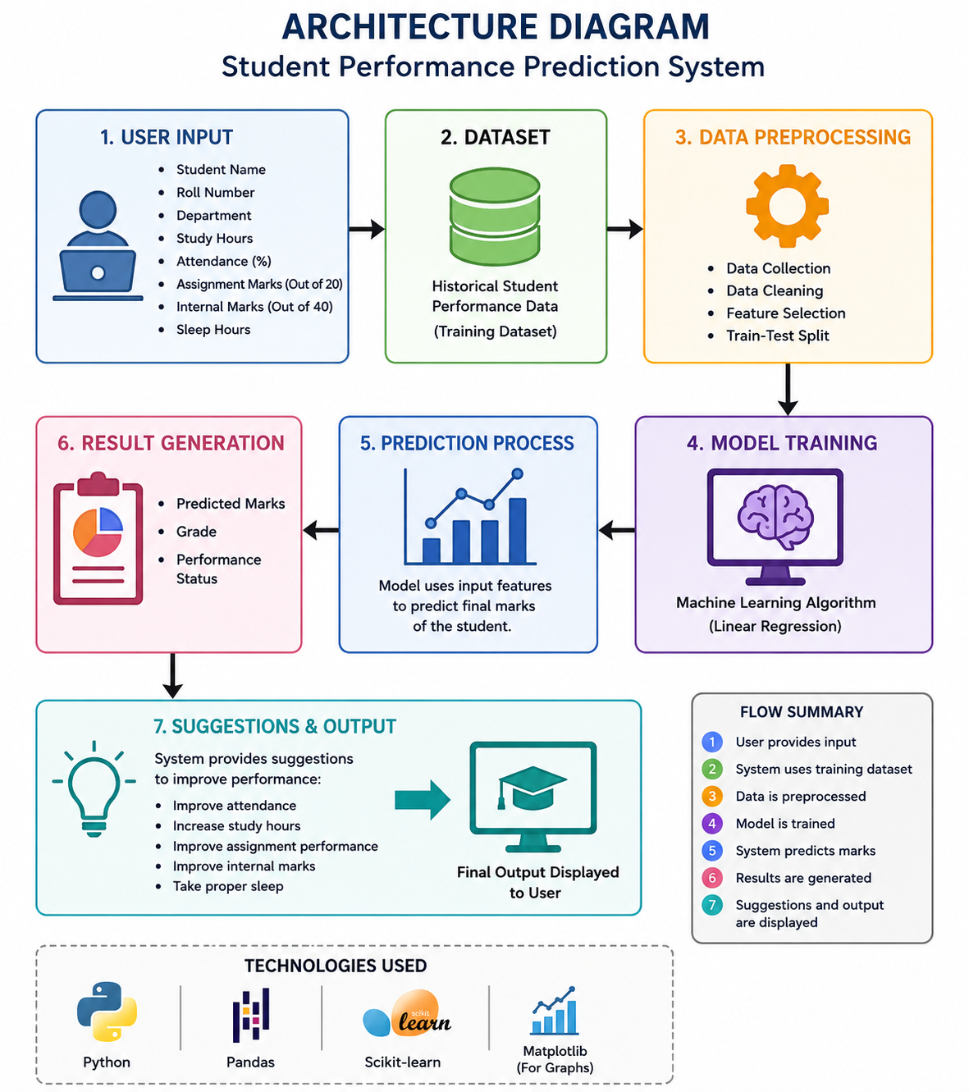

Slide 5
Algorithm
1.Start
2.Import Required Libraries
3.Create Student Dataset
4.Convert Dataset into DataFrame
5.Display Dataset
6.Select Input Features and Output Variable
7.Split Dataset into Training and Testing Data
8.Initialize Linear Regression Model
9.Train the Machine Learning Model
10.Predict Test Data Results
11.Calculate Mean Absolute Error
12.Get Student Details from User
13.Get Academic Inputs from User
14.Validate Assignment Marks
15.Validate Internal Marks
16.Prepare New Student Data for Prediction
17.Predict Final Marks Using Trained Model
18.Display Student Performance Report
19.Analyze Performance and Assign Grade
20.Generate AI Suggestions Based on Inputs
21.Display Final Suggestions

Slide 6
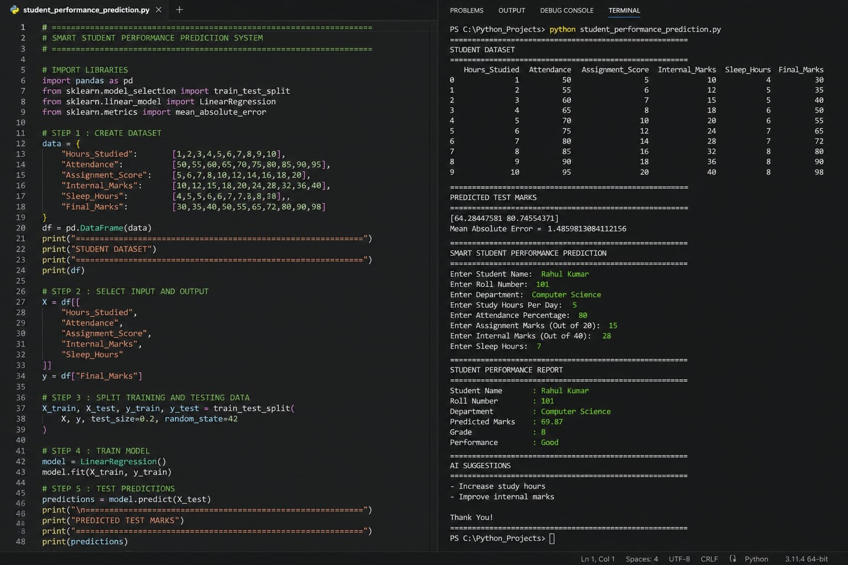
CODE:

Slide 7
Conclusion
The Smart Student Performance Prediction System successfully predicts a student’s final marks using Machine Learning with the help of academic factors such as study hours, attendance, assignment score, internal marks, and sleep hours.
The project demonstrates how Data Science and Python can be used in the education field to analyze student performance and help students improve academically. It is a simple, effective, and beginner-friendly machine learning project suitable for PPS and mini project presentations.

