Slide 1

SOFTWARE ENGINEERING
UNIT – I (Chapter-1)
Introduction to Software Engineering
Text Book: Software Engineering, A practitioner’s approach Roger s. Pressman 6th Edition -McGraw-Hill

Slide 2
Outline
Software
Software Characteristics
Changing Nature of Software
Legacy Software
Software Evolution
Software Myths

Slide 3
Software
Software is
Instructions(Computer Programs) that when executed provide desired features, functions and performance
Data Structures that enable the programs to adequately manipulate information
Documents that describe the operation and use of the programs

Slide 4
Software’s Dual Role
Software is a product
Delivers computing potential
Produces, manages, acquires, modifies, displays and transmits information
Software is a vehicle for delivering a product
Supports or directly provides system functionality
Controls other programs (Eg: an Operating System)
Effects communications (Eg: Networking Software)
Helps build other software (Eg: Software Tools)

Slide 5
Software Characteristics
Software is Engineered or Developed, it is not manufactured in the classical sense
Software “doesn’t wear out”
Although industry is moving towards Component-based construction, most software continues to be custom built

Slide 6
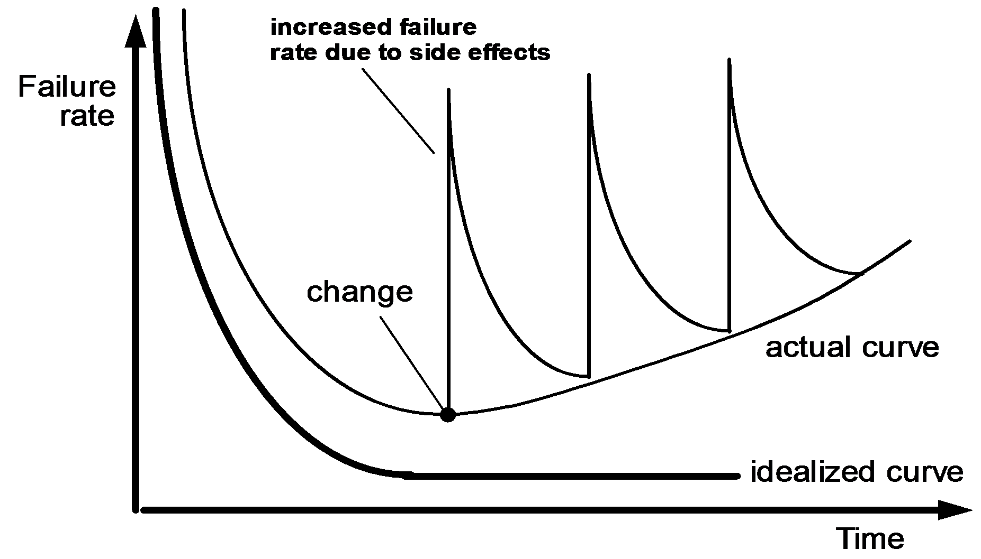
Failure curve for Software

Slide 7
Changing Nature of Software
System software
Application software
Engineering/scientific software
Embedded software
Product-line software
Web-applications
Artificial Intelligence software
Netsourcing
Open source
Also …
Data mining
Cloud Computing
Software for nanotechnologies

Slide 8
Legacy Software
Legacy Software Systems were developed decades ago and have been continually modified to meet changes in business requirements and computing platforms.
Why must it change?
software must be adapted to meet the needs of new computing environments or technology
software must be enhanced to implement new business requirements
software must be extended to make it interoperable with other more modern systems or databases
software must be re-architected to make it viable within a network environment

Slide 9
Software Myths
Beliefs about software and the process used to build it.
Management Myths
Customer Myths
Practitioner’s Myths

Slide 10
Software Myths
Beliefs about software and the process used to build it.
Management Myths
Customer Myths
Practitioner’s Myths

Slide 11
Any questions?

Slide 12
Thank you

Slide 13

Scan The QR for More Info

