Slide 1
AI-assisted loan file preparation
An underwriting copilot, SBA 7(a) first
The tool prepares the file. The underwriter decides.
Team briefing and demo. Runs locally on synthetic data. No real borrower data, no real lender system, nothing deployed.
Notes:
Open with the one rule that shapes everything: the software prepares, a human decides. Everything today is synthetic data on a local machine.

Slide 2
The problem: preparation crowds out judgment
1
Read
Hypothesis
Tax returns, bank statements, financials, ownership, the request
If the file arrives prepared, with every figure linked to its source and problems flagged, underwriters spend less time per file and miss fewer problems.
2
Key and cross-check
Do statements add up? Are they recent? Do owners total 100 percent?
3
Apply the rules
SBA SOP 50 10 requirements, one by one
Unproven until measured on real files.
4
Write the memo
Every figure traced back to a document
Notes:
Underwriters spend much of a file's time before the judgment call: reading documents, keying figures, cross-checking, applying rules, drafting the memo. This is a hypothesis about where time goes; we have not measured it on real files.

Slide 3
What we are building
Application
Documents
Rules
Exceptions and memo
Underwriter decides
Structured intake; tax ID encrypted
Checked, scanned, facts read with page and quote
11 SBA SOP 50 10 rules plus consistency checks
Problems flagged; cited memo drafted
Only a human can record it
AI extracts and drafts
A human decides
Everything is cited and audited
Calculations and rules are tested code, not model output.
The software never approves, declines or ranks a borrower.
No fact without a page and quote. Append-only, hash-chained log.
Notes:
One sentence: software that prepares a commercial loan file, with sources attached, and hands it to a human underwriter. The decision gate is enforced in the database.

Slide 4
Who uses it
Processor
Underwriter
Viewer
Admin
Can
Can
Can
Can
Enters the application, uploads documents, builds the file
Reviews the file, checks facts against sources, disposes exceptions, decides
Reads files
Users, roles, sessions, security events, the lender's own sign-in setup
Cannot
Cannot
Cannot
Cannot
Cannot record a decision
Cannot administer users
Cannot change anything
Cannot record a decision
Notes:
Roles live in our database, not in the sign-in provider, so a provider cannot grant itself underwriter rights. The processor who tries to decide is refused; the viewer sees no decision form.

Slide 5
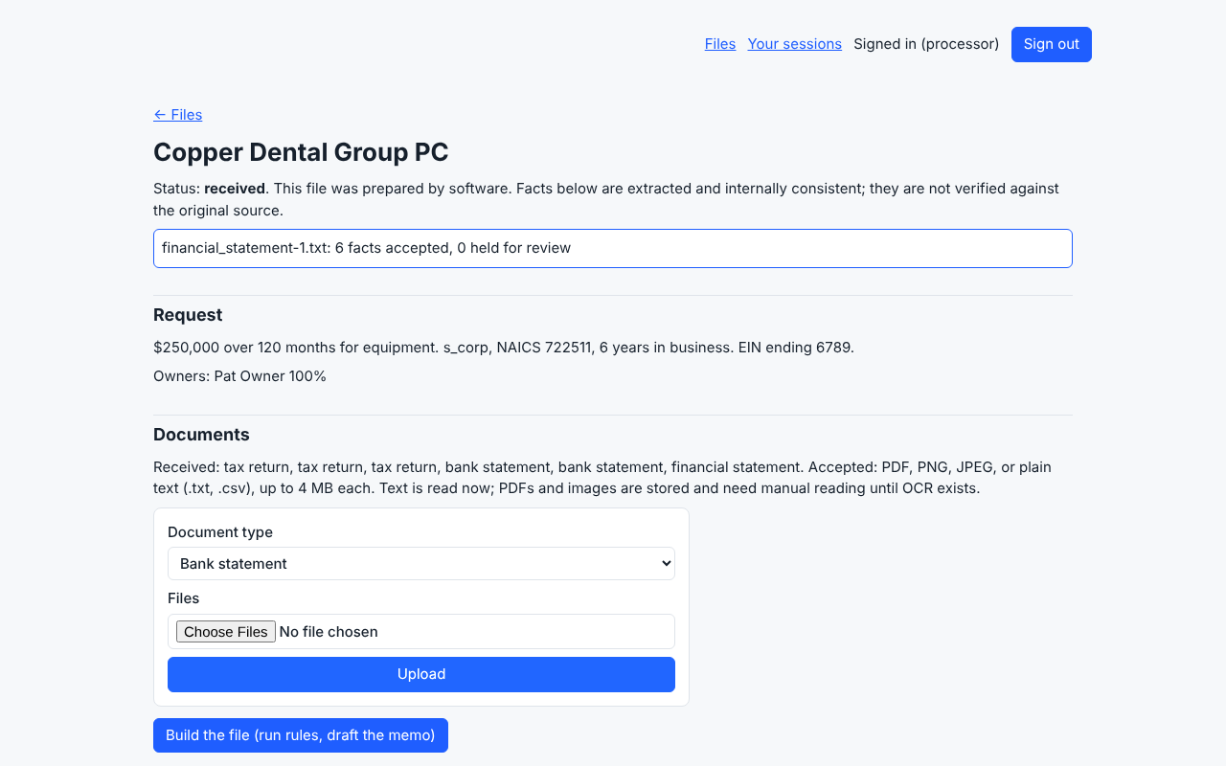
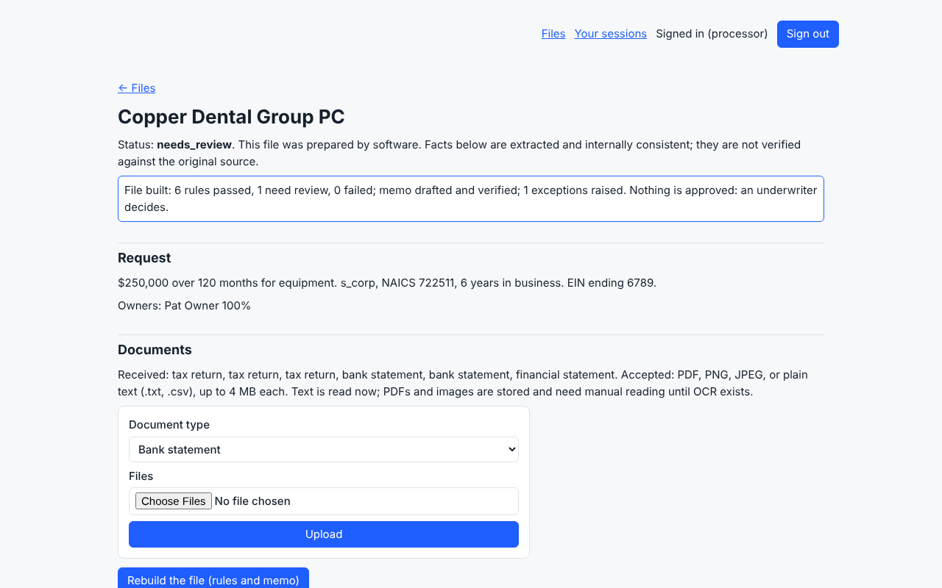
Live: documents in, file built
The processor uploads the packet. Each file is checked for type, content and malware before it is kept.
One click runs the rules and drafts the memo. The message states that nothing is approved.
Notes:
A processor uploads the packet through the case page. Each file is checked for type, content and malware before it is kept; if the scanner is unreachable, the upload is refused. One click builds the file: rules run, memo drafted and verified, nothing approved.

Slide 6
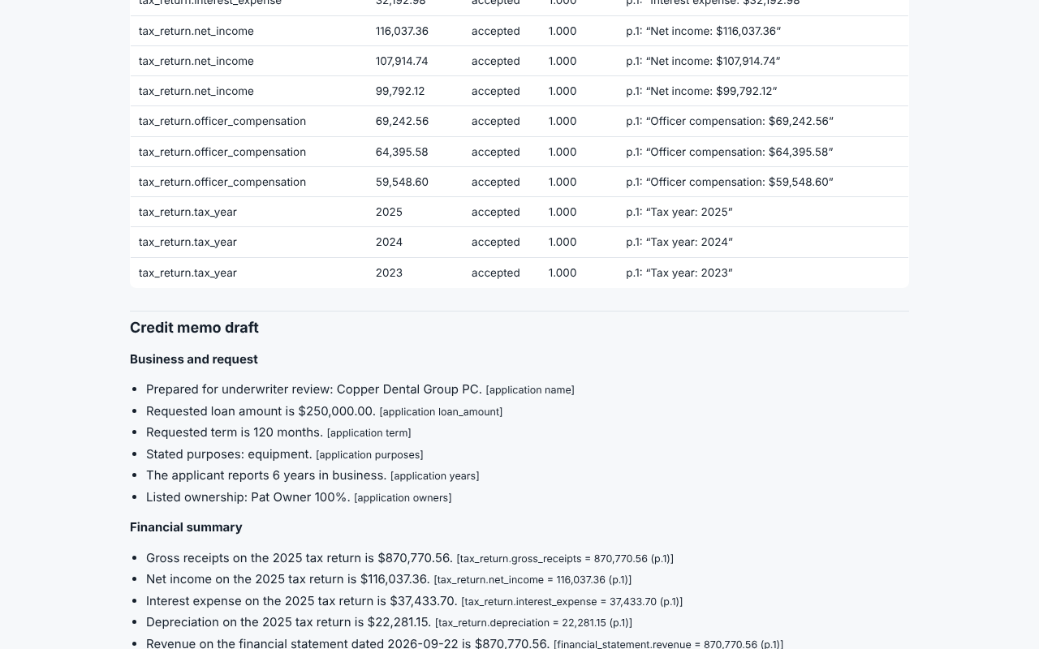
Live: the underwriter's file
Cited
Every fact carries document, page and the quoted passage.
Checked
Memo numbers are verified against their cited source.
Honest
The tool lists what it did not evaluate.
Notes:
Memo, rule results and facts on one page. Each figure links to its source passage. The memo cannot contain approve or decline language. The banner says accepted means faithfully extracted, not verified true.

Slide 7
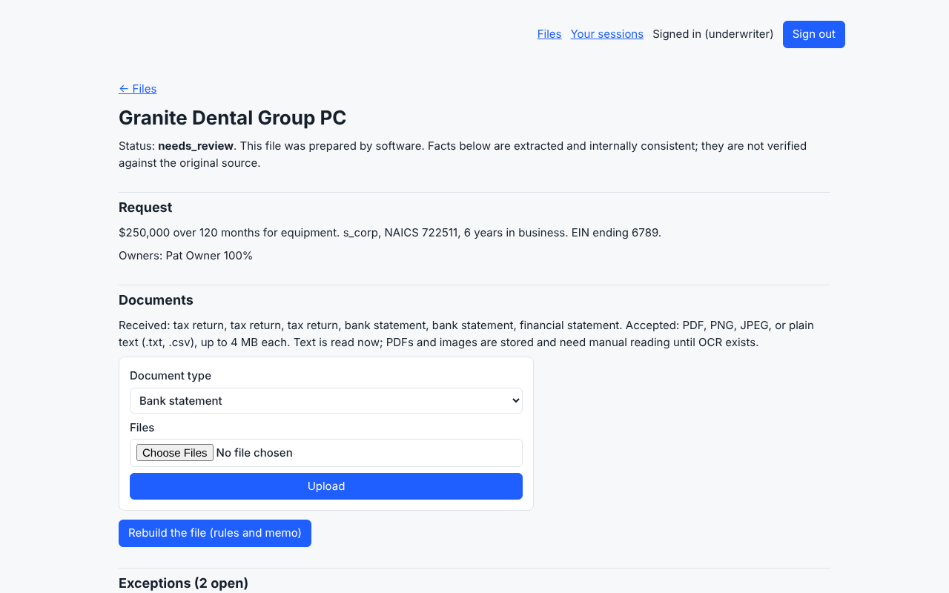

Live: problems are caught
Statements that do not add up raise a high-severity exception.
A document tried to instruct the system. It was treated as data, flagged critical, and its facts held for a human.
Notes:
Two planted problems. In the first file the bank statements do not add up and the rules raise a high-severity exception. In the second, a document contains instruction-like text: it is treated as data, flagged critical, and the facts from that document are held for review.

Slide 8
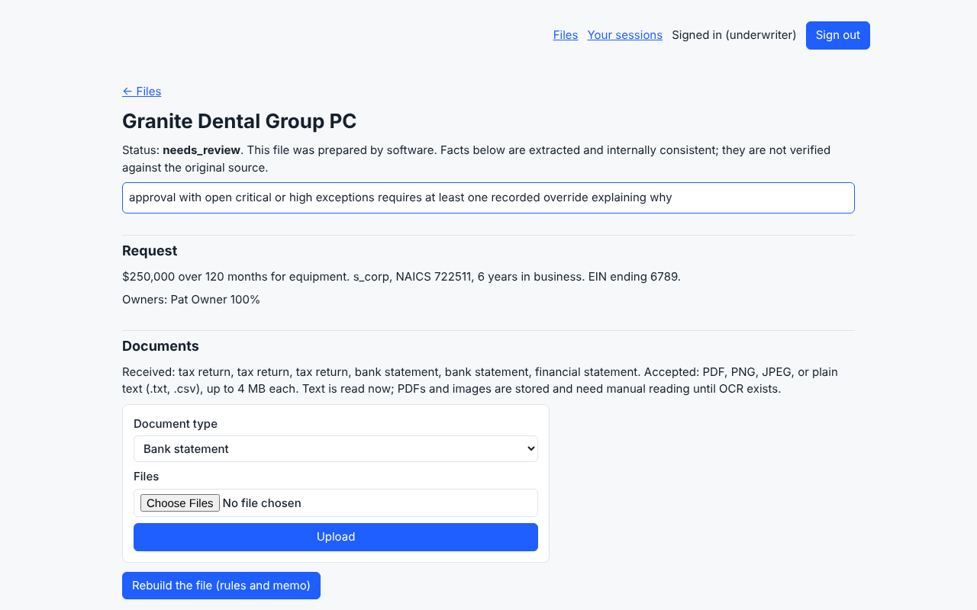
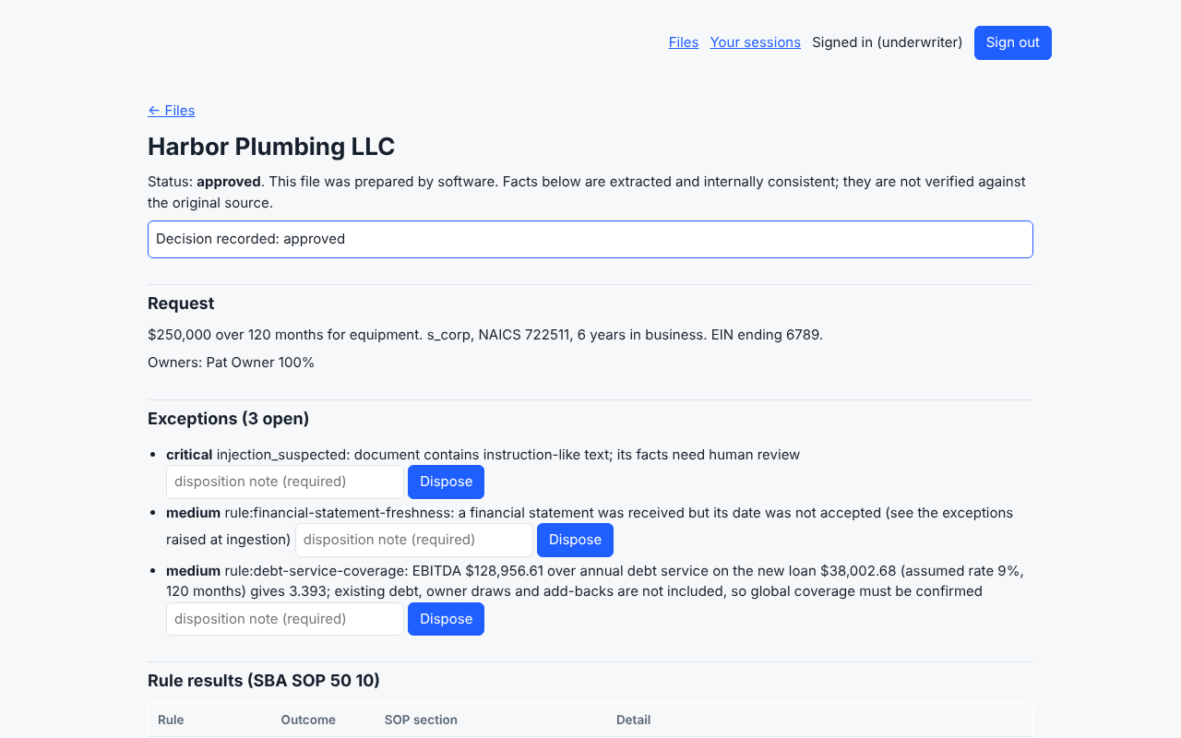
Live: the human gate
Approve past an open high exception with no override: refused, by the database.
With a written override from an underwriter: recorded with the reason.
Notes:
The database refuses an approval past an open critical or high exception without a written override, so a bug or another screen cannot bypass it. With an override, the decision is recorded with who, when, policy version and the reason.

Slide 9
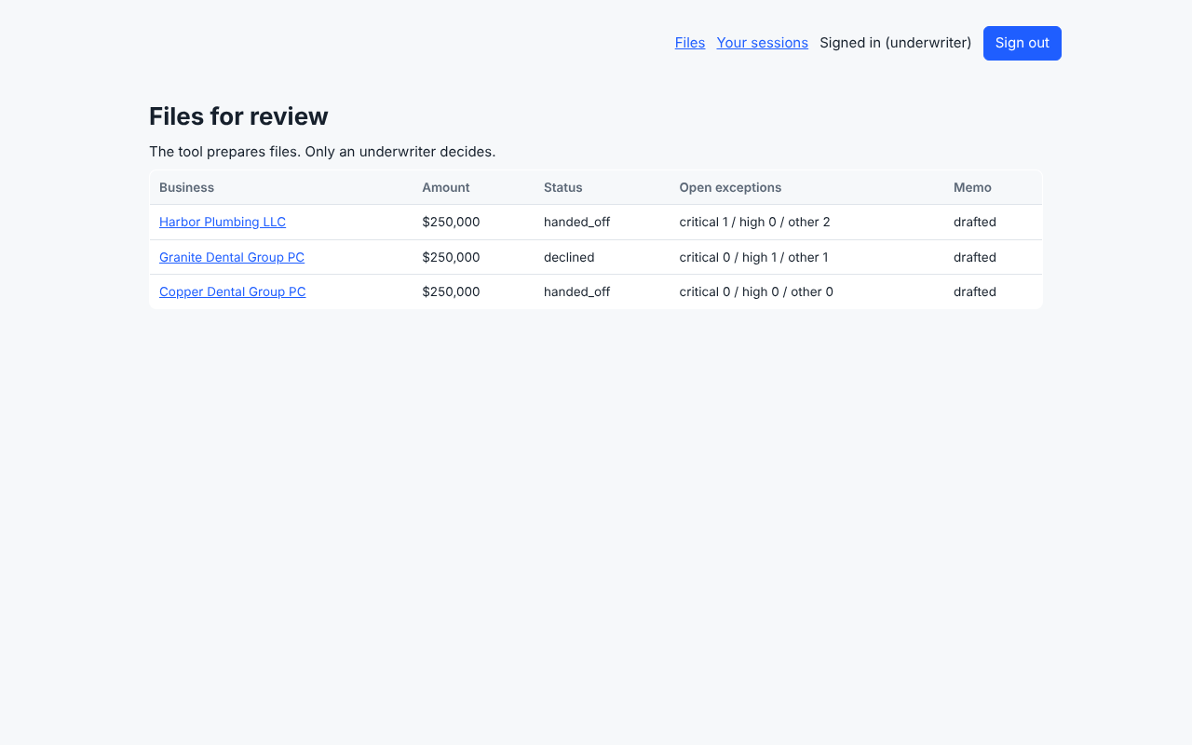
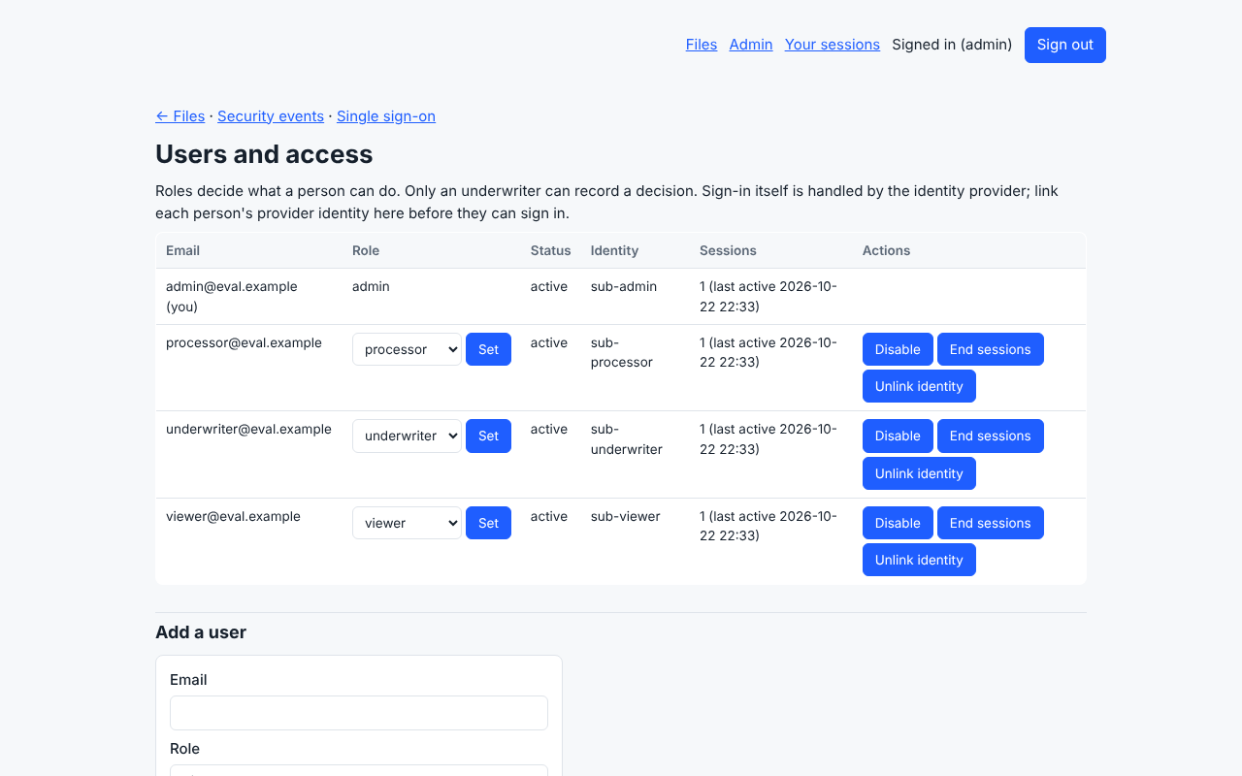
Live: after the decisions, and admin
Two files handed off to the mock servicing adapter, one declined.
Admin: users, roles and sessions. Every change is audited.
Notes:
Two files handed off to the mock lender servicing adapter; one declined. There is no real bank integration. The admin screen manages users, roles and sessions; an admin cannot demote or disable themselves.

Slide 10
How it is built to be trusted
Lender isolation
Human-only decisions
Evidence
Forced row-level security on every table. The app role is not an owner and cannot bypass it.
Enforced by database rules, not only screens. Decisions are append-only.
No fact without a page and quote. Model confidence never decides acceptance.
Safe documents
Sign-in and access
Audit
Name must match content; markup and active PDFs refused; malware scan fails closed.
OpenID Connect, four roles, revocable sessions, every change audited.
Hash-chained, append-only ledger the database can verify.
Notes:
These are design properties each backed by tests. Row-level security means each query is restricted by the database to one lender's rows; the app's database role cannot bypass it.

Slide 11
What we have measured
454
40 of 40
102
0
automated tests pass, including real-database tests
browser walkthrough steps pass: four roles, three files
facts in the run, every one with a source passage
falsely accepted fields in 4,030 (synthetic, stand-in model)
Also measured: 87.8 percent of fields accepted and correct, 8.4 percent not extracted (image-only files, no OCR). Every planted problem class was caught in 100 percent of packets; two classes also over-flagged.
Labels: measured on synthetic data. Not measured: accuracy on real documents, time saved.
Notes:
All of this is on synthetic data with a stand-in model that reads printed labels. It tests our checking layers, not a language model on real documents. The 87.8 percent accepted-and-correct and 0 false accepts come from 120 packets, 12 file types, 4,030 fields.

Slide 12
Our own reading of the security and AI standards
Self-assessed. 72 percent of the 150 applicable ASVS requirements are met. The gaps are listed in the repository with owners.
Notes:
Self-assessments with evidence cited in the repository, not certifications. ASVS 5.0.0 levels 1 and 2: 253 requirements. NIST AI RMF: 72 subcategories. A third-party penetration test, SOC 2 and lender vendor review are not done.

Slide 13
What it does not do yet
No real model provider or OCR; a stand-in model reads printed labels
No real documents or lenders have been tested
No identity provider chosen; sign-in tested with a stand-in
Not deployed; hosting is undecided
Not evaluated: eligibility, collateral, tax transcripts, personal financial statements, credit reports, global cash flow
Debt service uses only the new loan and a placeholder 9 percent rate
504 and SBA Express are not encoded
No third-party security test, SOC 2, vendor review or counsel review
Notes:
Be upfront about these before anyone finds them. The rule pack prints its own coverage gaps with every file run.

Slide 14
How we compare, honestly
Capability | Leading products (public claims) | This tool today
Scale, integrations, SBA forms and E-Tran | Yes (nCino, Abrigo, Baker Hill) | Behind: none
SOC 2 Type 2, ISO 27001, penetration test | Listed by several vendors | Behind: none yet
Fact-level citations, checked memo numbers | Described as sourced; method not described | Built and tested
Human decision enforced by the database | Not described on pages read | Built and tested
Accuracy published with its failures | Claims without method | Published, but synthetic only
No head-to-head test has been run. We will pre-register targets, test on the same files, and publish the result either way.
Notes:
Sources in docs/COMPETITIVE_SCAN.md and docs/BENCHMARK.md. Vendor statements are their public claims. No head-to-head test has been run, so we make no claim to outperform anyone.

Slide 15
The next 90 days
Days 1 to 30
Days 31 to 60
Days 61 to 90
Learn and baseline
Make it real
Pilot
Lender and processor conversations
Timed manual baseline with two underwriters
Choose identity provider
Decide hosting
One real model provider, after reviewing its data terms
OCR for scans and images
Rerun the evaluation, publish failures
Partner's policy inputs and debt schedule
External penetration test; counsel review
Redacted, consented files; time both flows
Gate: requirements and a measured baseline
Gate: go or no-go
Gate: measured comparison; continue or stop
Notes:
Stop conditions: a figure reaches a decision unflagged and wrong; the tool does not beat the measured baseline; a vendor or regulatory requirement cannot be met. Model calls need approval after reviewing the provider's data terms.

Slide 16
Decisions we need from the team
Which lending lines and volumes first, and what outcome defines success?
Who can arrange lender conversations and two underwriters for the timed baseline?
1
2
Hosting for a pilot (we recommend AWS containers; Vercel for testing only) and who approves vendor risk?
Which model provider to evaluate, and approval for external calls with synthetic data first?
3
4
Which identity provider?
Who reviews the rules against SOP 50 10 and the list for counsel?
5
6
Notes:
Hosting: the recommendation is AWS containers for a pilot with real lender data; Vercel is for testing with synthetic data only. This is a recommendation, not a decision. The reasons are in docs/HOSTING_OPTIONS.md.

Slide 17
Demo plan: 15 minutes
Min | Do | Point to make
1 | Sign in as Underwriter | Roles come from our database; sessions revocable; sign-ins audited
1 | Open the queue | Every file is needs review; the software never approves
2 | Open a flagged file | Instruction-like text held for a human, not obeyed
3 | Rules, facts, memo | 11 SBA rules with SOP sections; every fact cited; memo numbers checked
2 | Try Approve, then add an override | Refused first, recorded with a written reason; enforced by the database
1 | Audit trail and handoff | Append-only, hash-chained; only the approved file reached the mock adapter
3 | Processor: apply, upload, build | Intake to prepared file in a few clicks; tax ID shows last four only
1 | Admin screens | Users, roles, sessions, security events
Notes:
Say first: all data is synthetic, the model is a stand-in, the tool prepares files and a human decides. Mention the rough edges before they are noticed: coverage ratios look high because synthetic financials are generous; debt service uses a placeholder rate; the sign-in provider is a local stand-in.

Slide 18
The tool prepares the file.
The underwriter decides.
Reference: workspace/docs/TEAM_GUIDE.md. Demo: demo/walkthrough/WALKTHROUGH.html. Nothing here is legal advice.
Notes:
Close on the principle, then take questions. Point to the team guide for the full reference.

